Slide 1
Strategic Directions Committee
Data Gathering

Slide 2
Strategic Directions Core Team
Todd Coston, Information Technology (Lead)
Grace Commiso, Interim Dean of Counseling, Student Services
Liz Rozell, Dean of Instruction, Academic Affairs
Bill Moseley, Dean of Instruction, AIQ Representative
Jessica Wojtysiak, Faculty, AIQ Representative
Marcelyn Allen, Faculty
Teresa Mcallister, Faculty
Aricia Leighton, Web Team
Somaly Boles, Clerical Support

Slide 3
BC Mission
Bakersfield College provides opportunities for students from diverse economic, cultural, and educational backgrounds to attain Associate and Baccalaureate degrees and certificates, workplace skills, and preparation for transfer. Our rigorous and supportive learning environment fosters students’ abilities to think critically, communicate effectively, and demonstrate competencies and skills in order to engage productively in their communities and the world.
Notes:
Reminder that all initiatives should be in alignment with the mission of the college.

Slide 4
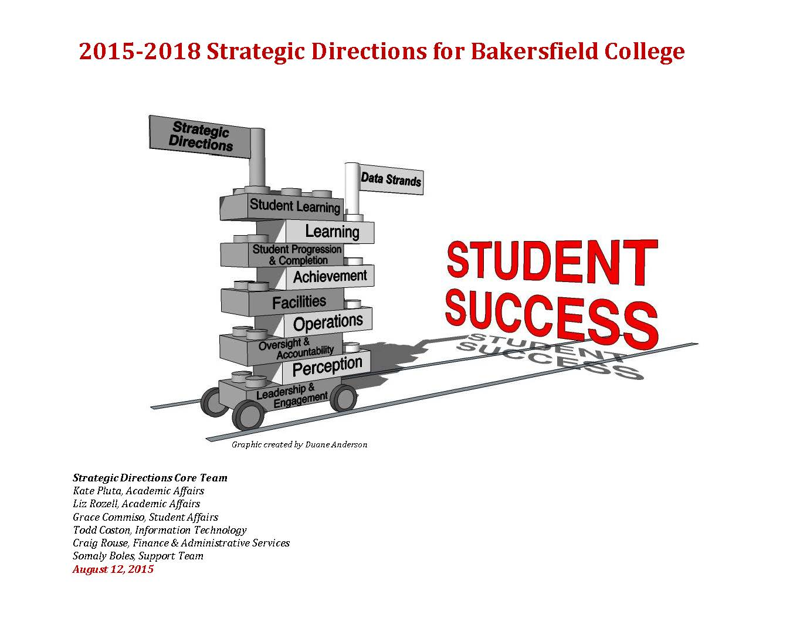
2015-2018 Strategic Directions for Bakersfield College
Notes:
Remind the audience of what our previous Strategic Directions document looked like.

Slide 5
2018-2021 Strategic Directions for Bakersfield College
In 2015 Bakersfield College completed the three-year strategic plan that would provide the direction through June 30, 2018.
It is time to evaluate, develop and prepare for the next three-year cycle of our strategic plan.
Notes:
Explain that we are developing the Strategic Directions for the next 3 years starting July 1, 2018.
We need their help in coming up with new initiatives to help get us moving in our four strategic directions.

Slide 6
What We Learned
Initiatives must be clearly stated.
Initiatives must be singular, not a list of items (no ands).
Initiatives must be measurable.
How the initiative will be measured must be stated.
Initiatives must have an end date. (Do not lend themselves to be scored as “perpetually in progress”)
Notes:
We try to constantly improve our processes and this includes improving our process we’ve used to develop our Strategic Directions.
(Walk through the four bullet points above)

Slide 7
What We Learned (cont.)
Initiatives should indicate a tie to Pathways where possible.
Initiative scoring must be the responsibility of one lead.
Committees are involved, but a tie breaker must have the final decision.
Previous Strategic Direction #4 removed, Oversight and Accountability is embedded in all directions.
Alignment with the mission of the college.
Notes:
(Walk through the bullet points above).
Remind them that with the removal of Direction #4, we know have a total of four SD’s.

Slide 8
Four Strategic Directions
Student Learning
Student Progression and Completion
Facilities and Technology
Leadership and Engagement
Notes:
Re-iterate our four directions.

Slide 9
Writing Initiatives
Strategic Direction
Initiative
Guided Pathways Pillar (where possible)
How will you evaluate and document the initiative's success?
What lead would be responsible for scoring?
What other positions and committees need to be involved?
Notes:
Explain that for each initiative we develop, we are interested in gathering the six pieces of information above.
(Walk through the 6 points above)

Slide 10
Activity
From your committee’s perspective, what initiatives can you think of to move us in the direction of the four directions?
Strategic Directions
Student Learning
Student Progression and Completion
Facilities (and Technology)
Leadership and Engagement
Pathway Pillars
Clarify the Path (Mapping Pathways to Student End Goals)
Get Students on the Path (Enter)
Keeping Students on Path (Intrusive Advising and Academic Support)
Learning with Intentional Outcomes
Notes:
Give them approximately 10 minutes (or whatever you can) to come up with ideas for Strategic Directions and then gather them up and get them back to Todd.

Slide 11
Initiative Form
Survey Monkey: https://www.surveymonkey.com/r/strategic-initiatives
Notes:
Also remind them they can provide initiatives later via our online form (I would not show them this until AFTER the activity is done.
I would also remind them there will be opportunities in the spring to review the final initiatives that get chosen to be included in our updated plan. This also sets the expectation that not all initiatives will be included. ☺

