Slide 1


SPRING 2022
AT A GLANCE
Leo Ocampo – Program Manager
Guided Pathways Strategies Meeting
Monday November 29th, 2021

Slide 2
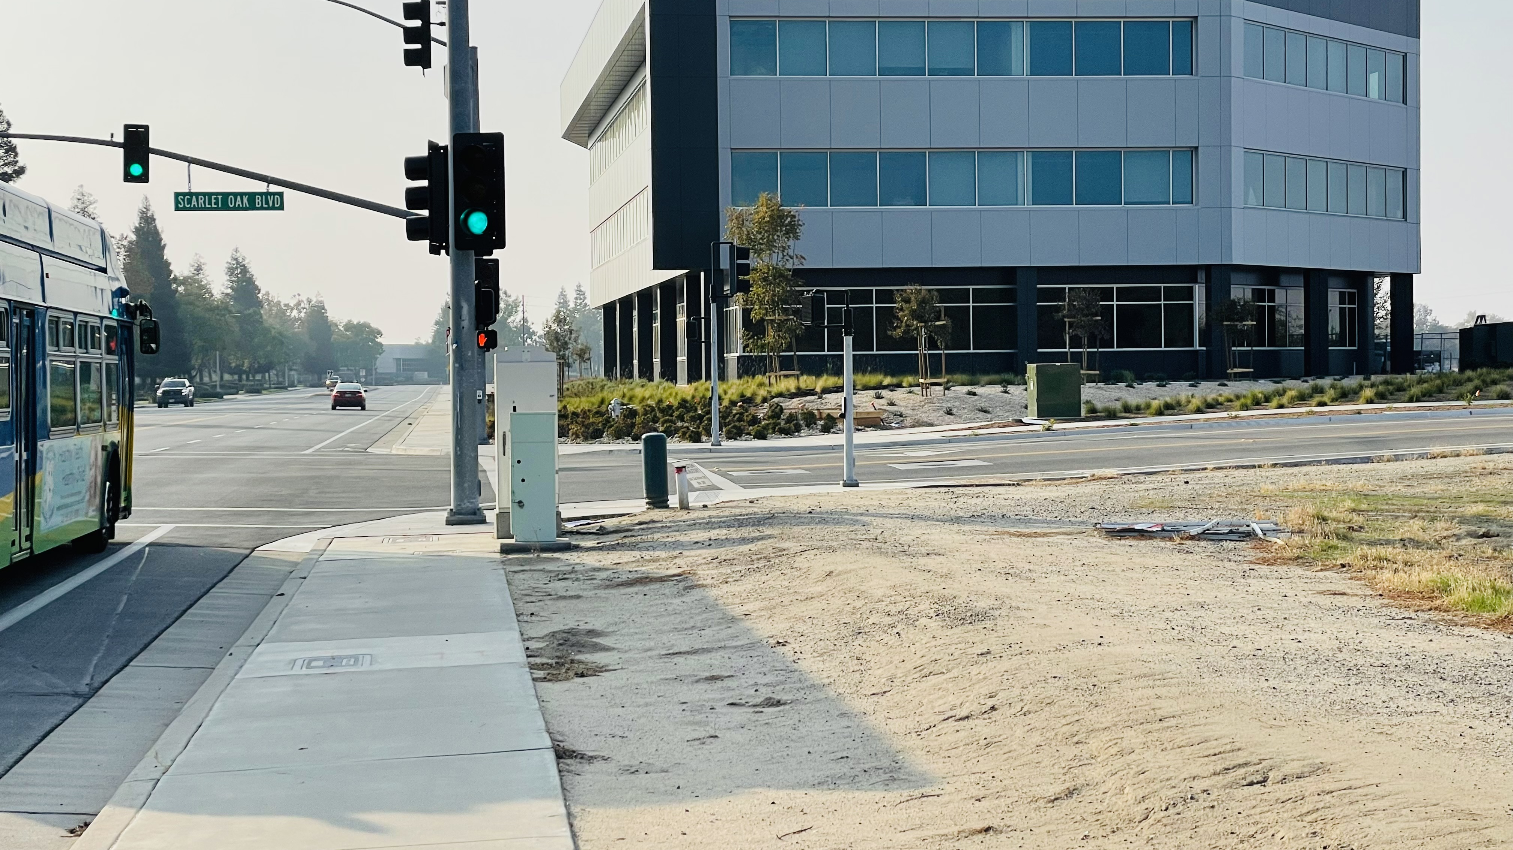

BC SouthWest: Coming Spring 2022!

Slide 3
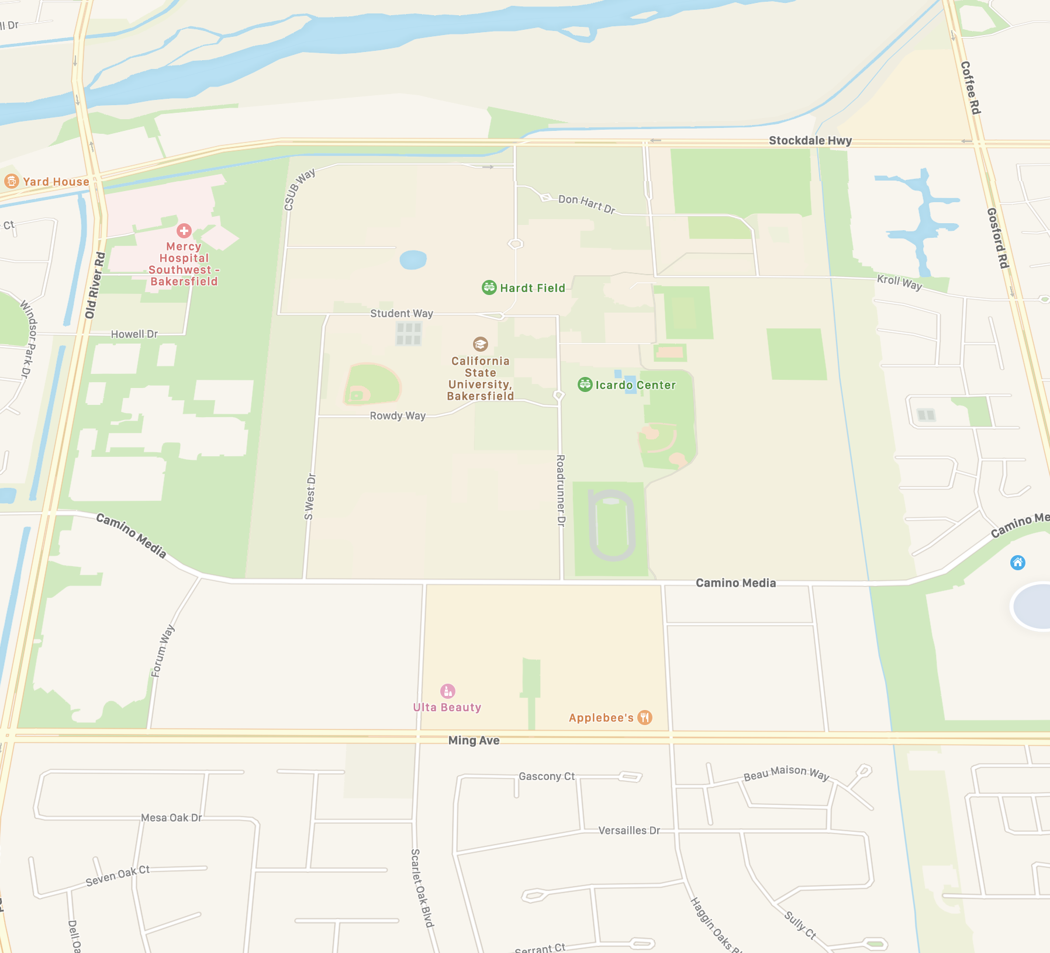
Location
9400 Camino Media
Bakersfield CA 93311
Southwest corner of CSUB
Across the street from Marketplace
Corner of Camino Media and Scarlet Oak Intersection

Slide 4
BC SouthWest: A Transfer Hub
Administration of Justice
Anthropology
Business Administration
Communication Studies
Early Childhood Education
Economics
Elementary Teacher Education
History
Kinesiology
Psychology
Sociology
BC GE CSU GE IGETC GE

Slide 5

Public Safety Training Pathway
Administration of Justice AS-T
  CRIM B1
  CRIM B2
  CRIM B3
  CRIM B4
  CRIM B5
  CRIM B8
  CRIM B9

Slide 6

Education Pathway
Elementary Teacher Education AA-T
  ENGL B3
  PHIL B9
  ART B1
  MUSC 22
  HIST B18
  BIOL B11
  CHDV B21
  COMM B1
  EDUC B24
  ENGL B1A
  ENGL B1B
  ERSC B10
  ERSC B10L
  HIST B17A
  MATH B4A
  POLS B1

Slide 7
Education Pathway
Early Childhood Education AS-T
  CHDV B20
  CHDV B22
  CHDV B21
  CHDV B32

Slide 8

Arts, Communication, & Humanities
Communication Studies AA-T
  COMM B1
  COMM B2
  COMM B5
  PSYC B1A
  SOCI B1

Slide 9

Social & Behavioral Sciences Pathway
Psychology AA-T
  PSYC B1A
  PSYC B1B
  PSYC B5
  PSYC B20
  PSYC B30

Slide 10
Social & Behavioral Sciences Pathway
History AA-T
  HIST B1
  HIST B2
  HIST B17A
  HIST B17B
  HIST B18
  ECON B2
  POLS B1

Slide 11
Social & Behavioral Sciences Pathway
Anthropology AA-T
  PSYC B5
  GEOL B10
  GEOL B10L
  ERSC B10
  ERSC B10L
  ART B1
  ANTH B1

Slide 12

Social & Behavioral Sciences Pathway
Kinesiology AA-T
  HLED B1
  KINS B1A
  KINS B2A
  PSYC B5

Slide 13

CSU General Education
A1 ✓
A2 ✓
A3 ✓
B1 ✓
B2 ✓
B3 ✓
B4 ✓
C1 ✓
C2 ✓
D ✓
E ✓
F* ✓
CSU AI ✓

Slide 14
BC SouthWest Student Services
Counseling and Advising
Financial Aid
DSPS/Accommodated Testing
Tutoring Center
Writing Center
Veterans
CSUB Transfer Specialists
Student Lounge
Open Computer Lab
Study Room
Instructor Office Hours
Bookstore
Food Truck Visits

Slide 15

Questions?
Leo
(661) 395-4361
gamaliel.ocampo@bakersfieldcollege.edu

Slide 16
Thank You!

