Slide 1

Dual Enrollment & Early College as Strategies for
Guided Pathways Design and Implementation
January 28, 2019
Dr. Anna Laven, Dual Enrollment Program Manager
Kylie Swanson, Dual Enrollment Program Manager

Slide 2
Presentation Outline
Dual Enrollment
From Dual Enrollment to Early College: Implementing Guided Pathways
Opportunities
Notes:
GP Landscape - 15 minutes
Bakersfield College - 30 minutes
Breakout and Questions - 15 minutes

Slide 3
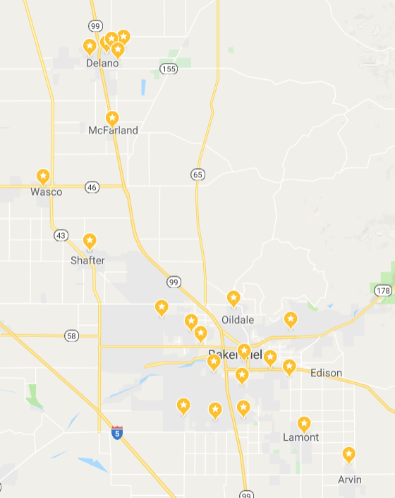
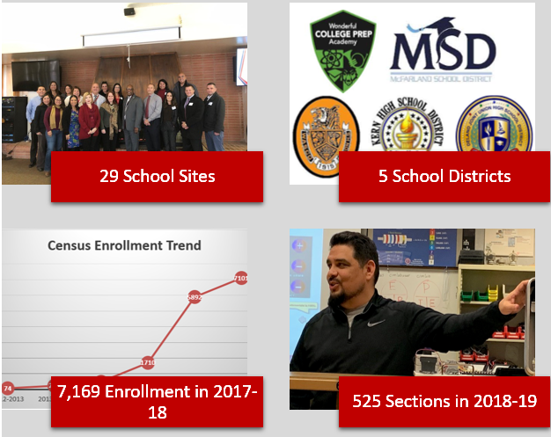
Snapshot
Serving Kern County
55% Courses Offered at Rural Sites
78% Hispanic/ Latino
Notes:
Anna
Kern County is 8,000 square miles
BC service area includes the majority of Kern County residents
Proud that the dual enrollment offerings reflect the service area
30 school sites currently offer dual enrollment
Ranges from Arvin on the south side to Delano on the north
We partner with five school districts - 4 school districts ( range in size from one school to over 20) plus a charter
Variety of course offerings in CSU and UC General Education courses, Career and Technical Education courses, and Student Development

Slide 4
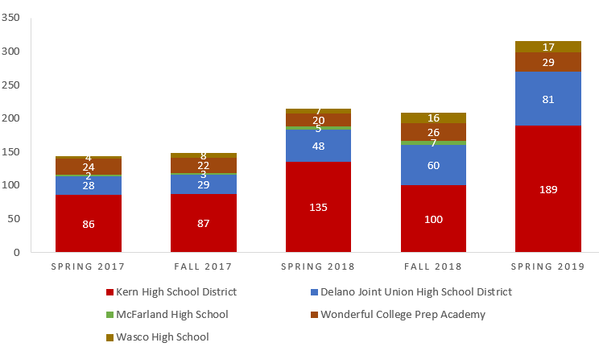
Think Culture Shift - Section Count by District
Dual Enrollment
316 Sections
English
253 Sections
Math
120 Sections
Notes:
Anna
Think culture shift - move from my course to “our students”
KHSD continues to be the largest source of scheduling
Unique - started with general college courses, now trying to use as a foundation toward the guided pathways focus
91 instructors in Fall 2018

Slide 5
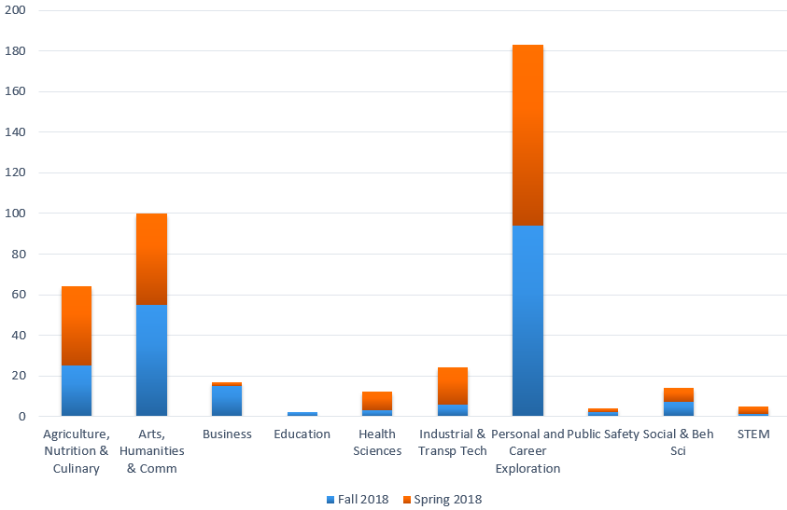
Think Career Exploration - Section Count by Pathway
Notes:
Anna
10 Career Pathways
DE is provided in all Pathways
The majority of enrollment has been in personal and career exploration - Get Focused Stay Focused curriculum - STDV B3
Second largest is Arts, Humanities and Design - these courses also comprise CSU GE requirements
Third largest is in Agriculture, Nutrition and Culinary Arts - a clear effort to support one of our biggest local industries
Primary areas when broken down by district:
Delano - Arts, Health, ITT, Career Exploration
Wonderful - Ag, Arts, Multi-path, breadth as well
KHSD - Ag, Arts, Career Exploration, greater breadth

Slide 6
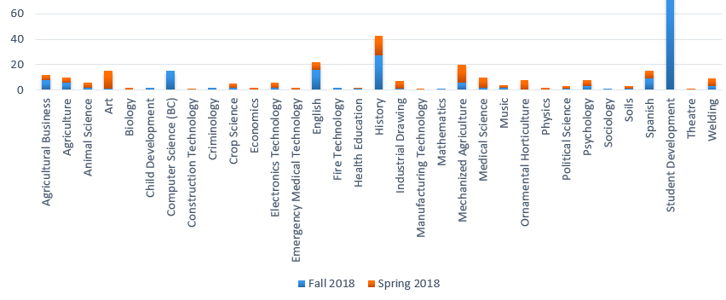
Think Student Pipeline - Section Count by Subject
180
Notes:
A more pronounced view of STDV B3
preliminary data shows DE as a feeder to BC
think about access - great for Hispanic/Latino, need work for Af-Am

Slide 7

Starting Pathways with Focus
Pillar I: Clarifying the Path
Get Focused...Stay Focused!®️
Sequenced, scaffolded courses
Opportunities to explore interests
UC & CSU transferable
STDV B3 “Career and Life Planning”
Notes:
Anna
BC is at the forefront of Guided Pathways and we see dual enrollment as an integral part of that work
GP is an intentional effort and framework that requires integration of instruction and student affairs
Also requires high level of collaboration across the education systems of K-12, 2 year and 4 year institutions
DE comes in because there is no assumption that students know how to navigate the pathways without a tour guide and a clear map
Pillar I - Clarifying the Path - DE provides a career planning course, opportunities to sequence courses, and opportunities to explore areas of interest with transferrable coursework
DE gets them started, and then they can move on to Pillar II (Enter the Path) through matriculation steps at every feeder high school (includes Outreach workshops, abbreviated education plans, and one-day registration events), then at BC they Stay on the Path and Ensure Learning.

Slide 8
From Dual Enrollment to Early College: Implementing Guided Pathways

Slide 9
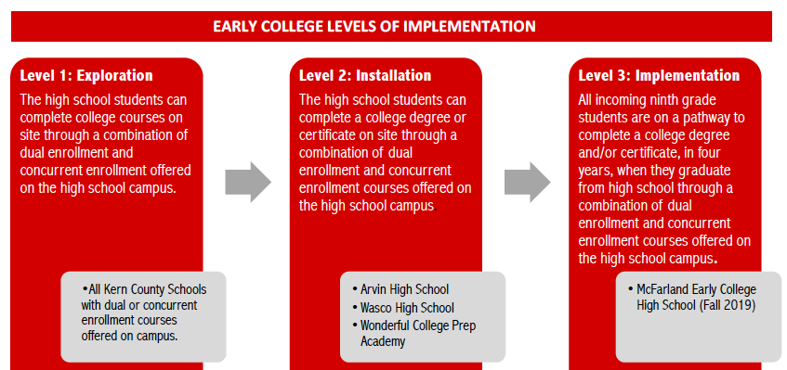
From Dual Enrollment to Early College

Slide 10

Dual Enrollment: Expanding Access During the High School Day
2019-2020 Dual Enrollment Courses
AGBS B6- Agriculture Sales/Communication
ENGLB1A- Expository Composition
STDVB3-Career and Life Planning
HIST B17A/B- United States History
MATH B22- Elementary Probability and Stats
WELD B1b- Intro to Welding Processes
COMP B5- Introduction to Microsoft Office
AGBS B3- Intro to Agriculture Business
INDR B12- Introduction to Drafting/CAD
WOODS B1- Intro to Woodworking Technologies
McFarland High School
2018-2019 Dual Enrollment Courses
AGBSB6- Agriculture Sales/Communication
ENGLB1A- Expository Composition
STDVB3-Career and Life Planning

Slide 11
Pathway Implementation: General Education with Dual Enrollment Courses Only
McFarland High School: Dual Enrollment Opportunities
9th | 10th | 11th | 12th
English 9 | English 10 | English 11 | ENGL B1A/B1B
Algebra 1 | Geometry | Algebra 2 | MATH B22
Biology | Chemistry | Earth Science
 | World History | HIST B17A/B | Gov/Econ
Spanish 1 | Spanish 2
STDV B3 | Elective | Elective | Elective
Health/PE | PE
Dual
Concurrent- At School Site
Concurrent-Online
Pathway Outcomes:
CSU General Education Certificate: 19/39-41 Units
IGETC General Education Certificate: 16/37 Units

Slide 12
Pathway Implementation: General Education with Dual Enrollment AND Concurrent Enrollment Courses
McFarland High School: General Education Certificates Pathway
9th | 10th | 11th | 12th
English 9 | English 10 | English 11 | ENGL B1A/B1B
Algebra 1 | Geometry | Algebra 2 | MATH B22
Biology | Chemistry | CRPS B5
MUSC B27 | World History | HIST B17A/B | POLS B1
Spanish 1 | Spanish 2 | SPAN B1
STDV B3 | COMM B1 PSYCH B1A | Elective | Elective
Health/PE | PE
Dual
Concurrent- At School Site
Concurrent-Online
Pathway Outcomes:
CSU General Education Certificate: 38/39-41 Units
IGETC General Education Certificate: 28/37 Units

Slide 13
Pathway Implementation: Expanding into Summers
McFarland High School: Associate Degree for Transfer Pathway
9th | 10th | 11th | 12th
English 9 | English 10 | English 11 | ENGL B1A/B1B
Algebra 1 | Geometry | Algebra 2 | MATH B22
Biology | Chemistry | CRPS B5 ERSC 10/10L
MUSC B27 | HIST B1 | HIST B17A/B | POLS B1
Spanish 1 | Spanish 2 | SPAN B1/2
STDV B3 | COMM B1 PSYCH B1A
Health/PE | PE
Summer: Major Requirement #1 | Summer: Major Requirement #2 | Summer: Major Requirement #3 | Spring: Major Requirement #4
Dual
Concurrent- At School Site
Concurrent-Online
Pathway Outcomes:
Associate Degree for Transfer: 60/60 Units- COMPLETE DEGREE
CSU General Education Certificate: 43/39-41 Units- COMPLETE CERTIFICATE
IGETC General Education Certificate: 35/37 Units

Slide 14
Equity: How do we include ALL students in Early College opportunities?
CTE
McFarland High School
Industrial Automation: Welding
WELD B1B Introduction to Welding Processes (2.0)
WELD 53AB Shielded Metal Arc Welding (4.0)
WELD 54A Blueprint Reading for Welders & Machinists (3.0)
44% Average Certificate Completion, 52% Degree Completion**
Agriculture Business Management
AGBSB3 Introduction to Agriculture Business(3.0)
AGBS B6 Agricultural Sales and Communication(3.0)
AGBS B2 Agricultural Economics(3.0)
23% Average Certificate Completion, 73% Degree Completion**
Industrial Automation: Architecture and Engineering
INDR B12 Introduction to Drafting and CAD (3.0)
INDR 20A Computer Aided Drafting and Design ( 3.0)
INDR 20B Computer Aided Drafting and Design ( 3.0)
64% Average Certificate Completion, 73% Degree Completion**
Pathways*
*McFarland Early College will start with 8 CTE pathways.
**Degree percentages include students taking general education courses.

Slide 15
Pathways for All, Starting in 9th Grade
All Incoming Freshman (STDV B3)
Associates Degree for Transfer Pathway
Agriculture Business Management Certificates Pathway
Media Arts Certificate Pathway
Business Certificates Pathway
IT Certificate Pathway
Education Certificates Pathway
Architecture & Engineering Certificates Pathway
Construction & Woodworking Certificates Pathway
Welding Certificates Pathway
General Education Certificates Pathway
McFarland High School

Slide 16
Opportunities

Slide 17
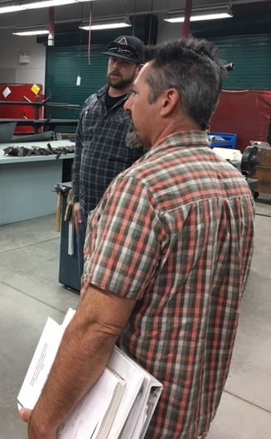
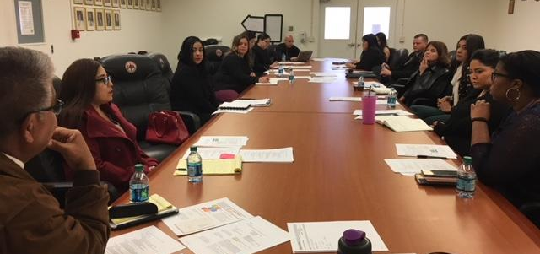
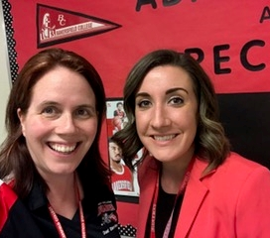
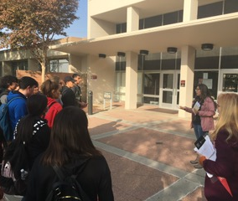
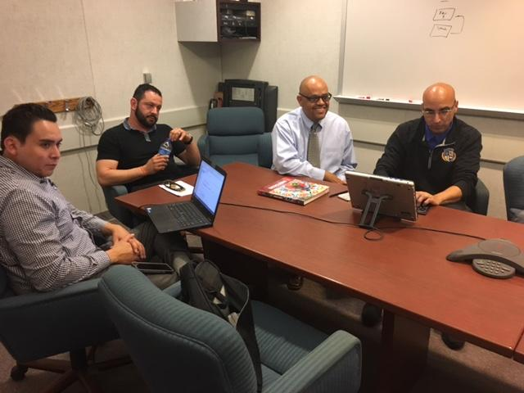
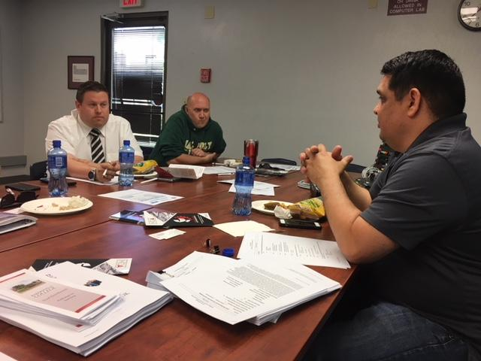
Think Stewardship
Notes:
We know that none of this would be possible without our partners.
Departments, especially the CTE, have put in strong work to collaborate.

Slide 18
Areas of Opportunity
Culture shift
Access
Data informed decision-making
Instruction
  Curriculum
  Professional Development
  Relationships & Stewardship
Student Affairs
  Infrastructure
  Student Services
  Counseling
Notes:
When making changes, look at min quals, hours, textbooks
move from “my course” to “our students”
start thinking in 9th grade & end with mid-level career
Curriculum & Scheduling- applying in HS setting by HS instructors
Look at department level relationships; integration of adjuncts
boot camps; syllabi; assignments
10 year plan integration

Slide 19
Questions?

Slide 20
Thank you!
Presenters’ Contact Information:
Dr. Anna Laven
anna.laven@bakersfieldcollege.edu
Kylie Swanson
Kylie.Swanson@bakersfieldcollege.edu
20

