Slide 1
Moving from TOP to CIP Overview
February 6, 2026

Slide 2
What are TOP and CIP codes?
The Taxonomy of Programs (TOP) is a system of numerical codes used at the state level to collect and report information on programs and courses. The Taxonomy of Programs was first published in 1979. It was designed by Chancellor's Office staff and is used only by the California Community College system.
The Classification of Instructional Programs (CIP) provides a taxonomic scheme that supports the accurate tracking and reporting of fields of study and program completions activity. CIP was originally developed by the U.S. Department of Education's National Center for Education Statistics (NCES) in 1980. It is used by every other system.

Slide 3
What TOP and CIP codes should not be used for
NOT
  Minimum qualifications
  How courses and programs are placed
  Faculty load calculations
  Department organization
  Local budget allocation
  Local program review

Slide 4
Differences with CIP codes
More detailed, several CIP codes may correspond to a single TOP code
Required for federal reporting, like Integrated Postsecondary Education Data System (IPEDS).
Descriptions identify programs as CTE or not CTE
  CTE include “prepares individuals to…”
  non-CTE include “focuses on…”
Noncredit description will include “not valid for IPEDS reporting”
  32 for all CDCP
  Others include 28, 32-37, 53, 60, 61
Only used for instructional programs and courses

Slide 5
Transition Process Introduction
TOP-CIP Crosswalk out for feedback through the TOP-CIP Crosswalk Survey by February 28, 2026.
Instructional codes to COCI by December 31, 2026
ADT and CCN will use consistent CIP (changed at CCCCO level)
Use both TOP and CIP but starting Summer 2027, only use CIP
TOP codes phased out by Fall 2027
  Including HR, fiscal, facilities
COCI changes
  Programs ready
  Courses ready at end of February
  Updating can occur until December 31st
    After, will be substantial change (new control number)

Slide 6
Local Process
A list of programs and courses will be sent to Deans, Department Chairs, and Curriculum Committee representatives.
Departments should review the selected CIP code, if one is present, for correctness according to the CCCCO TOP-CIP Crosswalk. Use the Noncredit TOP to CIP Code Map for noncredit programs and courses.
  If the CIP code is correct, do nothing.
  If the CIP code is not correct or missing, identify the correct one.
  Note, if anything other than the CIP code needs to be changed, a full revision must be done in fall 2026 with the deadline of October.
Report TOP-CIP Crosswalk issues by Thursday, February 26th
Programs CIP Review due mid-April
Course CIP Review due early May
Any revisions due October 2026

Slide 7
About the Crosswalk Data Tool
Built in Data Studio (Google login required to access)
Incorporates all possible TOP to CIP match and filters for Noncredit and CTE/non-CTE
Instructions, notes, and links to other supports
Noncredit Code Mapping

Slide 8
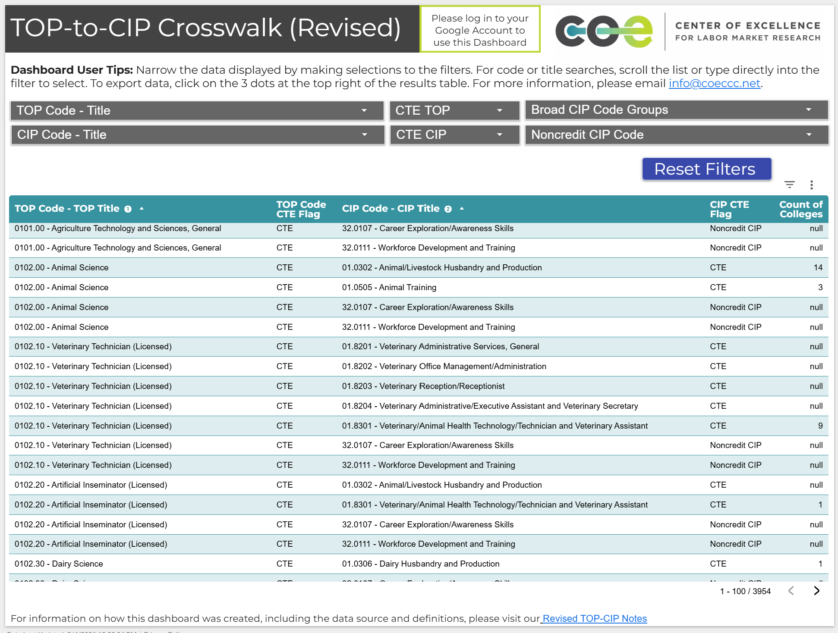
Crosswalk Data Tool Demo
Google login required to access the tool

Slide 9
Future Webinars
Noncredit TOP to CIP Open Office Hour: Tuesday, February 10, 2026, 1:00 p.m. – 2:30 p.m. Register.
Fiscal Process TOP to CIP Open Office Hour: Tuesday, February 24, 2026, 10:00 a.m. - 11:00 a.m. Register.
TOP to CIP Open Office Hours: Tuesdays, 9:00 a.m. – 10:00 a.m. bi-weekly.
Register for all Open Office Hours.

Slide 10
Resources
Top to CIP Code Transition Project Website
TOP-to-CIP Crosswalk
Noncredit TOP to CIP Code Map (PDF)
Timeline (PDF)
ESS 25-72 Memo: TOP to CIP Transition – Infrastructure and Operational Alignment (PDF)
ESS 26-06 Memo: TOP to CIP Transition – Implementation Guidance (PDF)
NCES CIP Code List (National Center for Education Statistics Classification of Instructional Programs)
BC Curriculum Co-Chairs email: bc_curriculum@bakersfieldcollege.edu

