Slide 1
Accessibility Basics Workshop
Spring 2023 Flex Workshop
Teresa McAllister
Erica Menchaca

Slide 2
Session Description
Need a refresher or crash-course on accessibility? We will go over the basics in make accessible content for your classroom, program or office. We will look at emails, Word Docs, Spreadsheets, PowerPoints, PDFs. Accessible content is required for compliance with Title 5, the Americans with Disabilities Act and section 508 of the Rehabilitation Act.

Slide 3
Outline
Introductions, Attendance, and Norms
Legislation, Regulations, and Expectations
Word Docs
Spreadsheets
PDFs
Take Aways
Accessibility Basics
PowerPoints
Emails

Slide 4
Introductions
Teresa McAllister
Education Faculty
Academic Senate Treasurer
Erica Menchaca
Education Faculty
Articulation Officer
Academic Senate Vice President

Slide 5
Attendance & Norms
Zoom Attenders
Use chat for questions or raise hands
We will pause for questions after each topic
Complete the evaluation

Slide 6
Expectations
What do you want to gain from this session?

Slide 7
Legislation, Regulations, and Expectations
Title 5, 55200
... instruction provided as distance education is subject to the requirements of the Americans with Disabilities Act ( 42 U.S.C. § 12100 et seq.) and section 508 of the Rehabilitation Act of 1973, as amended ( 29 U.S.C. § 794d ).
Section 508 of the Rehabilitation Act of 1973
agencies must give disabled employees and members of the public access to information comparable to the access available to others.
California state law SB105, 2002 - anyone receiving state funds must comply
Web Content Accessibility Guidelines (WCAG) 2.0
covers a wide range of recommendations for making Web content more accessible
Americans with Disabilities Act (1990)
Broader scope than 504 with similar objectives.
Section 504 of the Rehabilitation Act of 1973
Mandates equal access to services and programs offered by organizations receiving federal funding.
Requires providing appropriate accommodations, per request, that effect a level playing field

Slide 8
Principles of Accessibility
Perceivable
Alternative formats provided
Operable
Works when clicked
Easy to navigate
Can use all functionality with a keyboard
Understandable
Readable
Predictable
Avoid errors/mistakes
Robust
Compatible on current and future devices/programs/platforms
Assistive technology

Slide 9
Accessibility Basics
Headings
Hyperlinks
Alternative Text (Alt Text)
Color Contrast
Motion and Sound
Readability
Tables
Accessibility Checks
Video Captioning (different flex workshop)

Slide 10
Word Docs
Example file (Word Activity)
Use Headings
Provide Alt Text
Avoid Tables
Check Color Contrast
Embed Hyperlinks within text
Add Document Info
Forms must be converted to PDF
Microsoft Support - Word Accessibility

Slide 11
Spreadsheets
Example file (Excel Activity)
Clear names for tables
Readability
Format
Repeating Table Headings
Color contrast
Sheet Names
Microsoft Support – Excel Accessibility

Slide 12
PowerPoints
Example file (Activity)
Slide Titles
Navigation/Headings
Design
Color Contrast
Animations/Transitions/Media
Microsoft Support – PowerPoint Accessibility

Slide 13
Basic PDFs
Start with Word, Excel or PowerPoint first
Document Title and Initial View
Language
Reading Order
Tags
Links
Tables
Color Contrast
Forms
Acrobat Pro Support – PDF Accessibility

Slide 14
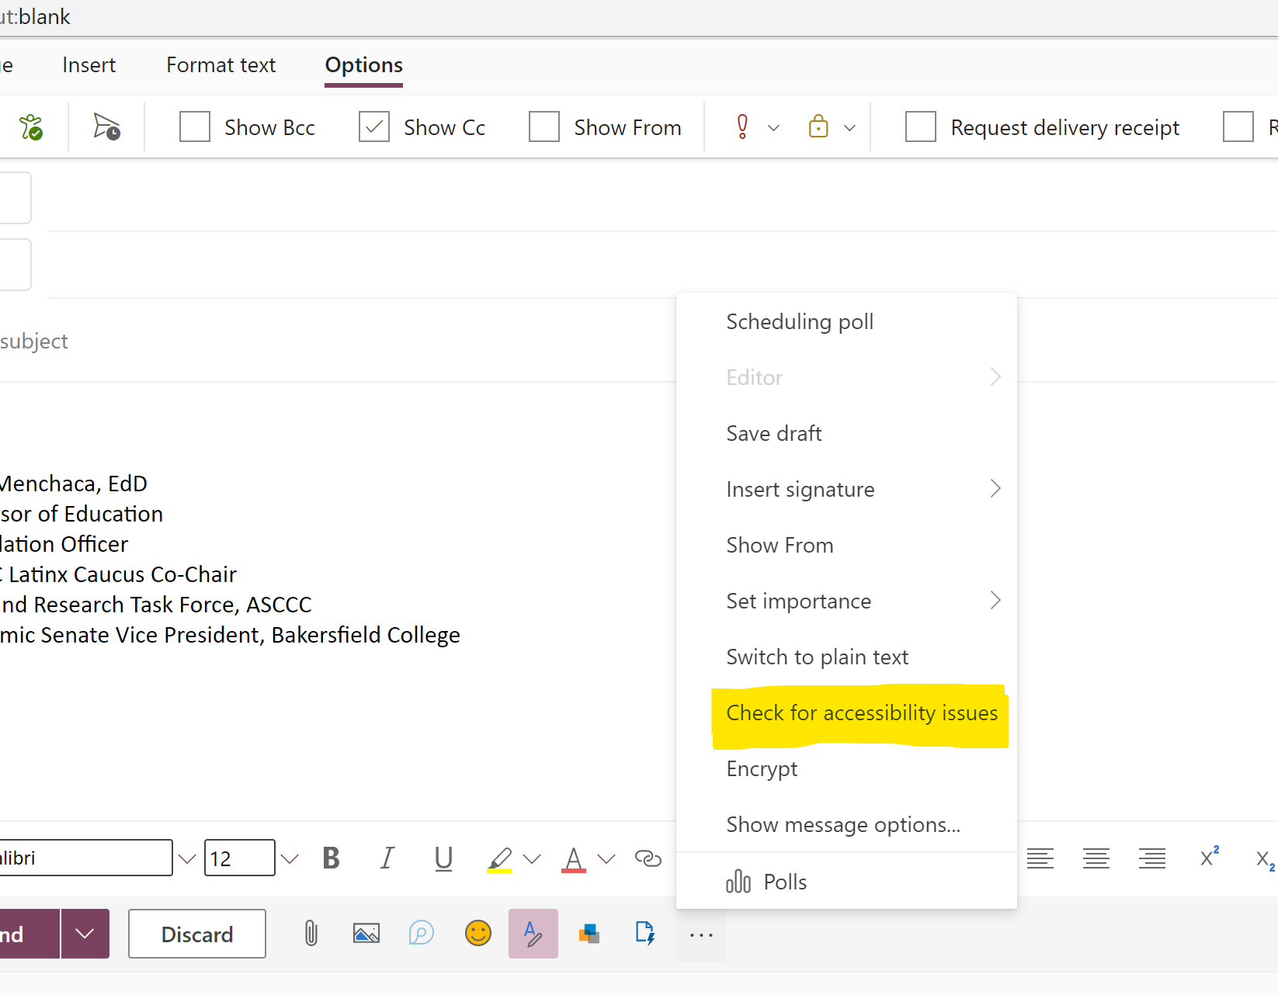
Emails
Font
Color Contrast
Alt Text
Headings
Tables
Microsoft Support – Outlook Accessibility

Slide 15
Resources
BC Academic Technology
BC Accessibility Center - Resources
CCC Accessibility Center – What We Do
CCC VRC– Accessibility Specialist Postings
NCDAE Cheatsheets
University of Oregon – Digital Accessibility
ASCCC OERI Accessibility Resources
Website Checker – WAVE tool
Color Contrast Checker - WebAim
Section 508 Accessibility Conformance Checklists

Slide 16
Take Aways
What did you gain?
What would you still like to know?
What can you use this semester?

