Slide 1
Committee of Co-Chairs
October 16, 2026
Levan Center @ 10:30 am
Contains Slides adapted from ASCCC Collegiality in Action (BC 2023)

Slide 2
Agenda
Welcome – President Stacy Pfluger
Committee Photo
Participatory Governance – Wade Ellis & Jessica Wojtysiak
Chairing Meetings Best Practices – Kimberly Nickell & Kristin Rabe
Committee Charges/Co-Chair Job Descriptions – Wade Ellis & Jessica Wojtysiak
Committee of Chairs Charge – Wade Ellis & Jessica Wojtysiak
Adjournment

Slide 3
The following slides are adapted from the Academic Senate for California Community Colleges (ASCCC) Bakersfield College Visit on Collegial in Action (2023)

Slide 4
Governance in the California Community Colleges
What is participatory governance?
What is shared governance?
What is the difference?
Notes:
Larry The idea here would be to encourage some discussion or audience comment. Neither of these terms has a definition on Ed Code or T5—which can lead to confusion and disagreement when the terms are used.

Slide 5
Participatory Governance
“…not a simple process to implement – goodwill, thoughtful people, a willingness to take risks and the ability to admit problems exist – can go far toward establishing a positive environment…
…The central objective should be creation of a climate where energy is devoted to solving crucial educational tasks and not to turf battles over governance.”
— CCT/CEOCCC Policy Paper, December 1989
Notes:
Larry Note: neither shared governance nor participatory governance have definitions in law or regulation. The terms used are effective participation and collegial consultation.

Slide 6
Title 5 Terminology: Effective Participation
Participating effectively in district and college governance is shared involvement in the decision-making process.
It does not imply total agreement;
The same level of participation by all is not required: and
Final decisions rest with the governing board.

Slide 7
Benefits and Values of our Governance System
Expertise and analytical skills of many
Understanding of objective/decisions
Commitment to implementation
Leadership opportunities
Promotion of trust and cooperation
Opportunities for conflict resolution
Less dissent

Slide 8
The Law – Education Code
Ed Code § 70902(b)(7)
Board of Governors shall establish “minimum standards” and local governing boards shall “establish procedures consistent” with those standards to ensure the following:
Faculty, staff, and students the right to participate effectively in district and college governance;
The right of the academic senates to assume primary responsibility for making recommendations in the areas of curriculum and academic standards.

Slide 9
Regulation – Title 5
Title 5 §53203
Academic Senate Role
The governing board shall adopt policies for appropriate delegation of authority and responsibility to its academic senate.
…providing at a minimum the governing board or its designees consult collegially with the academic senate when adopting policies and procedures on academic and professional matters.

Slide 10
Regulation – Title 5
Title 5 §53200
Academic Senate Role
“Consult collegially” means:
Relying primarily upon the advice and judgment of the academic senate; or
Reaching mutual agreement between the governing board/designee and representatives of the academic senate.

Slide 11
Regulation – Academic Senates
Title 5 § 53203
(d)(1) Governing board action: Rely Primarily
Recommendations of the academic senate will normally be accepted
Only in exceptional circumstances and for compelling reasons will the recommendations not be accepted
If not accepted, board/designee communicate its reasons in writing, if requested

Slide 12
Important Notes on Collegial Consultation
The Governing Board has final say
The Governing Board is never prohibited from acting

Slide 13
Academic and Professional Matters
The “10 + 1”

Slide 14
Regulation – Academic Senates
Title 5 § 53200
Academic and Professional Matters means the following policy development and implementation matters:
Curriculum, including establishing prerequisites and placing courses within disciplines
Degree and certificate requirements
Grading policies
Educational program development
Standards or policies regarding student preparation and success

Slide 15
Regulation – Academic Senates
Title 5 § 53200 (cont’d)
Academic and Professional Matters means the following policy development and implementation matters:
District and college governance structures, as related to faculty roles
Faculty roles and involvement in accreditation processes, including self-study and annual reports
Policies for faculty professional development activities
Processes for program review
Processes for institutional planning and budget development, and…

Slide 16
Regulation – Academic Senates
Title 5 § 53200 (cont’d)(2)
Academic and Professional Matters means the following policy development and implementation matters:
Other academic and professional matters as mutually agreed upon between the governing board and the academic senate.
This is known as the “Plus one” or “+ 1”

Slide 17
Other Legal Provisions Related to the Academic Senates
Equivalencies to Minimum Qualifications: process, criteria, and standards agreed upon jointly by the governing board designee and academic senate – Ed Code § 87359
Faculty Hiring: criteria, policies, and procedures shall be agreed upon jointly by governing board designee and academic senate – Ed Code § 87360
Administrator Retreat Rights: process agreed upon jointly; governing board to rely primarily upon the advice and judgment of the academic senate to determine that the administrator possesses minimum qualifications for employment as a faculty member – Ed Code § 87458

Slide 18
Other Legal Provisions Related to the Academic Senates – cont’d
Curriculum Committee: established by mutual agreement between the administration and the academic senate – Title 5 § 55002
Appointments to College Bodies: The appointment of faculty members to serve on college or district committees, task forces, or other groups dealing with academic and professional matters, shall be made, after consultation with the chief executive officer or his or her designee, by the academic senate. Notwithstanding this subsection, the collective bargaining representative may seek to appoint faculty members to committees, task forces, or other groups – Title 5 § 53203(f)
Notes:
Consultation is not the same as collegial consultation

Slide 19
Committee Chairs Best Practices:
Kimberly Nickell & Kristin Rabe (Program Review)

Slide 20
Committee Charges - Composition
  Charge Template (pdf)
  Charge Template (word)

Slide 21
Committee Charges – Composition cont’d
Required/Preferred/Recommended
  Charge must be accessible - standards (required)
  Word version (preferred – for editing purposes)
  Landscape orientation (preferred)
  Membership – use “admin” “faculty” “student” “group or designee” vs. titles (preferred)
  Ensure voting and non-voting members are identified.
  Ensure members are notified they are serving on the committee & understand their role.
  Ensure the charge is consistent with language in KCCD Board Policy, Academic Senate Constitution & By-laws, and other related policies & procedures (required)
  Mark Up Version Legend (preferred)
    Black language – Former Charge language unchanged
    New language – Red, italics
    Second new language – Blue, italics
    Third new language - Purple, italics
    Deleted language – Green, strike out

Slide 22
Committee Charge Review Process
The committee reviews its charge every other year (if there are no changes, document in Committee Report).
The committee makes proposed revisions (approved by the committee).
The charge with proposed revisions is submitted to the AS E-Board.
AS lists the charge on the agenda under consent.
CC lists the charge on the agenda item under Consent
  If the charge is pulled from consent & either amended or denied, the President’s Assistant will inform the Chairs.
The approved charge is updated (clean up doc to final version) – by Chair or AS office
  Finalize edits
  Add approvals & effective date (ensure membership isn’t impacted, if so -it will be effective the following Fall semester).
  Two charge documents (accessible word & accessible PDF document).
  Confirm final version with Chair(s) and AS-Pres.
The charge is posted to the committee’s webpage & the Senate webpage (charge repository section).
Update Committee Charge master tracking sheet.

Slide 23
Committee Charges – Annual Review
Academic Senate Constitution & By-laws: Article 8-Committees, Section 9, 3rd paragraph: College-wide committee charges are to be reviewed bi-annually in the Fall semester and any revisions must be approved by the Academic Senate before the new charge can take effect.
Changes normally take effect the following Fall semester.
If the changes to the charge are to take effect immediately, it requires a 2/3 votes of the Academic Senate
Past President Fliger (College Council-2025) announced that he will no longer accept committee work if they have not reviewed & updated their charge by the end of the Fall Semester.

Slide 24
Committee Charges & Job Descriptions
AS - Charge approved by Senate 09/2026 / JD – C’s & B’s
AGMC – Charge approved by CC 04/2026 / JD none
AIQ - Charge approved CC 09/2026 / JD revised 2025
AC - Charge approved by Senate 10/2026 / JD revised 2026
BAC - Charge reviewed with no change 09/2026 /JD - none
BTC - Charge approved by Senate 10/2026 / JD - none
CRC - Charge approved by CC 11/2025 / JD revised 2026
DEI - Charge approved by Senate 10/2026 / JD NEW 2026
DERC – Charge approved by Senate 09/2026 / JD none
EODAC Charge reviewed with no change 09/2026 / JD revised 2025
All websites are updated with most recent charge
* = up for review this academic year

Slide 25
Committee Charges & Job Descriptions (cont’d)
EMC - Charge approved by CC 11/2025 /JD revised 2025
EC - Charge reviewed with no change 03/2026 /JD revised 2025
FSC - Charge approved by CC 04/2026 /JD none
TechCom - Charge approved by CC 12/2025 /JD revised 2010
PDC - Charge approved by CC 5/2025 /JD 2025* (Spring 2027)
Flex Advisory - Charge approved by CC 10/2025 /JD none
PRC - Charge reviewed with no change 09/2026 /JD 2024
CCC - Charge approved by CC 11/2024
SC - Charge approved by CC 4/2025 /JD none * (Spring 2027)
SAC - Charge approved by CC 11/2025 /JD none
All websites are updated with most recent charge
* = up for review this academic year

Slide 26
Accessibility & Committee Website Training
Training Request Link
  When you fill out the form you check the box: “add user” and that is sent to MPR to let them know you are requesting training.
  Training Required:
    Level 1: BC Web Content Contributor Training [WCCT] is 1-2 hours and must be completed in 4 weeks
    Level 2: BC Committee Website Training -you will receive an email after you have completed the level 1 training to join the level 2 training session

Slide 27
Accessibility & Committee Website Training Completion
Co-Chairs and Support Staff Trained (Level 1 & 2)
  Karyna Bandy
  Grace Commiso
  Scott Dameron
  Michelle Hart
  Edie Nelson (support for CRC)
  Dillon Giblin
  Tom Greenwood
  Kimberly Nickell
  Ximena Ortega
  Shelly Payne (support for FSC)
  Kristin Rabe
  Rebecka Zepeda
  Sara Manuel
  Wade Ellis

Slide 28
Accessibility Tips for Document Preparation
In Microsoft Word, make sure to use Heading 1, 2, 3, etc. Do not use the “Title” Heading if you plan to convert to PDF.
  There is no “Title” Heading in adobe, so conversion is not accessible.
  If not converting to PDF, that heading style is fine if the document passes accessibility check.
Your final PDF should resemble the screenshot on the next slide when you click “Fix Reading Order” during accessibility check.

Slide 29
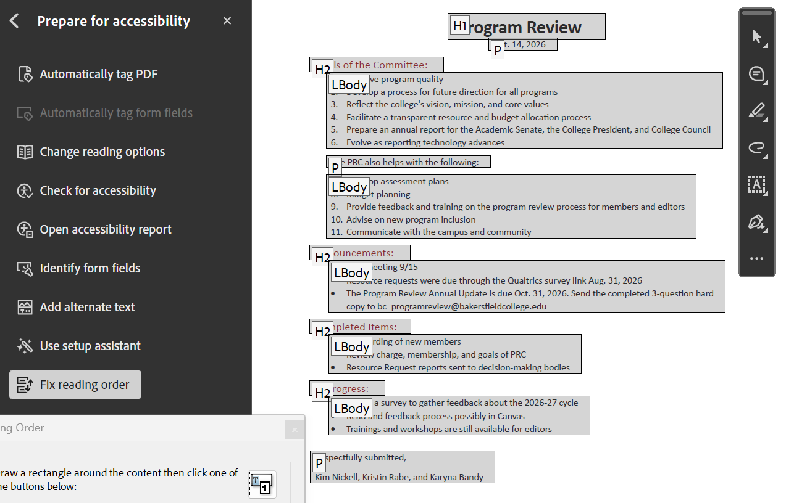
Accessibility Tips for Document Preparation - Adobe
Your final PDF should resemble the screenshot below when you click “Check Reading Order” during accessibility check.

Slide 30
Accessibility Tips for Document Preparation - alt text and tables
All images should have alt text. Both word and adobe accessibility checks will require it.
  If it is a QR code, do not input the link, describe the destination
All tables should include table summaries – 1-2 sentence description of the contents

Slide 31
Committee of Co-Chairs Charge

Slide 32
Thank you!
VPI Jessica Wojtysiak & AS VP Wade Ellis

