Slide 1
Bakersfield College Annual Admin Structure Review
2024-25
Jo Ellen Barnes
Somaly Boles
Grace Commiso
Nicky Damania
Sooyeon Kim
Timothy Mason
Richard McCrow
Ann Tatum
Calvin Yu

Slide 2
Timeline Review
Admin Structure Review Schedule
Feb 2 | College Council Meeting - Intro | Overview of Admin Structure Review Process, share the timeline, and introduction of team.
Feb 15 | Admin Structure Meeting #1 | Kick-off meeting. Overview of process and timeline and solicitation of org changes, title changes, and new positions
Feb 27 | Admin Structure Meeting #2 | Review previous history, Discussion of charge, Add additional task of reviewing Classified position requests
Mar 4 | Admin Structure Meeting #3 | Consolidate all positions and position descriptions, Requested Divisional review of positions within (eg FCDC, SALT)
Mar 13 | Admin Structure Meeting #4 | Review additional information, update ASR requirements, Begin rankings of Management positions
Mar 19 | Admin Structure Meeting #5 | Review and discussion of Management position rankings, Introduction and overview of Classified positions
Apr 1 | Admin Structure Meeting #6 | Review timeline and consultation process, Divisional review of positions within, Begin ratings of Classified positions
Apr 8 | Admin Structure Meeting #7 | Review and discussion of Classified position ratings, Begin documentation process to share results
April 10: Senate Eboard
April 17: Academic Senate
April 19: College Council 1st read
May 1: Academic Senate (if needed)
May 3: College Council 2nd read

Slide 3
Instruction
Management:
Program Manager, Math Learning Center
Associate Athletic Director, Women's Sports
Program Manager, Shafter Learning Center
Classified:
Dean of Instruction Theatre Technician
Academic Technology-Non Academic Department Assistant III
Apprenticeship CTE Educational Advisor
Food Service CTE Laboratory Technician I
Kinesiology/Health/Phys Ed CTE Office Supervisor
Library Science Library Technician II
Library Science (Delano) Library Technician I
Library Science (Arvin) Library Technician I
Music Athletic Trainer
Physics Laboratory Technician II
Research Laboratory Technology CTE Laboratory Safety Technician
Theatre Assistant Technical Director
Theatre Costume Shop Manager
Delano Campus Center Agriculture Technician
*Strikethrough signifies Division proposed removal

Slide 4
Student Affairs
Management:
Associate Vice President of Student Affairs
Dean of Enrollment and Retention
Dean of Categorical and Special Programs
Director of Residence Life
Residence Life Coordinator
Mental Health Clinician
Classified:
Residence Life Department Assistant III
Events and Scheduling Media Technician for Events
Events and Scheduling Events Staff
Student Success Technology Systems Support Analyst
Student Success Technology Program Technician
Financial Aid and Scholarships Financial Aid Assistant (3x)
Financial Aid and Scholarships Financial Aid Technician (3x)
Admissions and Records Admissions and Records Technician II (6x)
International Students Center Department Assistant III
Student Success and Counseling Educational Advisor
Transfer Pathways Educational Advisor
Veteran’s Resource Center Department Assistant III
*Strikethrough signifies Division proposed removal

Slide 5
Finance and Admin Services
Management:
Project Manager, Finance and Administration
College Safety Field Supervisor
Classified:
Food Services Accounting Technician I
Budget Office Budget Coordinator
Office of College Safety Public Safety Officer II
Office of College Safety Public Safety Officer I
Office of College Safety Department Assistant III
Maintenance and Operations Maintenance & Operations Technician
Maintenance and Operations Groundsworker II
Maintenance and Operations Custodian I
Maintenance and Operations Custodian I
Maintenance and Operations Custodian I
Maintenance and Operations Custodian I
*Strikethrough signifies Division proposed removal

Slide 6
Presidents' leadership team
Management:
None this cycle
Classified:
Technology Support Services Systems Support Specialist I
Technology Support Services Systems Support Specialist II
Institutional Effectiveness Senior Research Analyst
*Strikethrough signifies Division proposed removal

Slide 7
Ranking Considerations
Workload distribution
Compliance
Funding
Department needs
Budget Impact

Slide 8
Management positions Ranking
Committee Recommendations, Ordinal Ranking |  |  | Rank
Position | Area
Director of Residence Life | Student Affairs |  | 1
Associate Athletic Director, Women’s Sports | Instruction |  | 2
Project Manager, Finance and Administration | FAS |  | 3
Residence Life Coordinator | Student Affairs |  | 4
College Safety Field Supervisor | FAS |  | 5
Program Manager, Math Learning Center | Instruction |  | 6
Associate Vice President, Student Affairs | Student Affairs |  | 7
Mental Health Clinician | Student Affairs |  | 8
Dean of Enrollment and Retention | Student Affairs |  | 9
Dean of Categorical and Special Programs | Student Affairs |  | 10

Slide 9
Classified positions Ranking Top 9
Committee Recommendations, Numerical Ratings |  |  | Rank
Position | Area
Institutional Effectiveness - Senior Research Analyst | President |  | 1
Budget Office - Budget Coordinator | FAS |  | 2
Technology Support Services - Systems Support Specialist II | President |  | 3
Student Success Technology - Systems Support Analyst | Student Affairs |  | 4
Admissions and Records - Admissions and Records Technician II | Student Affairs |  | 5
Library Science - Library Technician I (Arvin) | Instruction |  | 6
Delano Campus Center - Agriculture Technician | Instruction |  | 7
College Safety - Public Safety Officer I | FAS |  | 8
College Safety - Public Safety Officer II | FAS |  | 9

Slide 10
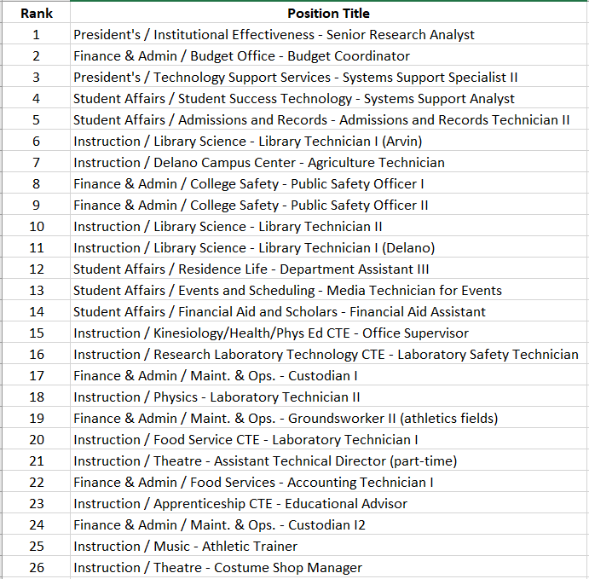
Classified positions Ranking All

Slide 11
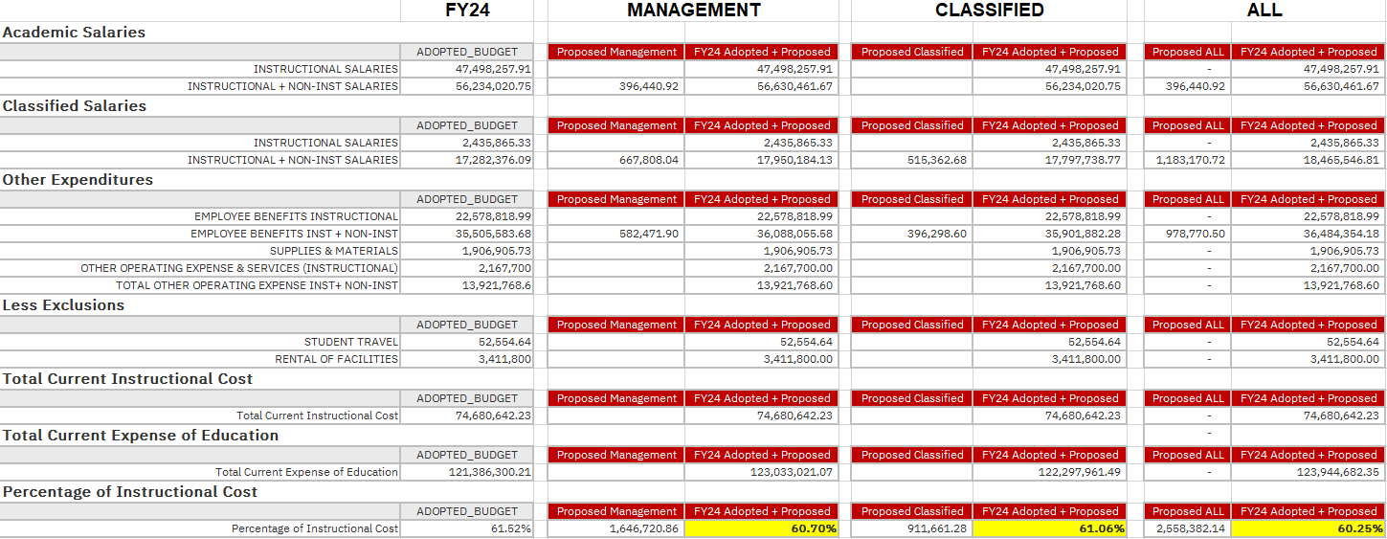
Budget implications

