Slide 1
ISER College Council Presentation
September 15, 2023
Billie Jo Rice, Jessica Wojtysiak, Jason Stratton, SONDRA KECKLEY & Talita Pruett

Slide 2
Key Terms for this ISER Cycle
ACCJC: Accrediting Commission for Community and Junior Colleges
Accreditation: process by which agencies [ACCJC] vet colleges to determine eligibility for continual Federal financial support, in addition to being a standard required for transferability of college students, plus other quality control characteristics.
Commendations: Recognition of specific achievements above expectations of standards.
ISER: Institutional Self-Evaluation Report, developed by collaboration of all constituent groups of the college.
Mission: College-define Mission Statement that is central to majority of college’s work with students and community.
Recommendations: Identification of areas for improvement before next ISER- which become focus of Mid-Term Reports.
Standards: Similar to SLOs, for the entire institution- standards of achievement that college’s must demonstrate compliance with to renew their status as Accredited.

Slide 3
ISER 2018: Bakersfield College Commendations
Commendation#1: Exceptional Leadership to advance student learning through use of governance committees.
Commendation#2: Commitment to mission by way of outreach and support to rural communities.
Commendation#3: Commitment to professional development.

Slide 4
How is the Accreditation Review Conducted?
1.Internal Evaluation
2.External Evaluation by Peers
3.Commission Evaluation
4.Institutional Self-Improvement
ISER
8 Years Cycle

Slide 5
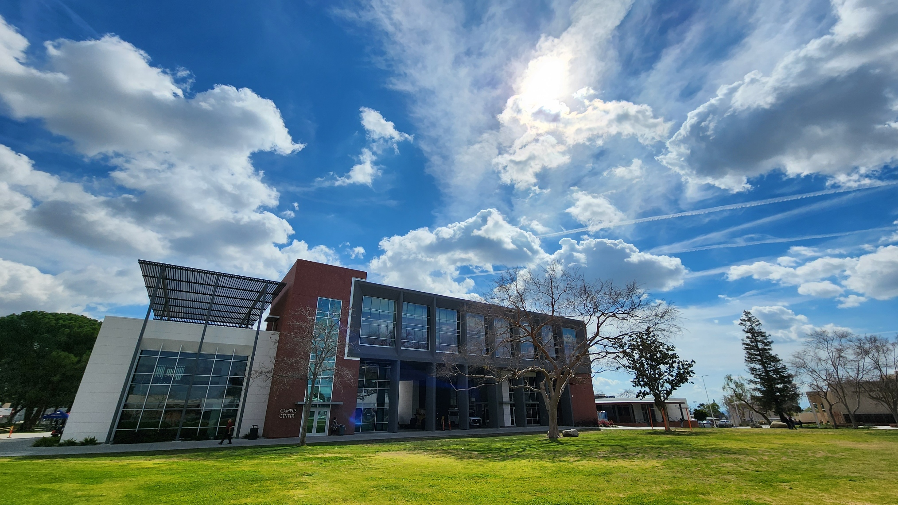
How is this ISER different from 2018?
Fewer standards: from 127 to only 30!
No QFE
Revised Data Prelude
Sections focus on equitable outcomes & improvement more than process: "What are the results and how do you use them?"(not evidence of meeting the standard and analysis of evaluation)
Checklists of evidence for documents that were difficult to write narratives for, such as parts of the catalog
Fewer pages: from 140 to only 60!!!
Shift from 7-year cycle to 8-year cycle
From "meet the standard" to a 4-level rubric

Slide 6
Example Rubric for Standard 1.1

Slide 7
BC ISER Timeline
Fall 23
Fall 2023
Form Standard Teams
Produce Drafts
Open Forum and Campus Meetings
Spring 24
Spring 2024
Revise/Edit Drafts
Committee Visits
Fall 24
Fall 2024
BoT: 1st Read October
AS/CC: 2nd read Sept
AS/CC: 1st read May
Submit by 12/24
By Dec.

Slide 8
Accreditation Review Timeline
College
Self-Reflection
ISER
Team ISER Review
Standards Validation
Core Inquires
Off-Campus Site
Focused Site Visit
Core Inquires
On-Campus Site
Team Report
Commission Action
(Affirmation)
College
Prep
ISER
Due
12/15/24
Spring
2025
Fall
2025
January
2026

Slide 9
Current Status of ISER Team
Developed and planned Campus-Wide informative forum to explain ISER to BC: 09/18/2023
Developed/Planned 2 training sessions for standard team leads [9/19/23 and 9/20/23]
Developed crosswalk of old vs new standards to facilitate evidence collection.
Fine-tuned evidence naming conventions to align with new standard requirements.
Working with AIQ Committee to ensure the annual AIQ survey contains targeted evaluative tools that will be beneficial in evaluating compliance with Accreditation Standards.
Developing timeline to work with standard team leads to ensure evidence is collected and drafts are compiled to enable us to remain on track with ISER Timeline.

Slide 10
Resources
Accreditation Handbook - Appendix D includes rubrics for each standard.
ISER 2024 Template
2024 Accreditation Standards with Review Criteria and Suggestions for Evidence
Bakersfield College Accreditation Page (review previous ISERs)
Standard Teams Document Spreadsheet?
slides

Slide 11
Standard Teams and Responsibilities
Composition
Administrator Lead
Faculty Lead
Team Members
Responsibilities
Gather evidence/documents
Produce a 1–2-page per standard draft by December 2023.

Slide 12
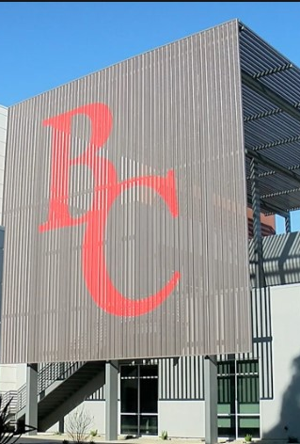
Your ISER Core Team
Accreditation Liaison Officer: Billie Jo Rice
Faculty Lead: Jason Stratton
Admin Lead: Jessica Wojtysiak
Editor: Talita Pruett
Indexer: Sondra Keckley
Marketing: Monika Scott
Accreditation and Institutional Quality Committee
And… You!

Slide 13
Any Questions?

