Slide 1
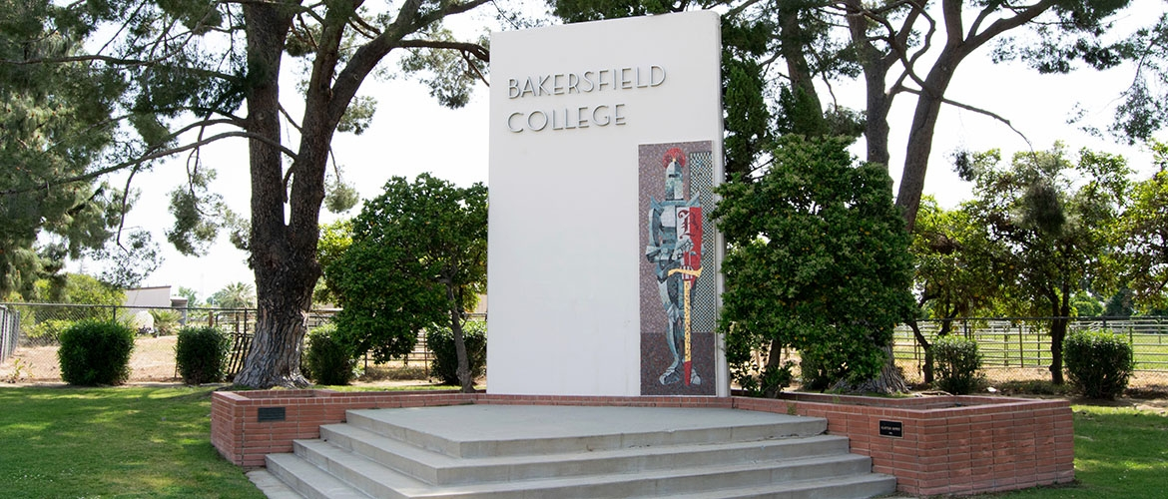
Facilities MASTER Plan-Update
May 05, 2023

Slide 2
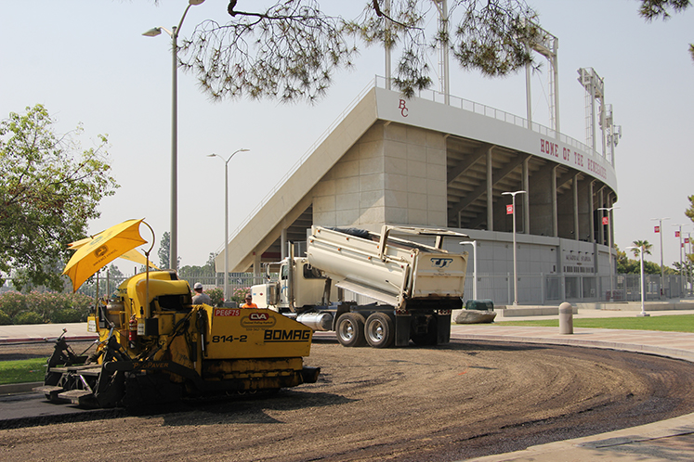
Educational Master Plan
A draft 2023 – 2026 EMP has been presented to Academic Senate on May 02, 2023
Awaiting Final Approval

Slide 3
Facilities Master Plan
Engaged and preliminary discussions with Cambridge west
Will begin overlaying the educational master plan
Document throughout the summer
Have preliminary Facilities master plan ready for beginning of fall for review through participatory governance committees
Nov/Dec to the board of directors for approval

Slide 4
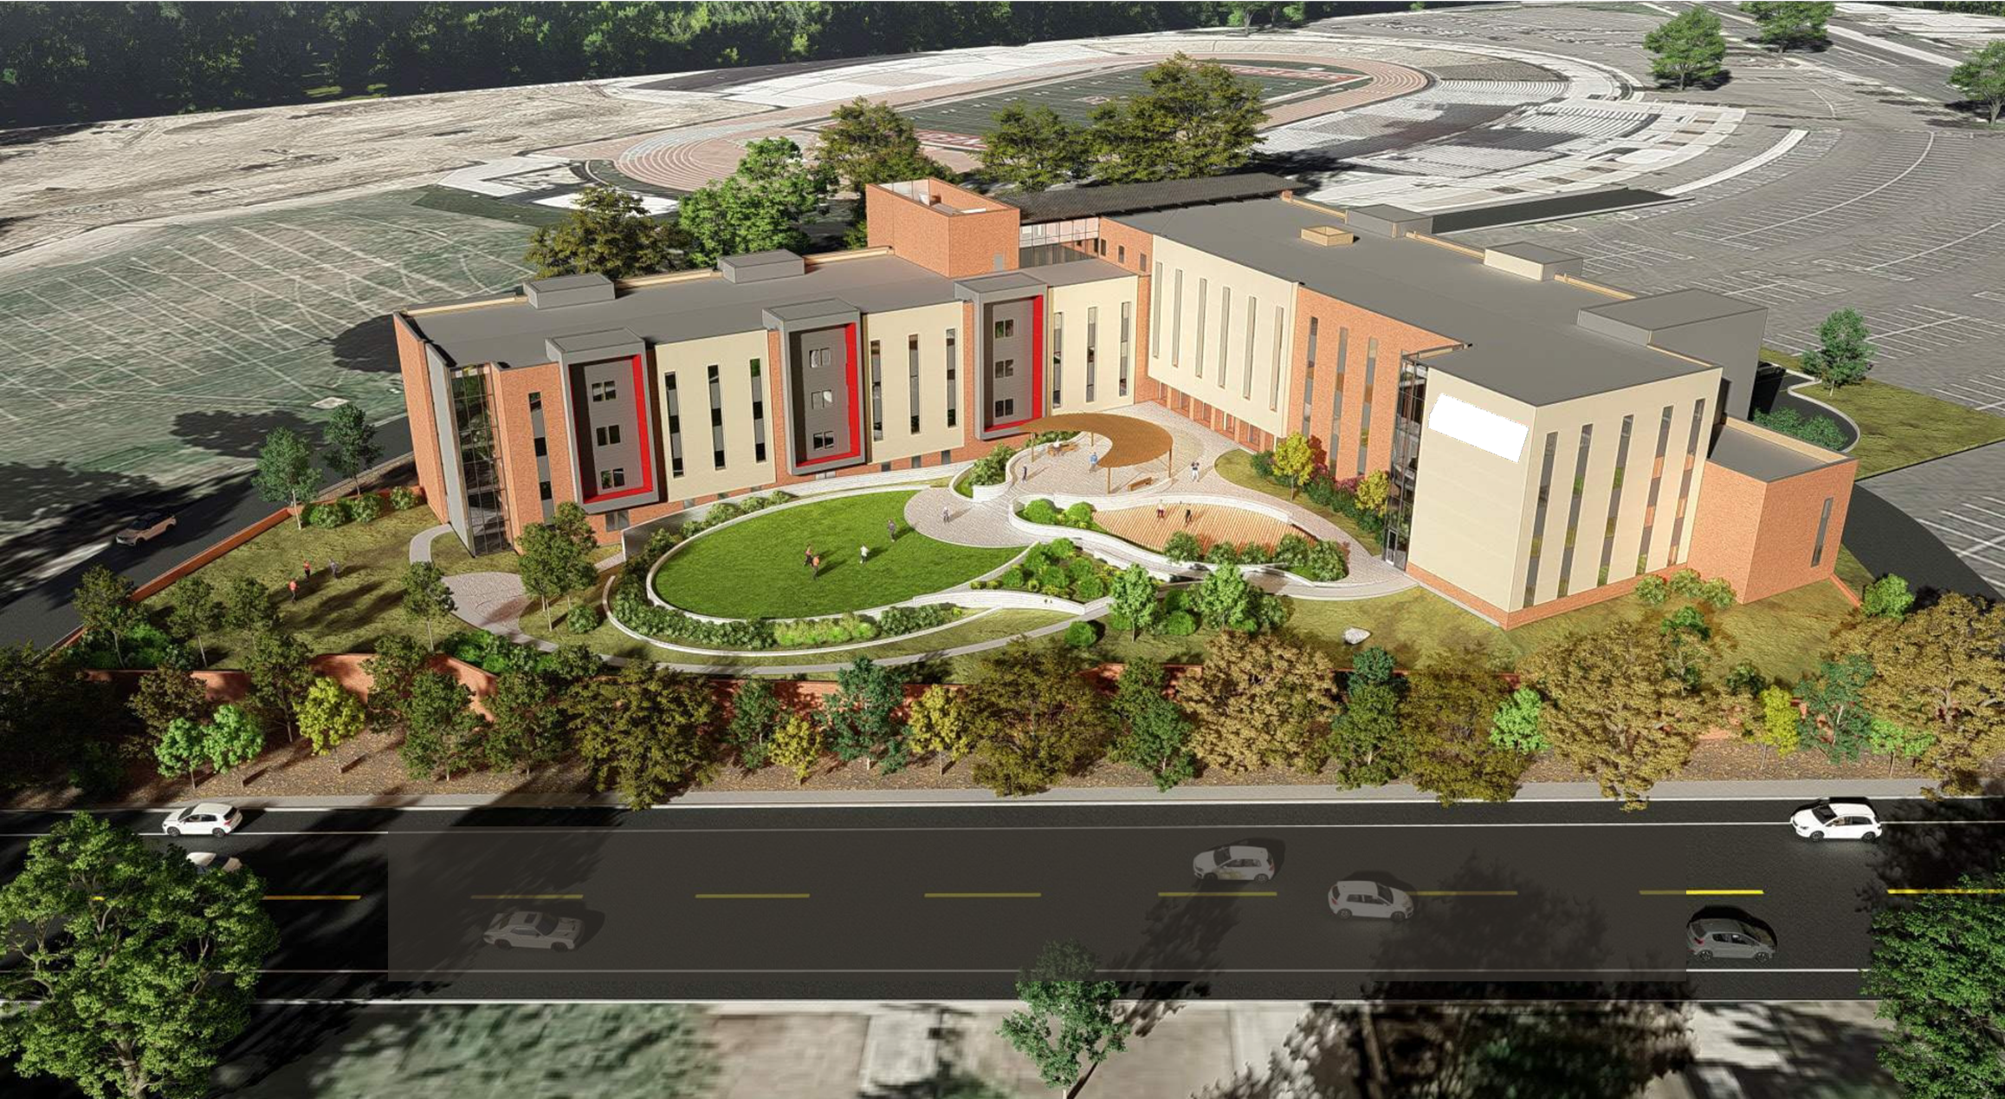
Questions?

