Slide 1
Educational Master Plan
College Council
February 24, 2023

Slide 2
MISSION
GUIDING PLANS
Educational Master Plan Technology Master Plan Facilities Master Plan
STRATEGIC DIRECTIONS
Student Learning Student Progression & Completion Infrastructure and Resource Development Leadership & Engagement
CLOSING THE LOOP
CLOSING THE LOOP
CLOSING THE LOOP
President's Document
Linking Budget Decisions
to Strategic Planning
Academic Affairs & Instruction
Baccalaureate Degree
Administrative Units
Student Affairs
SSSP/Equity/BSI
Integrated Plan,
Professional
Development Plan
RENEGADE SCORECARD

Slide 3
Bakersfield College Mission
Bakersfield College provides opportunities for students from diverse economic, cultural, and educational backgrounds to attain Associate and Baccalaureate degrees and certificates, workplace skills, and preparation for transfer. Our rigorous and supportive learning environment promotes equity and fosters students’ abilities to think critically, communicate effectively, and demonstrate competencies and skills in order to engage productively in their communities and the world.

Slide 4
Educational Master Plan
Strategic
Directions
Technology Master Plan
Facilities
Master Plan
Institutional Self-Evaluation Report
Notes:
Reminder: what we use to guide the work we do toward institutional quality and educational excellence.

Slide 5
Report Timelines
Educational Master Plan: October 2023
Strategic Directions: March 2024
ISER: December 2024

Slide 6
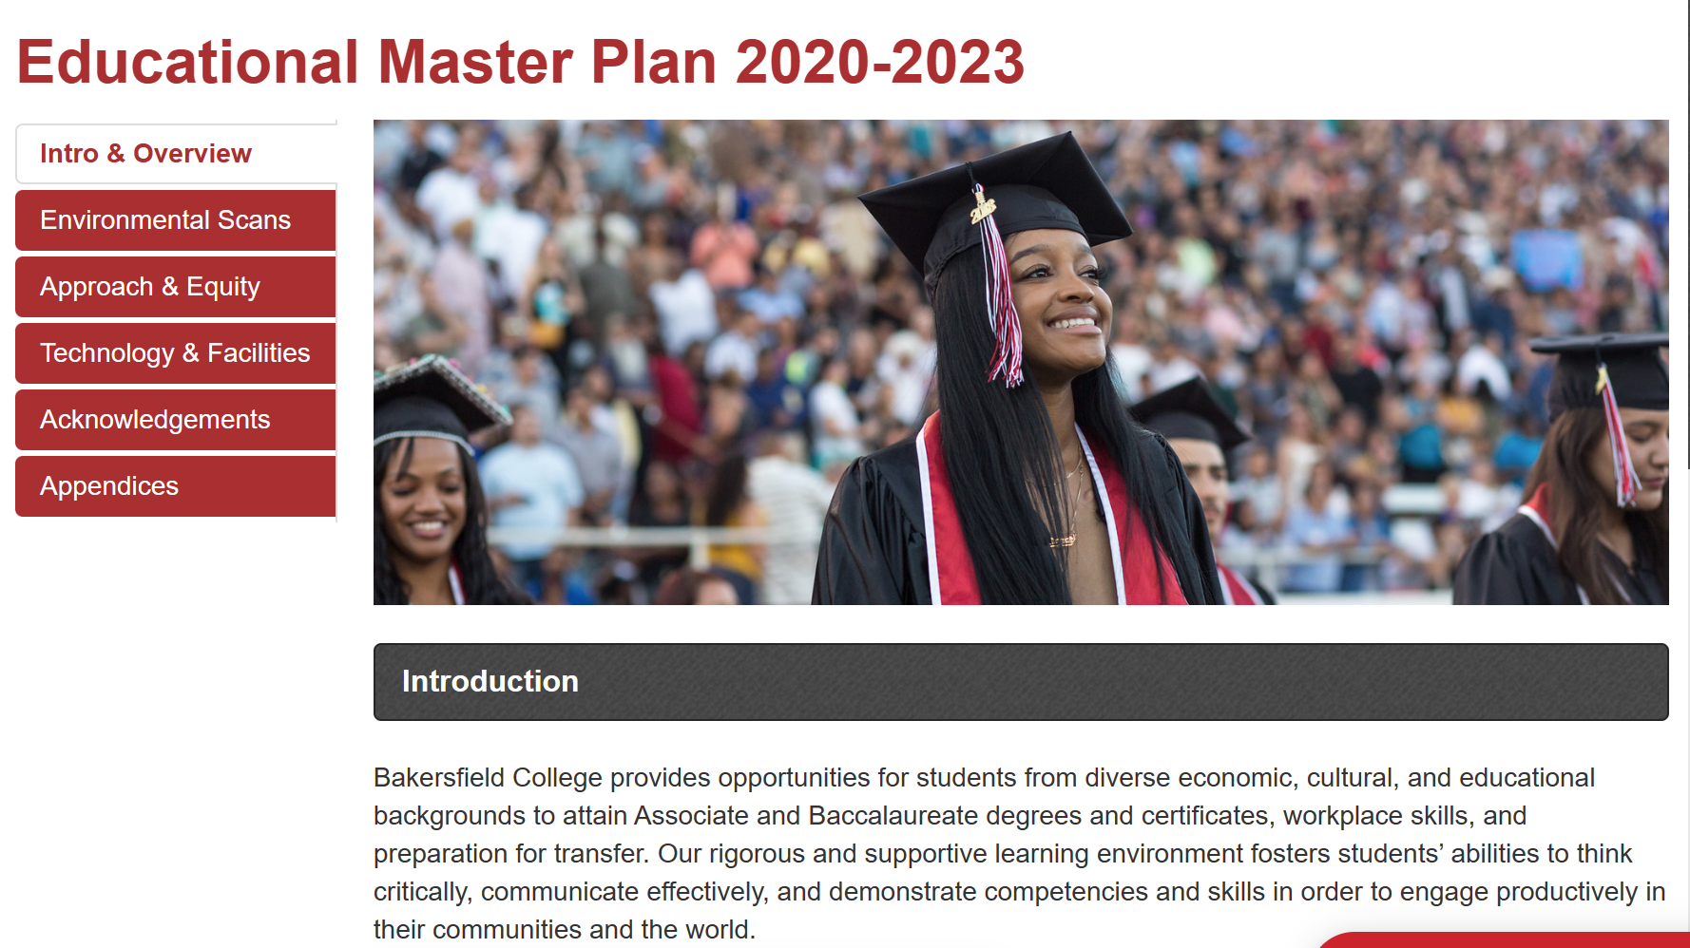

Slide 7
2023-2026 Emerging Themes
Intersegmental Approach to the Future
Early College to BC to Baccalaureate
Adult Education to BC to Baccalaureate
Rising Scholars Program to BC to Baccalaureate
Equity and Completion through Guided Pathways for the Future
Persistence
International Students
Evolving Workforce Preparation for the Future
HEAL, Apprenticeship, LAEP, Renewable Energy
Facilities & Infrastructure Opportunities for the Future
Delano, Arvin, BCSW, Weil
Measure J

Slide 8
2023-2026 EMP Steering Committee
Vice President of Instruction
Vice President of Student Affairs
Associate Vice President of Instruction
Academic Senate President
CCA Representative
CSEA Representative
SGA Representative
AIQ Faculty Co-Chair
Office of Institutional Effectiveness

