Slide 1



Regional Collaboration and Coordination
A New Model for collaboration and coordination to shape the future of work in California’s Central Valley

Slide 2
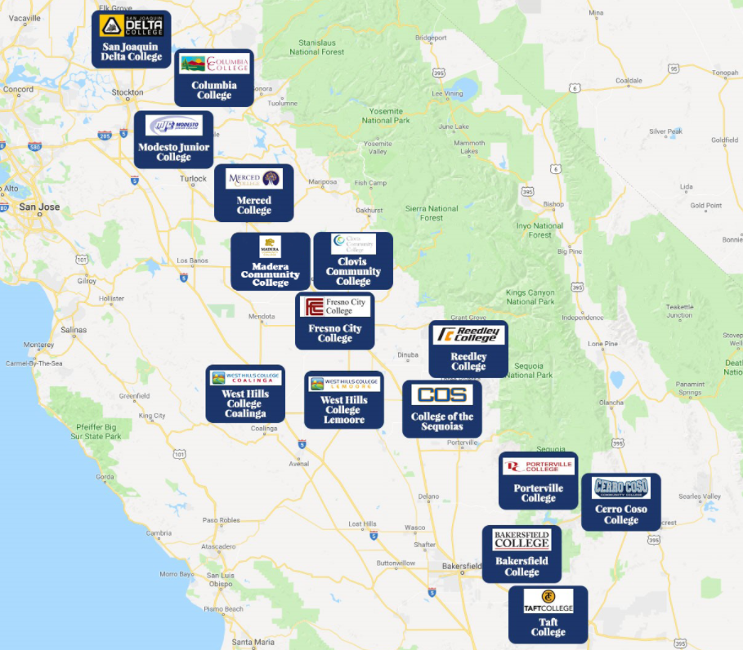
Central Valley / Mother Lode Regional Consortium
8 Districts
15 Colleges
3 Sub-regions
  North
  Central
  South
  46,000 square miles
  71,000 undersupply of workers

Slide 3
KCCD Endorsed by the Central Valley/
Mother Lode Regional Consortium (CVML)
In accordance with the selection process established by the Central Valley/Mother Lode Regional Consortium, Kern Community College District (KCCD) was chosen (11 for, 0 against, 1 abstention, and 3 absent) to serve as the sole applicant for the CVML host and fiscal agent on July 15, 2021.

Slide 4
KCCD and the CVML Ecosystem
The selection of KCCD is representative of the Central Valley/Mother Lode Regional Consortium’s commitment to a new structure and strategy that will allow for better alignment, communication, planning, execution, and continuous improvement while building an ecosystem that retains relevancy to our local economic and workforce development needs.

Slide 5
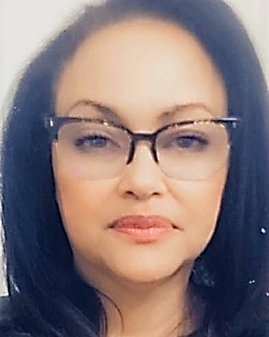

Regional Consortium Team
Leadership Dedicated Support
Trudy Gerald
Associate Vice Chancellor for Economic and Workforce Development will have senior administrative oversight over the Regional Collaboration and Coordination Host role
Dedicated Support Staff focused on the work of the Consortium
  Regional Program Manager
  Consortium Budget Analyst
  Consortium Accounting Coordinator
  Employer Engagement Key Talent (3)
  Subject Matter Experts (Ad Hoc)
  K-14 TAP (Transitioning)
Jessica Grimes
Central Valley/Mother Lode Regional Consortium Regional Chair,
has served on the CVML, has experience as a CTE Dean, and has worked on equity initiatives.

Slide 6
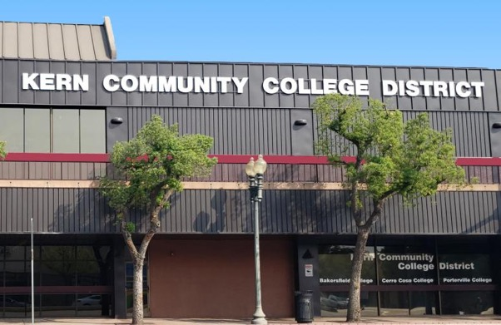
Qualifications
Regional Partnerships
Successful experience coordinating
multi-partner collaboratives
Kern Adult Education Consortium Host
Career Pathways Trust Grant
High Roads Training Partnership
(Strategic Workforce Development Planning Project)
Regional Key Talent
K14 TAP
Energy, Construction, Utilities TAP
KCCD has a history of leading successful intersegmental partnerships to achieve benchmarks.

Slide 7
Qualifications
Meeting Strategic Goals
KCCD has demonstrated its capacity to meet CCCCO and WEDD goals by designing projects to decrease the regional supply/demand gap; providing professional development in emerging economies; pursuing and strengthening strategic partnerships with industry; evaluating projects and making interventions where needed; and utilizing data to develop and/or innovate strategies.
Early adopter of Jobspeaker, a robust internship and job placement system.
Four building trades’ apprenticeship “learn and earn” educational models
More than 40 Early College programs in feeder high schools
Credit for Prior Learning and Competency Based Education Statewide Piloters - accelerated time to completion
A recognized leader in Guided Pathways, Pioneer of Pathway Program Mapper
8% annual increase in adult ed students served - with a dip in numbers in FY20-21 due to COVID

Slide 8
Qualifications
Meeting Strategic Goals
Demonstrated ability to meet strategic goals continued:
Leaders in distance education for over a decade.
Rural student college enrollment increased by more than 40%
A Logistics / Supply Chain Management credit and noncredit programming.
Clean Energy programs, expanding sustainability programs throughout all three colleges.
Improved completion rates of collegiate-level English and math for Black and Latinx students by ~7.6%
Extensive K-14 faculty non-credit, on-line distance education professional development to support the shift to an on-line credit and noncredit class environment due to the COVID pandemic.

Slide 9
Future Focus
Meeting Strategic Goals
K-14 Linkages
Kern CCD will ensure that the Regional Consortia Chair works intentionally to ensure strong linkages with the K14 Technical Assistance Provider and the K12 Pathway Coordinators.
Dual Enrollment Facilitation
The Regional Chair will develop opportunities to facilitate dialogue between our K-16 partners to create articulated pathways and enhance enrollment models.
Baccalaureate Degree Articulation
Kern CCD (Bakersfield College) and Yosemite CCD (Modesto Junior College) will work with the Regional Consortium and the Regional Chair to maximize opportunities for member colleges to articulate related CE programs to the Baccalaureate Degree programs at Bakersfield College and Modesto Junior College.
Central Valley Higher Education Consortium
The Regional Chair and the Associate Vice Chancellor will work with CVHEC to address career education projects that articulate to 4-Year Universities and/or lead to transfers.

Slide 10

Key Industries-Priority and Emerging Sectors

Slide 11
Employer Engagement
FOCUSED GOALS:
  Increased student employment outcomes
  Responsiveness to the training needs of employers
  The expansion of work-based learning for all students
INNOVATIVE APPROACH:
Regional Deliberation and Agreement Process to design the Employer Engagement model that is best for our region.
Consultation-Communication-Collaboration-Ad Hoc Committee
2. Review of three separate models based on agreed priorities and goals of the region.

Slide 12
Employer Engagement
Regional Director - 1 per subregion. RD would be hosted at college in each subregion and report to Regional Chair. Remaining EE resources used to activate and complete priority projects.
North
South
Central
Regional Chair
Regional EE Director
Regional EE Director
Regional EE Director

Slide 13
Questions?
Thank You!

