Slide 1
COVID-19 Team Updates
https://docs.google.com/presentation/d/1VUlg8DFuighVcgNxMS8_dhOwCUkDDsGI8boRln4lpiU/edit?usp=sharing

Slide 2
BC Interventions & California Pandemic Plan
BC Interventions
Vaccination
Jabs available in Fireside Room
Moderna, J&J, Pfizer peds & adult
Contact Tracing
COVID-19 team will reach out with standardized instructions
Masking
KN-95 masks available in Fireside Room
RNs available to assist with proper fitting
Daily Health Checker
Check-In Stations: 0700 to 1300
Complete online or on phone
SMARTER Plan
Shots
Masks
Awareness
Readiness
Testing
Education
Rx

Slide 3
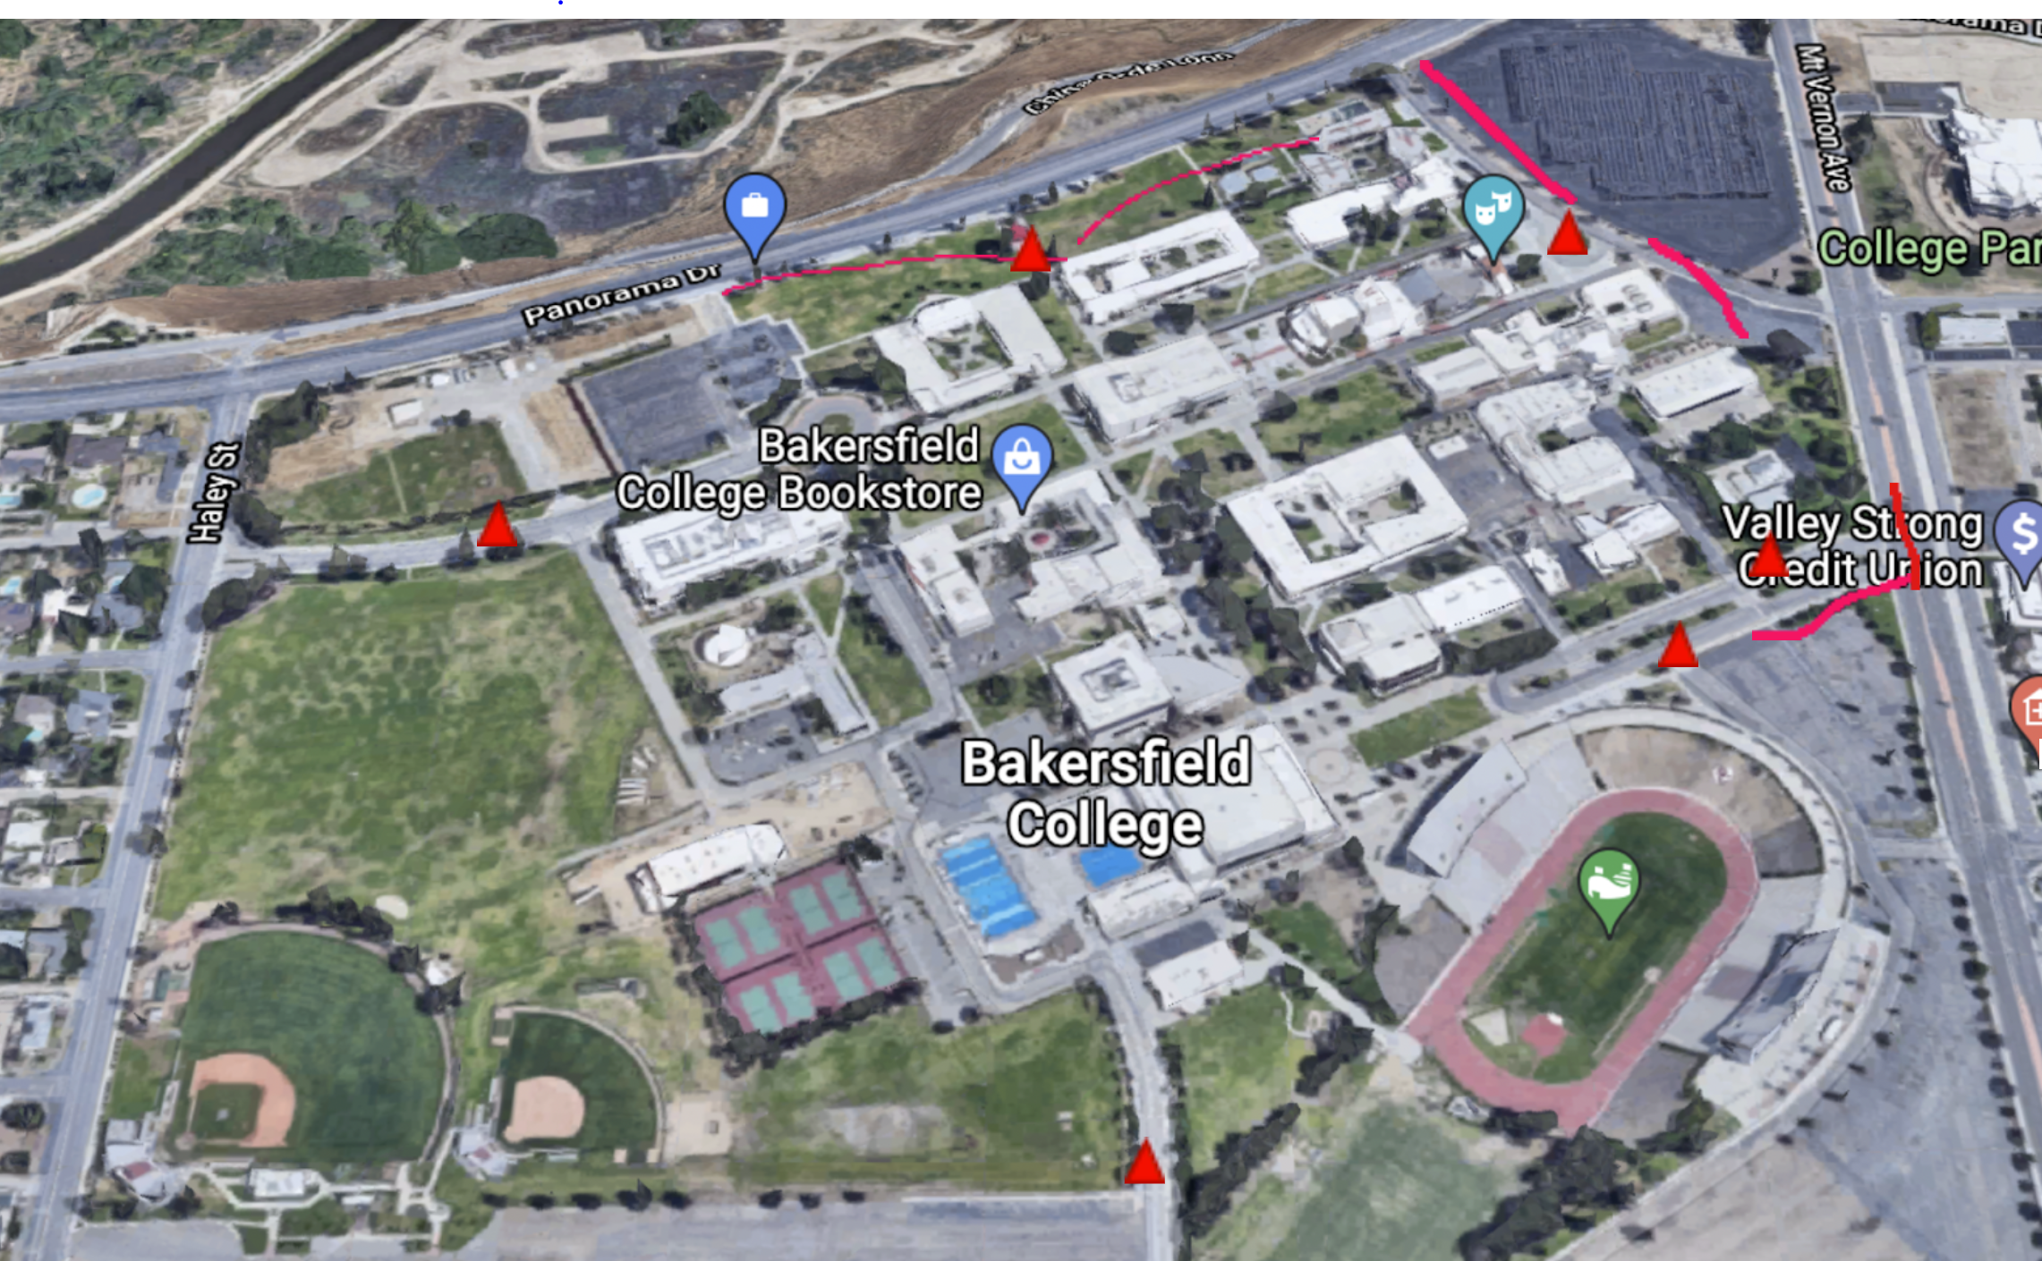
COVID Checkpoints

Slide 4
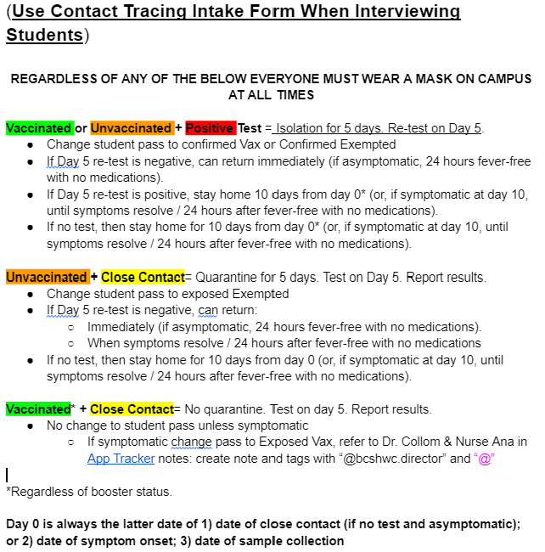
Return to Campus
A simplified version of Cal-OSHA’s algorithm.

Slide 5
Point (Daily) Positivity and Volume (Daily) Over Time (YTD)

Slide 6
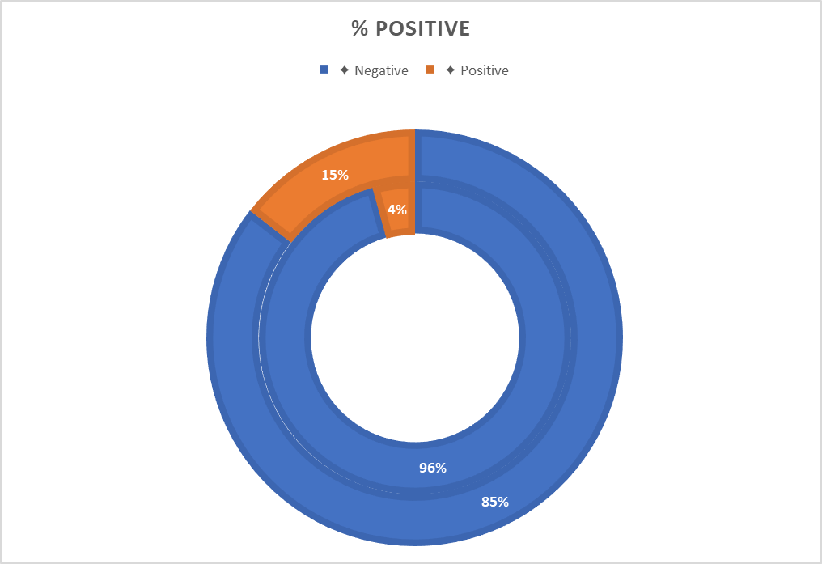
Moving Forward
Good News
Welcome Tyler Thoms
9 positive tests in prior WW
205 tests total in prior WW
Current WW positivity remains low (3.4%)
Mindful News
Kern Vax: 57%
CA Vax: 74%
Kern Unvax Hosp/Deaths: 87% / 92%
P(X≥1) = 75% = Cautious Optimism
California is beginning to look towards the end of the pandemic.
BC is leading the way in “endemic” policies.
Kern Vaccinated: 57%
California Vaccinated: 74%
Kern Unvaccinated Hospitalizations: 87%
Kern Unvaccinated Deaths/Deaths: 92%
P(X≥1) = 75% = Cautious Optimism

