Slide 1
BC Grant Opportunities
Stephen Waller, Oliver Rosales, and Bill Moseley
Feb. 11, 2022

Slide 2
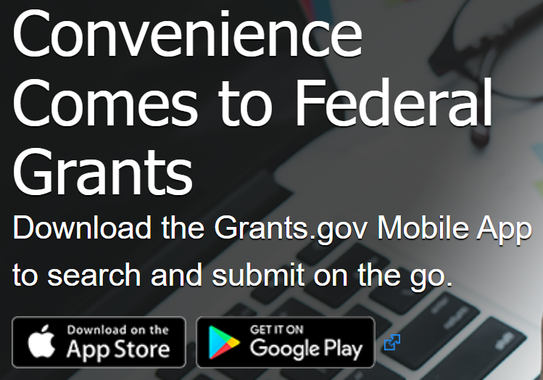
Grants.Gov
The quickest way to find grant opportunities is to use the Federal grants.gov website or app.
By Feb. 21st, this will require creation of a login, if you do not already have one.

Slide 3
Grants.Gov
Use the search function to find grants related to your interests.
For example: searching “community college” will give you any grant call for proposals that mention “community college”.

Slide 4
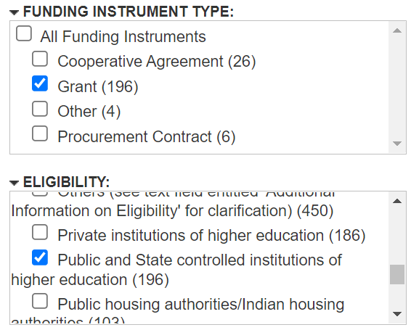
Grants.Gov
There are a variety of ways to refine your search. Most of the time, select…
Grant
Public and State controlled institutions of higher education

Slide 5
Grants.Gov
Look closely at the Close Date
You need to submit an intent to apply to the VP at least 2 weeks before that date and the final application to the District 1 week before that date.

Slide 6
Grants.Gov
Click on the blue “Opportunity Number” to get more information.
Make sure BC iseligible to apply.
Get help from Bobby Becka or Bonita Steele about eligibility or conflicts with applications.

Slide 7
Grants.Gov
How about this RISE grant?
That sounds like I want to apply!

Slide 8
California Opportunities
Many California state agency grants are announced through emails to the College President

Slide 9
California Opportunities
https://www.grants.ca.gov/

Slide 10
Association Grants

Slide 11
Foundation Grants

Slide 12
Oliver’s Picks
Humanities For All Quick Grants from California Humanities
(Deadline: Feb 22,2022) $1,000 - $5,000 quick grants
Small-scale public humanities programs and projects which take place within one year from the award date. Projects should be grounded in the humanities, show potential to provide high quality humanities learning experiences for participants and audiences, and demonstrate capacity for successful implementation.
Humanities Initiatives at Community Colleges
Maximum award amount: $150,000 (no match req.)

Slide 13
Quick Tips Summary
Get an idea of what you want to accomplish.
Look at grants.gov and search for other funders.
Talk with the BC Grant Development Team. Bill Moseley, Stephen Waller, Oliver Rosales, James McGarrah, Imelda Valdez, Bonita Steele, Bobby Becka
Ask our BC Foundation before approaching a corporation.
We hope you ask for external funds, but please keep your administrator and/or the executive team in the loop.

