Slide 1
Accreditation Institution-Set Standard Update
Grace Commiso and Jessica Wojtysiak
College Council, October 8, 2021

Slide 2
What is an Institution-Set Standard?
A standard that the College strives to not fall below and evaluates on an annual basis. When a college does not meet a set standard, it establishes and implements plans for improvement (AIQ).
ACCJC Standard I.B.3
“The institution establishes institution-set standards for student achievement, appropriate to its mission, assesses how well it is achieving them in pursuit of continuous improvement, and publishes this information. (ER 11)”
Part of Annual Report to ACCJC

Slide 3
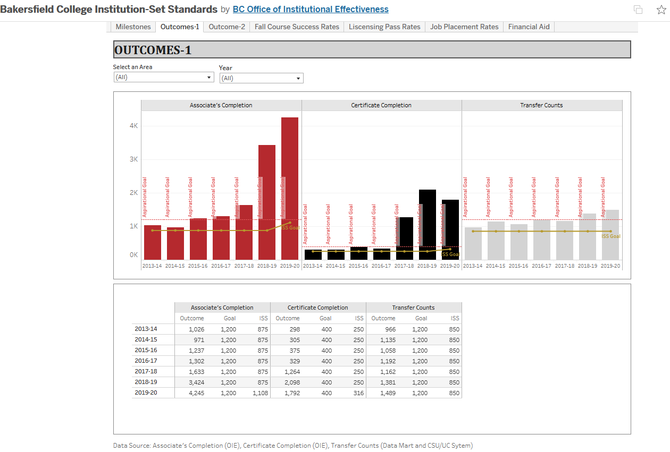
New Institution-Set Standard Dashboard

Slide 4
Financial Aid ISS
2015 | 2016 | 2017 | 2018 | 2019 | ISS | Aspirational Goal |  |  |  | Group
2.6 | 3 | 3.1 | 3.3 | 2.6 |  | 2.92 | 5% |  |  | Dreamers or AB540
67.8 | 75 | 74 | 73.9 | 72.7 |  | 72.7 | 75% |  |  | FAFSA
70.4 | 78 | 77.1 | 77.2 | 75.3 |  | 75.6% | 80% |  |  | Combined All Financial Aid

Slide 5
Assessment ILO ISS

Slide 6
Any Questions?

