Slide 1
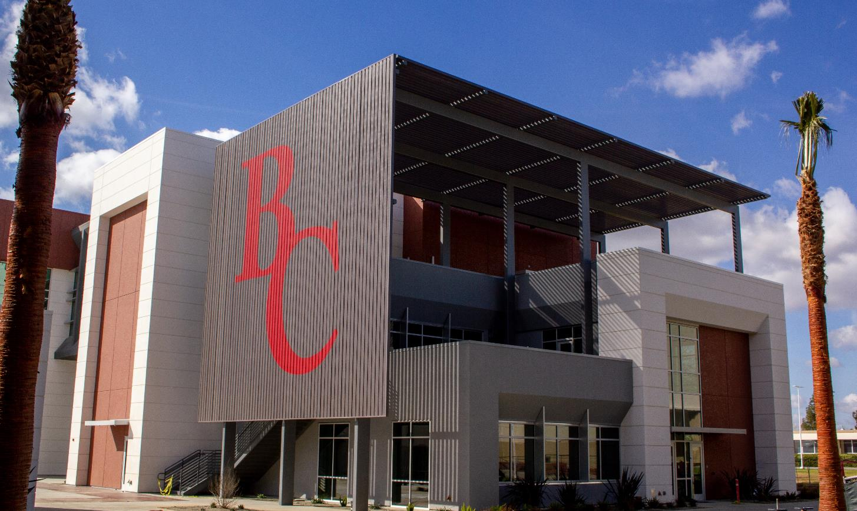
A Better BC: Updates from Measure J

Slide 2
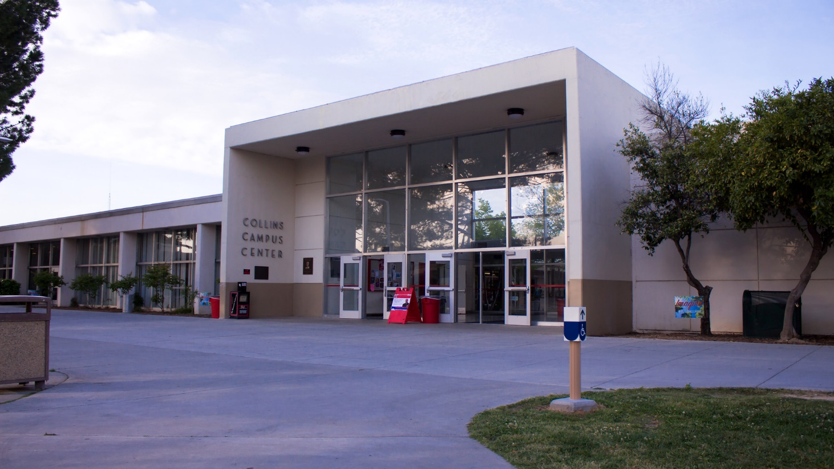
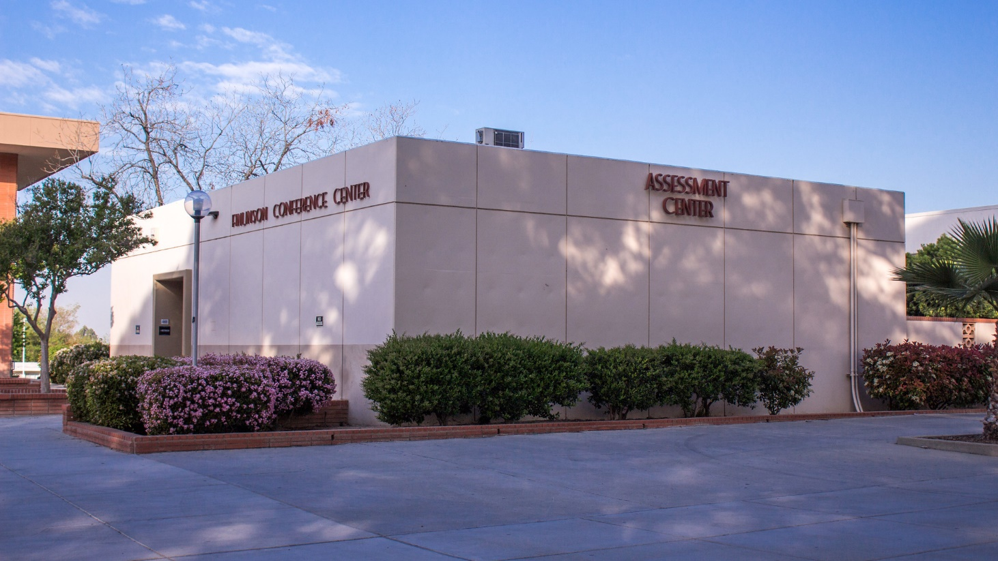
Bakersfield College Before Measure J

Slide 3
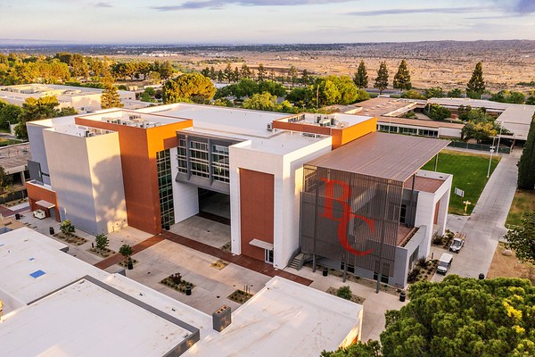
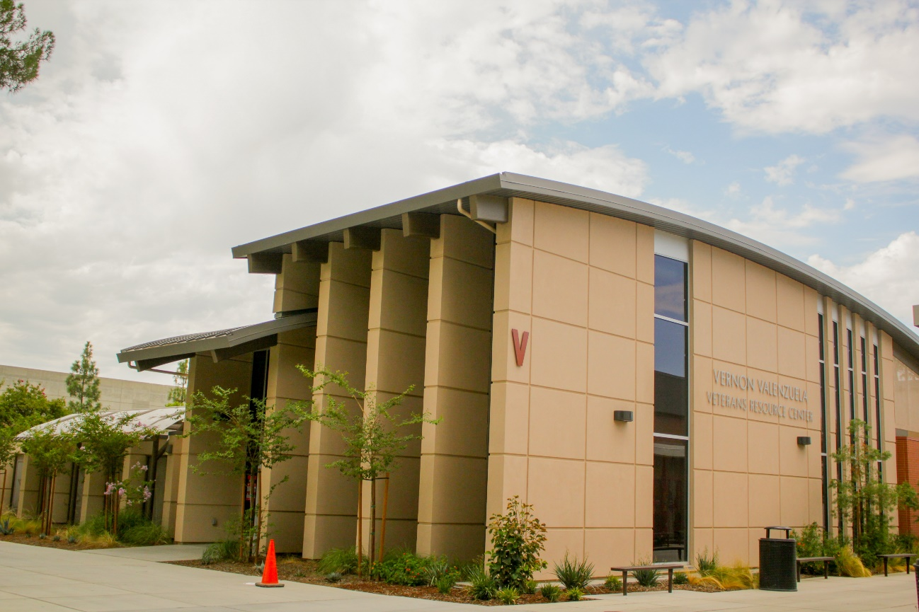
Bakersfield College Now

Slide 4
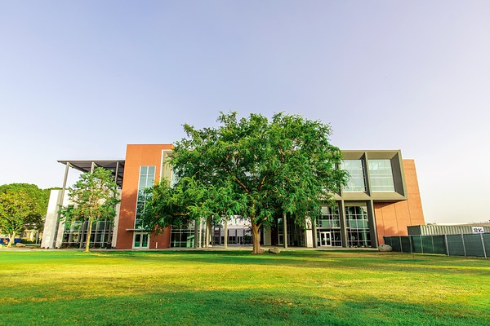
Bakersfield College in 2024
Accelerated timeline of major projects to optimize community investment
425,000 square feet of new construction and renovations (2018-2024)
The next 12 months are busiest for the project

Slide 5
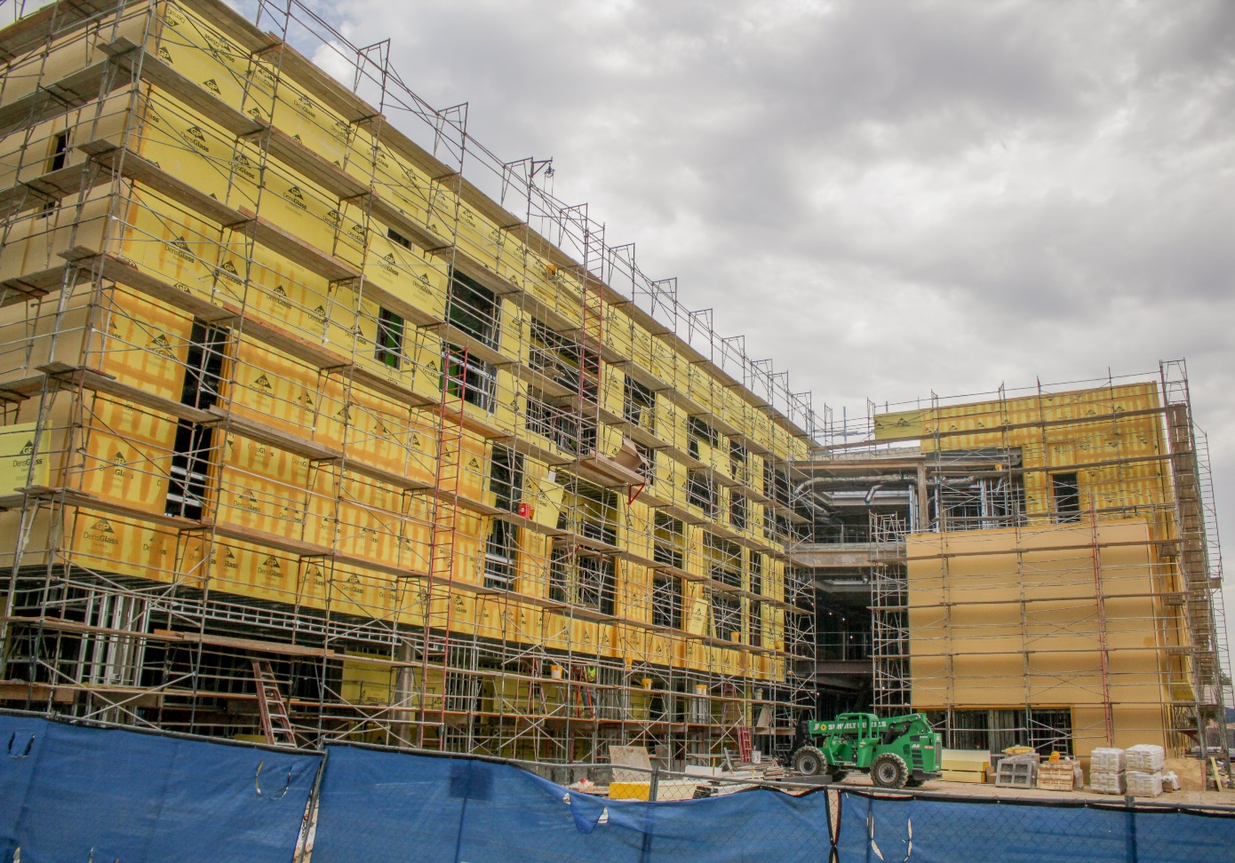
Science and Engineering
68,300 Square Feet
State-of-the art classroom and laboratory spaces for STEM education
In Construction: Completion projected for Spring 2022

Slide 6
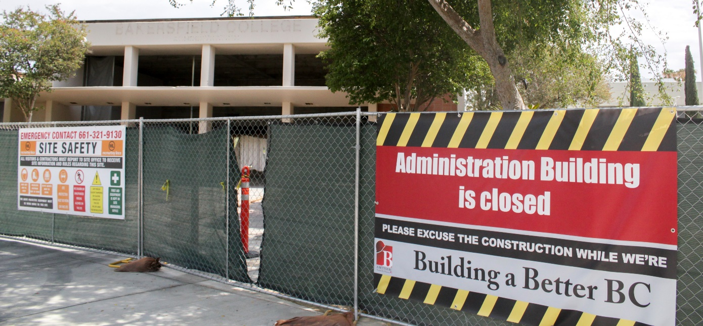
Welcome Center
12,500 square feet
Admissions and Records, Financial Aid, Outreach, Business Services
In Construction: Completion projected for Fall 2022

Slide 7
Administrative Services
In the old Bookstore building
College Safety, HR, Marketing, IR, Budget, Scheduling and Bargaining/Senate Offices
In Construction: Completion projected for Spring 2022

Slide 8
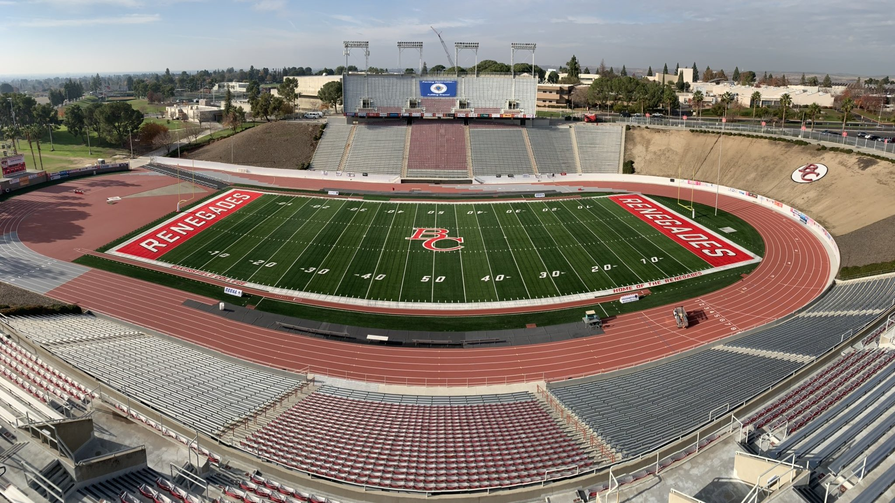
Memorial Stadium
Phase 1 Completed
New track and field
Artificial turf installed
Phase 2 Completed
Updates to first level Concessions, Restrooms, PA System and Scoreboard
Phase 3 Completed
Updates to second level Concessions, Restrooms, and Press Box

Slide 9
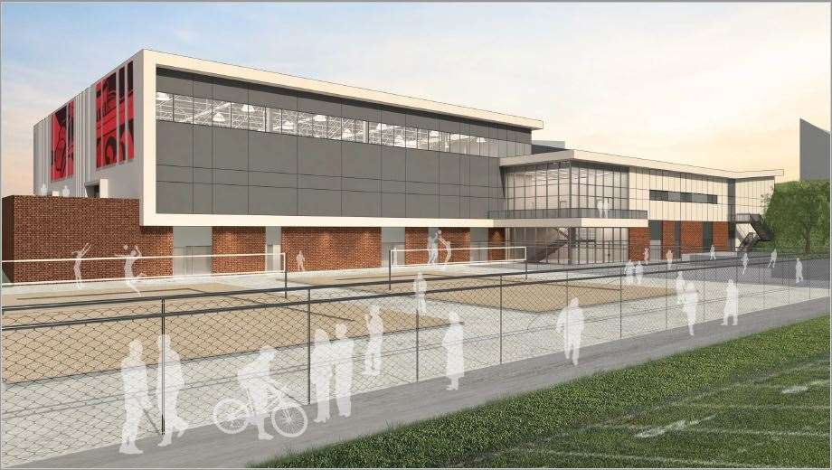
Renegade Athletic Complex
71,100 square feet
Modern athletic facility with training rooms, rehab center and more
Beach volleyball courts adjacent to the building
In Construction: completion projected for Spring 2023

Slide 10
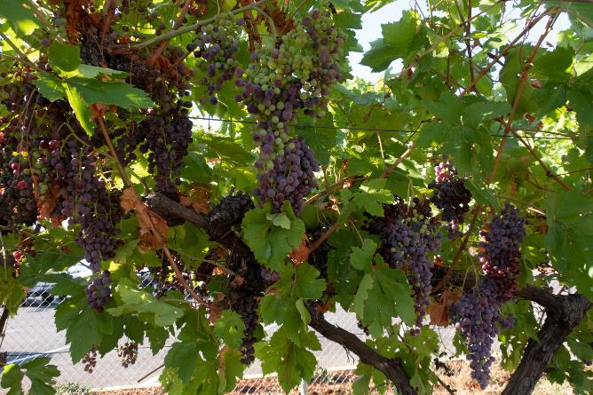
Agriculture Building
26,600 square feet
State-of-the-art classroom and laboratory spaces for ag sciences
In Design: Completion scheduled for Fall 2024

Slide 11
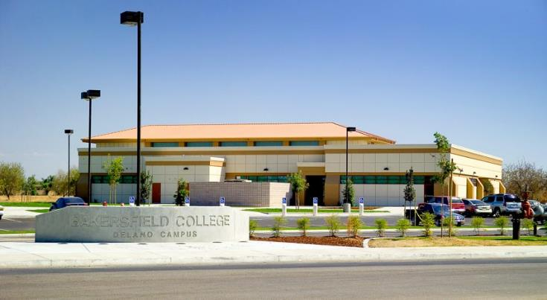
Delano Learning Resource Center (LRC)
39,900 square feet
Library, study hall, classrooms, tutoring center, computer labs and student services
DSA Approved: Completion scheduled for Spring 2023

Slide 12
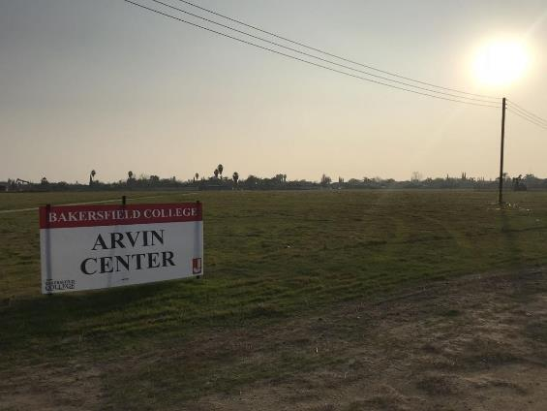
Arvin General Education Center
31-acre campus
General education building for rural students in Kern County
Completion scheduled for Spring 2024

Slide 13
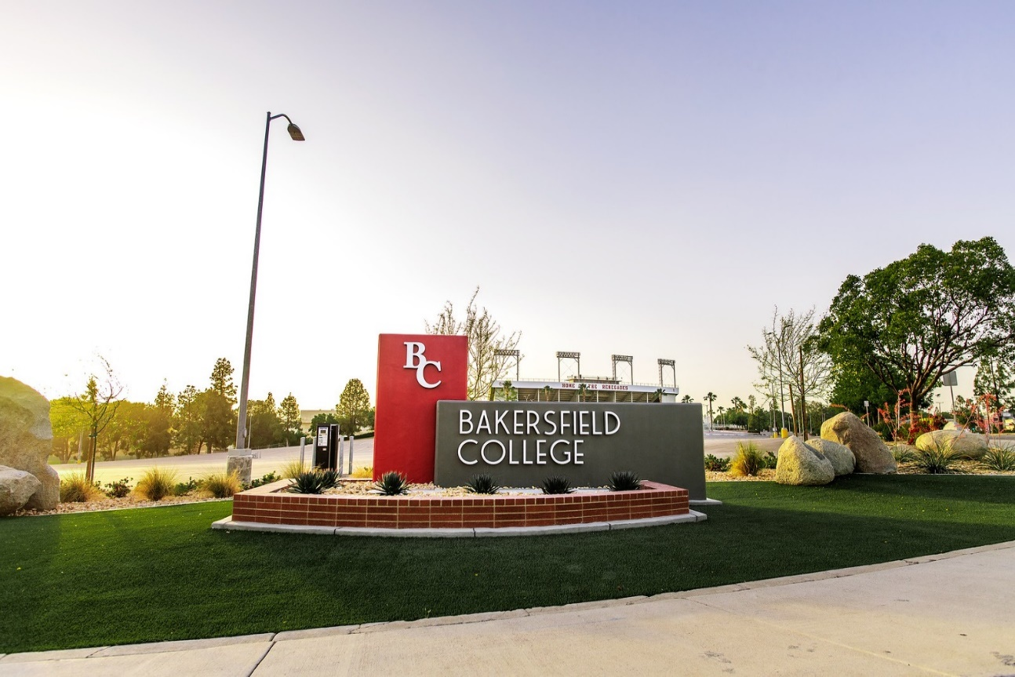
Additional Projects
Street signage (Panorama and Mt. Vernon)
New parking/sports field
Infrastructure
Ag fencing
Campus Center 3rd Floor Kitchen

Slide 14
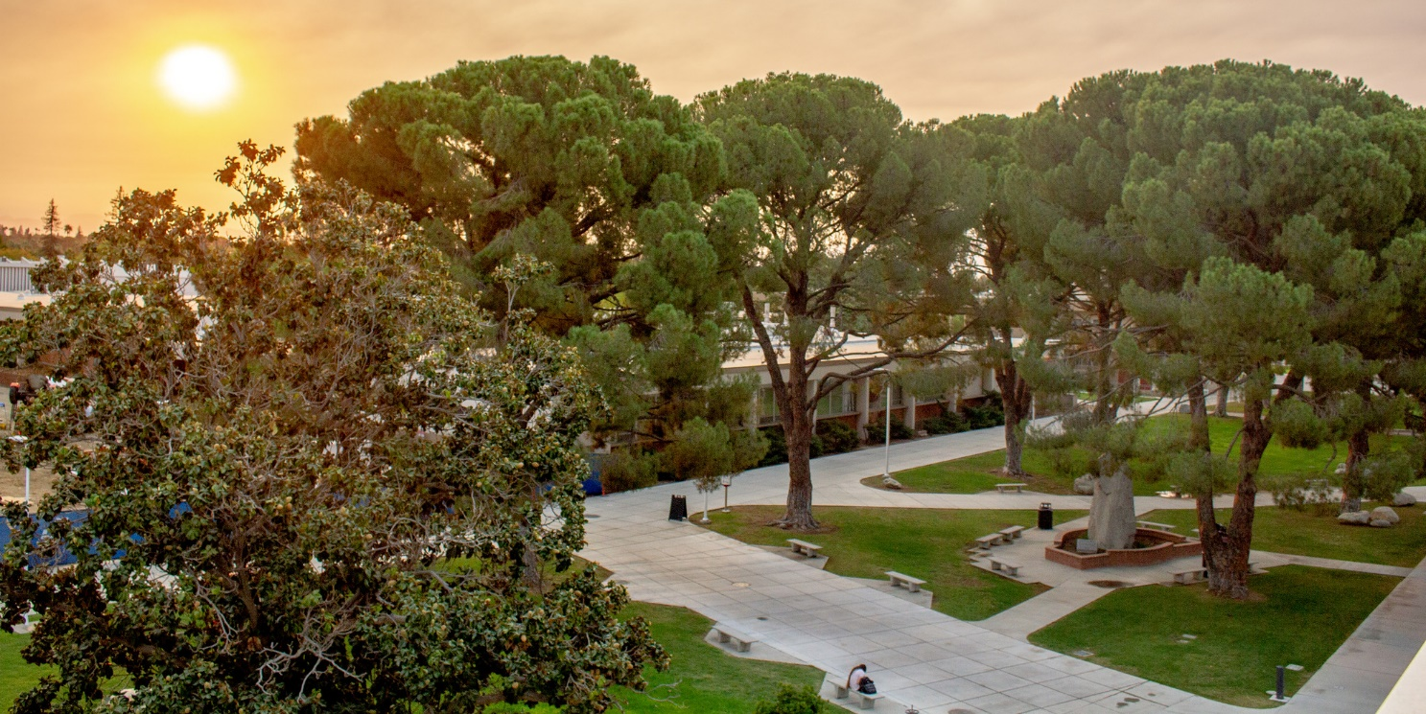
Future Swing Space Considerations
During Ag Building construction, ag and construction programs will move to the old SE building, which is being renamed Essential Sciences
When the Ag Building is completed, the remaining CSS occupants will be moved to Essential Sciences for renovation on CSS

