Slide 1
Program review
Summary Report 2019
Prepared by the Program Review Committee

Slide 2
Presented to College Council
December 6, 2019
Stephen Waller, Administrative Chair
Kimberly Nickell, Faculty Chair
Kristin Rabe, Classified Chair

Slide 3
PRC Members Co-chairs: Stephen Waller, Kim Nickell, Kristin Rabe
Committee Members:
LeeAnn Riley
Keri Wolf
Casandra Goodman
Mindy Wilmot
Klint Rigby
Anna Collins
Jennifer Johnson
Neeley Hatridge
Meg Stidham
Aneesha Awrey
Jason Dixon
David Wayne Collins II
Andrea Tumblin
Nicole Hernandez
Anna Melby
Brent Burton
Brian Sivesind
Katie Ganster
Brent Wilson
Amber Hroch
Kalina Hill
Linda McLaughlin
Maurice Muller-Quinhoneiro
Gabriel Searcy
F. Javier Llamas

Slide 4
This will be a hit!

Slide 5
Purpose of the Annual Report
To summarize themes and trends among the 105 program reviews:
Annual Updates Instruction 58 out of 60
Annual Updates Non-Instruction 27 out of a possible 45 = includes, Administrative, Student and Academic Affairs areas.
Total 85 out of 105 possible.

Slide 6
Facilitating the Resource Allocation Process
To provide information to help decision-making bodies
Classified Position Requests = 57
Faculty Position Requests = 63
Facilities Requests = 93 (about 5 work orders)
ISIT Tech Requests = 105
Other Equip Requests = 31
Budget Development Forms Completed = 18

Slide 7
Submission Trends:
Over the past several Program Review cycles, the number of programs included in the Program Review process has increased:
2016-17 108 programs: 96% submitted
2017-18 112 programs: 97% submitted
2018-19 119 programs: 86% submitted
2019-20 85 programs: 88% submitted
Why turn in your program review?

Slide 8
Observations Program Review as an Agent for Change
Opportunity to promote educational excellence.
Improve instruction and services to students.
Integrate systems between committees and initiatives.
Feedback is a two-way street for improvement, which leads to greater potential for resources.
eLumen to create a user-friendly and meaningful program review process.
Accreditation
Program Review, resource requests, and budgeting
Strategic Directions
Closing the loop
CCCC Vision for Success

Slide 9
Changes to the 2019 cycle
The Annual Update was fully in eLumen!
Program Review was available in spring (instructional) and early summer (non-instructional)
List of programs was more conclusive this year in eLumen
Program reviews were more relevant to instructional and non-instructional programs.
KCCD Data in Tableau
Administrative Unit Outcomes were aligned with Institutional Learning Outcomes.
CCCC Vision for Success was incorporated in the AU.

Slide 10
Trends
Some were hesitant to work in eLumen
Some goals are still reading as resource requests.
Goals should reflect stated challenges
Goals should be student or campus centered, not resource centered.
Resources should tie to a need, goal, challenge, or show justification
What to do with data, disproportionate impact and equity.
Received resources were not assessed
Blank Mission Statements and Conclusions.
New Tableau trend data not used effectively to analyze programs.

Slide 11
Trends
Many program reviews were effective
Good feedback on the process in eLumen
Well-established goals
Some programs used feedback from last year to improve their processes
Conclusions were better drafted
AUOs were better developed and aligned to the Institutional Learning Outcomes.

Slide 12
Planning for the 2020-21 Cycle
Create a Program Review process with a timeline and milestones to make the work a continuous process
Create the 3-Year Comprehensive cycle in eLumen
Develop a program review that is relevant to hybrid programs that are both instructional and non-instructional- Umoja, Library
Provide better eLumen guides and examples of exemplary program reviews.
Program Review rubric
Workshops:
department specific eLumen/Program Review
Data/Tableau
Administrative Unit Outcomes

Slide 13
Planning for the 2020-21 Cycle
ASCCC-create a program review that ties in with Guided Pathways and Student Support Services
Consider the questions less isolated and connect:
Guided Pathways
Student Support Services
Equity and disproportionate impact
CCCC Vision for Success
Refine questions
Goals
Assessment
Reformat eLumen questions and feedback sections
Give relevant and constructive feedback…hold programs accountable
Incorporate Program Mapper
Accessibility

Slide 15
The work continues…
Our commitment to improve will lead us into a better process in eLumen for the 2020 cycle!
We will work to be transparent and steer ourselves in a positive direction to benefit future generations to come at Bakersfield College.

Slide 16
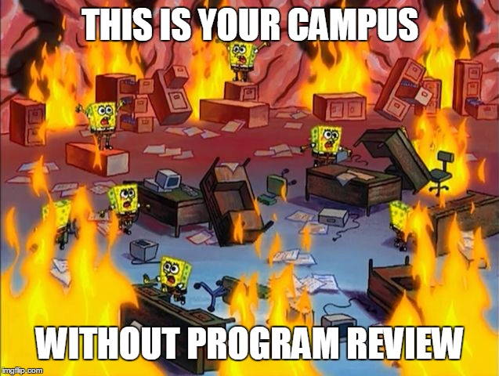
Programming and Planning a Better BC!

Slide 17
This has been a DJ Jazzy Steve and Double K production

