Slide 1
Education Pathway
Isabel Castaneda,Bill Chapman & Jessica Wojtysiak
College Council
December 6, 2019

Slide 2
Education Pathway Background
Certificates
Degrees
Child Development Assistant Teacher (JSC)
Child Development Associate Teacher (JSC)
Child Development Master Teacher – Infant/Toddler (COA)
Child Development Master Teacher- Special Education (COA)
Child Development Teacher (COA)
Transitional Kindergarten (COA) – NEW!
Education Paraprofessionals I,II, III (COA) – New!
Early Care and Education CDCP – New!
Early Childhood Education (ADT)
Elementary Teacher Education (ADT)

Slide 3
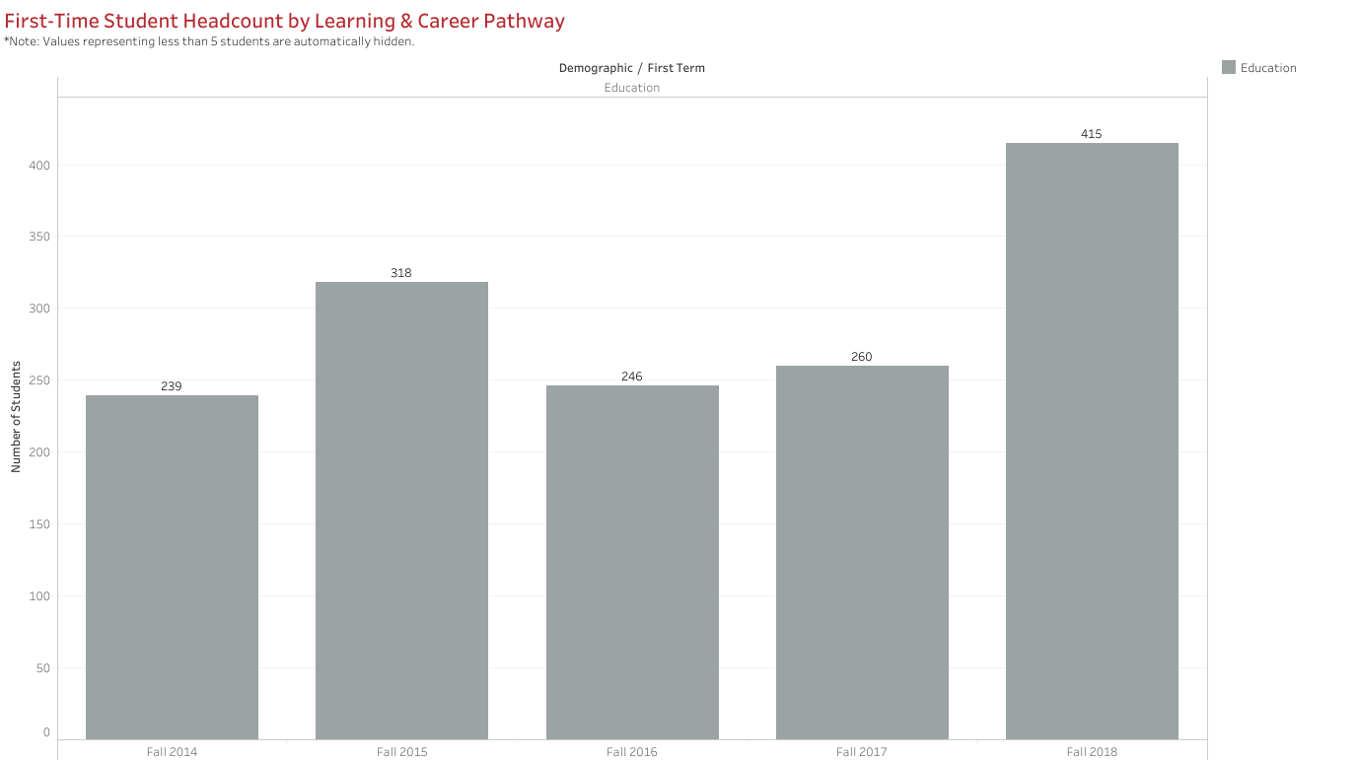

Slide 4
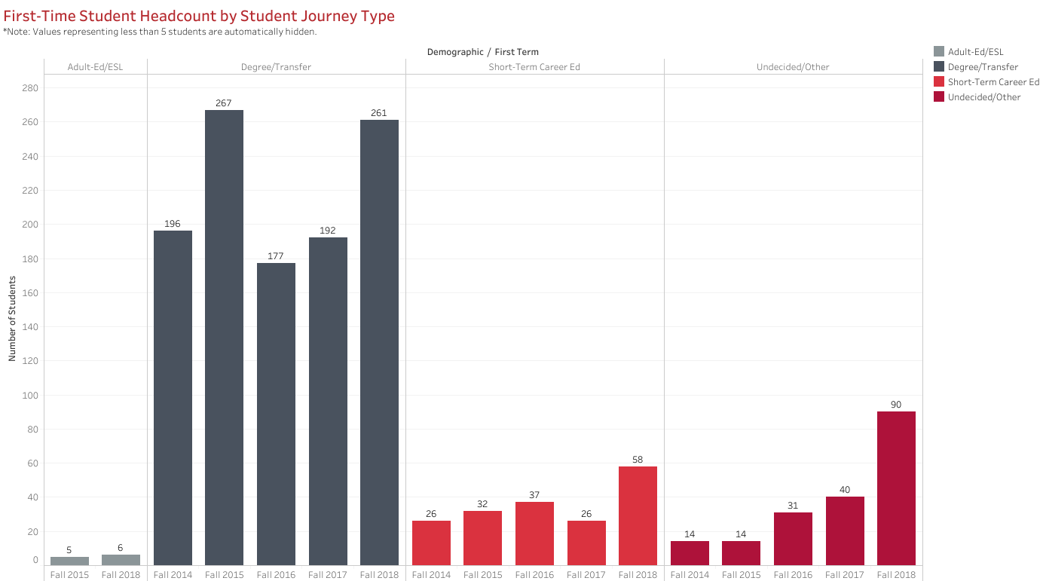

Slide 5
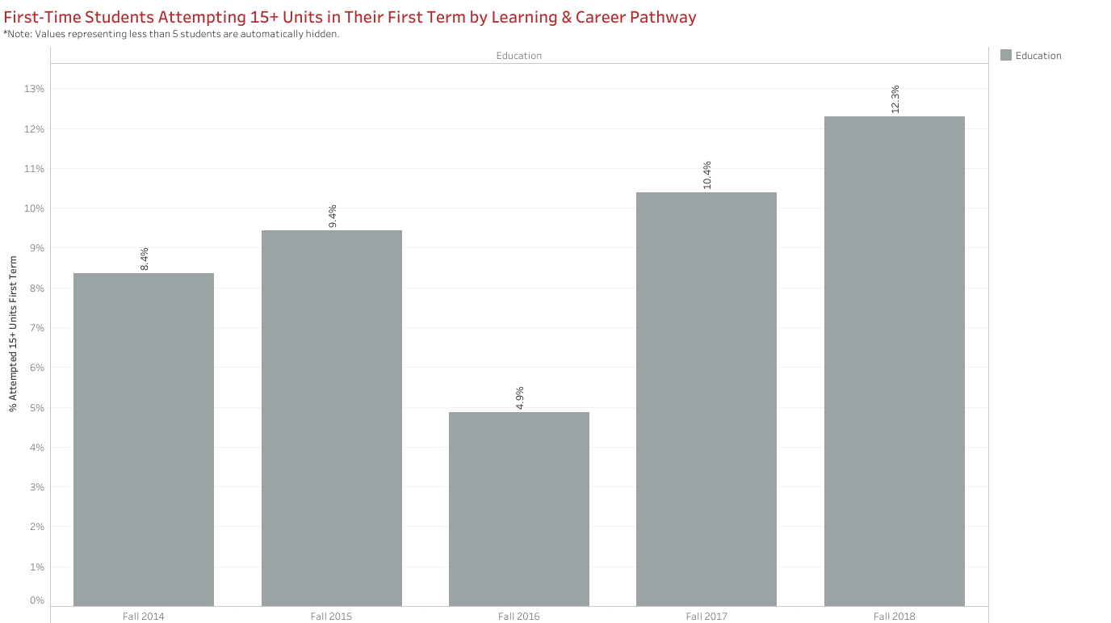

Slide 6
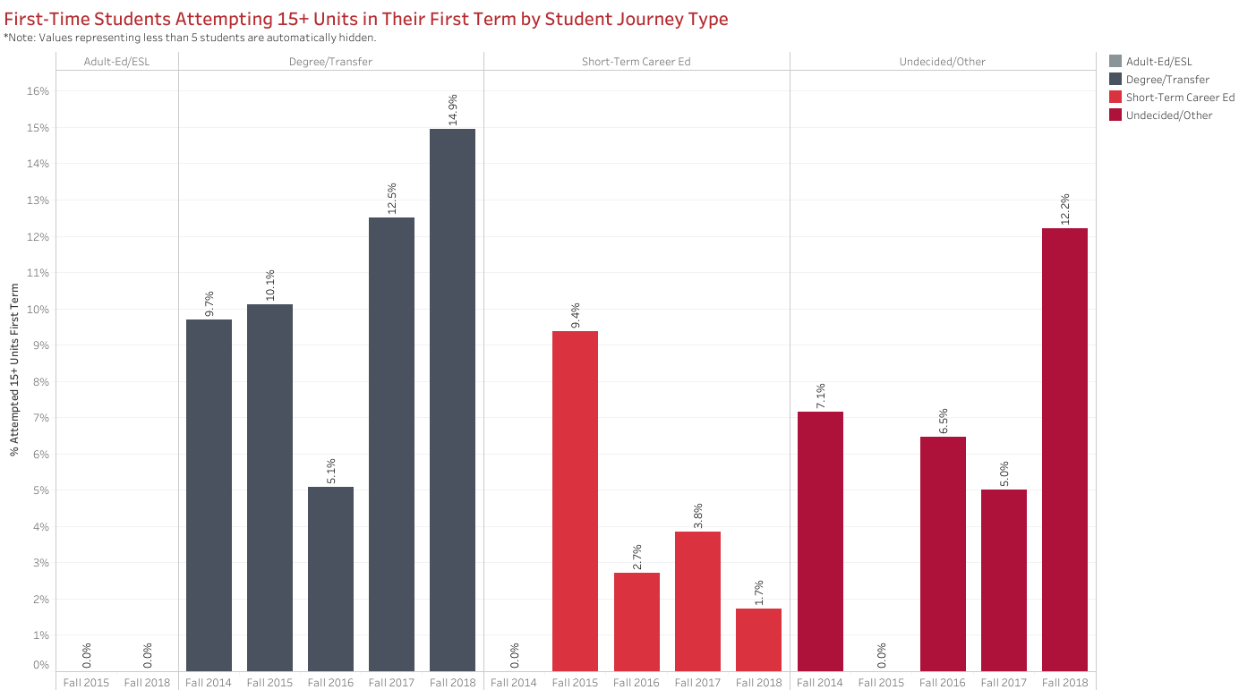

Slide 7
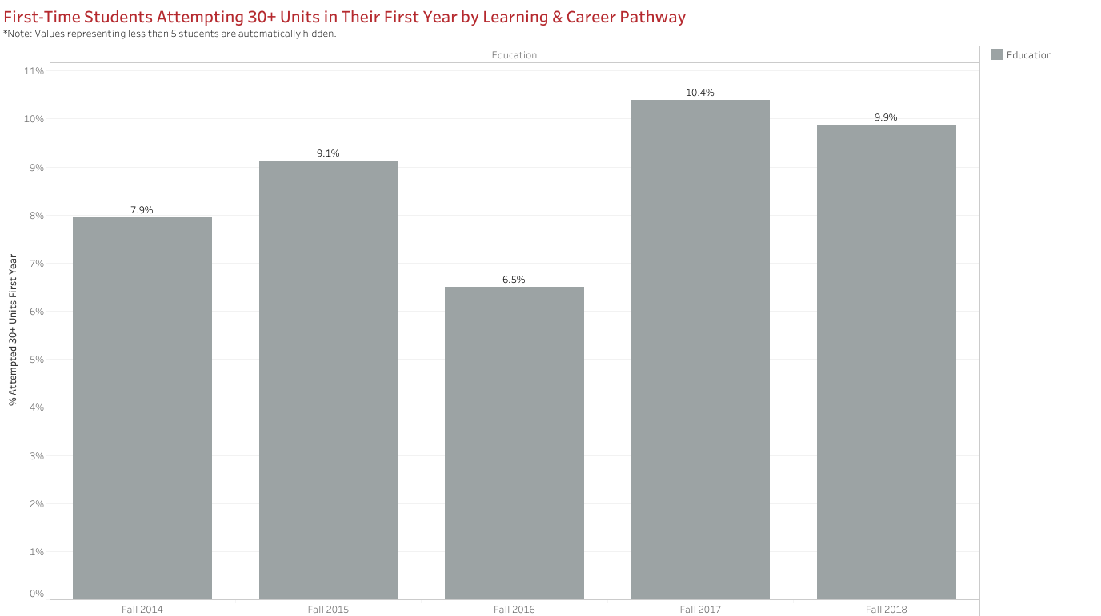

Slide 8
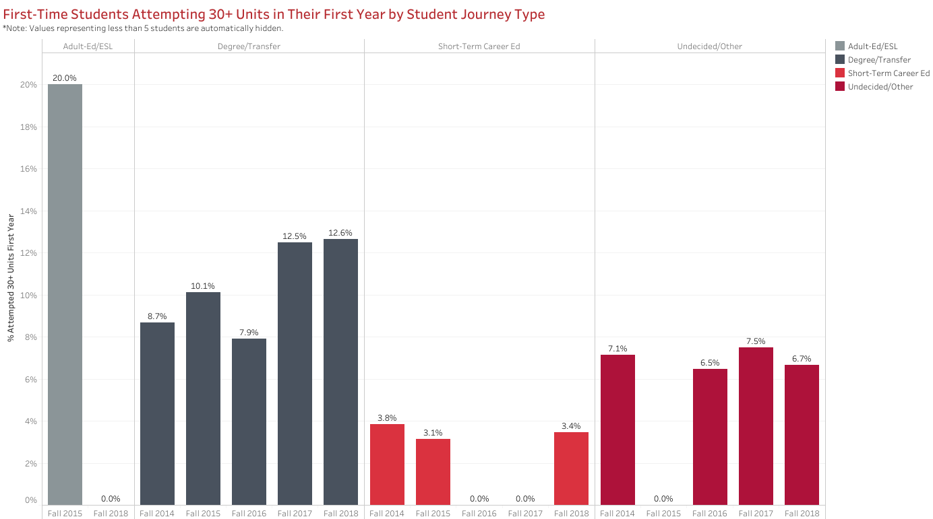

Slide 9
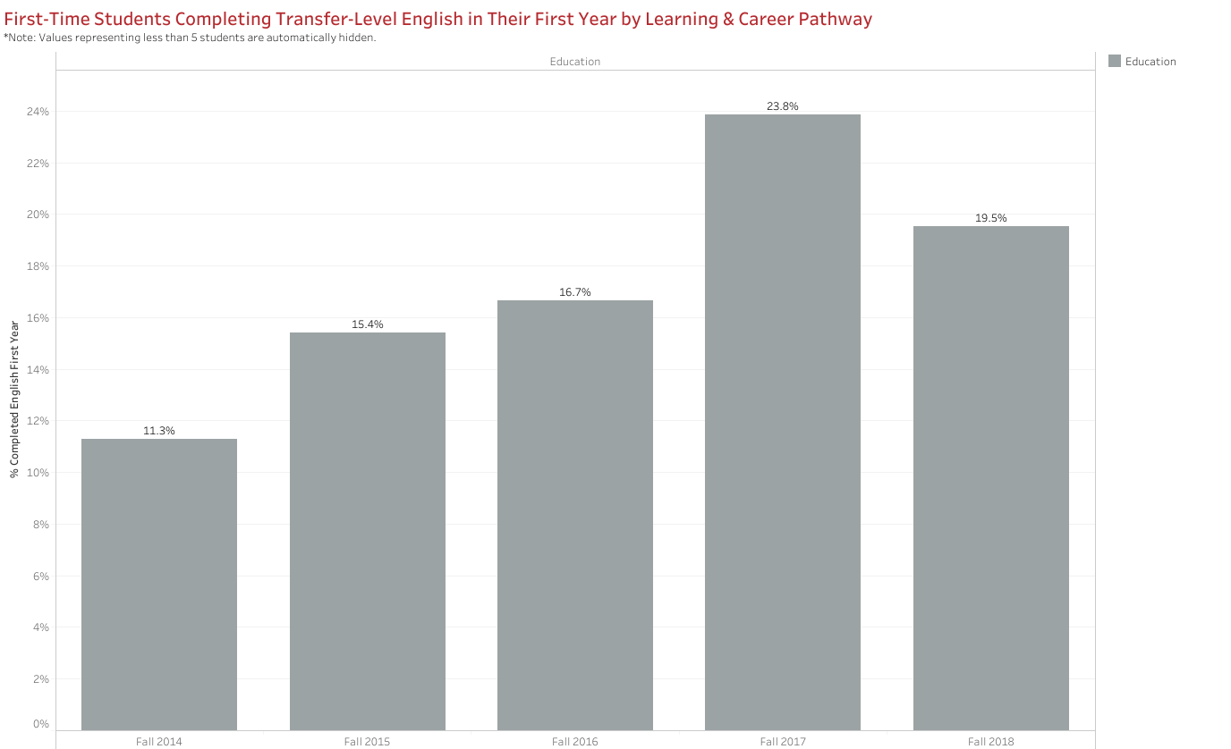

Slide 10
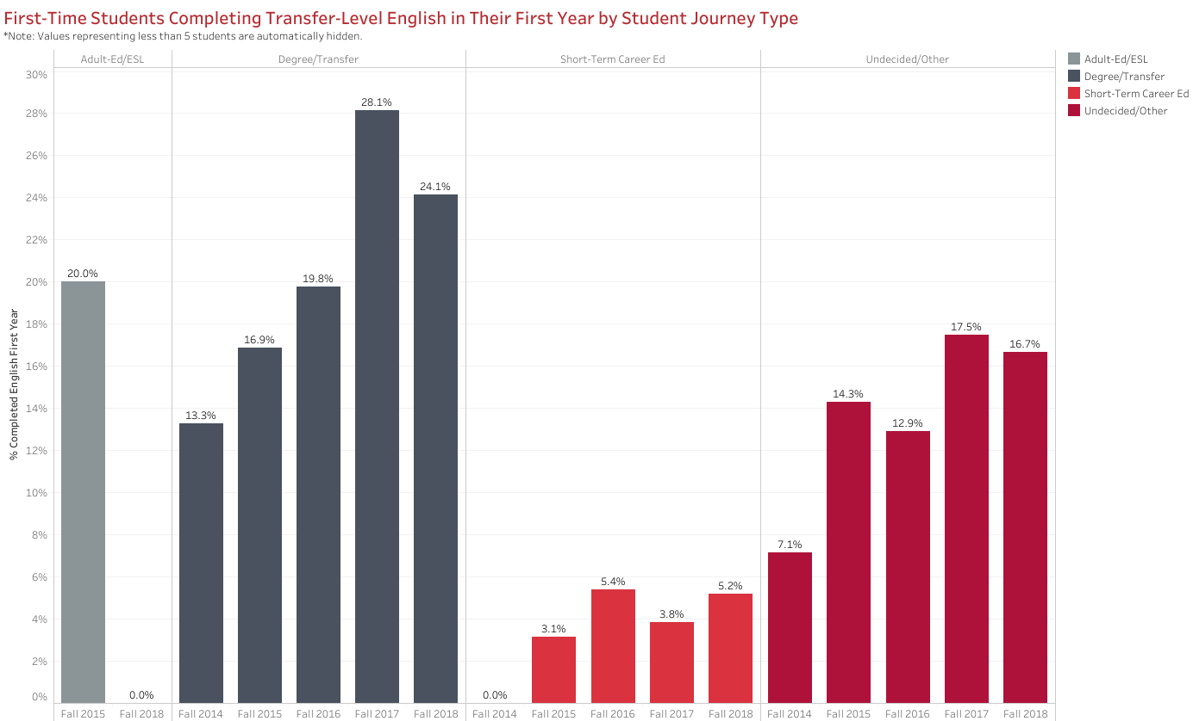
ISS Transfer English Achievement in Year 1: 17%
EDUC Pathway Degree/Transfer Seekers: 24.1%

Slide 11
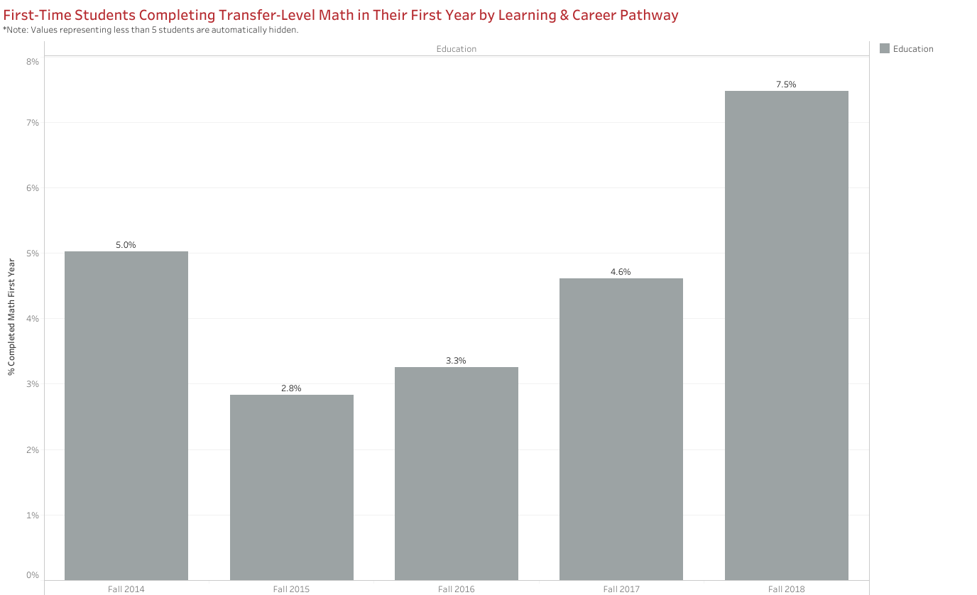

Slide 12
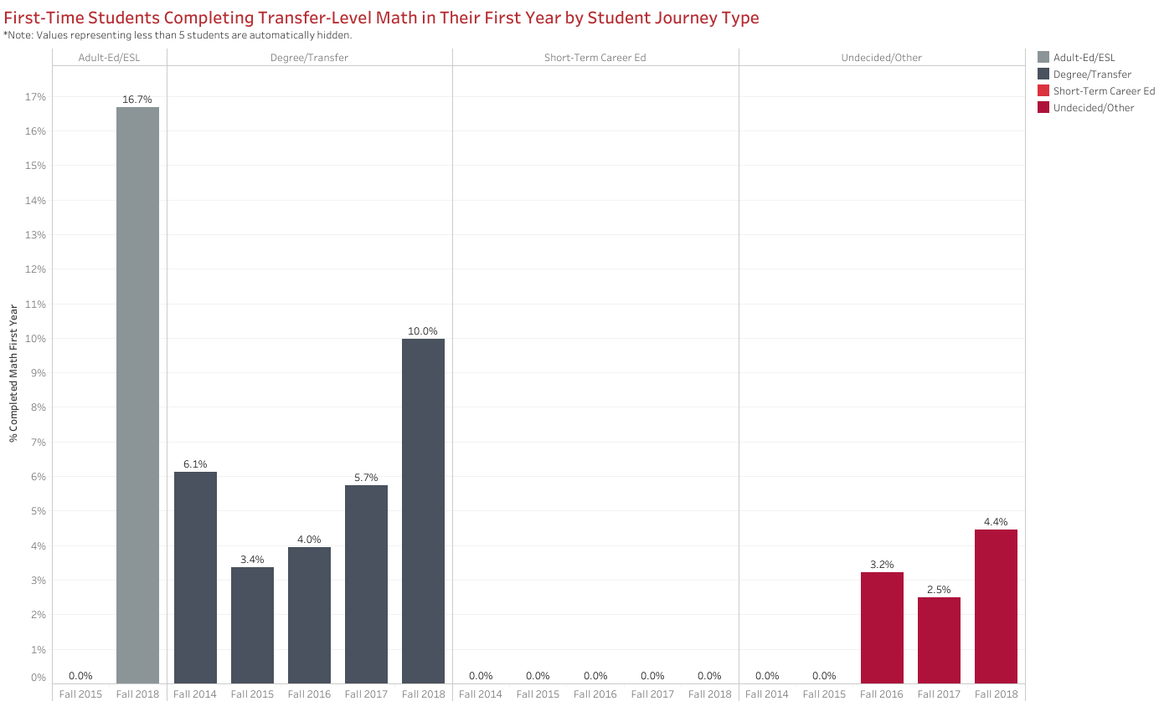
ISS Transfer Math Achievement in Year 1: 12%
EDUC Pathway Degree/Transfer Seekers: 10%

Slide 13
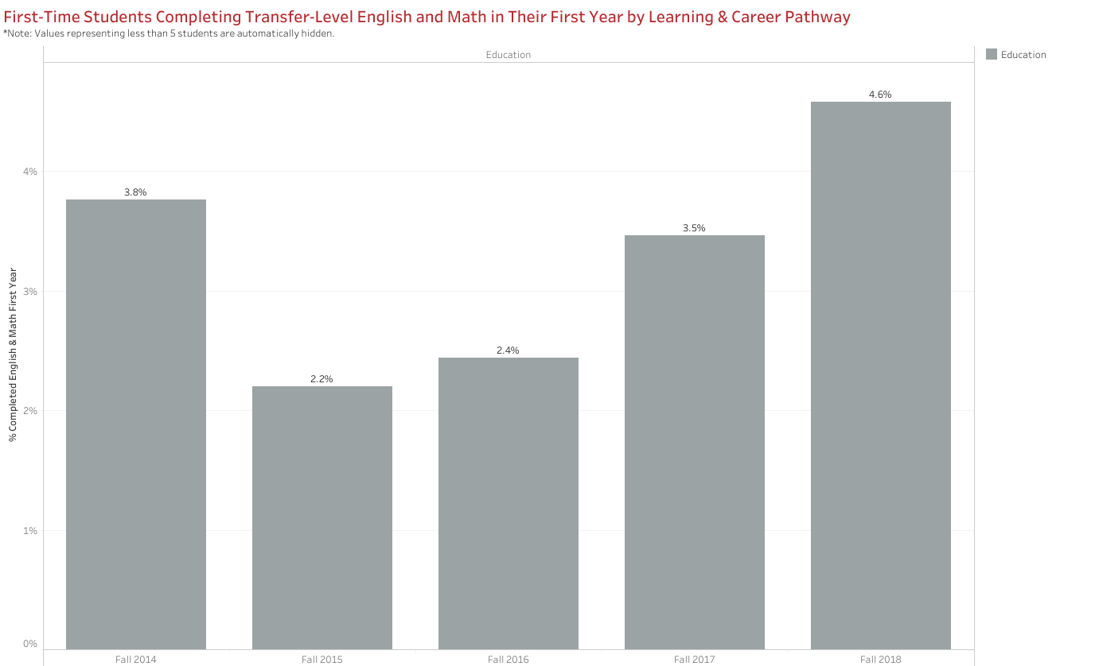

Slide 14
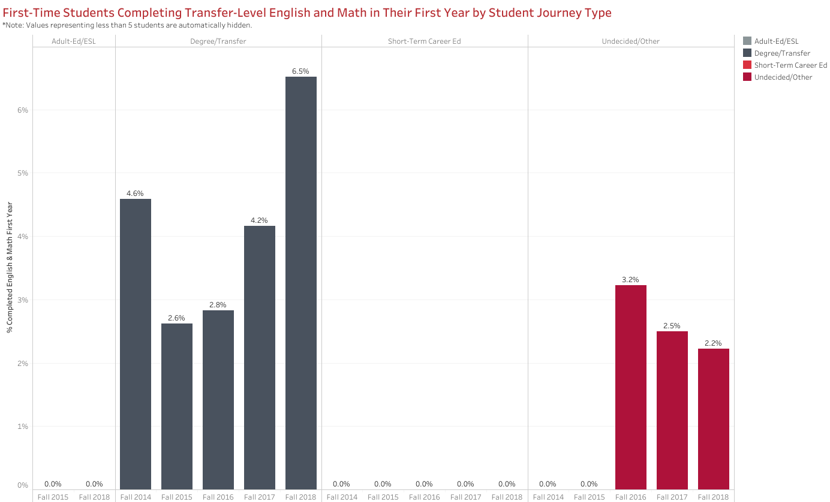
ISS Transfer English & Math Achievement in Year 1: 7%
EDUC Pathway Degree/Transfer Seekers: 6.5%

Slide 15
Elementary Teacher Education ADT
4th largest degree in 2019 Finish in 4 Cohort
10th Most Popular Degree Overall (Renegade Scorecard)

Slide 16
Growing the Pathway
Expansion to New Sites
BC Southwest
Rural
Early College
Education Futures 2-year Grant
Fund Science Labs at BCSW
Monthly Huddle
L.E.T.S. Teach Conference

Slide 17
Staying Connected
Classroom Visits
How to navigate Starfish
Program Mapper
Staying on the path to completion
Math
English
Complete 15 units
Complete Financial Aid Application & Scholarships

Slide 18
Staying Connected

Slide 19
Fieldwork
MOUs finalized for Classroom Observations
7 districts, increasing to 10
Increased Student Placements
EDUC B24
CHDV B41

Slide 20
Increase Curriculum Offerings
New Courses to be added to Elementary Teacher Education ADT
EDUC B8: Sociocultural Foundations of Education (CSUB Requested) (Fall 2020)
EDUC B9: Foundations of Literacy
EDUC B10: Foundations of Educational Technology
New Courses and Program for Introduction to Early Care and Education CDCP
CHDV B70NC: Introduction to Careers in Early Childhood Education
CHDV B71NC: Early Care Licensing & Workforce Readiness
CHDV B72NC: Introduction to Developmentally Appropriate Curriculum

Slide 21
Any Questions?

