Slide 1
October 18, 2019
UCTPs:
Expanding Inclusive Access
MARISA MARQUEZ
MARK OSEA

Slide 2
Transfer has become such a popular route to a UC education that nearly one in three UC undergrads comes from a community college.
UC is working to streamline the transfer process and support the educational success of transfer students.
-JANET NAPOLITANO, UC PRESIDENT

Slide 3
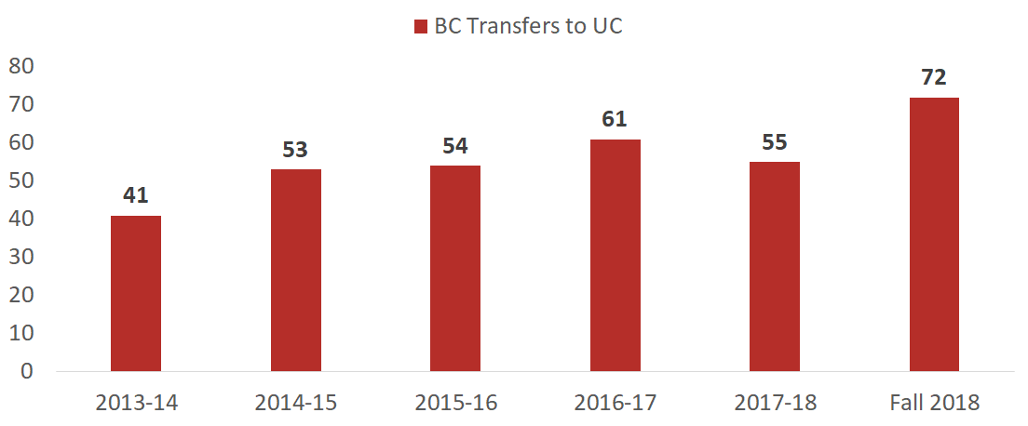
Trend in BC Transfers to UC
Source: UC Information Center Data Warehouse

Slide 4
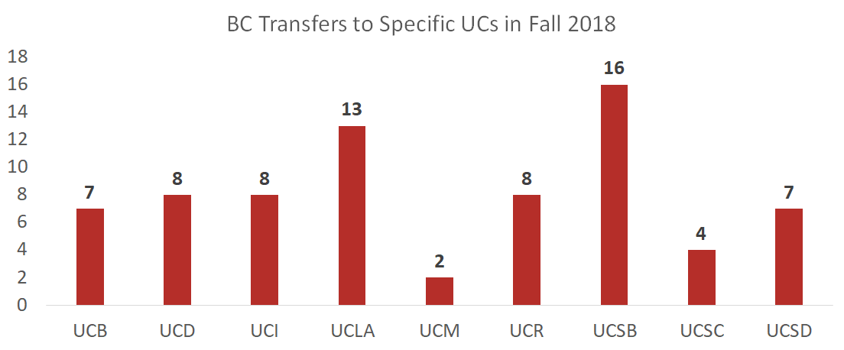
BC Transfers to Specific UC Campuses in Fall 2018
Source: UC Information Center Data Warehouse

Slide 5
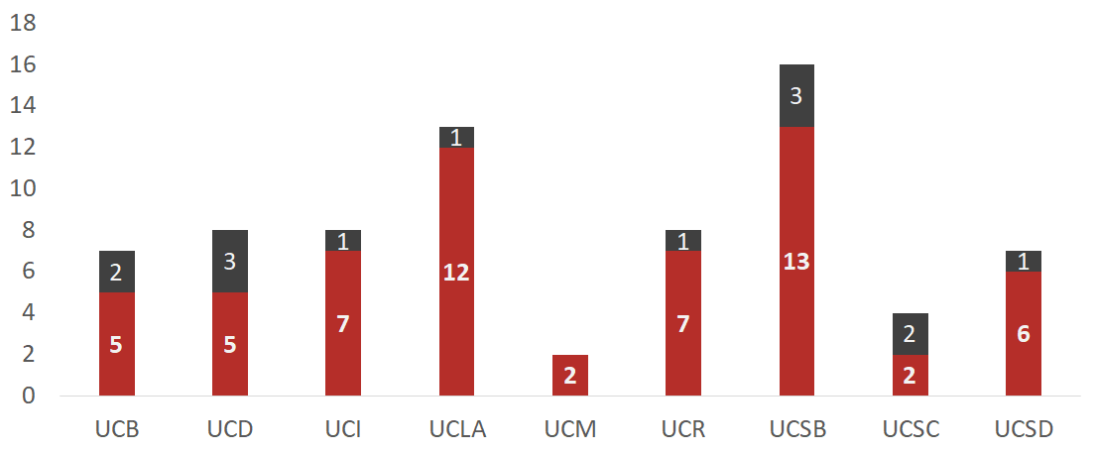
BC Transfers to Specific UC Campuses in Fall 2018 in UC STEM Pathways STEM
Source: UC Information Center Data Warehouse

Slide 6
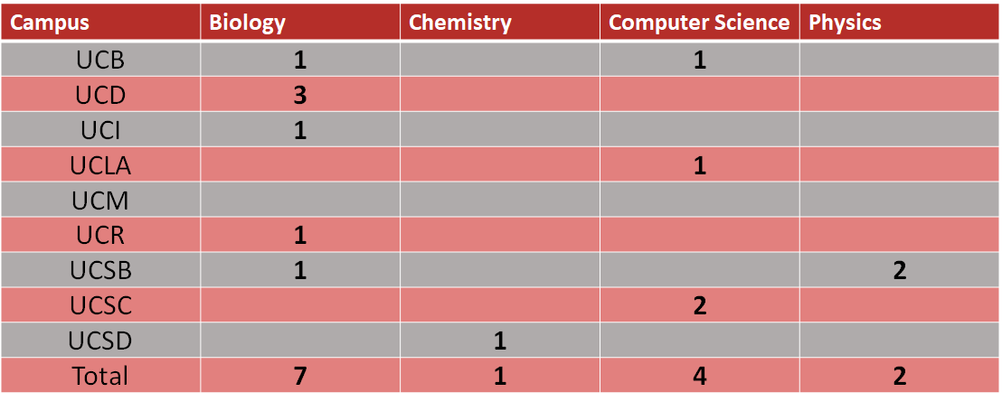
Fall 2018 UC STEM Pathways Transfers-
Detail By Campus
Source: UC Information Center Data Warehouse

Slide 7
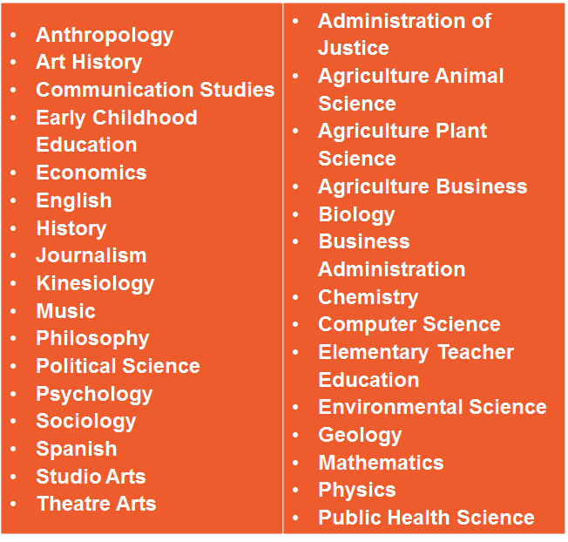
31 Associate Degrees for Transfer at BC

Slide 8
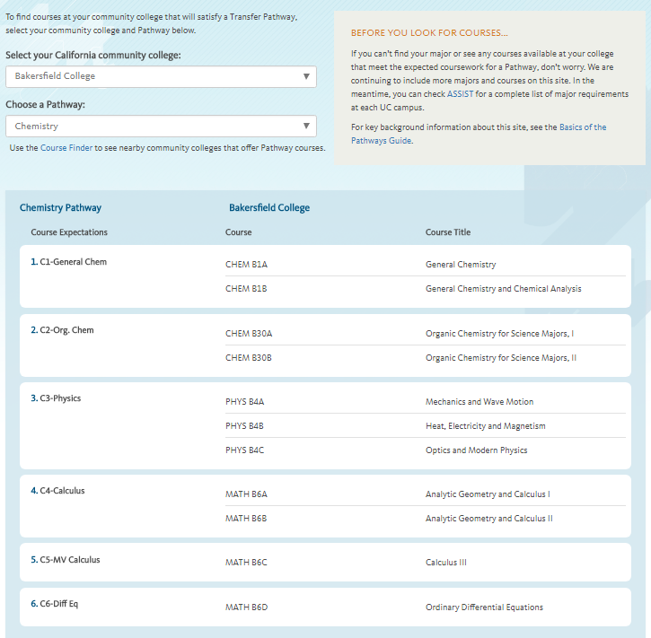
20 UC Transfer Pathways provides a clear roadmap to prepare for the major at BC
Anthropology
Biochemistry
BIOLOGY
Business Adminstrattion
Cell Biology
CHEMISTRY
Communication
COMPUTER SCIENCE
Economics
Electrical Engineering
English
History
MATHEMATICS
Mechanical Engineering
Molecular Biology
Philosophy
PHYSICS
Political science
Psychology
Sociology

Slide 9
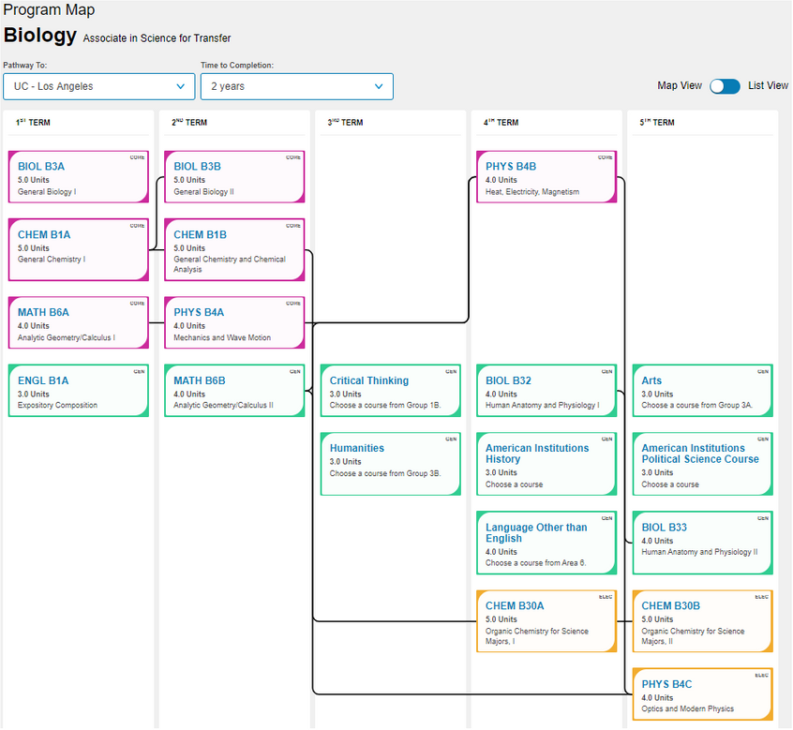
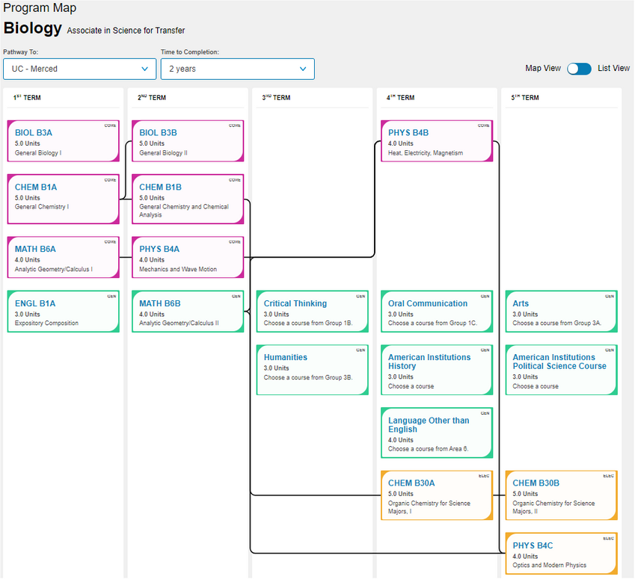
Program Mapper
BIOLOGY

Slide 10
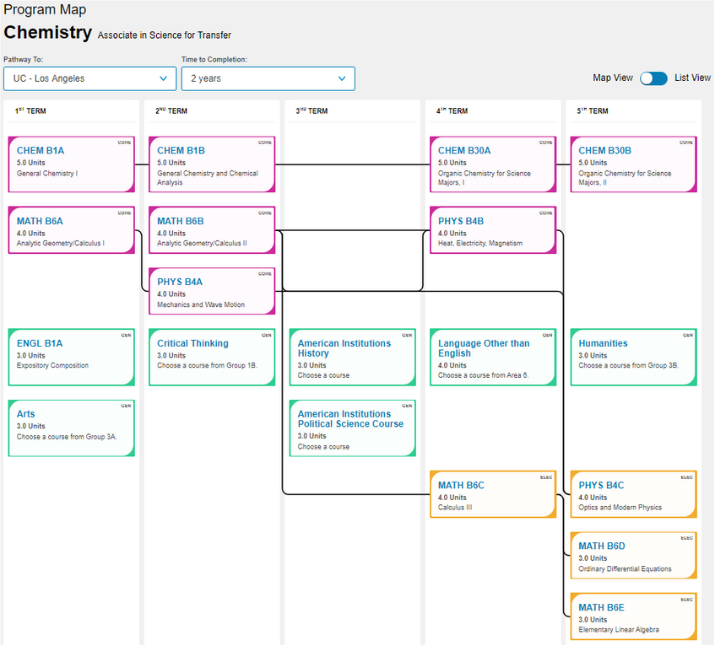
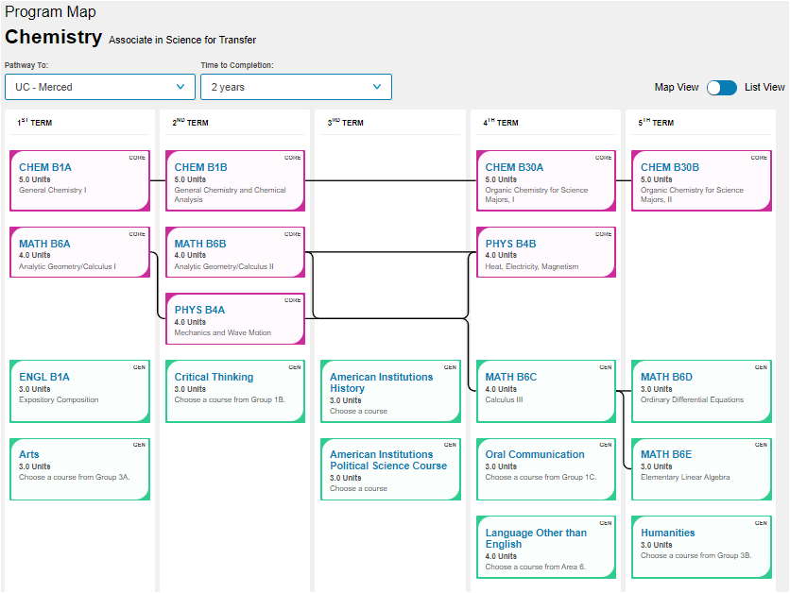
Program Mapper
CHEMISTRY

Slide 11
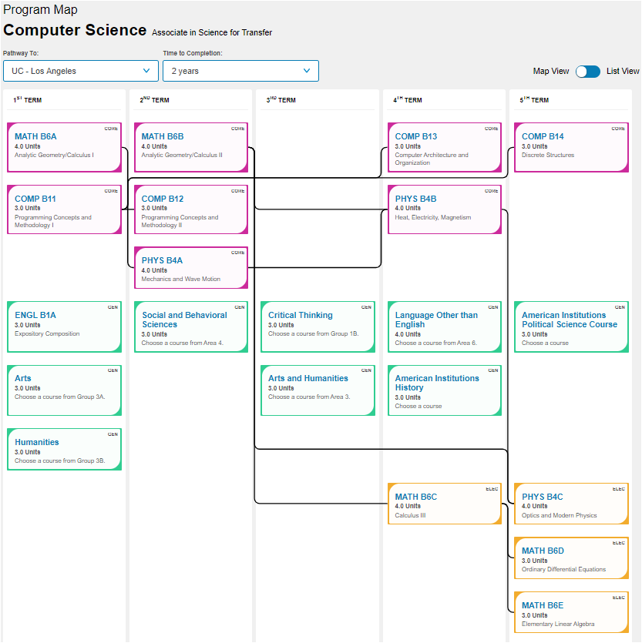
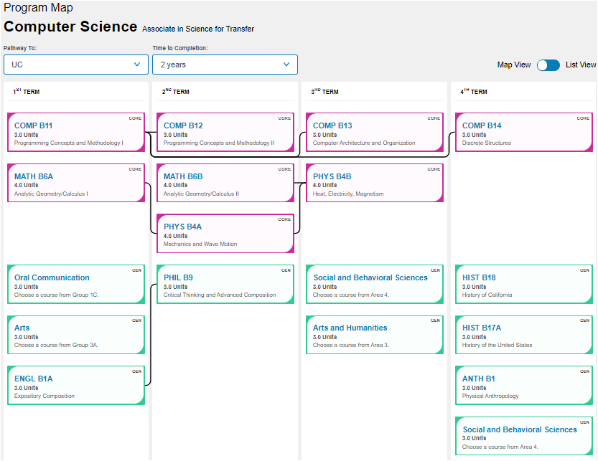
Program Mapper
COMPUTER SCIENCE

Slide 12
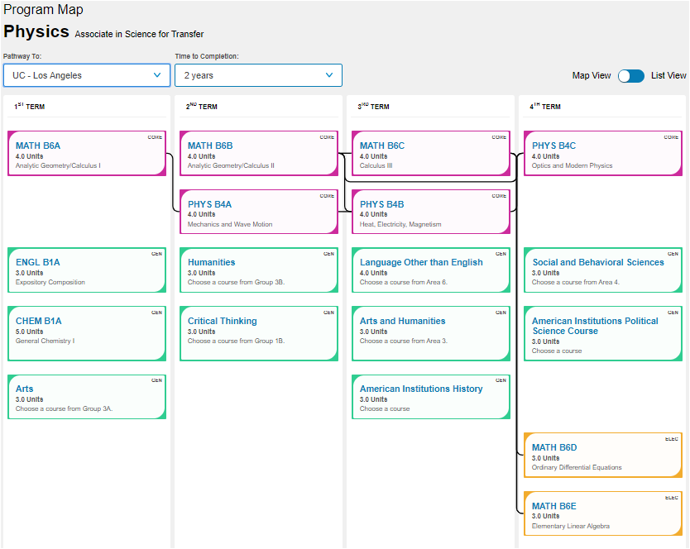
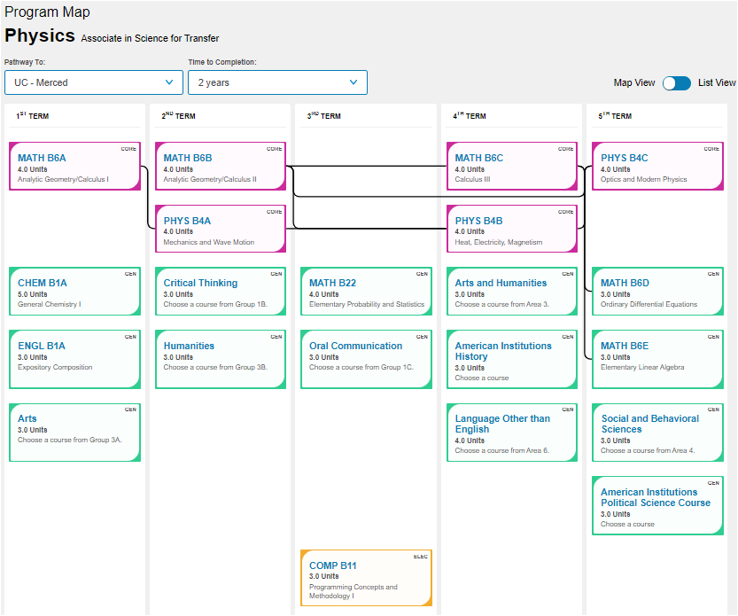
Program Mapper
PHYSICS

Slide 13
Similar to the ADTs developed for the CSU system, a UCTP guaranteed admission is to the UC system, not one individual campus.
The student that earns a UCTP degree:
Completes lower division preparation in the major of Chemistry or Physics
Is guaranteed admission to the UC system with a minimum 3.5 GPA
Should be able to graduate within two years of attending a UC at full time status
Why UCTPs?
CHEMISTRY AND PHYSICS ASSOCIATE IN SCIENCE
PILOT PROJECT

Slide 14
CHEMISTRY UCTP vs. ADT:
Inclusion of general education
Addition of:
Third semester of calculus-based Physics course
Multivariable Calculus
Differential Equations or Linear Equations (as a selection)

Slide 15
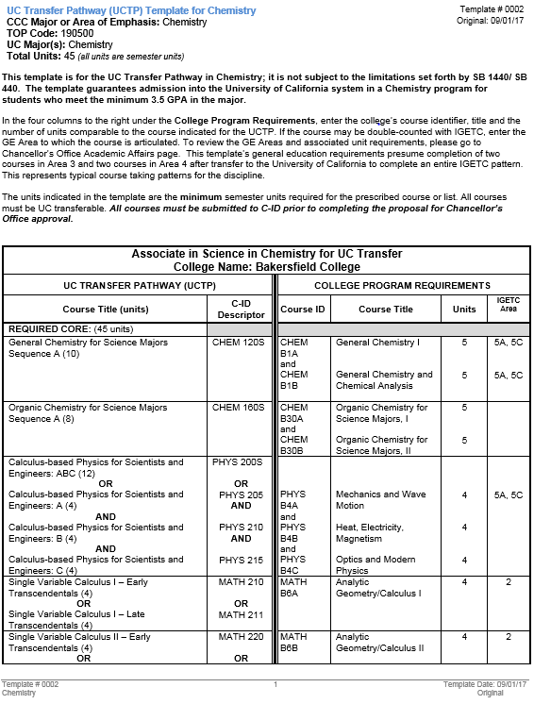
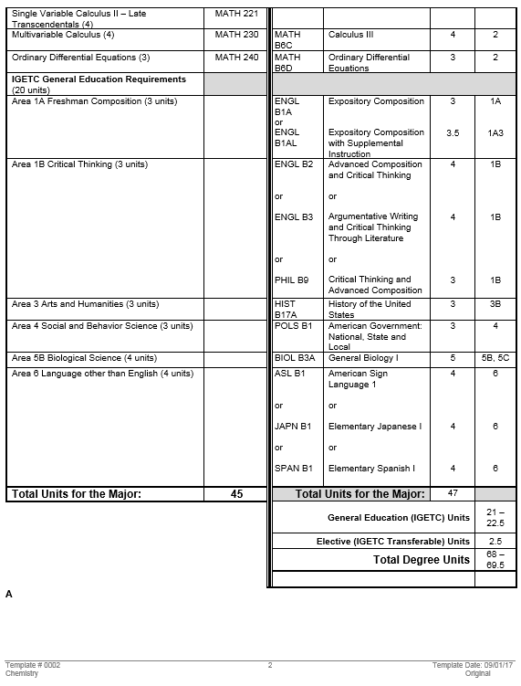

Slide 16
PHYSICS UCTP vs. ADT:
Inclusion of general education
Addition of:
One year of General Chemistry
Differential Equations
Linear Equations

Slide 17
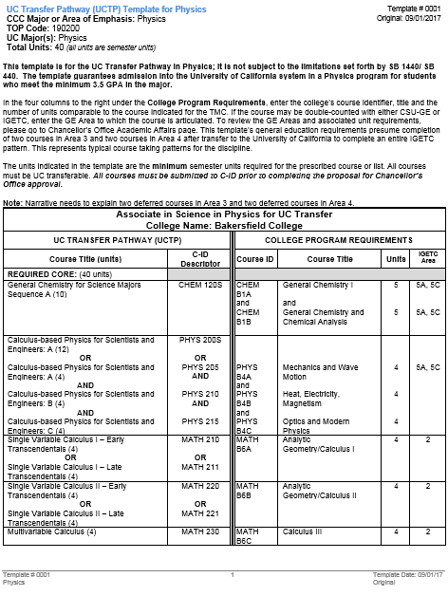
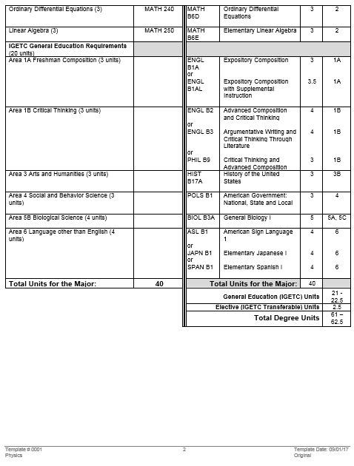

Slide 18
UCTP Process at BC

Slide 19
UCTP Added Benefits
Students who obtain the UCTP will also meet same discipline ADT requirements (IGETC) to receive a guaranteed admission to one CSU.
Students may earn this degree whether they meet the 3.5 GPA or not.
Students who do not meet with GPA requirement are still eligible to apply to the UC system, but they will not be covered under the transfer guarantee.
Students will still be competitive at a number of UC campuses with a GPA below the 3.5 threshold.

Slide 20
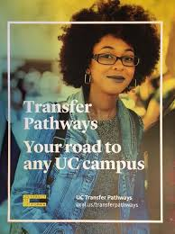
QUESTIONS or COMMENTS?

