Slide 1
Heal: Rural Health Equity and Learning Collaborative
Presentation to College Council – October 4, 2019
Cindy Collier AND Norma Rojas-Mora

Slide 2
What is Health equity?
Health equity means that everyone has a fair and just opportunity to be as healthy as possible. This requires removing obstacles to health such as poverty, discrimination, and their consequences.
Mission
To lift the voices of rural communities of the san Joaquin valley by connecting available resources and bringing about policy changes needed to improve rural health

Slide 3
Heal Advisory committee
The Rural HEAL Advisory Committee is a regional representation of partners working to improve the lives of rural residents. Partners pictured here represent UC Merced, UC San Francisco at Fresno, Central Valley Health Policy Institute, Central Valley medical professionals, and Bakersfield College Health and Workforce training

Slide 4
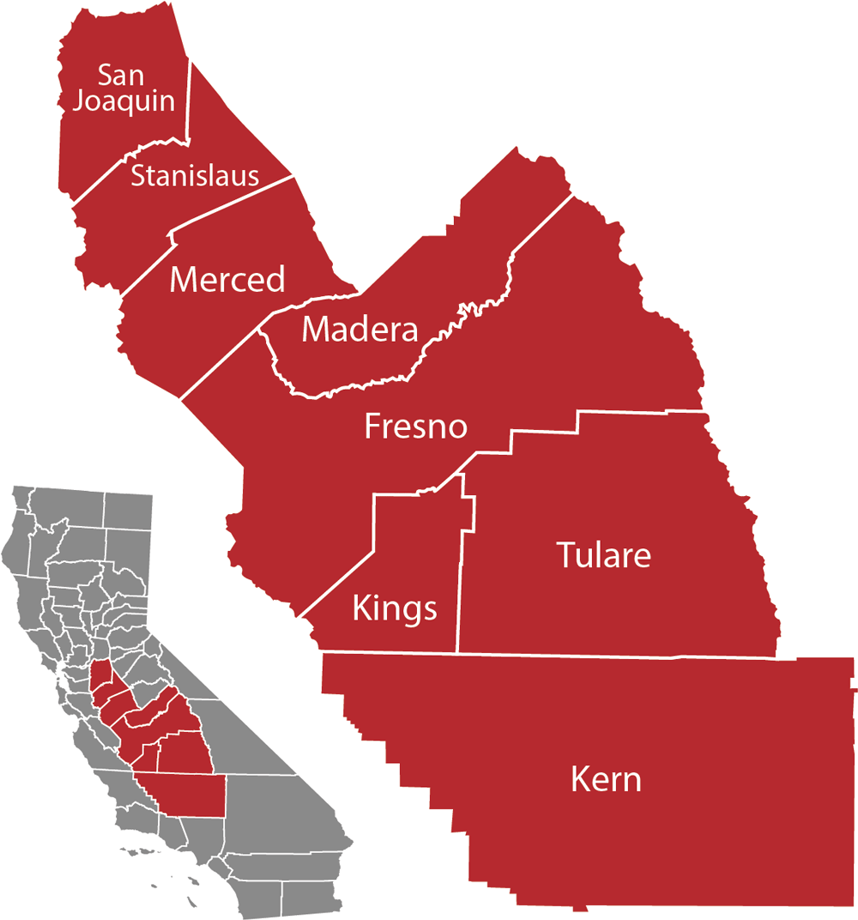
About the Rural heal collaborative
Rural HEAL Collaborative partners are passionate about improving health, education and economic outcomes in rural communities throughout the San Joaquin Valley. Our methodology for engagement takes the shape of effective partnerships, which are essential for community-based solutions for advancing health equity
The 26,000-square miles from Merced to Kern counties constitute a significant population of low-income rural residents with the nation's lowest educational attainment. The lack of education translates to reduced employment opportunities, increased poverty, and limited access to healthcare.

Slide 5
American Human Development Index
Composite measure of well-being and opportunity
Health – measured by life expectancy
Knowledge – measured by school enrollment and degree attainment
Standard of living – measured by median earnings of all workers 16 and older

Slide 6
Central valley outlook
Unemployment
Poverty

Slide 7
Strategic priorities
Advocate for Rural Health and Healthy Communities by informing policy makers and stakeholders about Central Valley circumstances
Launch pilot studies designed to create regional outreach toolkits and trainings addressing rural health, food security, and well-being
Strengthen the regional workforce and economy
Engage in regional dialog to engender policy creation at the national level
Enhance rural economic and community growth across the nation through a linked network of information, resources and political action
Generate funding to ensure that resources are commensurate with rural community needs.

Slide 8
Projects and initiatives
to address regional inequities in educational attainment, meet regional workforce demands, and improve community wellness using a three-pronged approach:
Develop and scale regionally high demand high wage pathways in education and health sciences
Establish programs that meet rural workforce development needs
Focus on advancing rural health equity and well-being to improve social and economic mobility of families in rural America through the lens of research projects and community outreach in California's Central Valley

Slide 9
Long-term goals
Identify statewide/national opportunities to advance HEAL’s mission
Secure grant funding for a HEAL Research Center located in the Central Valley
Host rural Health Equity and poverty Summit convenings in the Central Valley
Contribute to and guide the narrative regarding opportunities/projects for improving rural health in America

Slide 10
Short-term Goals
Build regional awareness and visibility of HEAL
https://twitter.com/RuralHEAL
Recruit and increase HEAL partnerships
Lead and direct the narrative regarding opportunities/projects for improving rural health in Central Valley communities
Identify and secure grant funding to finance opportunities for HEAL to implement the initiative’s short-term strategies and long-term goals
Host 3 regional rural health convening's with HEAL partners and community leaders to grow awareness and position of HEAL as a key participant in addressing rural health equity, workforce, and education
Hold the Date – November 22, 2019

Slide 11
Partnerships
https://www.bakersfieldcollege.edu/president/heal

Slide 12
Local Opportunities for engagement
Host Regional convenings to discuss poverty, health equity, economic development, and education.
1st Convening will be coordinated in partnership with the National Academy of Sciences
Date: November 22, 2019
Time: 9:00am-2:00PM
Location: Delano (TBD)
Topics: poverty, air Quality, Substance Abuse, Economic Development, Education/workforce

Slide 13
Local projects
Establishment of a Delano Wellness Program leveraging our Public Health Pathway and Industry Partners
Address Healthy People 2020 priorities
Nutrition and Weight status, diabetes, Heart disease and stroke
Utilizes Health Belief Model to create Behavior Change
Establishment of a Wellness program for Bakersfield College’s Main Campus in partnership with SGA and Dignity
Develop a blueprint for ARVIN in partnership with Industry Partners, leveraging Bakersfield College’s campus by 2023

Slide 14
Workforce Development Projects
Identify and establish workforce development strategies in allied health/public health
BC’s Nursing Program has secured approval from the Board of Nursing to increase enrollment in the Registered Nursing Program
Program has implemented dual enrollment program with 4 year colleges so that students complete an Associate and Bachelors degree simultaneously
Public Health Sciences is beginning conversations with UC Merced 1+2+1 program
Establishment of Nurse Assistant programs in Wasco and McFarland
Focus on providing early college opportunities in Health Science for our Rural communities

