Slide 1
New employee orientation And year long seminars
Todd Coston
College Council
October 4, 2019

Slide 2
Introduction
Employee Orientation
Management Seminar
Classified Seminar

Slide 3
Orientation and Academies
HR Perspective
Initial HR orientation
How these orientations tie in with HR’s work

Slide 4
How we came up with content
Polled managers on content they wanted their new employees to know.
Worked with the Professional Development Committee co-chair and pulled ideas from past surveys of employees.
Polled some of our newer employees asking about things they wish they knew when they started.

Slide 5
Employee orientation
One orientation a month
All new employees
Consistent, defined curriculum

Slide 6
Classified and management academies
8 sessions a year
New employees start at the next session after being hired
Topics based on President’s cabinet feedback
Notes:
Todd slide

Slide 7
Flow (September Orientation)
New Employee Orientation
Sep
Oct
Nov
Dec
Feb
Mar
Apr
May
Year Long Seminar
Sep
Oct
Nov
Dec
Feb
Mar
Apr
May
Done!

Slide 8
Flow (November Orientation)
New Employee Orientation
Sep
Oct
Nov
Dec
Feb
Mar
Apr
May
Year Long Seminar
Sep
Oct
Nov
Dec
Feb
Mar
Apr
May
Done!

Slide 9
Topic Layout
Year Long Seminar
(Classified)
Sep
Oct
Nov
Dec
Feb
Mar
Apr
May
Each session is approximately 90 minutes
Some sessions the same and some different between Classified and Management.
IT Security
…etc.
Program Review
Outlook Productivity
Emergency Preparedness

Slide 10
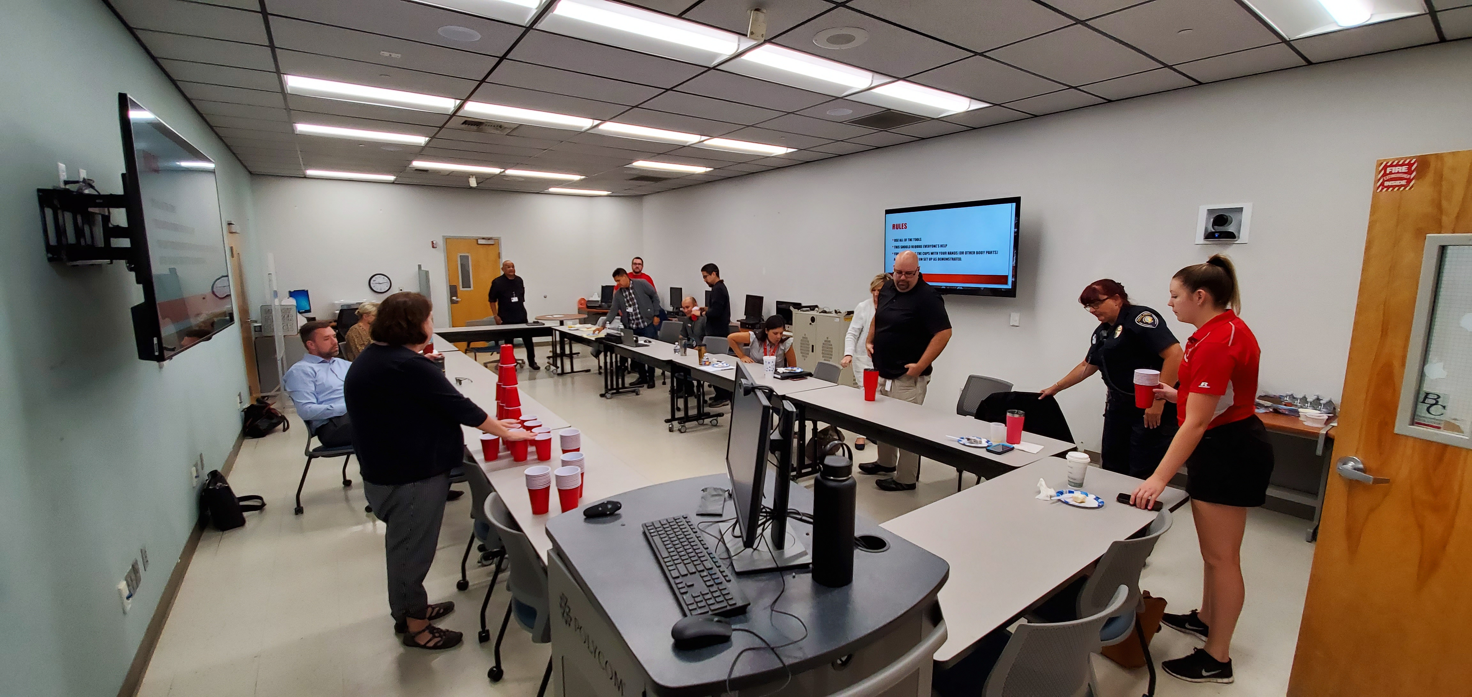
October 1st ^{Kick off session}
Notes:
Todd slide

Slide 11
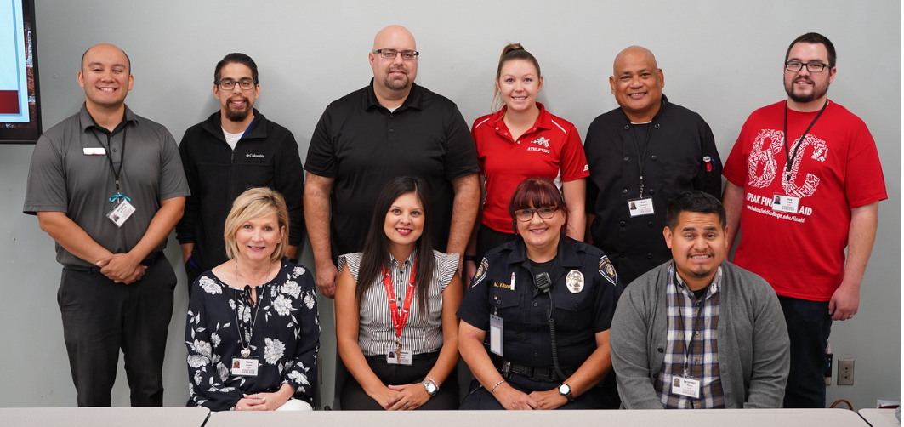
October 1st ^{Kick off session}
Notes:
Todd slide

Slide 12
Questions?

