Slide 1
Social, Behavioral & Human Services Pathway
Presented by Yvonne Armendariz
May 3, 2019

Slide 2
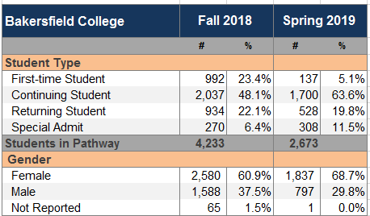
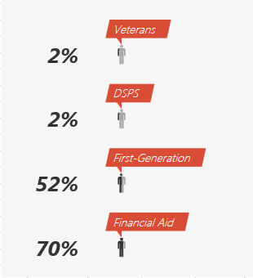
Student Demographics

Slide 3
Students by Major (F’18)

Slide 4
14.9 units or less attempted in first semester (F’18)

Slide 5
15 units or more attempted in first semester (F’18)

Slide 6
Math/English attempted in first term (F’18)
First-time Students who are currently enrolled and either Math or English (or both) in their first semester (Fall 2018) at Bakersfield College.
N:
Math = 40
English = 113

Slide 7
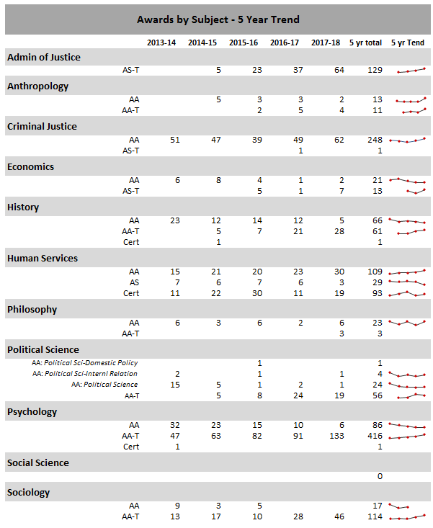
Awards by major
Top 5 Majors awarded:
Psychology (N=503)
Criminal Justice (N=249)
Human Services (N=231)
Sociology (N=131)
History (N=128)

