Slide 1
ACH Pathway Data
Dean of Instruction, Andrea Thorson
October 2018 update

Slide 2
Number of Students in Pathway

Slide 3
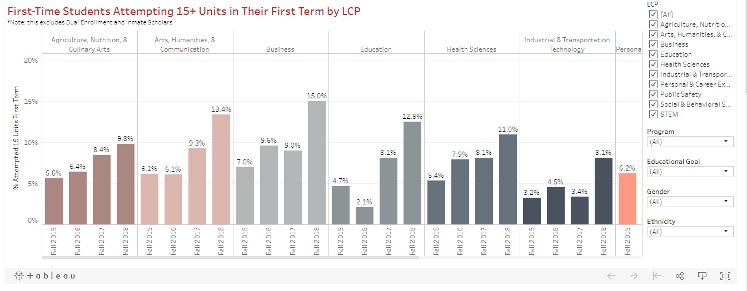

Slide 4
15 units: ACH
2015 | 2016 | 2017 | 2018
6.1% | 6.1% | 9.3% | 13.4%

Slide 6
30 units: ACH
2015 | 2016 | 2017
8.2% | 10.4% | 15.6%

Slide 7
30 units examples
Year | 2015 | 2016 | 2017
Communication | 11.3% | 26.2% | 46.3%
English | 10.3% | 11.8% | 15.4%
Digital Arts/Arts | 1.9% | 5% | 11.8%

Slide 8
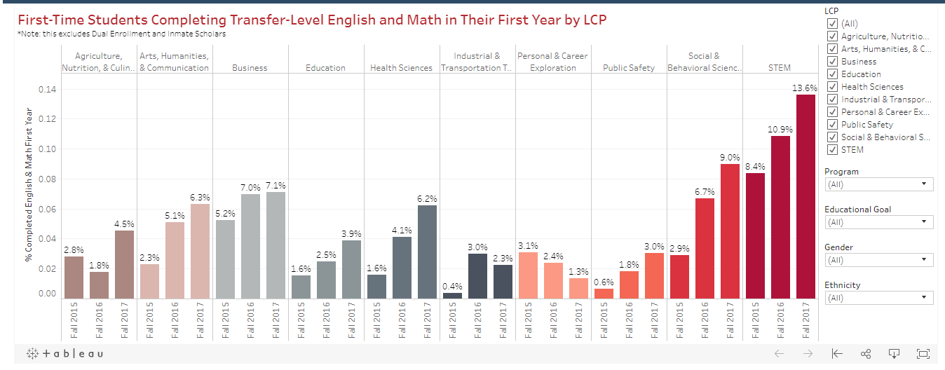

Slide 9
Math and English
Year | English /Math | English | Math
2015 | 2.3 | 15.9 | 3.8
2016 | 5.1 | 23.7 | 5.6
2017 | 6.3 | 27.4 | 7.7

Slide 10
