Slide 1
Bakersfield College Annual Admin Structure Review Presentation to College Council April 17, 2015
Chairs: Nan Gomez-Heitzeberg
Financial Analysis: Anthony Culpepper/Laura Lorigo
Classified: Bernadette Martinez
Faculty: Ann Tatum, Jason Stratton
Management: Todd Coston, Cindy Collier
Administrative Support: Jennifer Marden

Slide 2
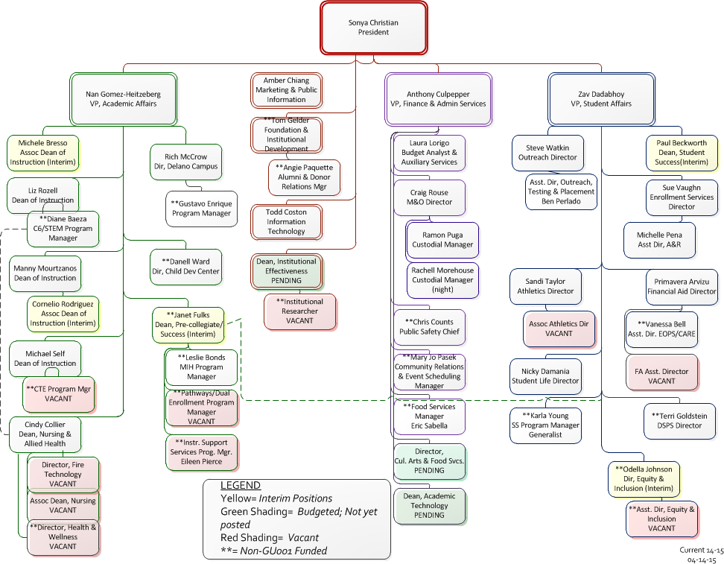
Current Org Chart

Slide 3
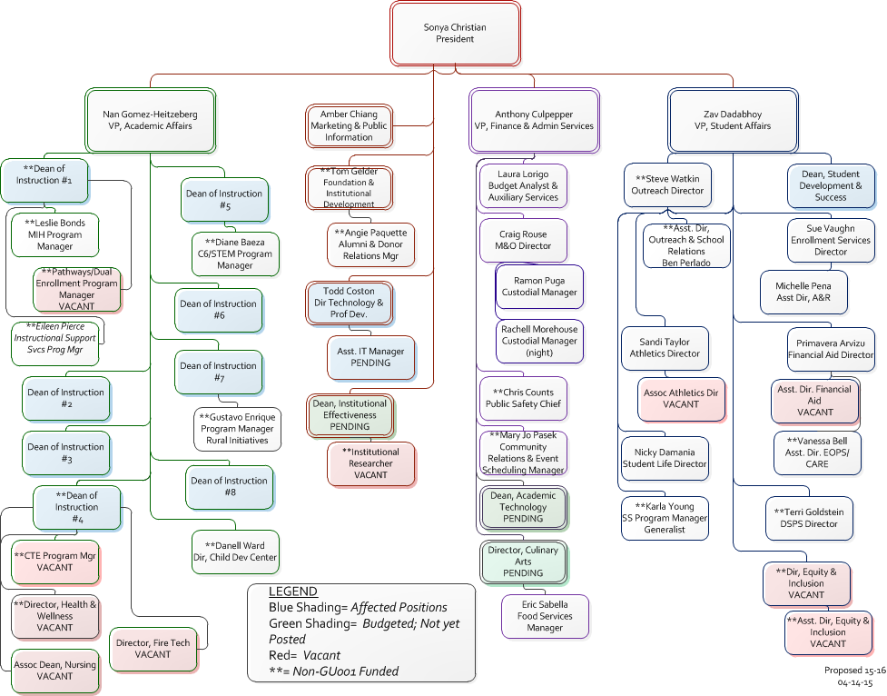
Proposed Admin Structure

Slide 4
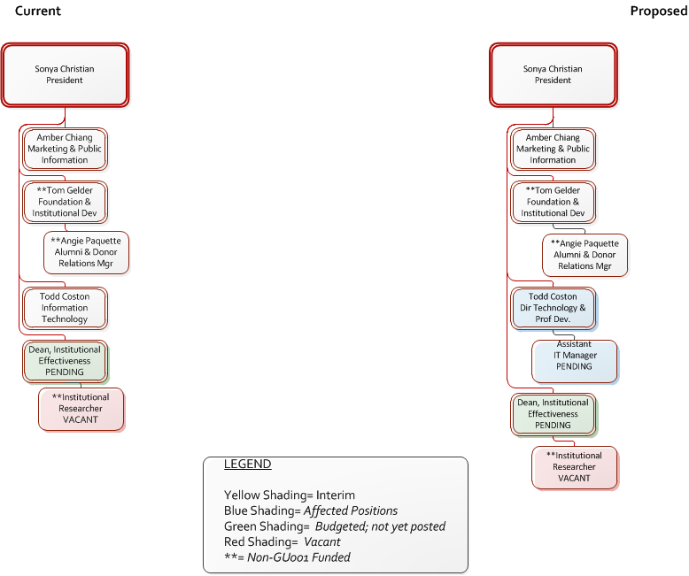
President’s Office Structure Comparison

Slide 5
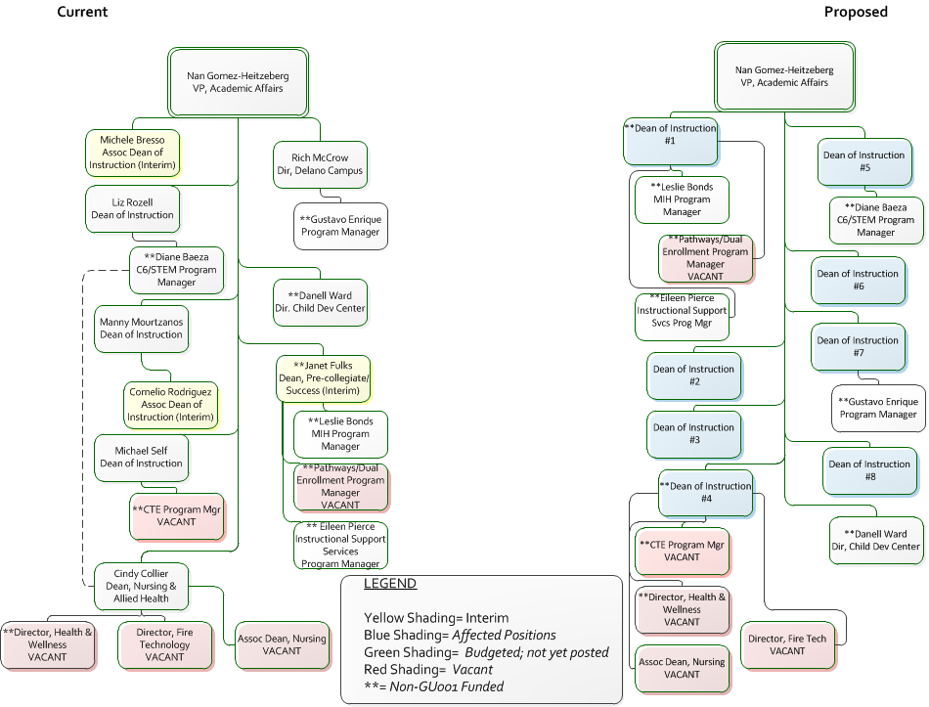
Academic Affairs Structure Comparison

Slide 6
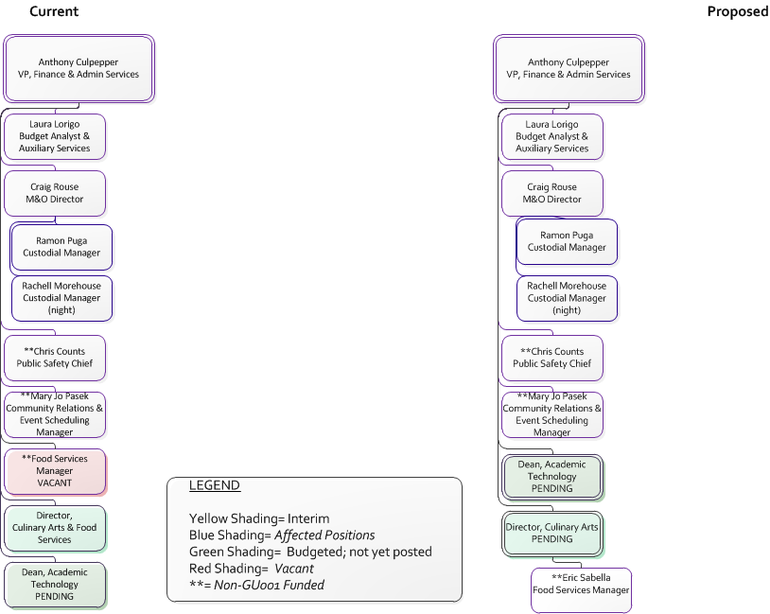
Finance & Admin Services Structure Comparison

Slide 7
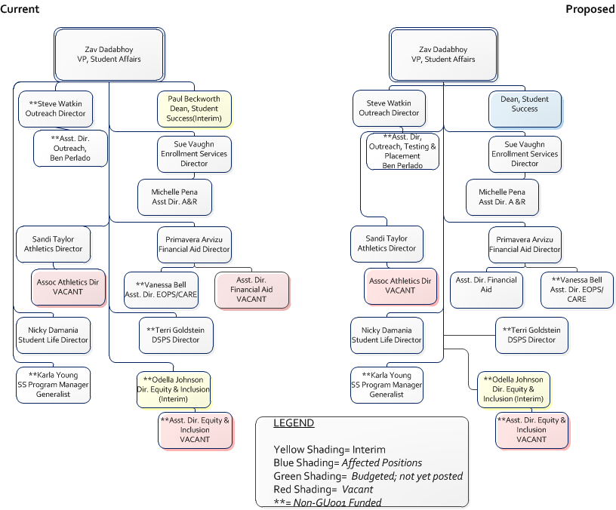
Student Affairs Structure Comparison

Slide 8
Budget Impact

Slide 9
Bakersfield College Annual Admin Structure Review Presentation to College Council April 17, 2015
Chairs: Nan Gomez-Heitzeberg
Financial Analysis: Anthony Culpepper/Laura Lorigo
Classified: Bernadette Martinez
Faculty: Ann Tatum, Jason Stratton
Management: Todd Coston, Cindy Collier
Administrative Support: Jennifer Marden

