Slide 1
Bakersfield College All Campus Budget Forum April 29, 2024 presented by Jerry Fliger, President Calvin Yu, Vice President, Finance and Administrative Services Erica Menchaca, Academic Senate President
Notes:
Updated - SB

Slide 2
Topics of Discussion
President
State of the College
Vice President, Finance and Administrative Services
State of California – Budget Talk
BC Budget Premise
Categoricals
50% Ratio
24-25 Budget Schedule
Academic Senate President
College Reserves
Spring/Summer/Fall Registration
District Wide Budget Committee

Slide 3
The State of the College
Dr. Jerry E. Fliger
President
Notes:
Updated - SB

Slide 4
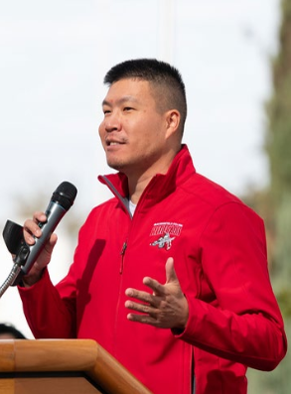
All Campus Budget Forum
Calvin Yu
Vice President, Finance and Administrative Services
Notes:
Updated - SB

Slide 5
BC Budget Office
https://www.bakersfieldcollege.edu/about/administration/finance-and-administrative-services/budget.html
Somaly Boles, Director, Finance and Grants
Cristal Rios, Budget Analyst
Yvonne Stallion, Budget Analyst
Jerry Harris, Budget Analyst
Sachiko Morrison, Accounting Coordinator

Slide 6
Governor’s Budget Plan
Governor’s budget proposal should be considered a win for CCs – has held true since January
Total funds proposed for the CCC in 2024-25 are $21.6B – May revise forthcoming
$69.1M ongoing Prop 98 funding for 0.76% COLA for Student Centered Funding Formula apportionments – base adjustments bring the effective rate to -0.14%.
$29.6M ongoing Prop 98 funding for 0.5% enrollment growth
Proposed withdrawals of $235.9M in 2023-24 and $486.2B in 2024-25 to support ongoing SCFF costs
$60M one-time Prop 98 funding to expand nursing programs and Bachelor of Science in Nursing partnerships
Student Housing funding
No proposed Deferred Maintenance funding

Slide 7
College Budget Premise
Increase of revenue from PY due to the SCFF, COLA, and base: $9.7M*
Basic - $11.8M ($10.9M)
Credit - $79.4M ($68.4M)
Dual Enrollment - $18.2M ($17.9M)
Incarcerated and non-credit – $4.8M ($4.9M)
Supplemental – $34.7M ($30.3M)
Success - $19.8M ($18.3M)
Step/Column increases 2.5%
PERS (5.8%) increase; STRS flat
 | 2020-21 | 2021-22 | 2022-23 | 2023-24 | 2024-25
CalPERS | 20.70% | 22.91% | 25.37% | 26.28% | 27.80%
CalSTRS | 16.15% | 16.92% | 19.10% | 19.10% | 19.10%
*After 3.55% deficit factor applied to the district – BC raw SCFF growth was $13.3M.

Slide 8
Labor Budget
Faculty Obligation Number Analysis | KCCD | BC | CCCC | PC
Fall ‘24 Advanced FON* | 437.80
Fall ‘23 Actual FON | 502.00 | 367.00 | 66.00 | 69.00
FTF required for FON | (50.20)
Retirements/Separations/Resignations | 14.00 | 8.00 | 1.00 | 5.00
Proposed ‘24-’25 Recruitment Target** | 17.00 | 9.00 | 2.00 | 6.00
*10% deficit factor applied due to decrease in state revenues.
**2023 actual + one per college.
Admin Structure Review: Classified Positions Recommendations | Classified Positions Recommendations
1 | Senior Research Analyst, Institutional Effectiveness
2 | Budget Coordinator, Budget Office
3 | System Support Specialist II, Technology Support Services
4 | Systems Support Analyst, Student Success Technology
5 | Admissions and Records Technician II, Admissions and Records
6 | Library Technician I (Arvin), Library Science
7 | Agriculture Technician, Delano Campus Center
8 | Public Safety Officer I, College Safety
9 | Public Safety Officer II, College Safety
Admin Structure Review: Management Positions Recommendations | Management Positions Recommendations
1 | Director of Residence Life, Student Affairs
2 | Associate Athletic Director, Women’s Sports, Instruction
3 | Project Manager, Finance and Administration
4 | Resident Life Coordinator, Student Affairs
5 | College Safety Field Supervisor, Finance and Administration
6 | Program Manager, Math Learning Center, Instruction
7 | Associate Vice President, Student Affairs, Student Affairs
8 | Mental Health Clinician, Student Affairs
9 | Dean of Enrollment and Retention, Student Affairs
10 | Dean of Categorical and Special Programs, Student Affairs

Slide 9
Categorical/Restricted Funding
24.74% Growth
Notes:
Updated - SB

Slide 10
50% Ratio Historical Review of BC’s 50% Ratio **
**Ratios are before the District Office Chargeback
Notes:
Updated - SB

Slide 11
BC BUDGET SCHEDULE October 2023-June 2024
Timeline | FY23 | FY24 | FY25 | BC Deadline | Tasks | Responsible
October 2023 |  |  | X | 10/11/2023 | Send FY25 Program Review Budget forms for GU001 Non-Labor Budgets to Budget Managers. | Budget Office
 |  |  | X | 10/31/2023 | Deadline for FY25 Program Review Budget forms for GU001 Non- Labor Budgets. | Budget Managers
November 2023 |  |  | X | Early November | Compile FY25 Program Review Budget forms for GU001 Non-Labor Budgets. | Budget Office
December 2023 |  |  | X | Early December | Prepare FY25 Program Review Budget forms for GU001 Non-Labor Budgets for Executive Team review. | Budget Office
January 2024 |  |  | X | Early January | Prepare FY25 Labor Budgets. | Budget Office
 |  |  | X | Early January | Executive Team review of FY25 GU001 Non-Labor Budgets. | Executive Team
February 2024 |  |  | X | Mid February | Updates to FY25 GU001 Non-Labor Budgets from Executive Team. | Budget Office
 |  |  | X | Mid February | Review Org Codes and Approval Queues for FY25. | Budget Office
March 2024 |  |  | X | Early March | Executive Team review of FY25 Labor Budgets. | Executive Team
 |  |  | X | Late March | Prepare FY25 Restricted Funding Budget forms. | Budget Office
April 2024 |  |  | X | 4/1/2024 | Send FY25 Restricted Funding Budget forms to Budget Managers. | Budget Office
 |  |  | X | 4/19/2023 | Deadline for FY25 Restricted Funding Budget forms. | Budget Managers
 |  |  | X | Late April | Compile FY25 Labor Budgets, GU001 Non-Labor Budgets, Restricted Funding Budgets for Tentative Budget upload. | Budget Office
May 2024 |  |  | X | Early May | Activate/Cancel/Freeze FY25 positions. | Budget Office
 |  |  | X | Early May | FY25 Tentative Budget upload. NO CHANGES TO FY25 BUDGETS UNTIL NEW FY 7/1/24. | Budget Office
 |  |  | X | Mid May | Governors May Revise Issued. | District
June 2024 |  |  | X | 6/13/2024 | Board Approval of FY25 Tentative Budget. NO CHANGES TO FY25 BUDGETS UNTIL NEW FY 7/1/24. | District
Notes:
Updated - SB

Slide 12
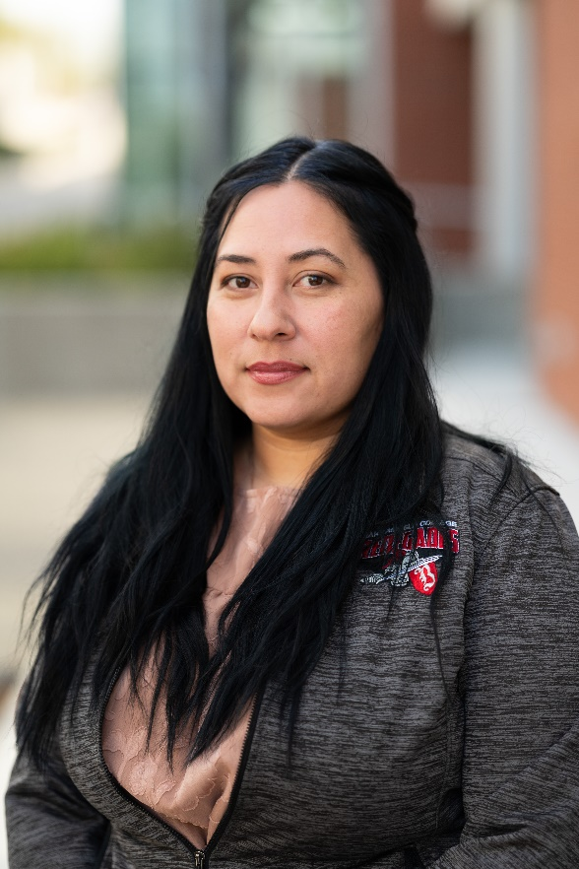
All Campus Budget Forum
Erica Menchaca
Academic Senate President
Notes:
Updated - SB

Slide 13
Notes:
Updated - SB

Slide 14
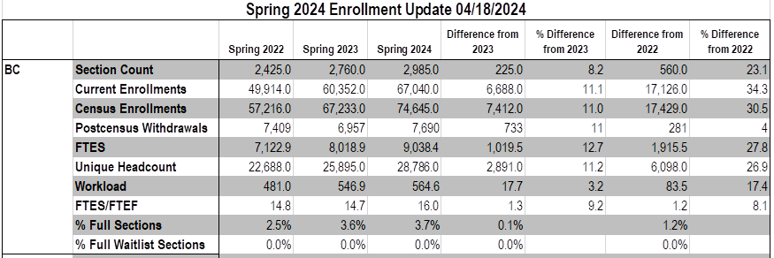
BC Spring 2024 FTES
From KCCD Institutional Research Email 4/18/24
Notes:
Updated - SB

Slide 15
BC Summer 2024/Fall 2024 FTES
From KCCD Institutional Research Email 4/18/24
Notes:
Updated - SB

Slide 16
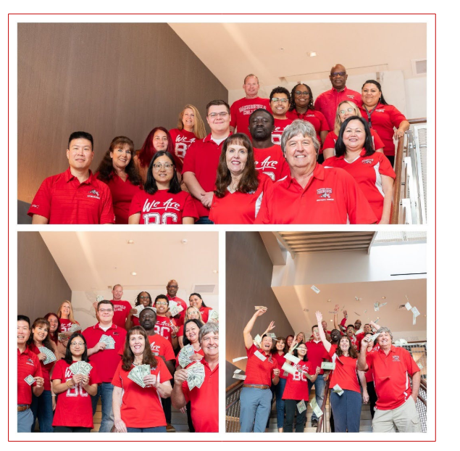
Thank You!
Budget Committee
Steven Holmes, Faculty Co-chair
Victor Crosthwaite, Classified Co-chair
Calvin Yu, Admin Co-chair
Dr. Jerry Fliger
Billie Jo Rice
Imelda Simos-Valdez
Erica Menchaca
Reggie Bolton
Somaly Boles
Cristal Rios
Jacob Palmbach
John Gerhold
LeAnn Riley
Gilbert Ayuk
Kyungjin Menjivar
Tim Bohan
Kimberly Nickell
Jessalyn Choate
Angela Williams
Jo Ellen Barnes

Slide 17
A Short 10 years…
March 2014 – March 2024:
CPI Change: $1.00 – $1.32
2014: 12,322 FTES
2024: 18,348 FTES (+49%)
2014 FTES funding rate: $4,564
2024 FTES funding rate: $9,732 (+113%)
2014 Labor+Benefits GUI proportion: 67.9%
2024 Labor+Benefits GUI proportion: 80.4% (+18.4%)
2014 Total GUI Budget: $54.2M
2024 Total GUI Budget: $139.0M (+156%)

Slide 18
Thank You!
Budget Committee
Steven Holmes, Faculty Co-chair
Victor Crosthwaite, Classified Co-chair
Calvin Yu, Admin Co-chair
Dr. Jerry Fliger
Billie Jo Rice
Imelda Simos-Valdez
Erica Menchaca
Reggie Bolton
Somaly Boles
Cristal Rios
Jacob Palmbach
John Gerhold
LeAnn Riley
Gilbert Ayuk
Kyungjin Menjivar
Tim Bohan
Kimberly Nickell
Jessalyn Choate
Angela Williams
Jo Ellen Barnes

