Slide 1
Bakersfield College Budget Open Forum November 22, 2021 presented by Zav Dadabhoy, Interim President Mike Giacomini, Vice President, Finance and Administrative Services Teresa Mcallister, Budget Committee Faculty Co-Chair Nick Strobel, Academic Senate President

Slide 2
Topics of Discussion
President
State of the College
Faculty and Budget Committee Co-Chair
Budget Committee Work
Fall FTES
Vice President, Finance and Administrative Services
Adopted Budget Longitudinal Review
Categoricals and Restricted Funds
Adopted 2021/22 Budget by Expense Type
Adopted 2021/22 Budget by Division
COVID-19 Relief Funds
Reserves
Budget Committee Member
District Wide Budget Committee
FTES P2
Faculty Obligation Number FON

Slide 3
The State of the College
Zav Dadabhoy
Interim President

Slide 4
Budget Committee Work
Teresa Mcallister
Budget Committee Faculty Co-Chair

Slide 5
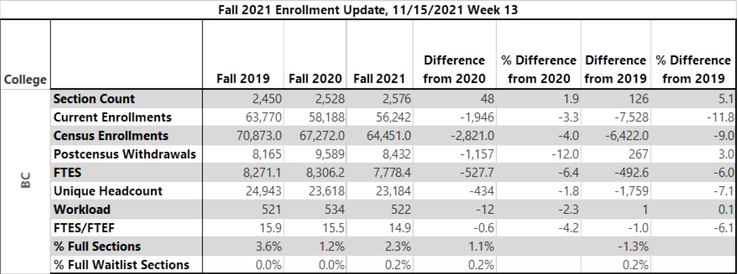
BC Fall 2021

Slide 6
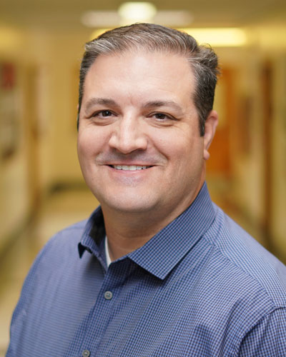
Budget Open Forum
Mike Giacomini
Vice President,
Finance and Administrative Services

Slide 7
Adopted Budget Longitudinal View

Slide 8
FY22 BUDGETS Categoricals and Restricted Funds

Slide 9
FY22 Adopted Budget by Expense Type
Account Code | GU001 |  | RP/CE |  | TOTAL
 | Amount | % | Amount | % | Amount | %
SALARIES | 64,589,999 | 59% | 15,183,586 | 17% | 79,773,584 | 40%
BENEFITS | 24,098,725 | 22% | 5,223,069 | 6% | 29,321,794 | 15%
SUPPLIES/MATERIALS | 2,428,805 | 2% | 1,597,049 | 2% | 4,025,854 | 2%
MAINTENANCE & OPERATIONS SERVICES | 7,373,660 | 7% | 0 | 0% | 7,373,660 | 4%
EQUIPMENT | 3,991,754 | 4% | 4,779,159 | 5% | 8,770,914 | 4%
OTHER* | 5,985,624 | 6% | 63,023,288 | 70% | 69,008,912 | 35%
TOTAL** | 108,468,567 |  | 89,806,151 |  | 198,274,718
*Includes Other Non-Instructional Consulting Services, Contract Instruction (Dual Enrollment), Student Travel, Employee Travel, Institutional Dues/Memberships, Other Services and Expenses, Other Student Aid, etc.
**Excludes Reserves and Chargebacks
Notes:
**To get to 88% salaries/benefits, need to remove 7000s from GU001 (Reserves, chargeback, and debt expenses)

Slide 10
Division Breakdown for GU and RP
Fiscal Period | 2017-18 Actuals | 2018-19 Actuals | 2019-20 Actuals | 2020-21 Actuals | 2021-22 Budget
President | 5,145,907 | 7,739,129 | 11,598,891 | 5,381,397 | 7,769,744
VP Instruction | 65,599,090 | 69,343,134 | 70,445,646 | 81,434,643 | 84,245,122
VP Student Affairs | 17,201,124 | 25,455,910 | 26,736,988 | 30,153,774 | 35,267,323
VP Finance and Admin Services* | 9,966,603 | 11,159,952 | 14,529,712 | 15,072,315 | 70,626,170
*Excludes Reserves and Chargebacks; includes COVID/HEERF Funds, Salary and Benefit increases for all BC positions due to Salary Schedule and Steps
Notes:
Does not include Chargebacks or Reserves

Slide 11
COVID-19 RELIEF FUNDS

Slide 12
COVID-19 RELIEF FUNDS - Cont

Slide 13
STUDENT HOUSING SITE PLAN – 4 STORY ~150 BEDS

Slide 14
Notes:
Updated - SB

Slide 15
All Campus Budget Forum
Nick Strobel
Academic Senate President
Notes:
Change pic

Slide 16
FTES P2 Report

Slide 17
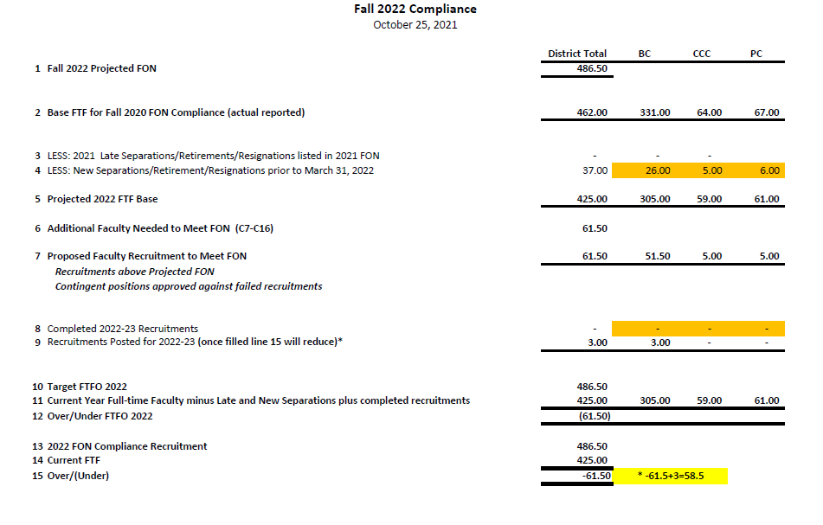
Faculty Obligation Number FON

