Slide 1

SOF Grant Application
Working Families Party Club at Bakersfield College
Present To:
BCSGA

Slide 2

Club Banner and Table Cloth Cost:
$50
(Accounting for Sales Tax)

Slide 3
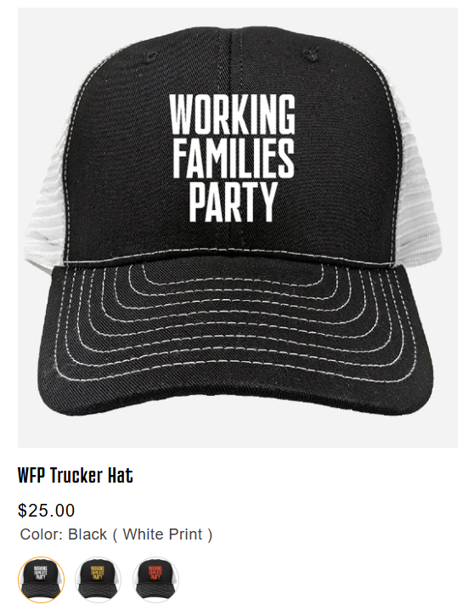
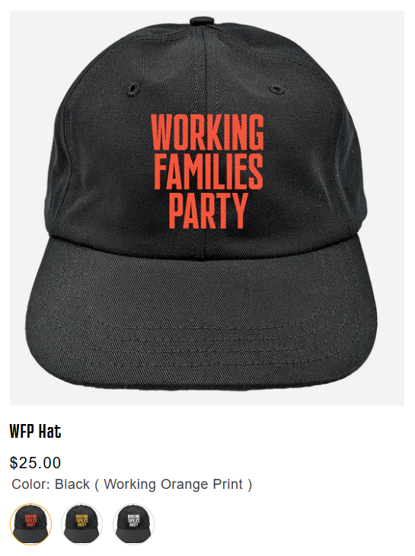
2 Hats ($25 each) Cost:
$50
(No sales tax)

Slide 4
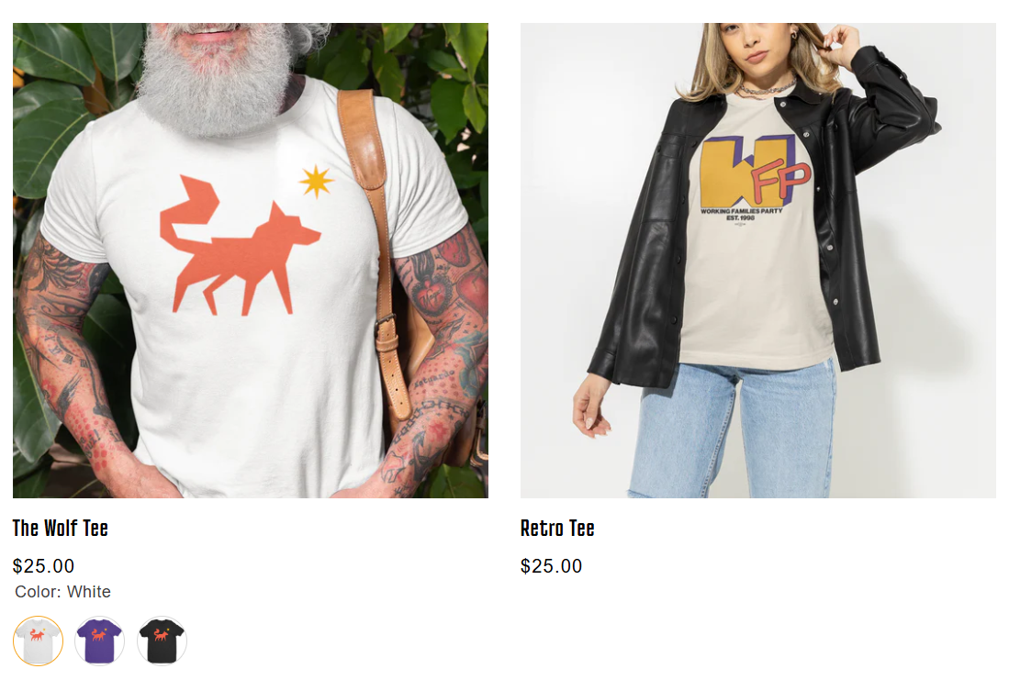
2 T-Shirts ($25 each) Cost:
$50
(No sales tax)

Slide 5
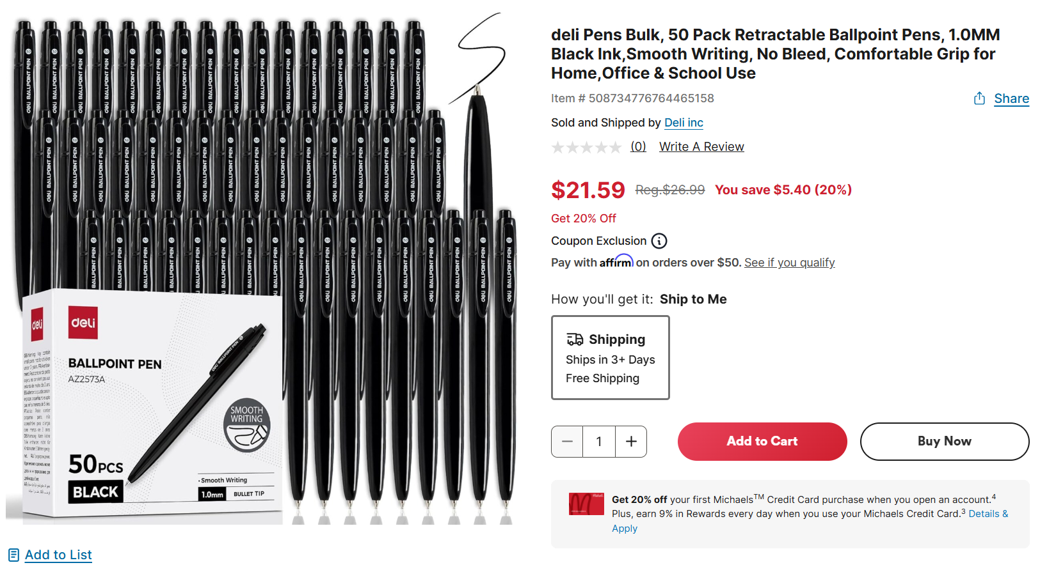
2 Pens in bulk ($25 each) Cost:
$50
(Accounting for Sales Tax)

Slide 6
Budget:
SOF-Grant-Itemized-Budget-Report-Template.xlsx

