Slide 1
The Spanish Club SOF Grant!

Slide 2

Mission Statement
The Mission of the Spanish Club is to bring students together to celebrate the Spanish language and the diverse cultures of the Spanish-speaking world. We create a welcoming space for friendship, cultural exchange, and fun activities that build community and strengthen connections across campus and improve and practice the Spanish language.

Slide 3
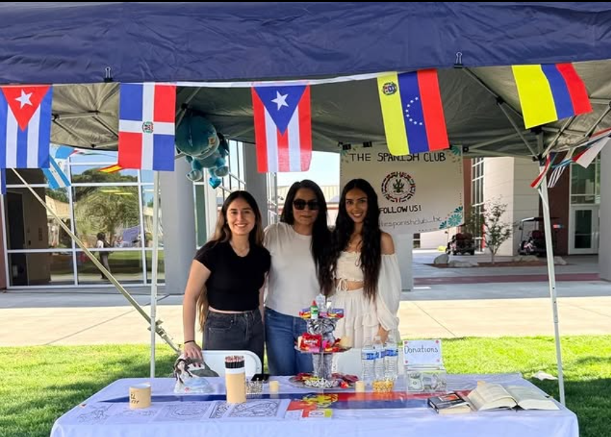
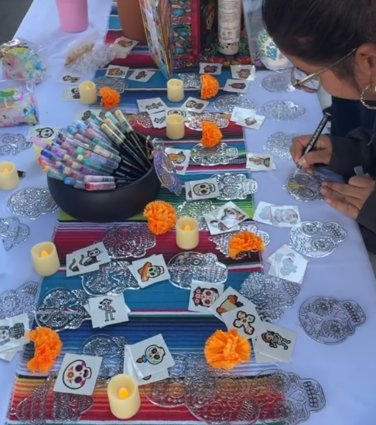
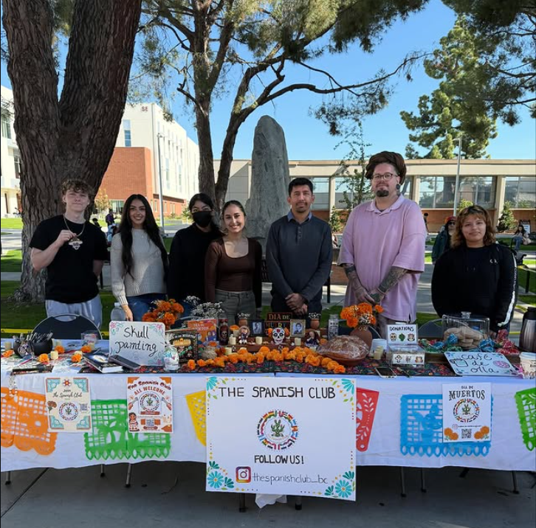
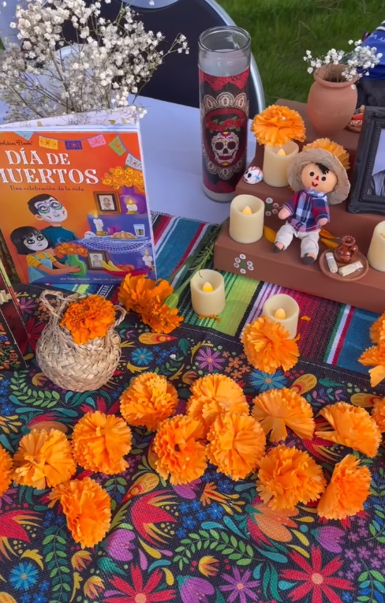
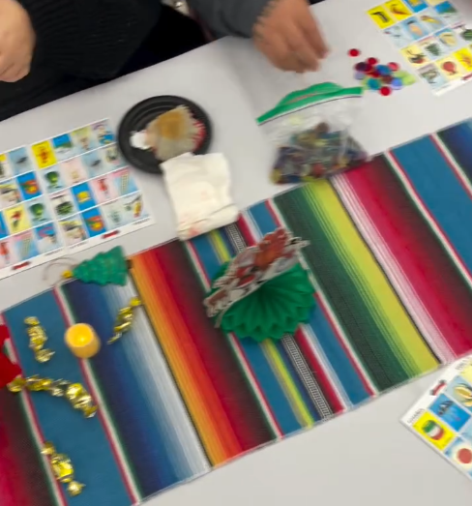
¡Nuestras Experiencias!

Slide 4
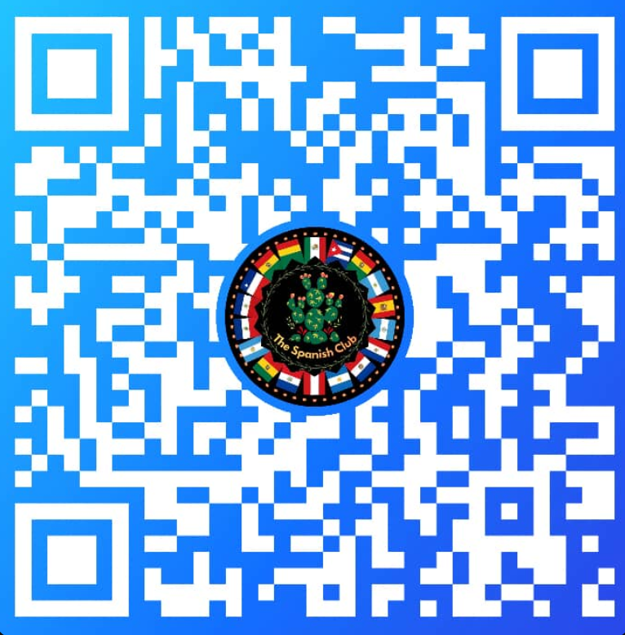

Meeting Dates
Every 2nd and 4th Tuesday of the month from 9:00am-10:00am
Follow our GroupMe and Instagram for
← updates! →
https://groupme.com/join_group/111142203/WKIURaeq

Slide 5
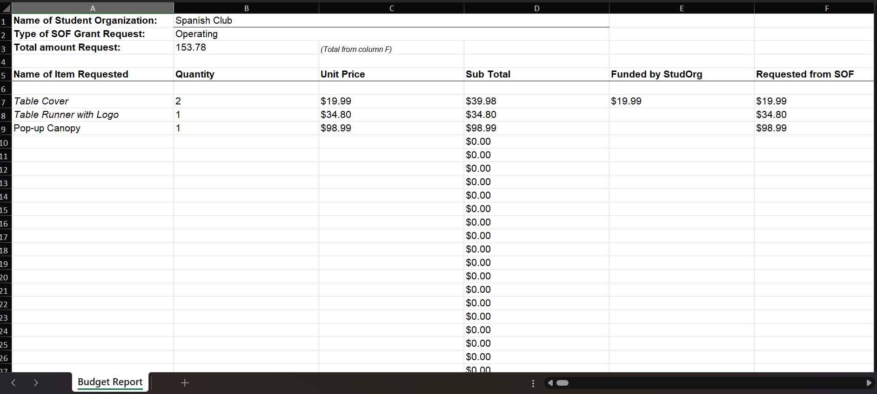
Budget

Slide 6
How will this impact our club?
The items being requested will directly support the mission of the Spanish Club by helping us create a visible, welcoming, and culturally engaging presence on campus. As a new student organization, we currently lack the essential materials needed to establish a consistent and recognizable presence at campus events and activities.

