Slide 1

GRAB A BUDDY & STUDY
Hosted by the Bakersfield Psychology Club

Slide 2


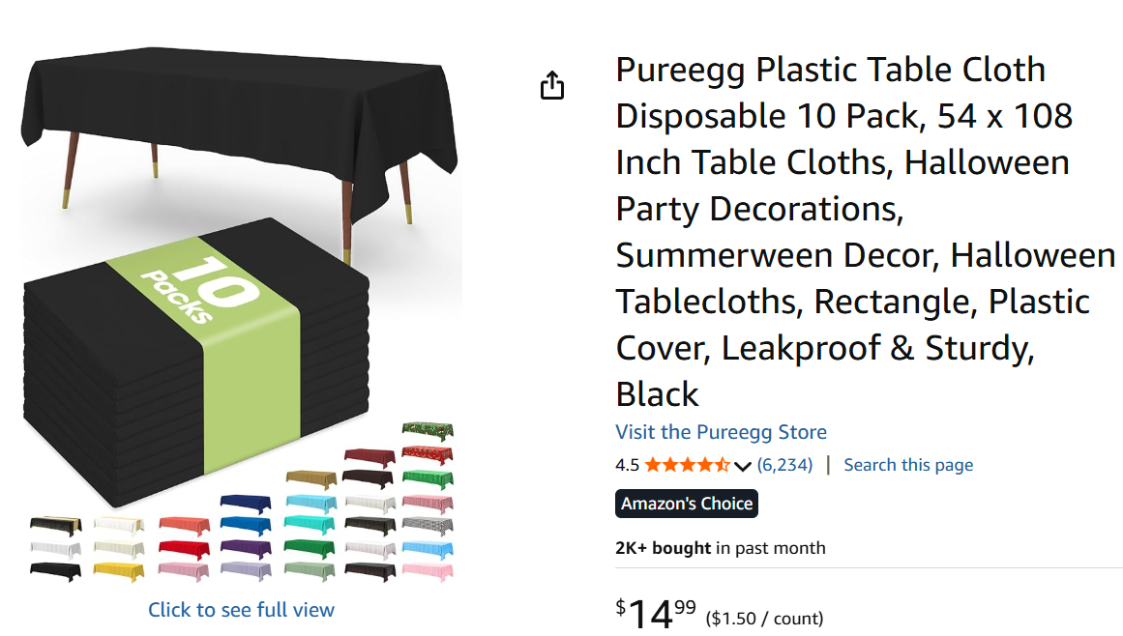
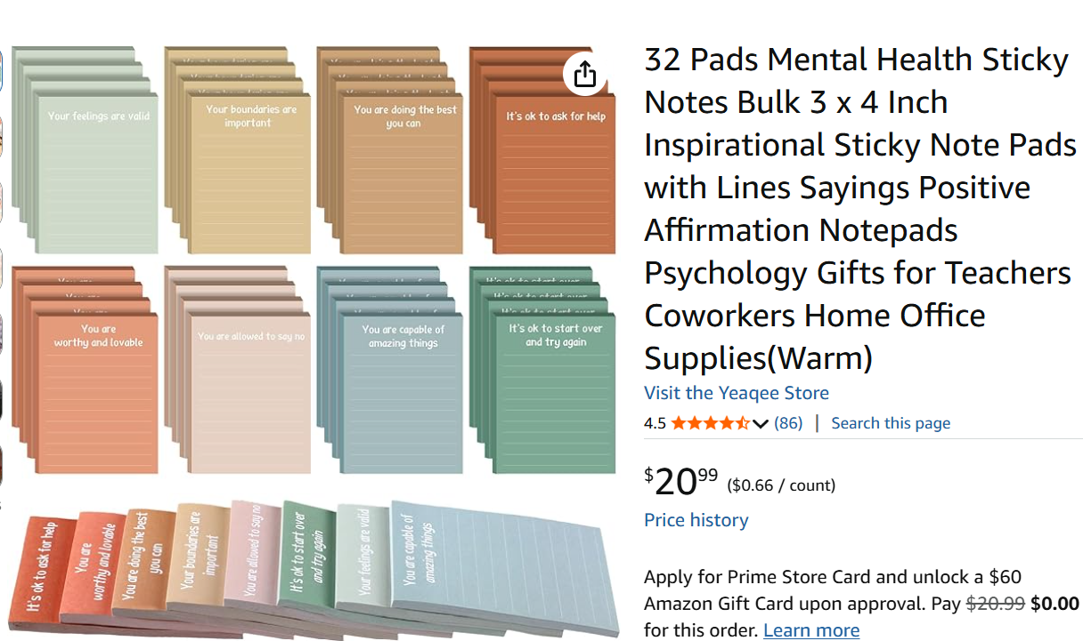
Items Needed for Event

Slide 3
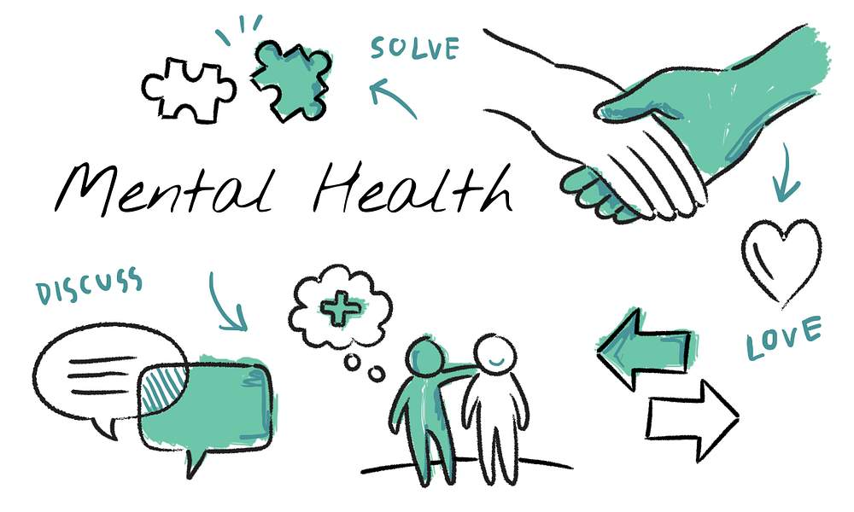
While also promoting Mental Health Awareness

Slide 4

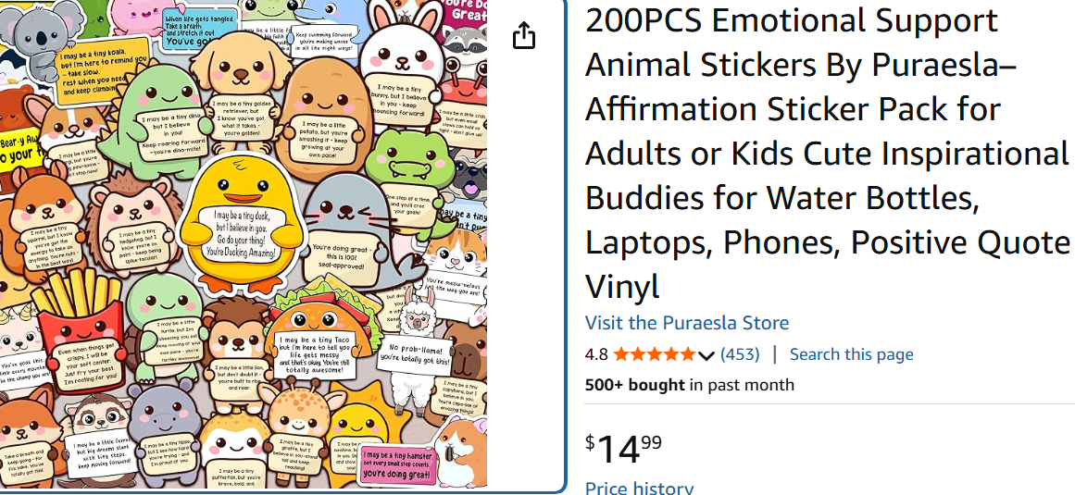
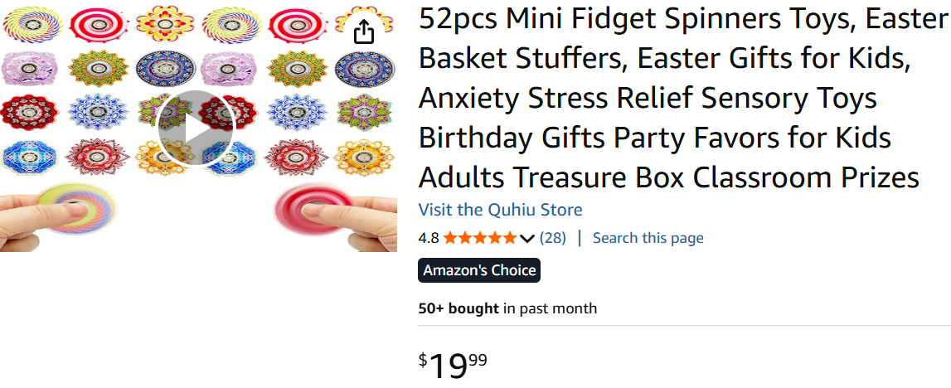
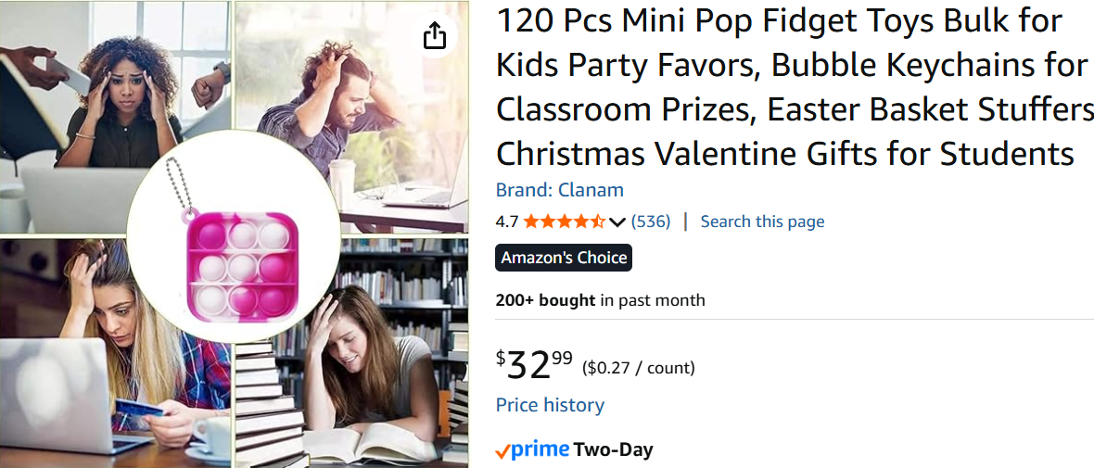
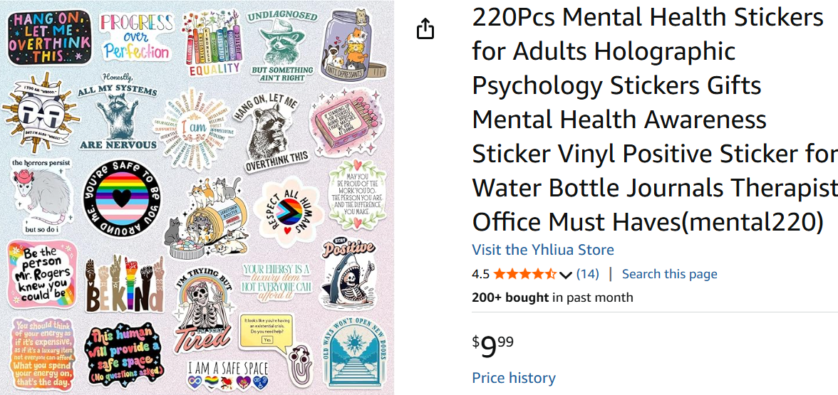
Items to promote Mental Health Awareness month
This Photo by Unknown Author is licensed under CC BY-SA

Slide 5

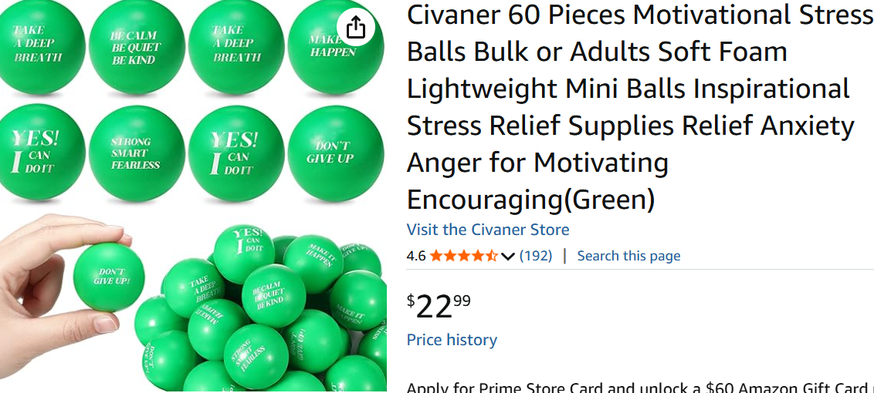

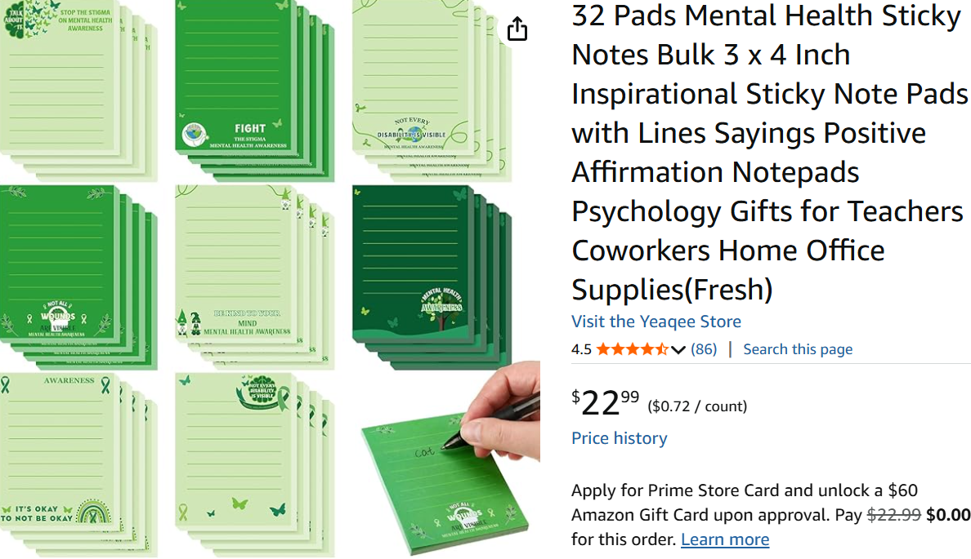
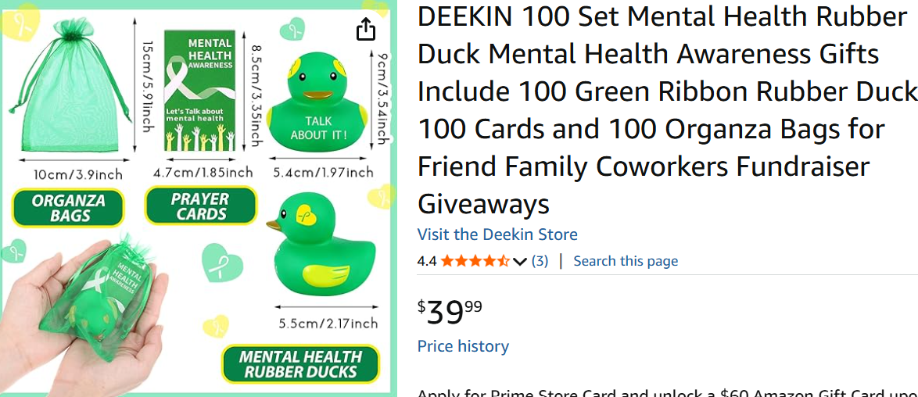
This Photo by Unknown Author is licensed under CC BY-NC

Slide 6
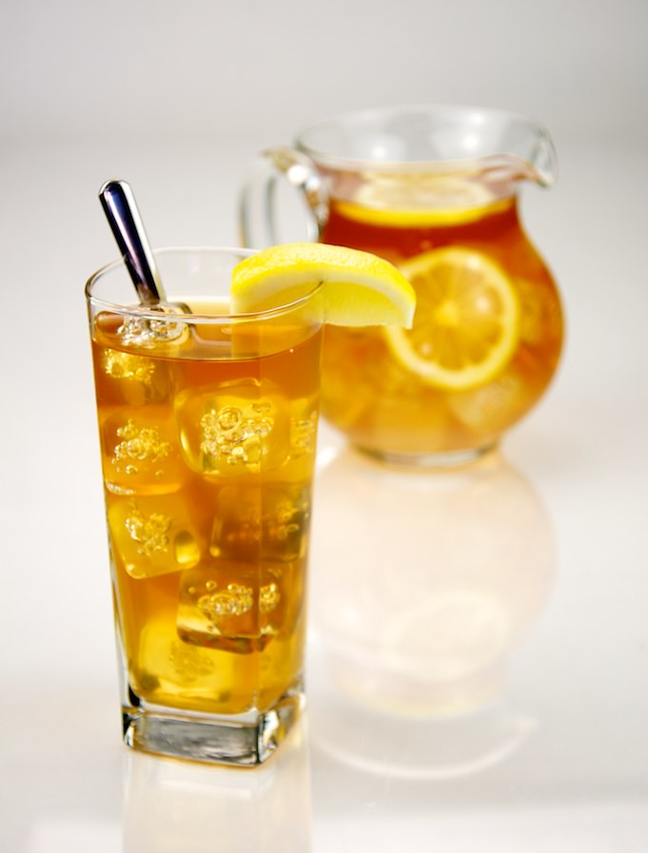
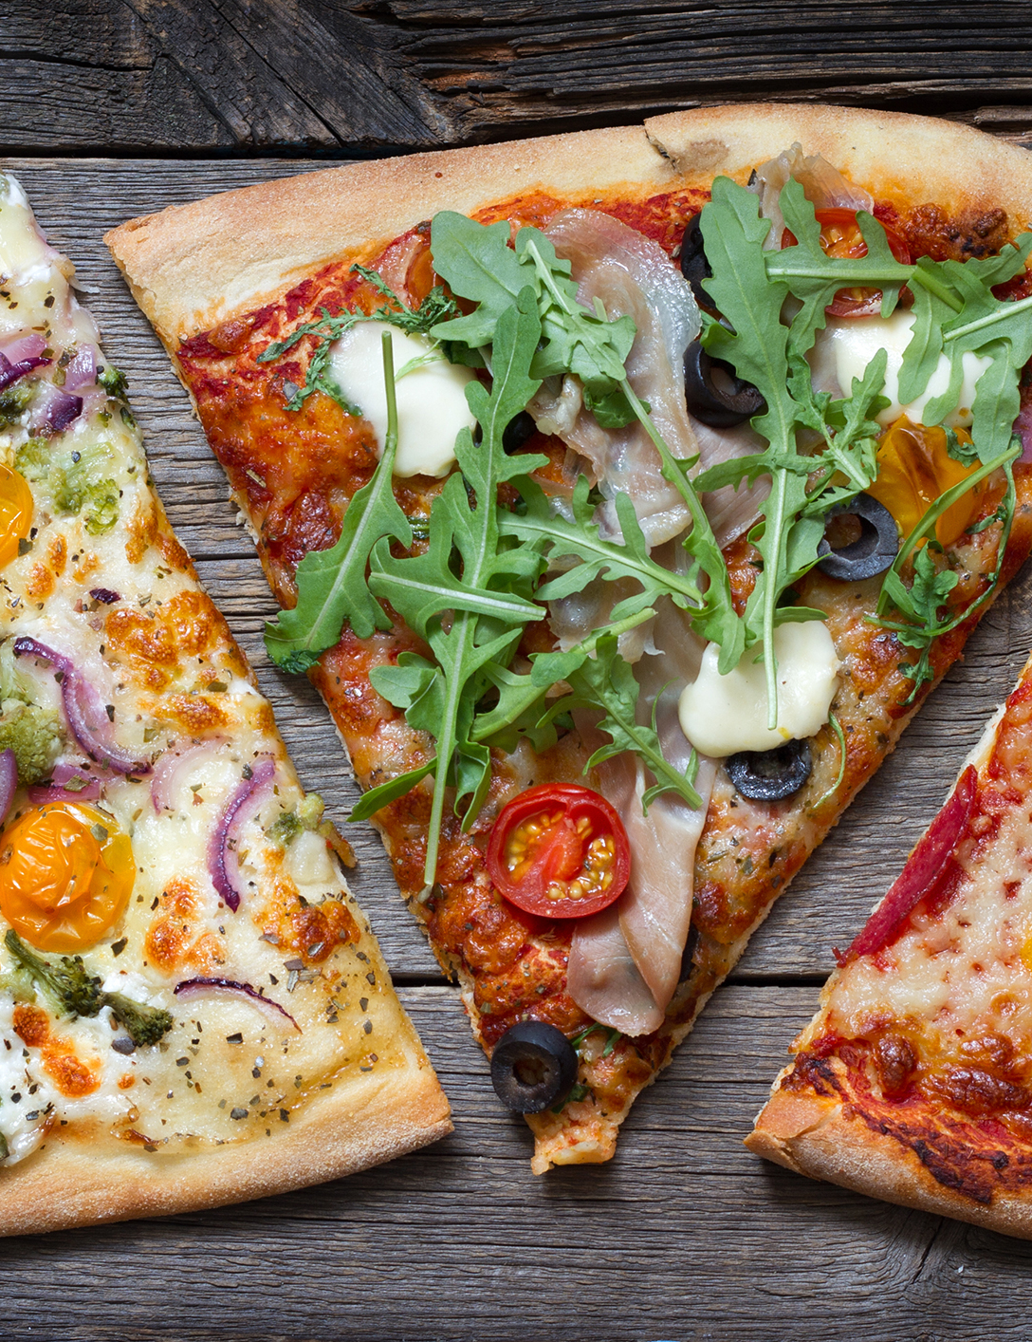
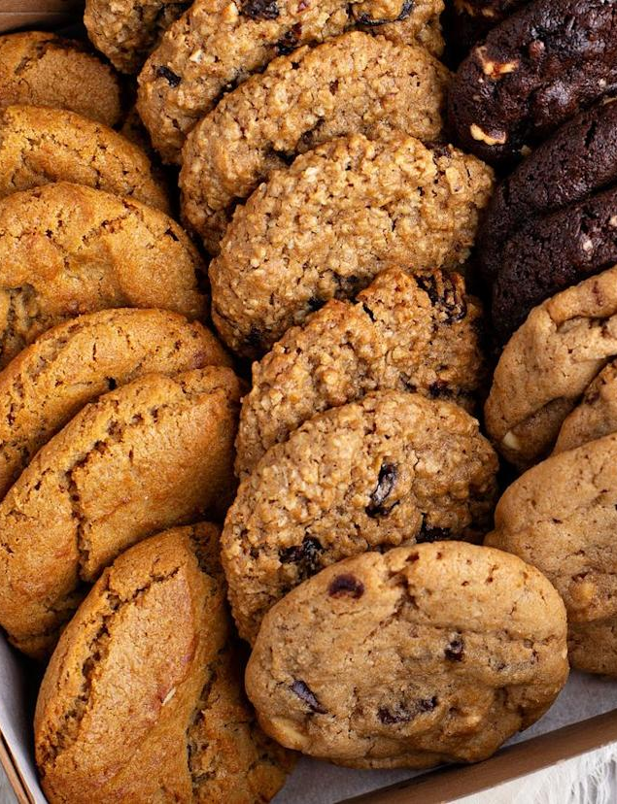

Food Items
This Photo by Unknown Author is licensed under CC BY
This Photo by Unknown Author is licensed under CC BY-NC-ND

Slide 7

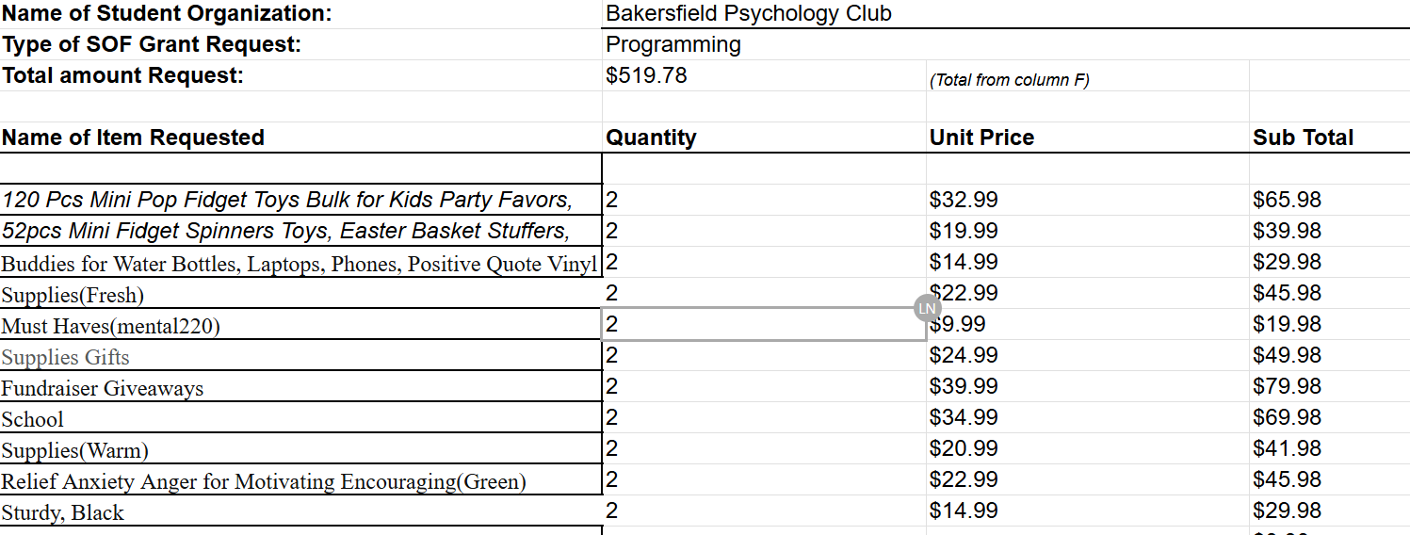
Total Merchandise Items

Slide 8

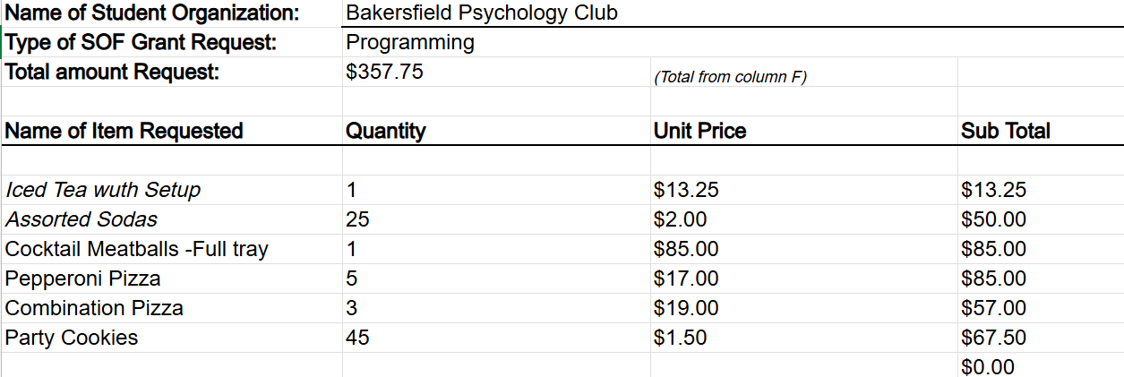

Total For Food Items

Slide 9

Thank You

