Slide 1




American sign language club
SOF Operating Grant

Slide 2


our mission
THE PURPOSE OF THE BAKERSFIELD COLLEGE ASL CLUB SHALL BE TO ENHANCE THE LEARNING EXPERIENCE OF ALL THE STUDENTS INVOLVED IN OR INTERESTED IN SIGN LANGUAGE. TO PROVIDE BOTH ASL AND DEAF STUDENTS WITH A WAY TO REPRESENT DEAF ISSUES AND FOSTER DEAF STUDENTS WITH A WAY TO REPRESENT DEAF ISSUES AND FOSTER DEAF AWARENESS THROUGH SUPPORT OF CAMPUS ACTIVITIES. TO PROVIDE PRACTICE OPPORTUNITIES AND INTERACTION WITH MEMBERS OF THE DEAF COMMUNITY. THUS ENCOURAGING PROFICIENT USE OF THE LANGUAGE AS WELL AS CULTIVATION APPRECIATION AND DEEP RESPECT FOR DEAF CULTURE.

Slide 3
approvals needed
  BCSGA Advisor and Dean of Students, Dr. Nicky Damaia
  ASL Club Advisor, Professor Jaclyn Krause
  ASL Club Co-Advisor, Professor Jerome Legaya
  ASL Club Executive Officers

Slide 4
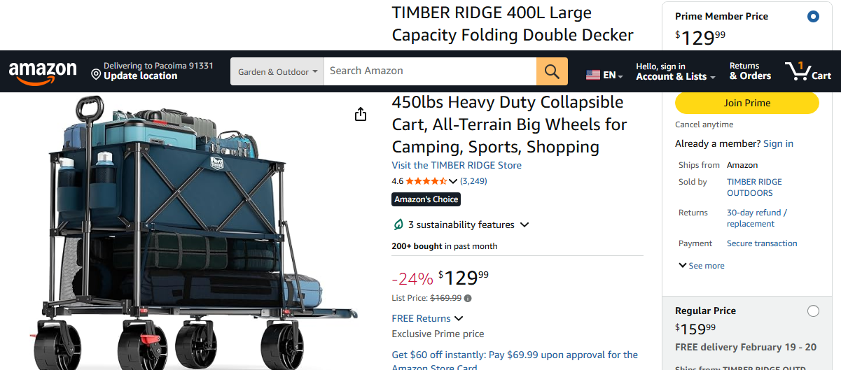
requested item:

Slide 5
Why we need it:
Keeping it really simple:
  Storage of the ASL Club supplies is in the Advisor’s Office on the second floor of the LA building
  transportation of supplies for tabling and to load/unload from vehicles
  better organization/consolidation of ASL Club supplies in Advisor’s Office
  Obvious piece of equipment that will support the needs of the club as it as now and it continues to grow

Slide 6
Thank You

