Slide 1


California Student Nurses Association (CSNA) Conference 2025
Student Nurses Association – Bakersfield College
November 14 – 16, San Diego California

Slide 2
About CSNA
The California Nursing Students’ Association (CNSA) exists to contribute to nursing education and support the highest quality healthcare.
CNSA does this by:
Providing programs reflecting current nursing issues
Encouraging student participation in community health & social issues
Promoting student leadership in education, legislation, and healthcare policy
Representing nursing students to consumers, institutions, and professional organizations

Slide 3
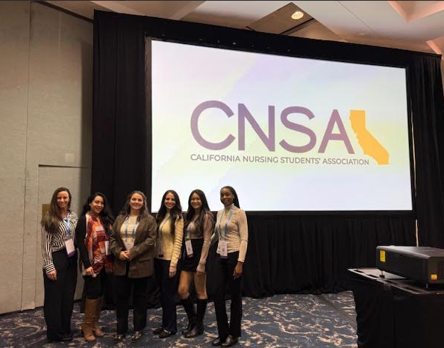

2024 Conference Highlights
Attended as part of Bakersfield College’s House of Delegates
Activities included:
Parliamentary briefings & credentialing of delegates
Review & voting on resolutions and amendments to CNSA bylaws
Candidate presentations and elections for Board of Directors
Four proposed amendments in 2024 included:
Adding a Table of Contents to bylaws
Updating CA law on remote communications
Revising eligibility requirements for service
Revising Board of Directors’ meeting structure

Slide 4
Impact for BC SNA
Empowered our students to:
Engage in parliamentary processes
Provide direct input on nursing education standards
Shape organizational policy affecting all CA nursing students
Strengthened leadership skills and professional confidence
Provides Bakersfield College nursing students with tools to further our educational and career goals

Slide 5
2025 CNSA Agenda
Hands-On Trainings – skills-based workshops with clinical nurse specialists
Career Readiness Workshops – led by hiring managers and recent graduates
Leadership & Governance – House of Delegates, resolutions, and bylaw review
Networking – statewide connections with peers, faculty, and nursing leaders

Slide 6
Bakersfield College Representation
BC SNA represented at state level by chapter president and delegates
Builds leadership credibility for our chapter within CNSA
Ensures BC’s student nurses have a direct voice in policy decisions
Strengthens our campus profile and supports Bakersfield College’s mission of student success
Leadership development at CNSA → directly benefits future BC nursing cohorts
Supports Bakersfield College’s commitment to professional readiness and community health leadership

