Slide 2
WELCOME TO
BCSGA

Slide 3
WHAT IS BCSGA?

Slide 4
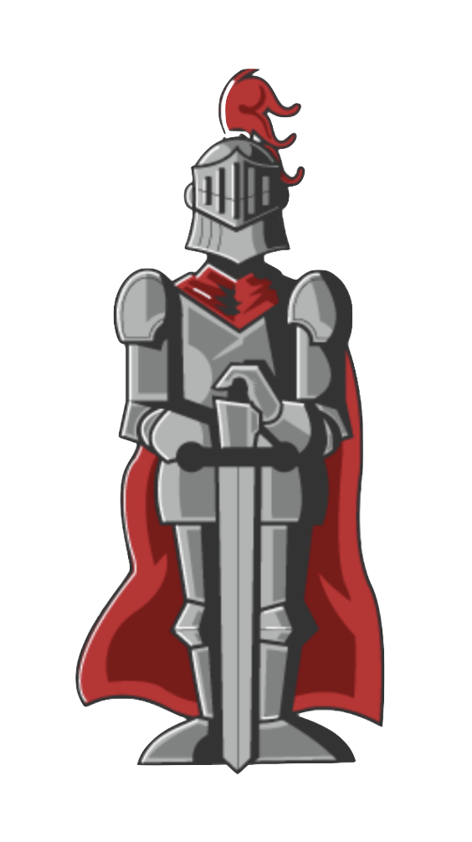
Bakersfield College Student Government Association (BCSGA) is your organization. The Association presents your opinions, needs and concerns to such groups as the College Council, the State Student California Community College (SSCCC) and many campus-wide and district-wide committees.

Slide 5
WHAT IS IMPORTANT
TO KNOW WITHIN
BCSGA?

Slide 6
Important to Know:
➔ COBRA
➔ Robert’s Rules of Order
➔ Brown Act
🤔
🤔

Slide 7
The purpose of the Codes of the Bakersfield Renegade Association (COBRA) is to provide a single, well-organized document that encloses all the established bylaws, codes, protocols, procedures, agreements, etc. of the Bakersfield College Student Government Associated (BCSGA) at Bakersfield College (BC) in Bakersfield, California.
COBRA 😰

Slide 8
Robert's Rules of Order is the standard set of rules first published in 1876 by Henry M. Robert to run orderly meetings with maximum fairness to all members.
Robert's Rules
of Order 🤯

Slide 9
The Ralph M. Brown Act (referred to as the “Brown Act”) is intended to provide public access to meetings of California local government agencies.
Brown Act 😵‍💫

Slide 10
WHERE DOES
EACH POSITION
IN BCSGA GO?

Slide 11
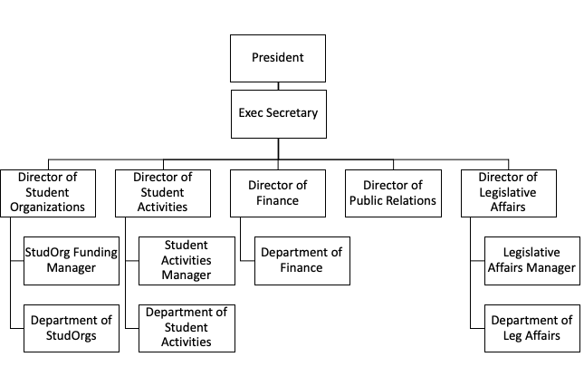
Executive Branch

Slide 12
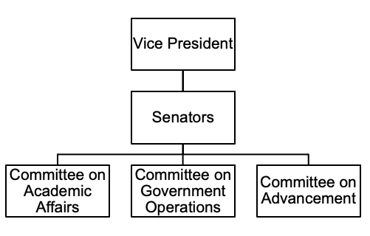
Legislative Branch

Slide 13
Student Senate of
California Community
Colleges (SSCCC)

Slide 14
Student Senate of California
Community Colleges (SSCCC)
The Student Senate for California Community Colleges works to promote and safeguard access for current and future students to California public higher education in accordance with the Master Plan for Higher Education through system participatory governance, legislative and policy advocacy, and regional support and development.

Slide 15
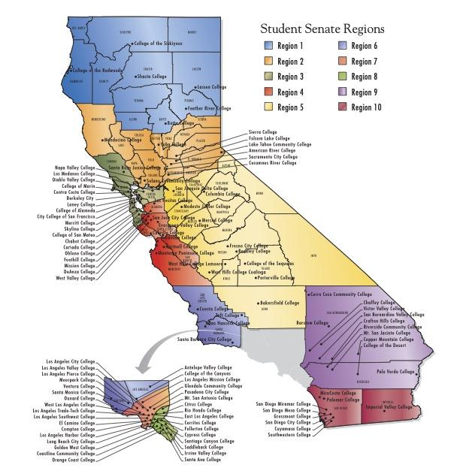
Map of SSCCC Regions
Map of SSCCC Regions

Slide 16
REGION V COLLEGES
Bakersfield College | Fresno City College | Porterville College
Cerro Coso College | Madera College | Reedley College
Clovis College | Merced College | West Hills College – Coalinga
College of Sequoias | Modesto Junior College | West Hills College – Lemoore

