Slide 1
Accreditation Visit
October 1st-4th

Slide 2
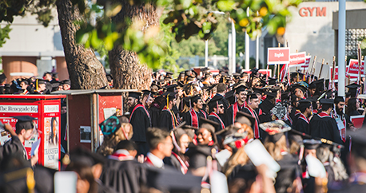
Discussion:
What is Accreditation?
How are we involved?
What should we expect?

Slide 3
What is the ISER?
The Institutional Self-Evaluation Report
It has the Accreditation standards that BC states they meet with evidence explaining how they meet it

Slide 4
How are we involved?
Discussion
What services do we provide the students?
What does SGA do for the students?

Slide 5
What you need to know before Accreditation
What your position entails
Departments/ Committees do
How we are funded

Slide 6
Overview of Departments
Department of Student Organizations (Director Lopez and Manager Caldwell)
Department of Student Activities (Director Hilbe)
Department of Legislative Affairs (Director Barraj and Manager Arias)
Department of Finance (Director Maddon)

Slide 7
Overview of Committees
Committee on Academic Affairs
Committee on Advancement
Committee on Government Operations

Slide 8
What should we expect?
11 people coming to make a site visit
Driving them around in the carts
Talking points
What has BC done for you?

Slide 9
Accreditation Team Roster

Slide 10
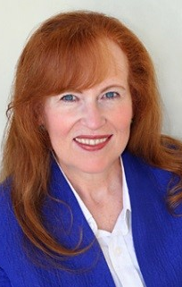
Dr. Kathleen Burke Chancellor, South Orange County Community College District
BC Accreditation team chair

Slide 11
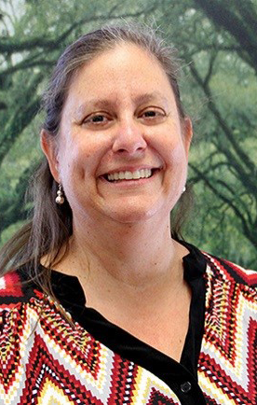
Sheri Berger Vice President of Academic Affairs Accreditation Liaison Officer Los Angeles Pierce College
Accreditation team assistant

Slide 12
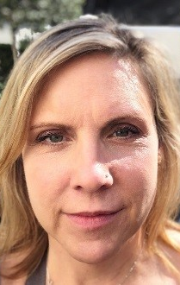
Ms. Cheryl Bailey Instruction Librarian Student Learning Outcomes Coordinator Irvine Valley College
Academic Representative

Slide 13
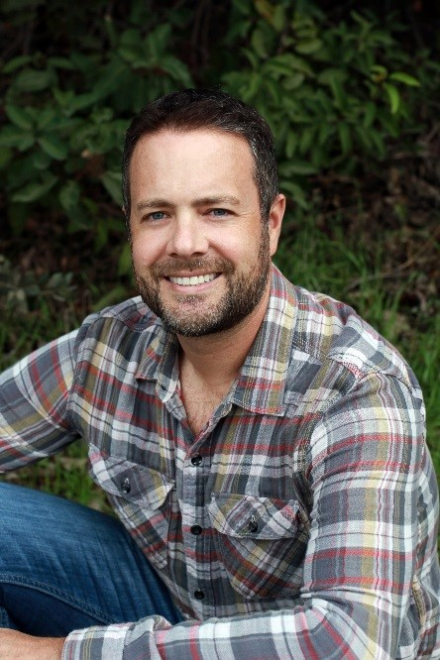
Mr. Michael Fino Dean Math and Sciences MiraCosta College
Academic Representative

Slide 14
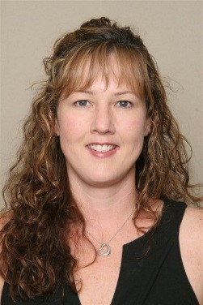
Ms. Elizabeth Romero Child Development Instructor Academic Senate President Clovis Community College
Academic Representative

Slide 15
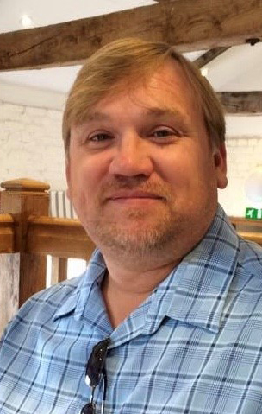
Dr. Duncan Sutton Director of Institutional Effectiveness and Strategic Planning Salvation Army College for Officer Training at Crestmont
Administrative REpresentatives

Slide 16
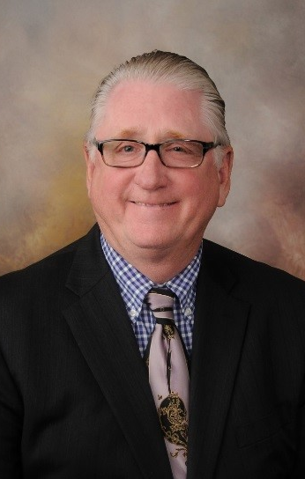
Mr. Ken Stoppenbrink Deputy Chancellor West Hills Community College District
Administrative Representative

Slide 17
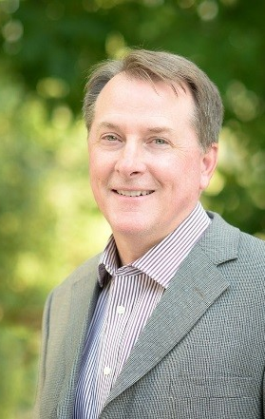
Mr. Dale van Dam Vice President of Instruction & ALO Reedley College
Administrative Representative

Slide 18
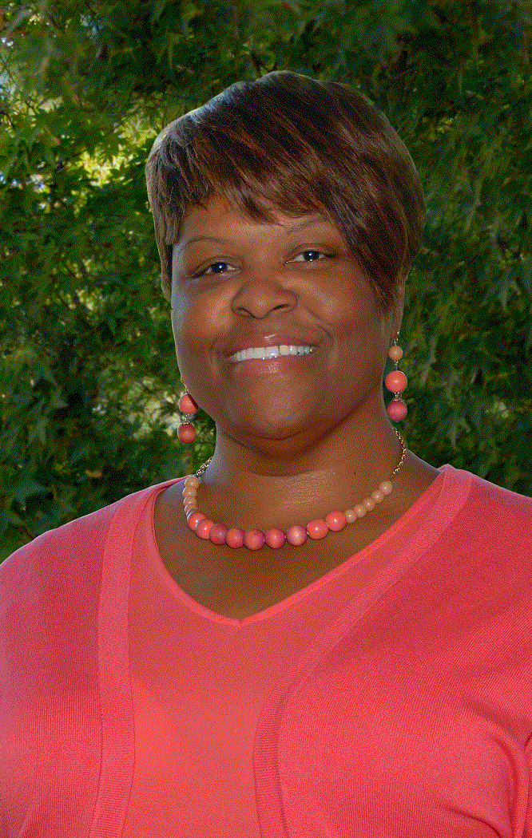
Dr. Lisa Cooper Wilkins Assistant Superintendent/Vice President of Student Services San Joaquin Delta College
Academic Representative

Slide 19
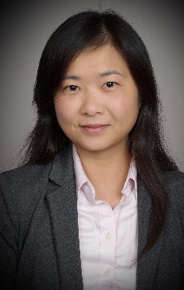
Dr. Mandy Liang Interim Associate Dean of Matriculation and Assessment City College of San Francisco
Academic Representative

Slide 20
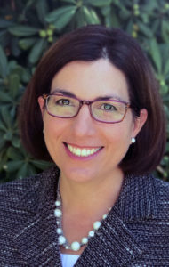
Ms. Gohar Momjian Vice President ACCJC
ACCJC Staff Liason

