Slide 1
KCCD I³ Immersion Innovation and Instruction Taskforce
Assessment Committee
Admin Co-Chair Report
Oct. 17, 2025

Slide 2
5-Year Goals
Identify priority uses of technology to enhance student learning.
Develop an implementation plan for identified technologies.
Document outcomes and student success.
Document expansion and efficacy of technology-enhanced teaching and learning.
Document outcomes and feedback.

Slide 3
Technologies
Immersion Virtual Reality
Augmented Reality
Gamification
Simulations
Artificial Intellegence – AI Tools

Slide 4
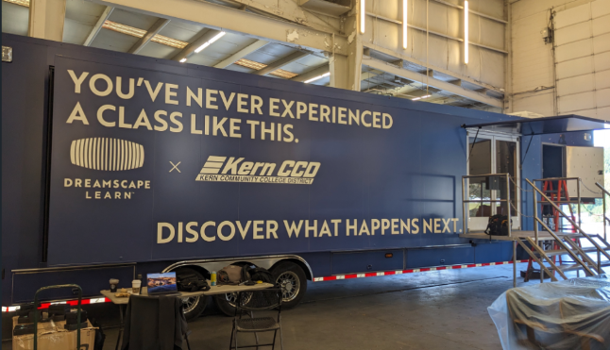
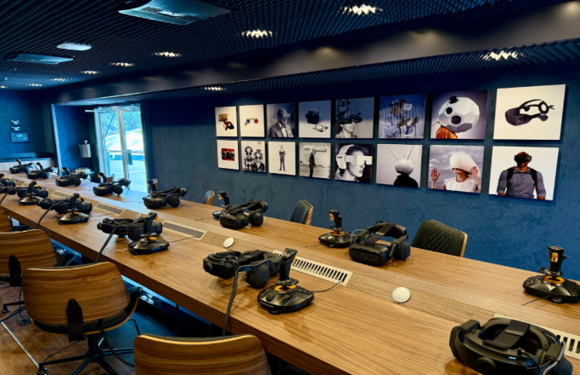
VR Technologies
Dreamscape Learn
16-seat towable van
Unity
BC Nursing VR Lab – MS-14
BC BS Industrial Automation

Slide 5


AI Tools and Training
District Chat GPT
Privacy protected logins
Training - https://forms.office.com/r/p0QPvz1hL5
CCCCO Gemini Partnership
No-cost access to Google Gemini for Education
https://blog.google/feed/ccc-gemini-partnership/
Canvas OpenAI Partnership
AI grading in Canvas
https://blog.google/feed/ccc-gemini-partnership/
Free access to Adobe FireFly
Playlab and Nekter AI

