Slide 1
SLOs Assessment Committee Summer Retreat May 24, 2016

Slide 2
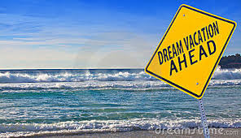
enroll now in Vacation Planning 101

Slide 4
SLOs
Upon successful completion of this course, students will be able to . . .

Slide 5
Define criteria for their desired vacation.
Examine websites for vacation information.
Construct a financially-viable vacation plan that meets the criteria for their desired vacation.

