Slide 1

Program Review
Budget Request
Budget Managers Training
Fall 2026

Slide 2
Annual Budget Cycle
BC Master Budget-Fiscal Calendar July 2026-June 2027
Budget Development
  GU001 Operating Budget
    Reorganization – Advise by May 1st for budget development upload
    New Department Budget Requests – Please discuss through chain of command
  Non-GU001 / Restricted Budgets-
    Will be Sent out on 12/08/26, due 1/25/2027
  Permanent Labor Budget for All Funds
  Board Dates
    Tentative Budget for June Board Approval- 6/28/2027
    Adopted Budget for September Board Approval
BC Program Review: Budget Managers Training
2

Slide 3
Program Review Process
Program Review Committee (PRC)
  Qualtrics
    Resource Requests DUE 8/31 – Permanent Labor (Management, Classified, and Faculty), one-time projects for M&O, IT, and professional development
    Report DUE 10/31 – Narrative
  Budget Requests
    Budget request excel spreadsheets are prepped by BC Budget Office
    PRC sends out to Budget Managers
    Budget Requests DUE 10/29 – Budget Managers coordinates requests from departments under their purview
BC Program Review: Budget Managers Training
3

Slide 4
Program Review Process – Resource Requests
Permanent Management / Classified Positions
Admin Structure Review prioritizes and recommends to President.
Permanent Faculty Positions
Faculty Chairs and Directors Council prioritizes and recommends to President.
M&O Projects
Facilities and Sustainability Committee prioritizes and recommends to President.
IT Projects
Technology Committee(pending approval) / TECH Committee prioritizes and recommends to President.
Professional Development
Professional Development Committee prioritizes and recommends to President.
BC Program Review: Budget Managers Training
4

Slide 5
Program Review Process – Budget Requests
Budget Managers
Complete and submit budget request forms to PRC
PRC
Collects the budget request form submittals and forwards to BC Budget Office
BC Budget Office
Reviews and consolidates for Executive review
Executive’s
Respective Executive reviews the files
VP of FAS review
Budget Office consolidates all budget files for VP of FAS review and final recommendations, as needed.
BC Program Review: Budget Managers Training
5

Slide 6
Program Review Budget Requests
GU001 Operating Budget
  Permeant Labor Accounts – (for transparency only)
    Accounts that are highlighted in green on your Program review budget request.
  Temporary Labor Accounts – See Temp Benefits Calculator tab
    1310, 1320, 1330 – Adjuncts, Intersession, Overload
    1340/1419 – Instructional / Non-Instructional Stipends
    2392/2411 – Non-Instructional / Instructional Student Workers (See Student Budget Request Tab)
    2394/2412 – Non-Instructional / Instructional Professional Experts
    2399 – Non-Instructional Temp Classifieds
BC Program Review: Budget Managers Training
6

Slide 7
Program Review Budget Requests
GU001 Operating Budget
  Non Labor Accounts – See Account Codes tab
    4000’s – Supplies and Materials
    5000’s – Services
    6000’s – Equipment / Capital Outlay
LR001 Restricted Lottery Tab – Instructional Supplies/Materials/Software
    Request all 4310 Inst Supplies & Materials and 5650 Software with instructional program code
BC Program Review: Budget Managers Training
6

Slide 8
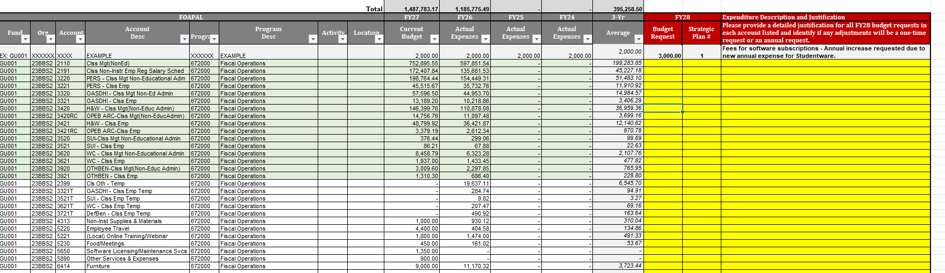
Program Review Budget Requests cont.
Review FY28 Program Review Budget Request
  EXAMPLE
BC Program Review: Budget Managers Training
7

Slide 9
Additional Information
50% Law
  Numerator
    11xx, 13xx, 22xx, or 24xx where program code is less then 500000 or 6110
    Account is a benefit account that ends in xx10 or xx10T where program code is less then 500000 or 6110
    3119 and 3919 where program code is less then 500000 or 6110
    515x where program code is less then 500000 or 6110
  Denominator – Non-Instructional Salaries/Benefits, Accounts in 4000’s, 5000’s
  Exclusions
      Accounts in 6000’s, Athletic Co-Curriculars, Student Transportation (Moving budget from 6000’s requires further discussion with Executive Team)
      Program Code greater then 680000
BC Program Review: Budget Managers Training
8
Notes:
Emphasize software includes renewals

Slide 10
Additional Information cont.
Funding Source | Purpose | Account Codes | Program Codes
General Unrestricted 50% Law GU001, CE, and IC’s | Numerator – Instructional Salaries/Benefits, Instructional Services Denominator – Numerator + All other expenses except exclusions Exclusions – New Capital Outlay, Equipment, Co-Curriculars, Student Transportation, Lottery Expenses | Numerator Faculty Teaching 11xx, 13xx Instructional Classified 22xx, 24xx Contract Education 5150 Exclusions Capital Outlay 6xxx (except 642x Exact Equipment Replacements) | Instructional 010100-499900 Non-Instructional 600xxx-67xxxx Exclusions 68xxxx-793xxx
Restricted Lottery LR001 | Instructional Supplies & Materials Software | Instructional Supplies & Materials 4310 Software 5650 Student Financial Aid 75xx | Instructional 010100-499900
BC Program Review: Budget Managers Training
9

Slide 11
Resources
BC Budget Office Website
  https://www.bakersfieldcollege.edu/about/administration/finance-and-administrative-services/budget.html
CCCCO
  50% Law
    https://www.cccco.edu/About-Us/Chancellors-Office/Divisions/College-Finance-and-Facilities-Planning/Fiscal-Standards-and-Accountability-Unit/Fifty-Percent-Law
BC Program Review: Budget Managers Training
10
Notes:
Emphasize software includes renewals

