Slide 1
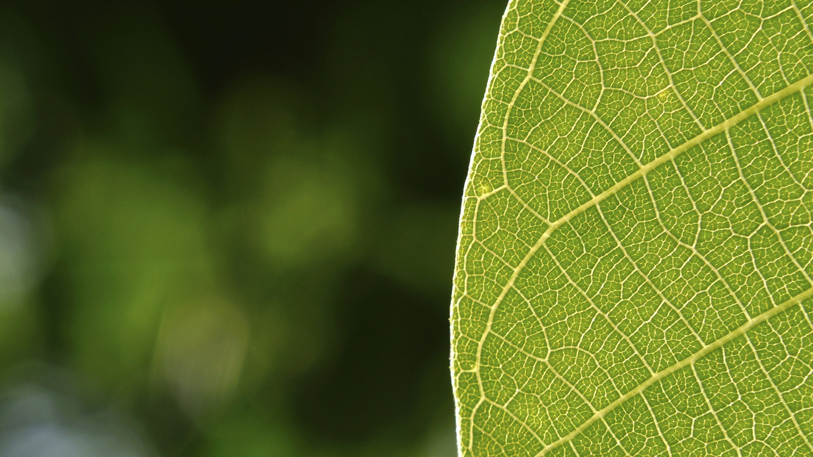

August 10, 2026
Marcos A. Rodriguez – MSci., MBA, PCA, QAL, CA, TRAQ, UCMG
Executive Director for Facilities & Operations

Slide 2

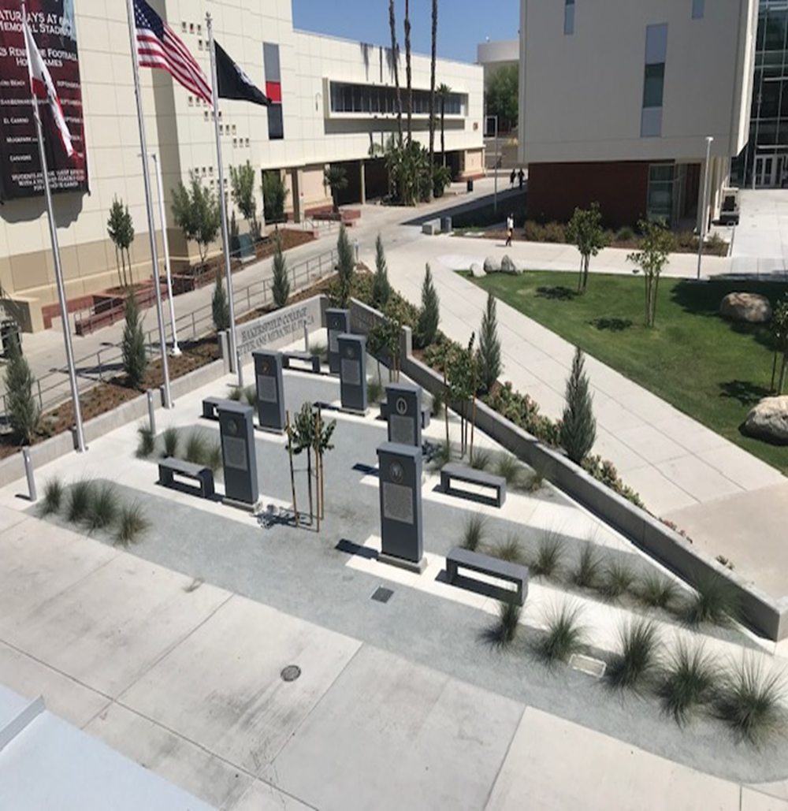
INTRODUCTION
What is Tree Campus
Higher Education?
The Standards
Reaching Campus
Forestry Goals

Slide 3

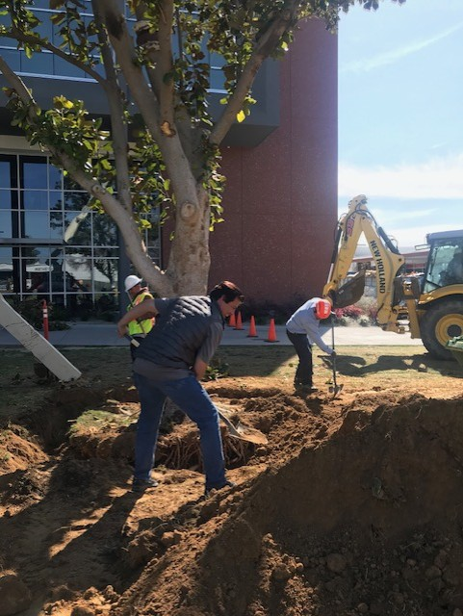
Modeled after
Tree City USA
Standards-based
Encourages best tree management practices

Slide 4
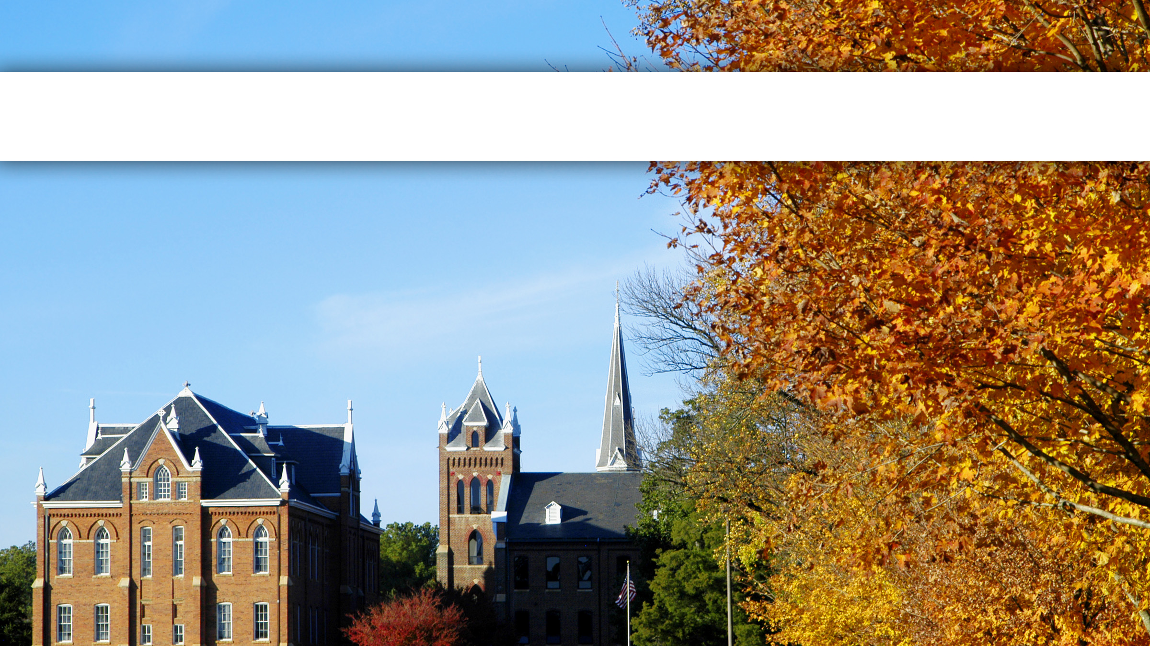
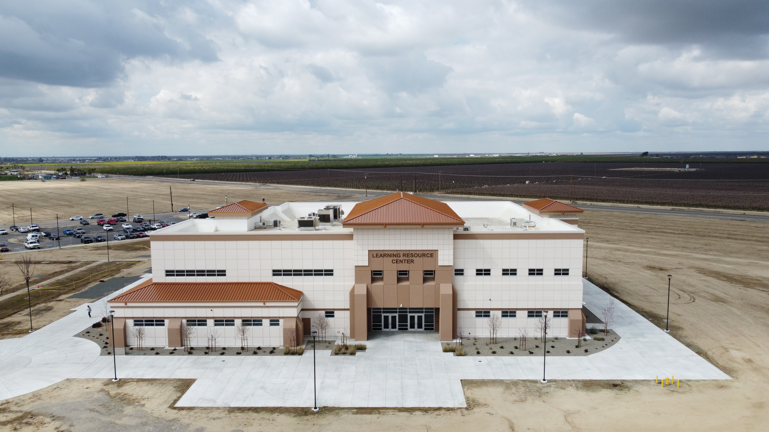

TREE CAMPUS HIGHER EDUCATION
Recognizing best practices in campus community forestry

Slide 5

TREE CAMPUS HIGHER EDUCATION STANDARDS
Campus Tree Advisory Committee
Campus Tree Care Plan
Dedicated Annual Expenditures
Arbor Day Observance
Service-Learning Project

Slide 6

WHY Does PARTICIPATE?
Our commitment to trees has significantly reduced the amount of energy on campus, and community, needs to generate.
Planting and maintaining trees has absorbed carbon dioxide in the atmosphere, mitigating the effects of climate change.
Green space provides important mental health benefits to students, faculty, staff, and community as well as encourages physical activity.
Involving students in tree-related service-learning projects helps educate the next generation about the importance of caring for the environment.

Slide 7
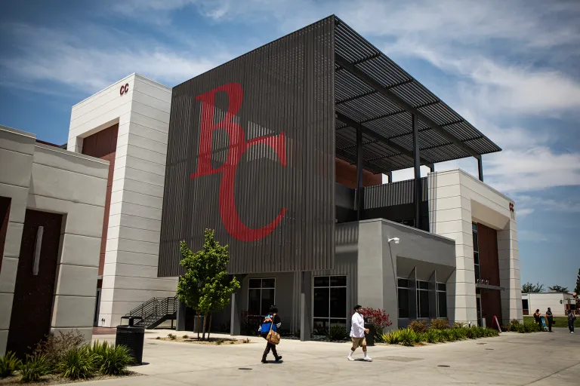
WHAT WE’VE DONE
Spread the word
Tree Advocates
Community Engagement
Planned Arbor Day Observances
and/or Service-Learning Projects

Slide 8
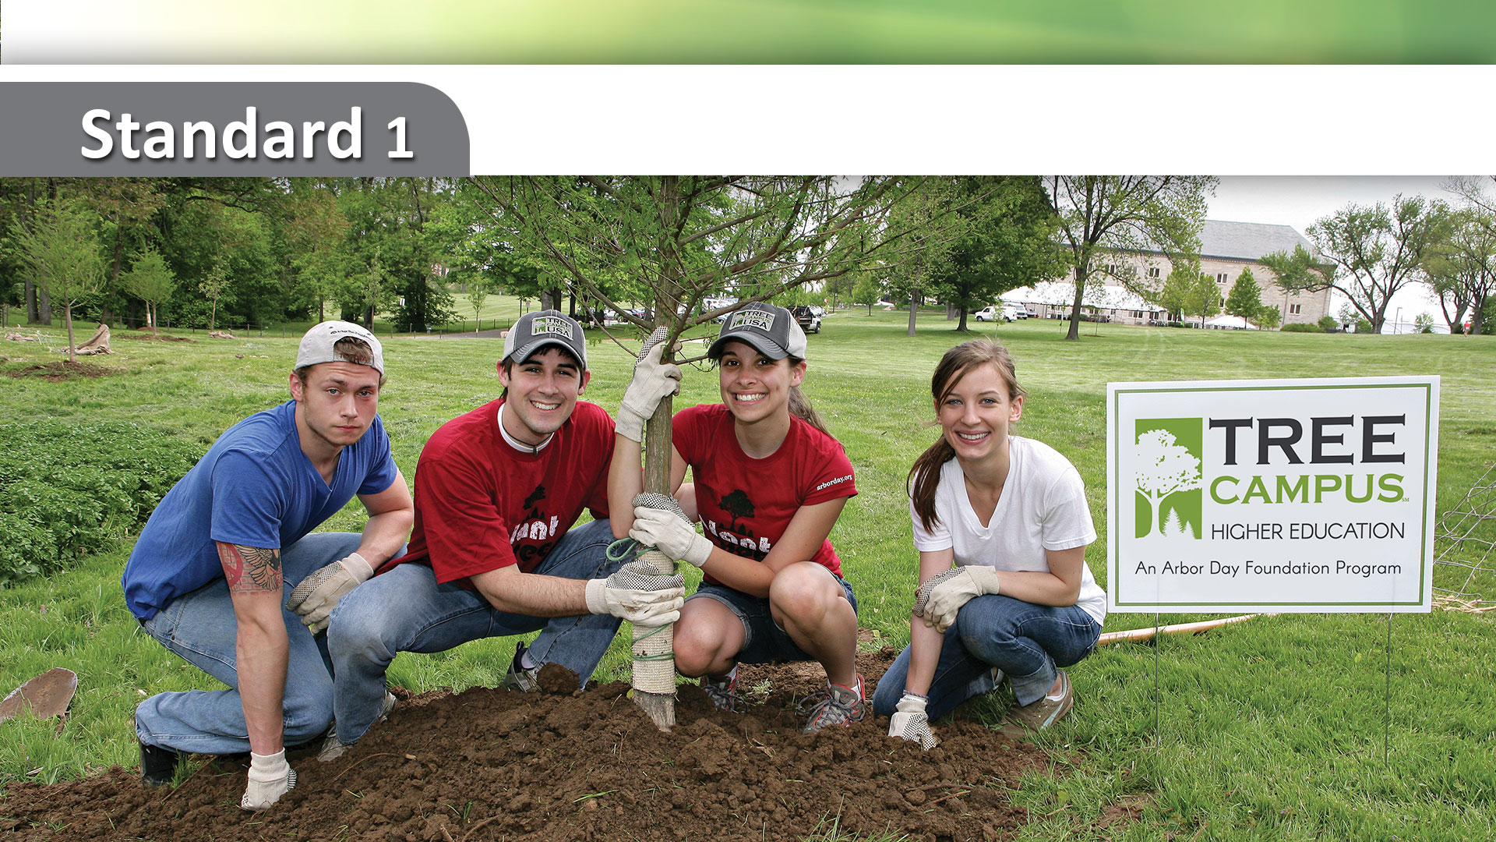
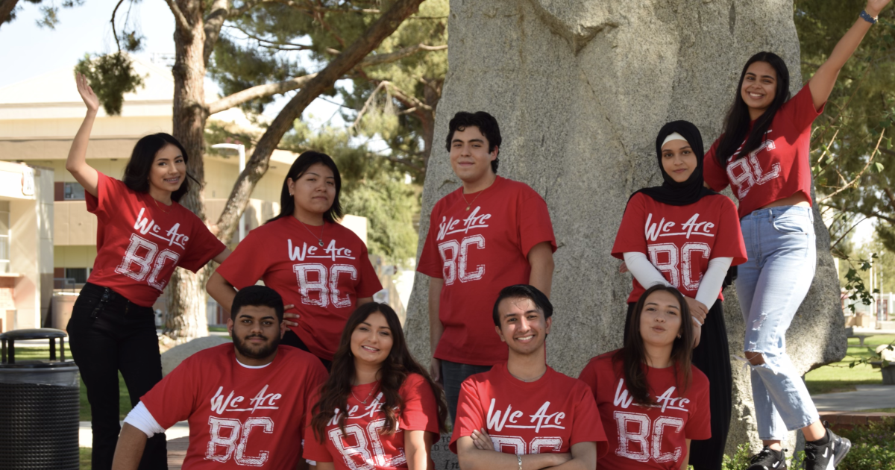
Campus Tree Advisory Committee

Slide 9
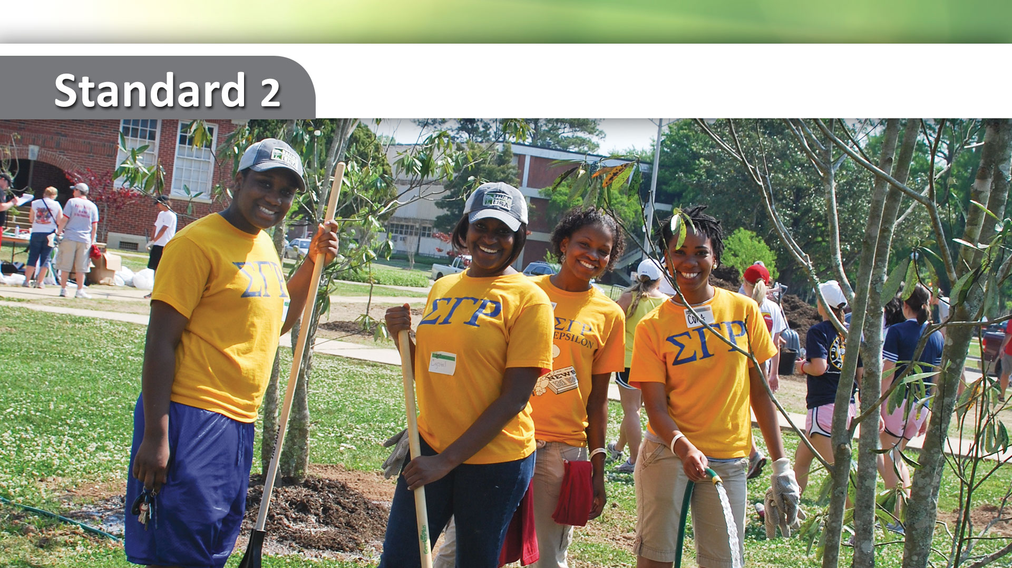
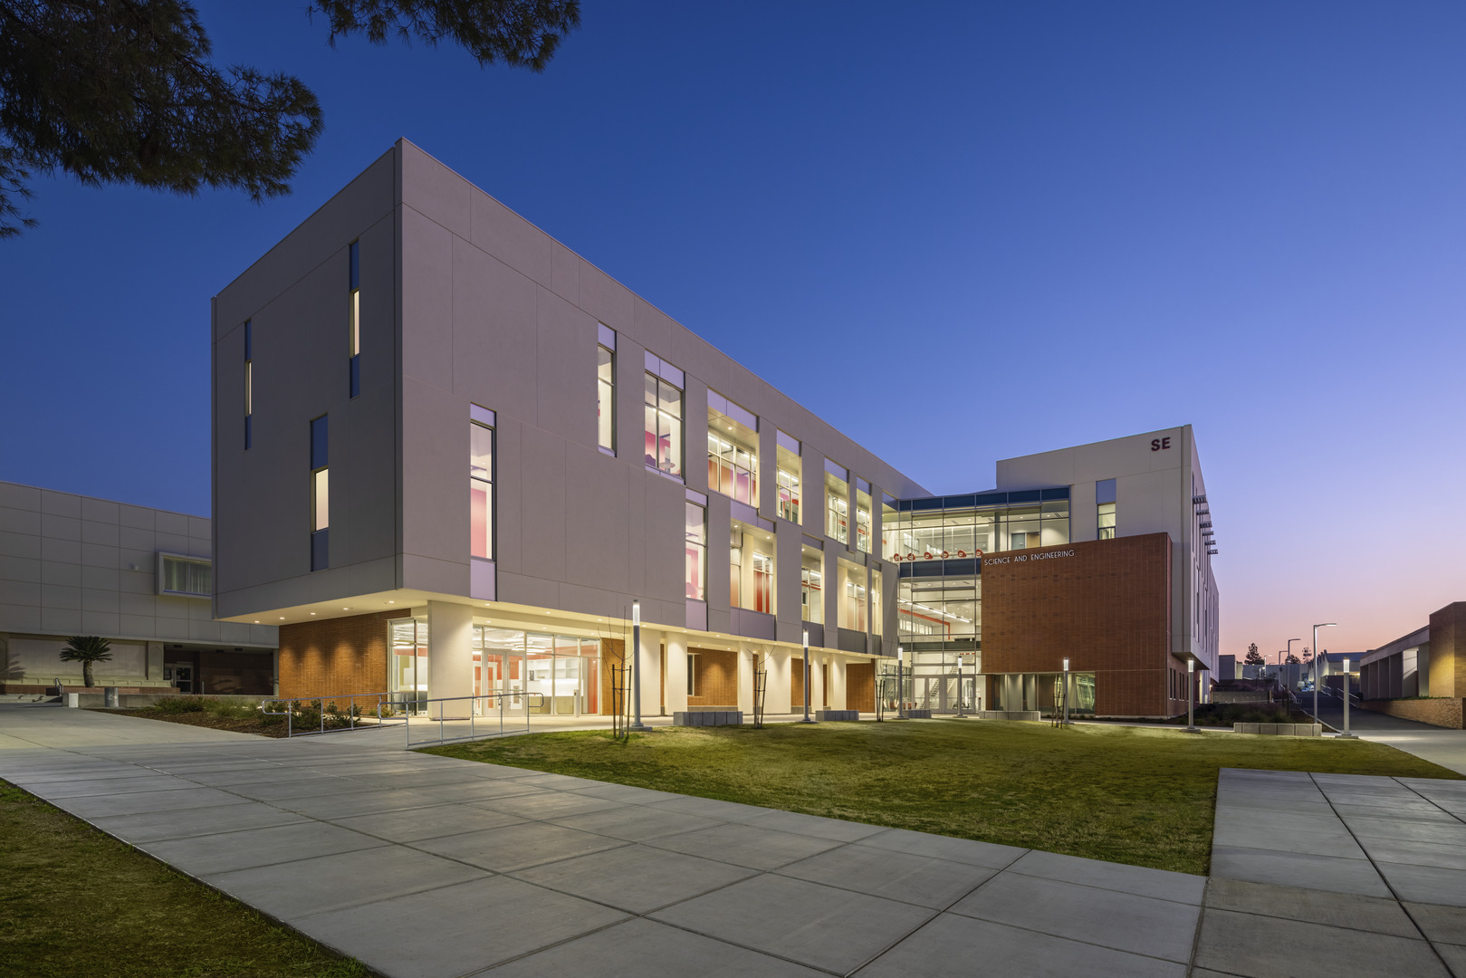
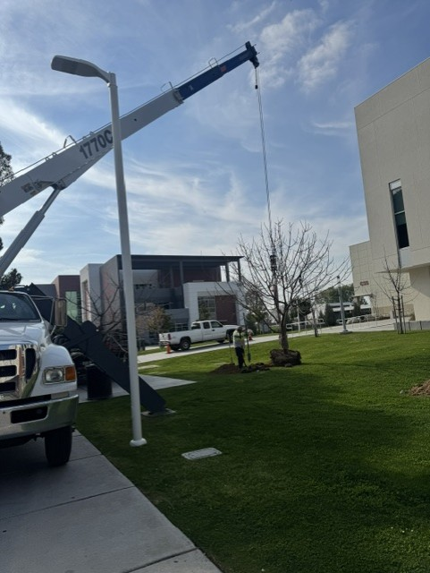
Campus Tree Care Plan

Slide 10
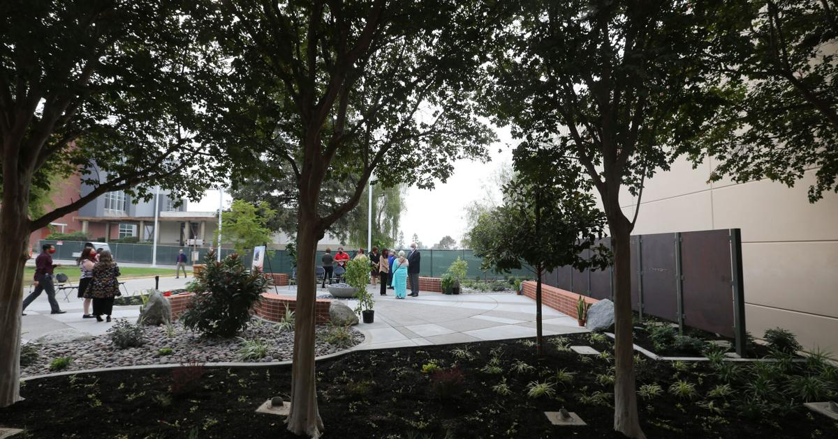
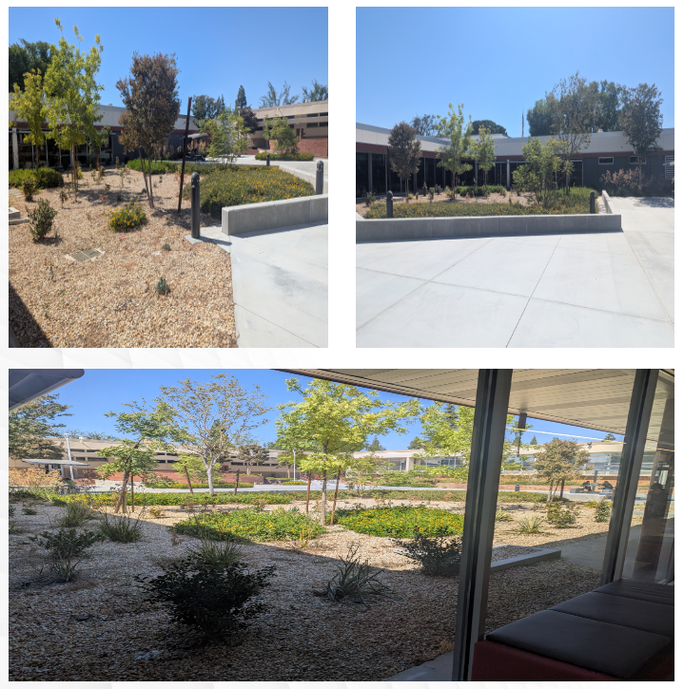
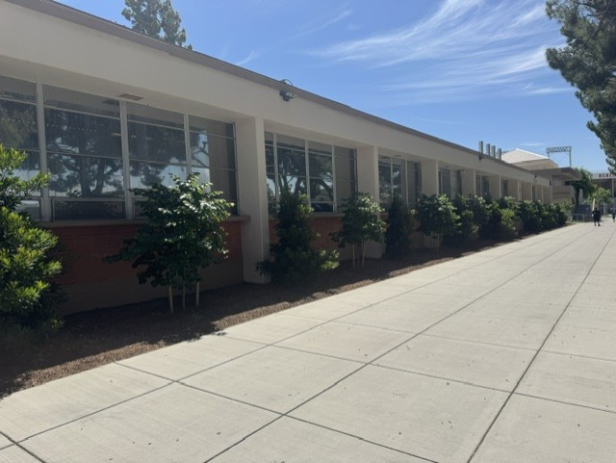

Slide 11
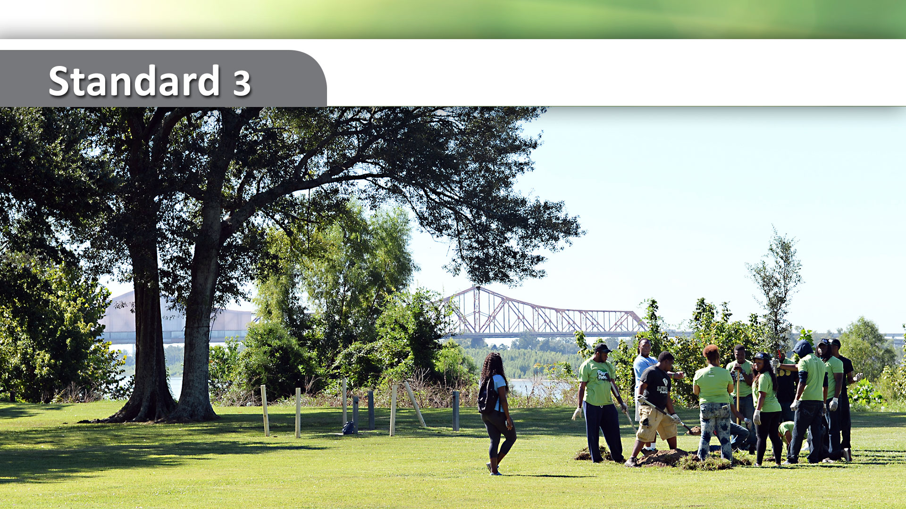
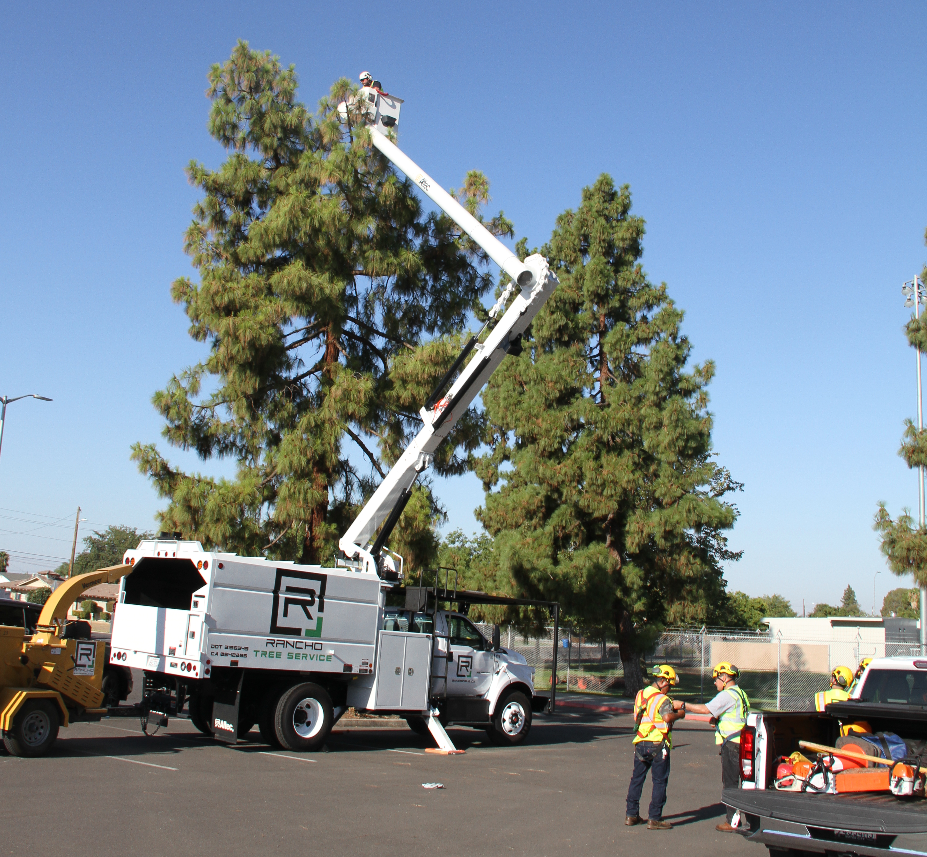
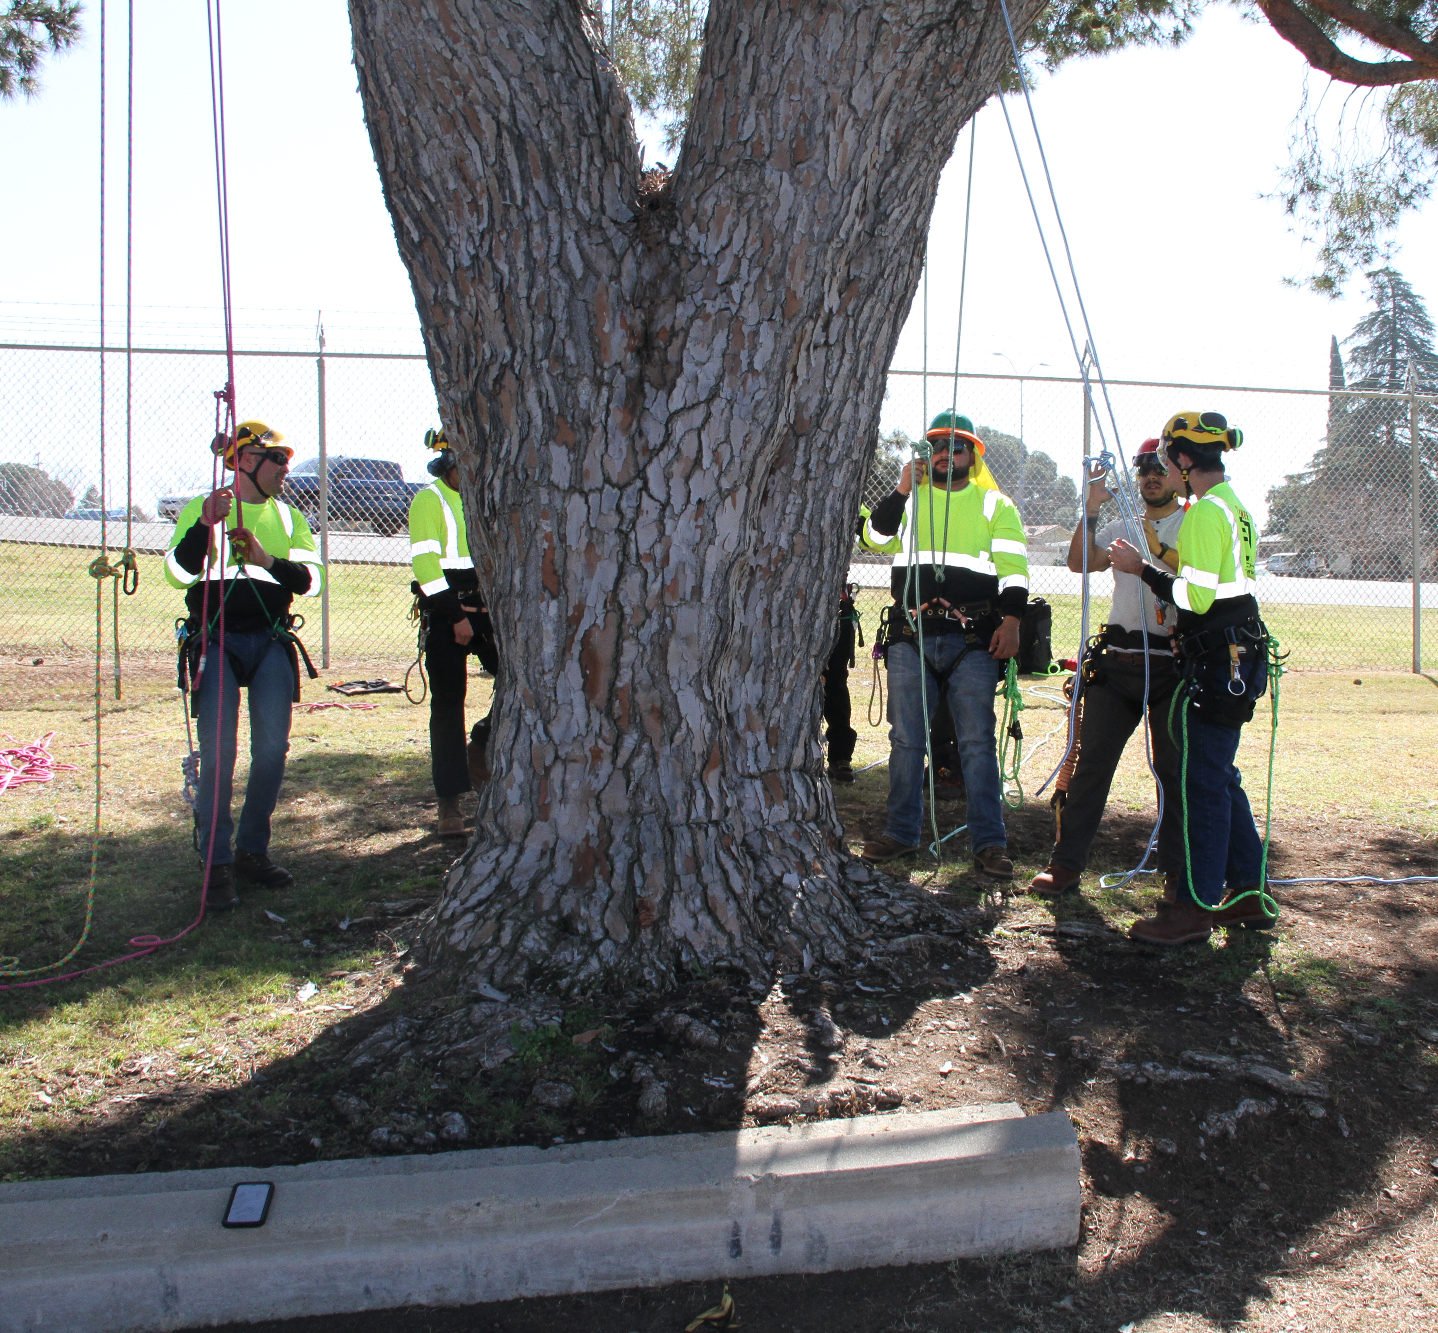
Dedicated Annual Expenditures

Slide 12

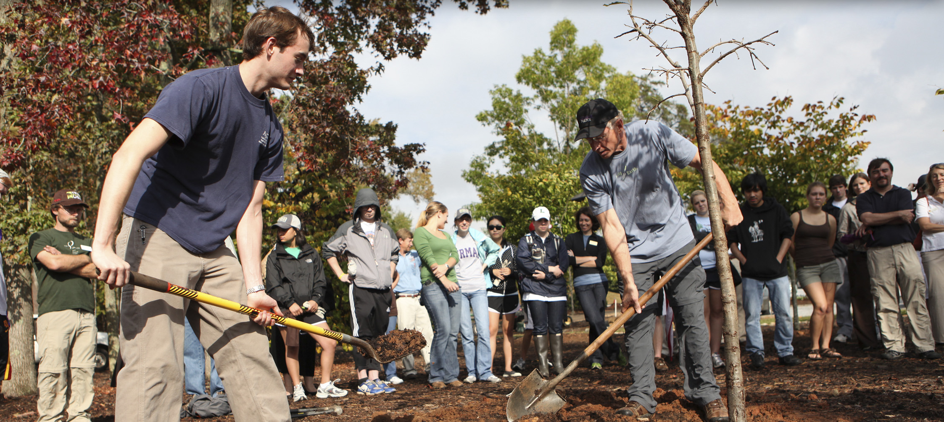
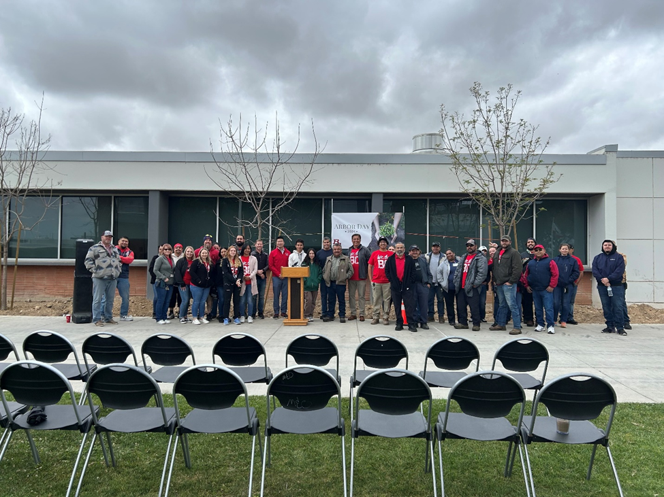
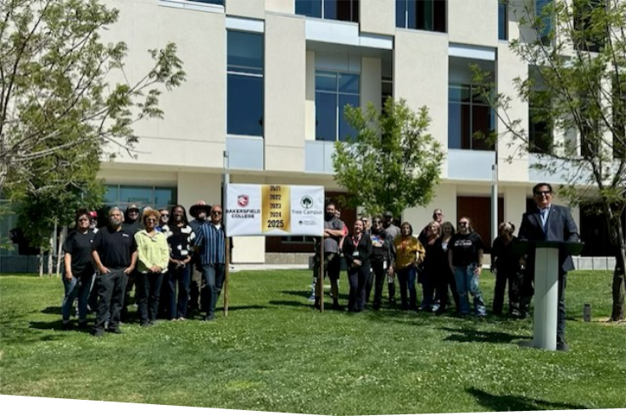
Arbor Day Observance

Slide 13
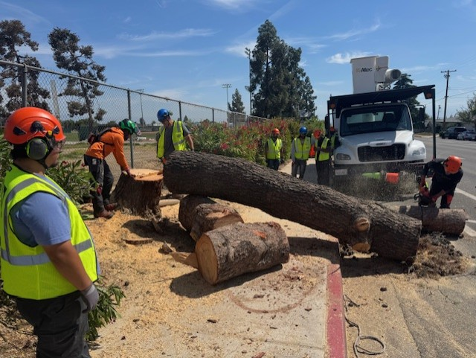
Service-Learning Project
STANDARD 5

Slide 14
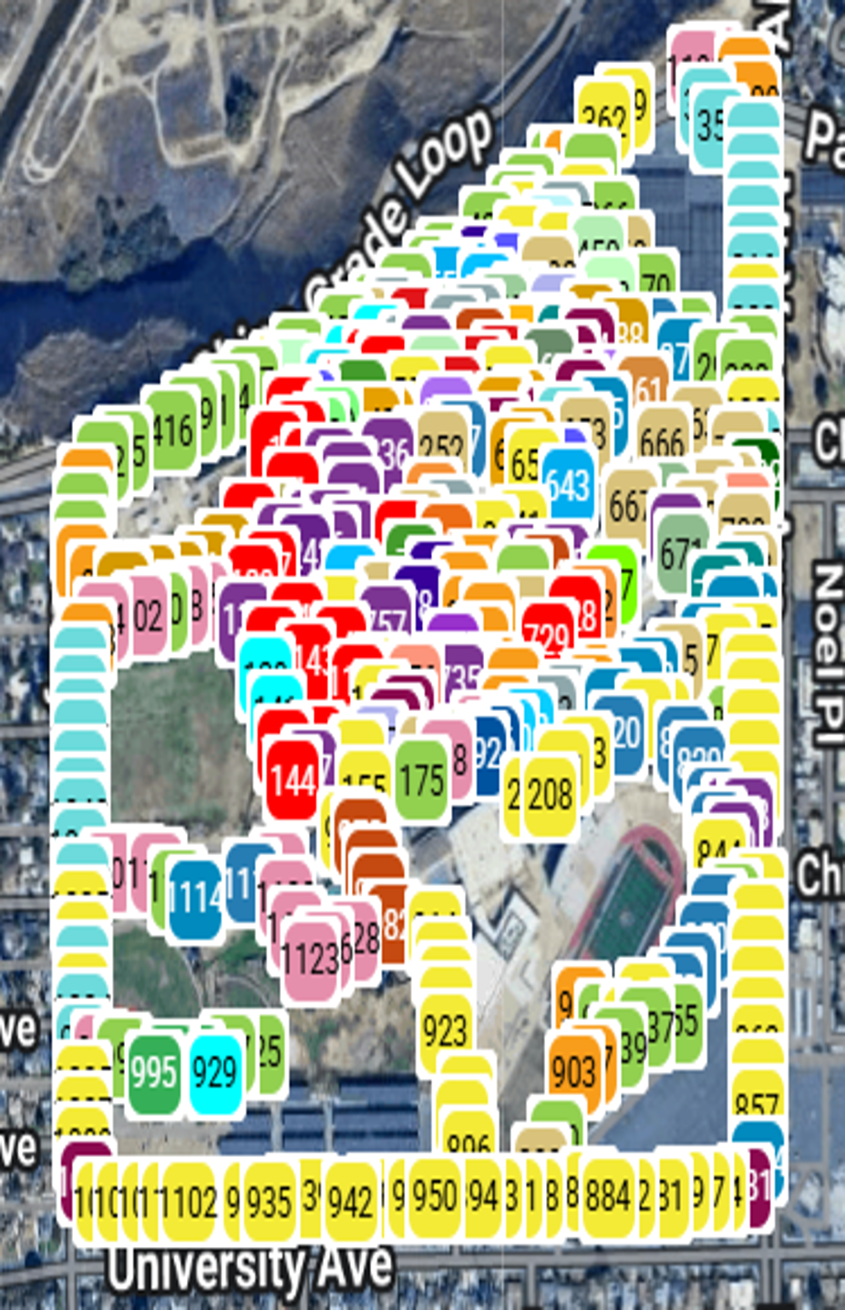
The Results
Educate people on trees
Tree care initiatives
Stewardship and volunteer opportunities on campus
or in the community

Slide 15

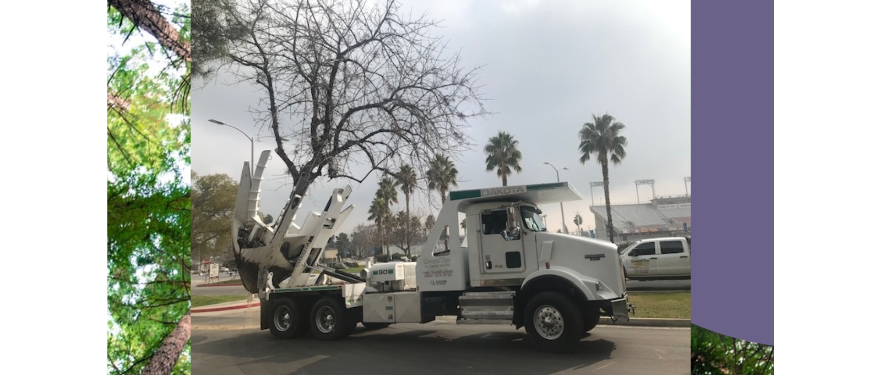
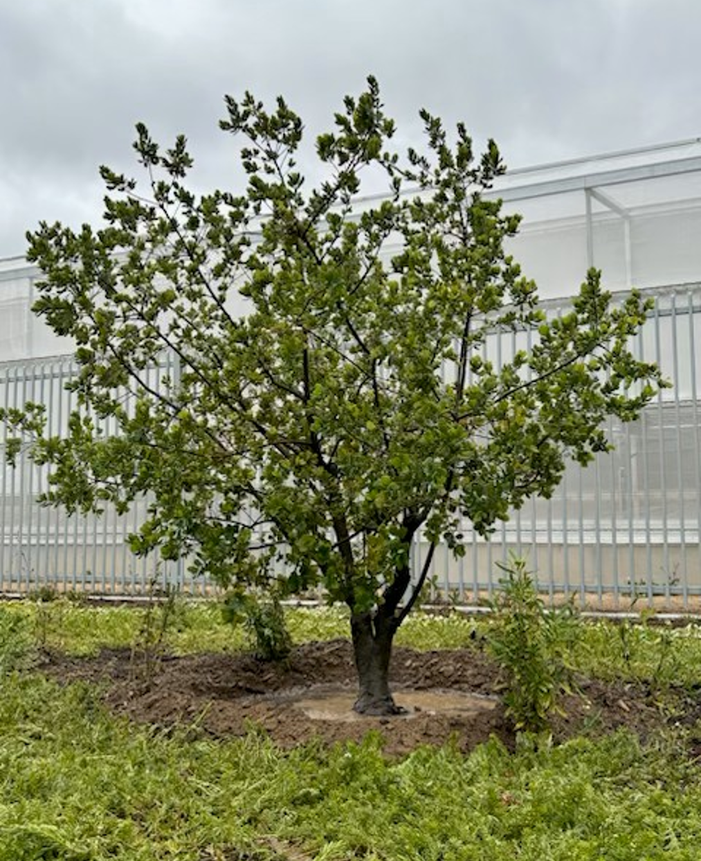
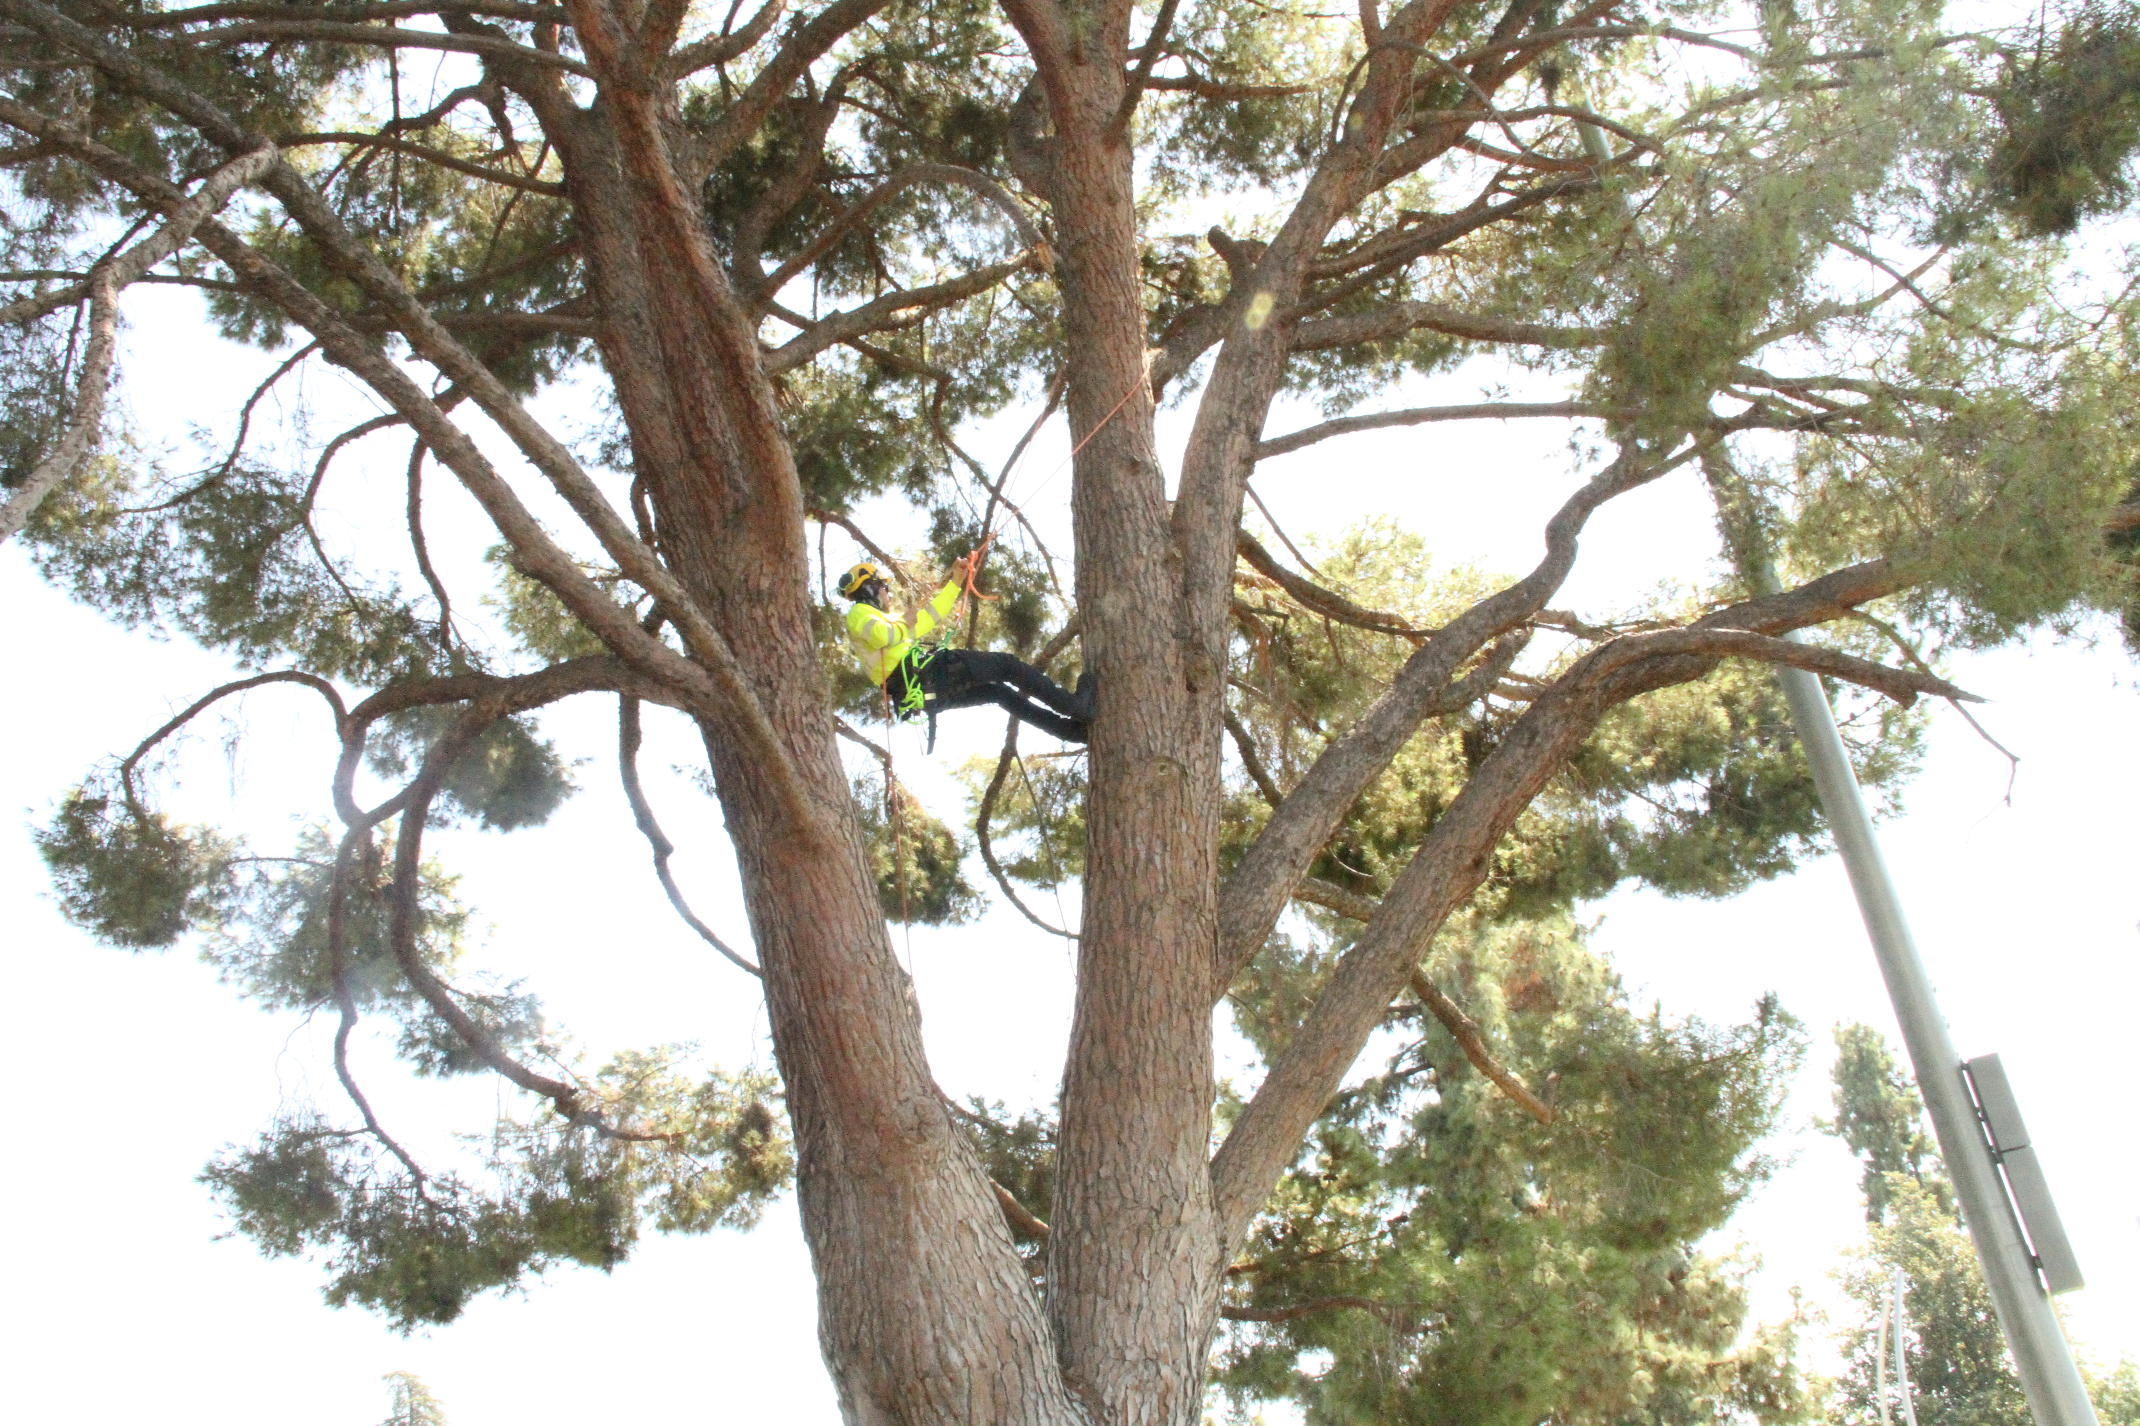

Tree Related Activities In Our Urban Forest
Eight Utility Arborist Classes
Four Tree ID Classes
Three Tree Care Seminars
One ISA TRAQ Certification Course
Four ISA Arborist Certification Classes with TFOK
Tree Plantings
Tree Classes
Future Recognition
Recognition
Trees Planted Since 2021 - 655
Transplanted Trees (Spaded/Craned/Dug) - 85
Arvin – 110 & BCSW – 150
Delano – 80 & Panorama - 1675
Total BC Tree Inventory – 2015/10.39 per acre
Recognized May 2023

Slide 16

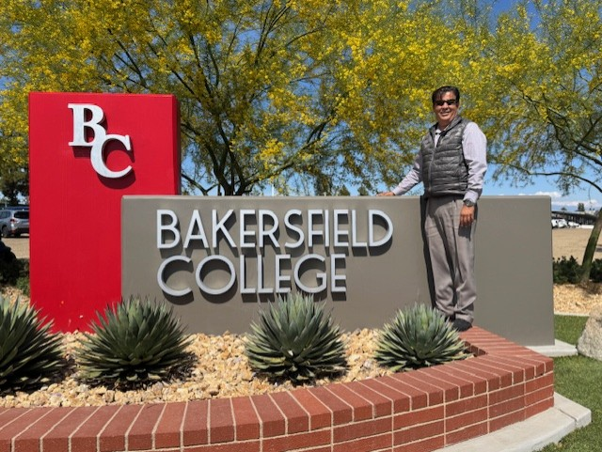
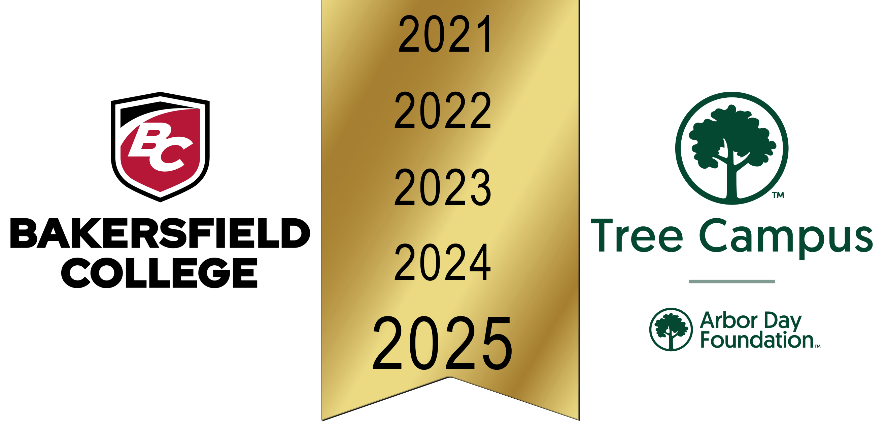
Questions?
Thank You!

Slide 17
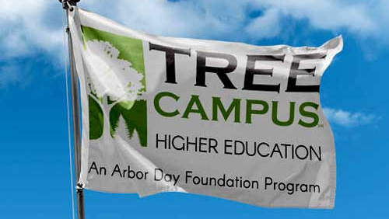
Other 2025 California Recognized Campuses
Cal Poly Humbolt
2 Years
CSU Northridge
12 Years
CSU San Bernadino
10 Years
CSU Bakersfield
3 Years
CSU San Marcos
2 Years
CSU Dominguez Hills
8 Years
LA Valley College
15 Years
Mount San Antonio College
4 Years
Riverside Community College
3 Years
Sonoma State University
1 Year
Santa Clara University
8 Years
University of California, Irvine
16 Years
University of California, Riverside
5 Years
University of California. Davis
16 Years
University of Southern California
3 Years

Slide 18
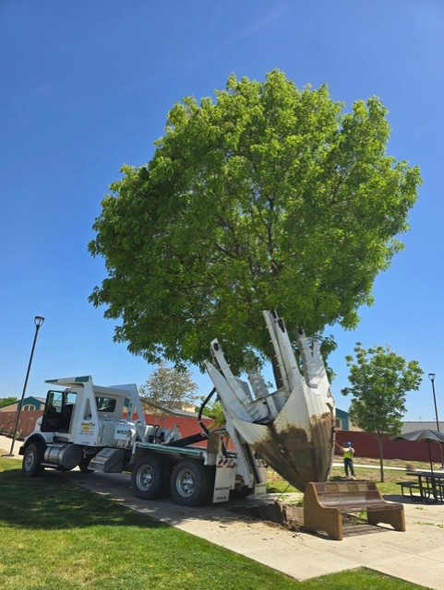
Questions?
Thank You!

