Slide 1

ADMIN COUNCIL
Welcoming the
Fall 2026 Class
New Student Convocation through Welcome Weeks
August 2026
A coordinated campus welcome builds confidence, connection, and belonging.

Slide 2
FALL 2026 STUDENT WELCOME
This is a campus-wide welcome, not a single event
Students experience one Bakersfield College. Our collective role is to make the first connection clear, warm, and useful.
01
02
03
04
PROMOTE
PREPARE
PARTICIPATE
REFER
Share dates and encourage students to attend.
Make sure teams can answer basic questions and give directions.
Support assigned staff and department involvement.
Connect students to the right office without unnecessary handoffs.
OFFICE OF STUDENT LIFE | BAKERSFIELD COLLEGE
2

Slide 3
FALL 2026 STUDENT WELCOME
The welcome unfolds across five key moments
AUG 18
AUG 21
AUG 24-27
AUG 25
SEP 3
New Student
Convocation
Find Your
Classroom
Welcome Tents
& Events
Renegade Rally
of Belonging
Student Involvement
Festival
Welcome students and families into the BC community.
Help students navigate before the first day.
Offer directions, answers, and a friendly first contact.
Create a visible moment of energy and connection.
Connect students to clubs, programs, and opportunities.
OFFICE OF STUDENT LIFE | BAKERSFIELD COLLEGE
3

Slide 4
FALL 2026 STUDENT WELCOME
Family Bridge to BC: Open House & New Student Convocation begins the relationship with students and families
6:00 PM
7:00 PM
TUE
AUG 18
Student and family check-in
Faculty processional and program
The experience includes
Outdoor Theatre
Panorama Campus
Family Bridge to BC scavenger hunt and resource connections
DSPS & Financial Aid Workshops on navigating college
Parking: P3 Solar Lot
Student IDs until 5:30 PM, free dinner, free parking, and a WE ARE BC shirt for registered students
Special Invitations for the Flash Mob: Monday, August 17 from 6:00 p.m. to 8:00 p.m
OFFICE OF STUDENT LIFE | BAKERSFIELD COLLEGE
4

Slide 5
FALL 2026 STUDENT WELCOME
Before and during week one, navigation is the service
A student who finds the right classroom, office, or answer quickly is more likely to feel that they belong here.
FRI AUG 21 | 12:00-4:00 PM
MON-THU AUG 24-27 | 7:30 AM-1:30 PM
Find Your Classroom @ Renegade Night
(Extended Hours)
Welcome Tents
Friendly support at Panorama, Arvin, Southwest, and Delano helps students get directions and connect to resources.
Students can walk their schedules, locate buildings, and ask questions before classes begin.
OFFICE OF STUDENT LIFE | BAKERSFIELD COLLEGE
5

Slide 6
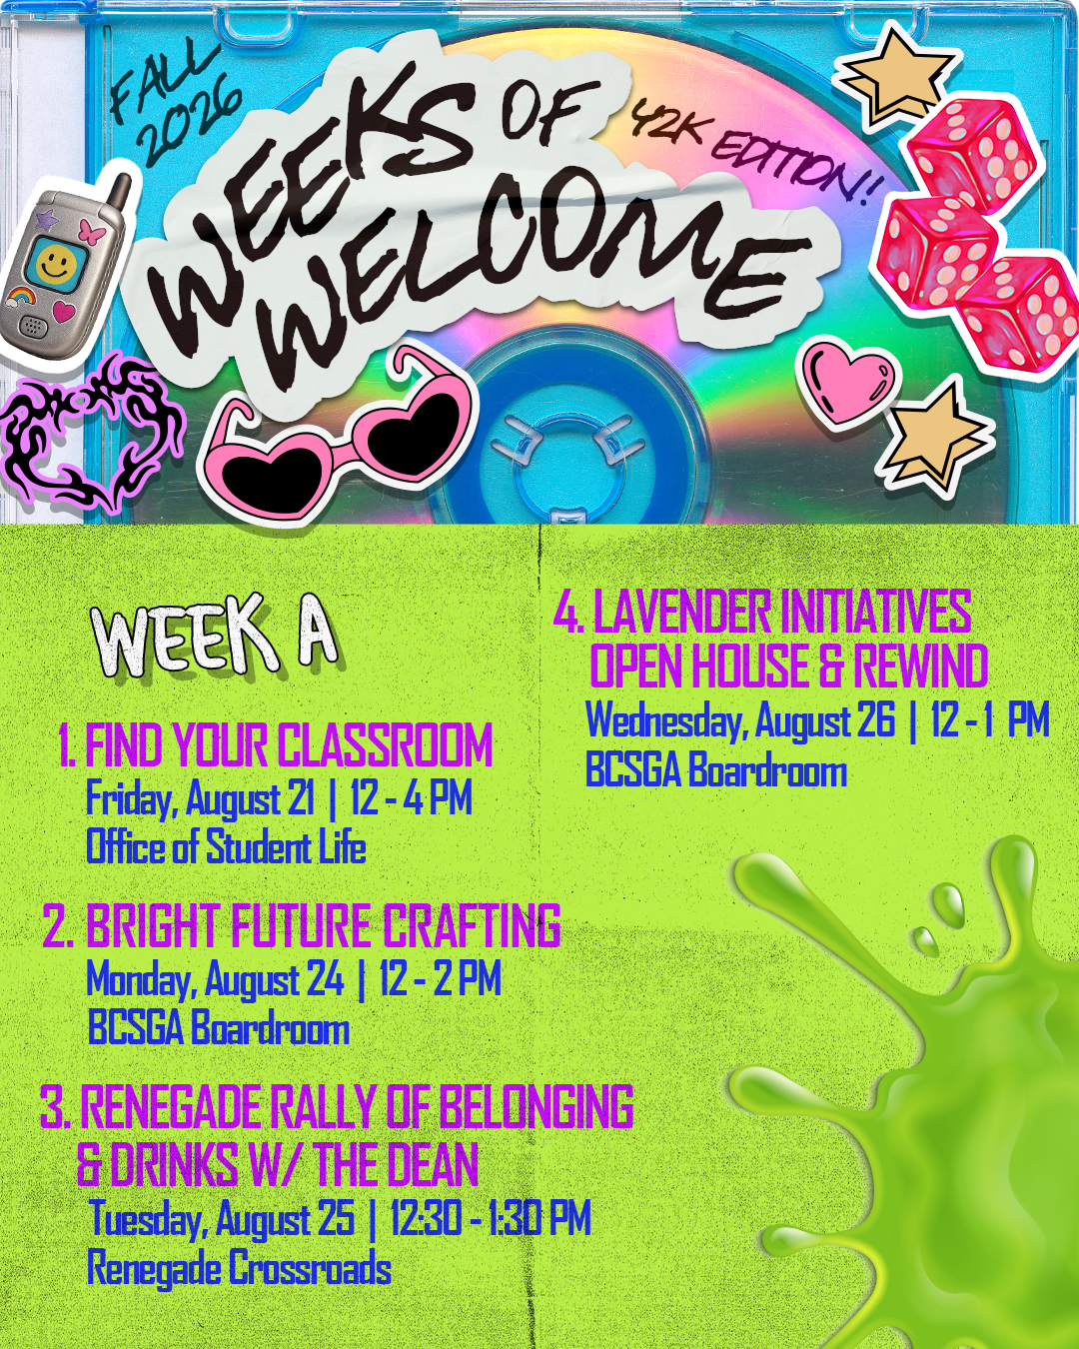
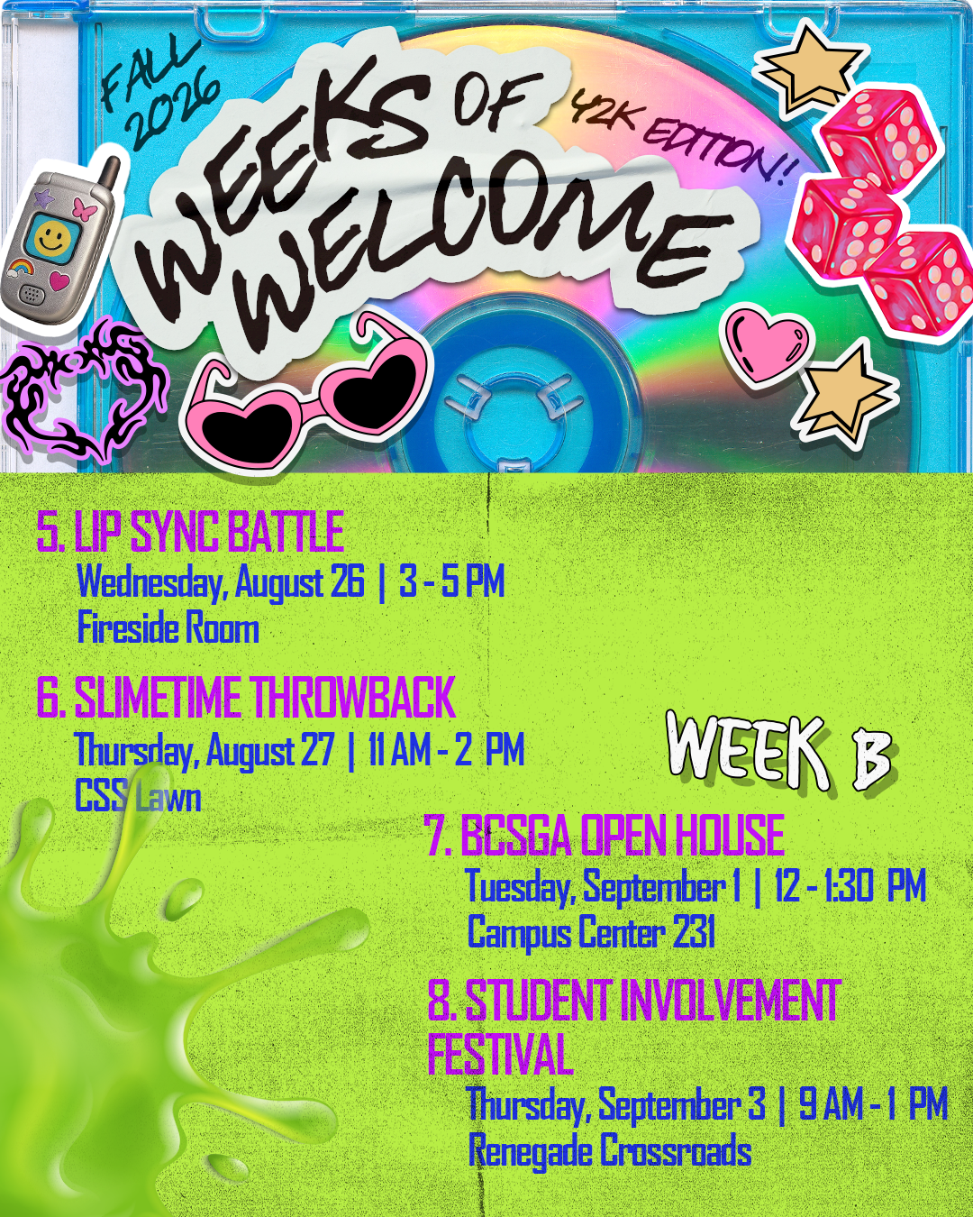
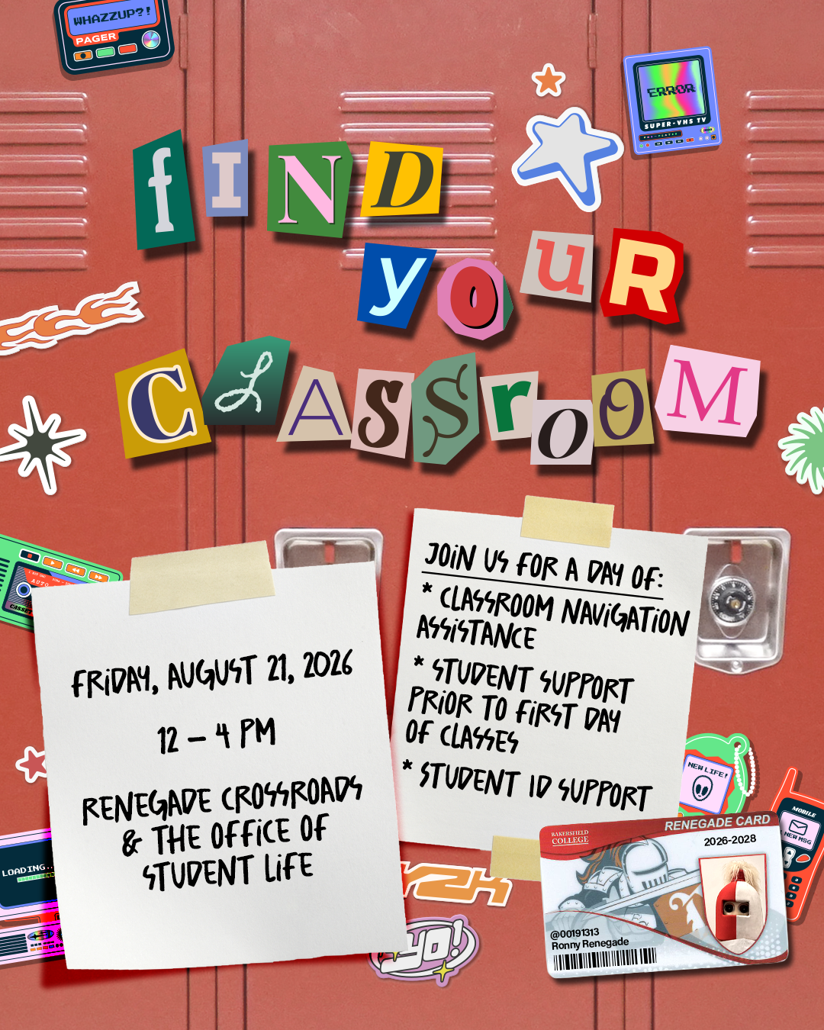
FALL 2026 STUDENT WELCOME
Before and during week one, navigation is the service
MON-THU AUG 24-27 | 7:30 AM-1:30 PM
Friendly support at Panorama, Arvin, Southwest, and Delano helps students get directions and connect to resources.
OFFICE OF STUDENT LIFE | BAKERSFIELD COLLEGE
5

Slide 7
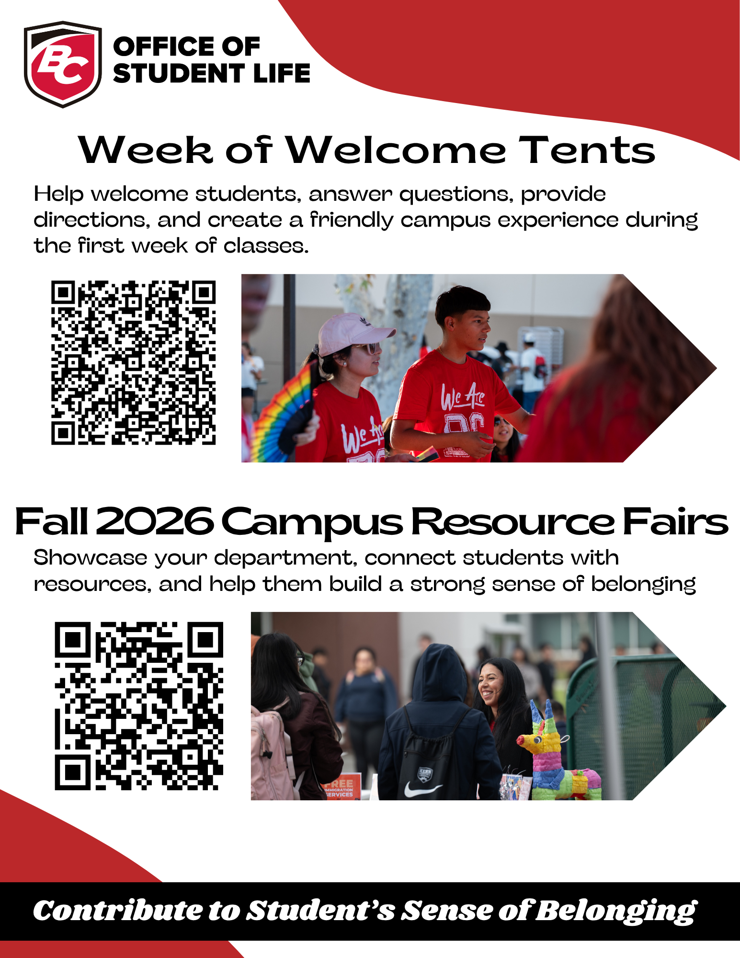
7

Slide 8

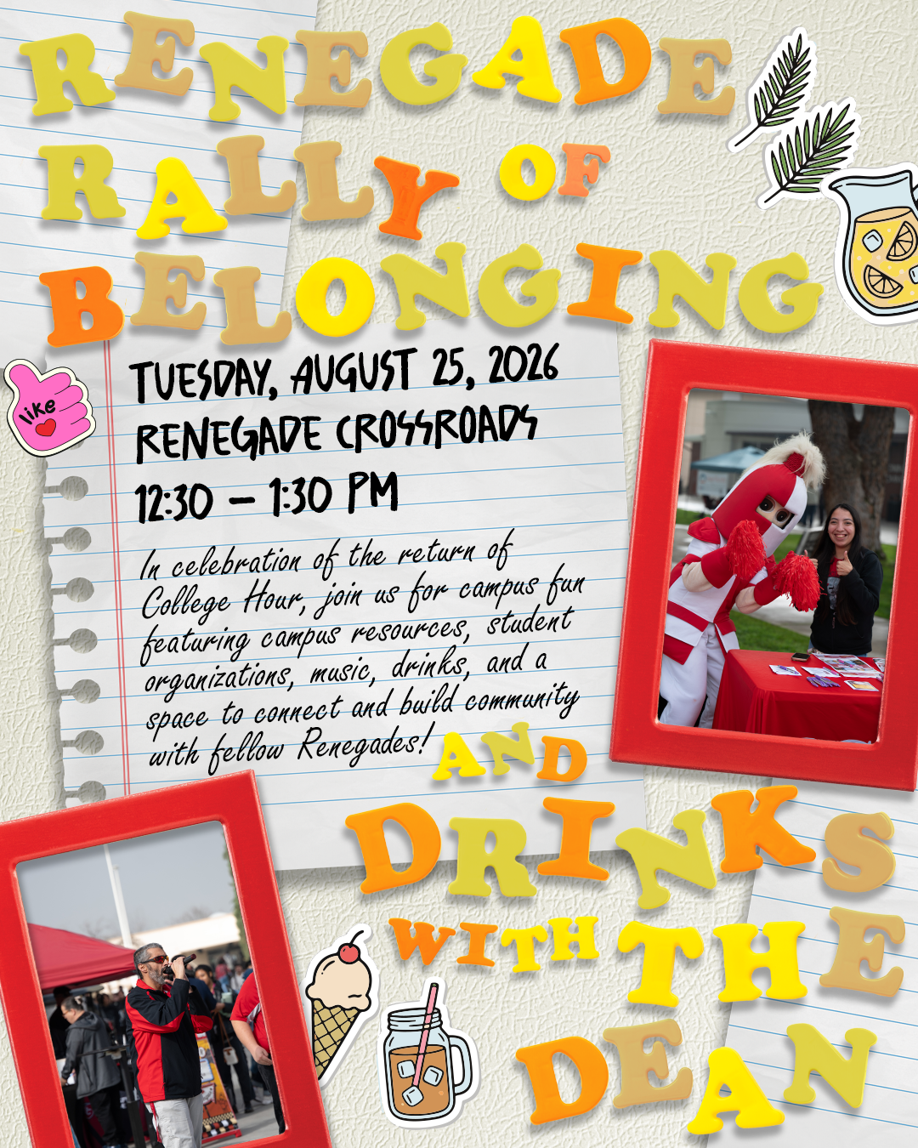

FALL 2026 STUDENT WELCOME
Three visible moments create energy and connection
AUG 24-25
AUG 25
SEP 3
Coffee, Tea & Doughnuts
Renegade Rally of Belonging
Student Involvement Festival
7:30 AM
12:30-1:30 PM
9:00 AM-1:00 PM
A simple welcome at the start of the day.
A shared moment that signals: you are part of BC.
Clubs, internships, research, and programs in one place.
OFFICE OF STUDENT LIFE | BAKERSFIELD COLLEGE
6

Slide 9
WHAT WE NEED FROM MANAGERS
Help your team become part of the welcome
01
SHARE
Place key dates in team communications and encourage student participation.
02
PLAN
Confirm coverage and allow assigned employees time to participate.
03
PREPARE
Review locations, hours, and the correct referral points with front-facing staff.
04
CONNECT
Promote department opportunities through the Student Involvement Festival and future resource fairs.
OFFICE OF STUDENT LIFE | BAKERSFIELD COLLEGE
7

Slide 10
THE GOAL
One coordinated welcome.
Many points of connection.
When every area participates, students do not have to figure out Bakersfield College alone.
PARTNER • PROMOTE • REFER • PARTICIPATE
Office of Student Life | studentlife@bakersfieldcollege.edu
8

Slide 11
7

