Slide 1
Measure J, Deferred Maintenance,
& Student Housing Projects
August 10, 2026
Marcos A. Rodriguez – MSci., MBA, PCA, QAL, CA, TRAQ, UCMG
Executive Director for Facilities & Operations

Slide 2
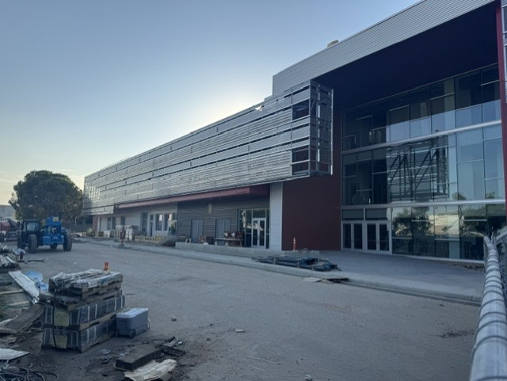
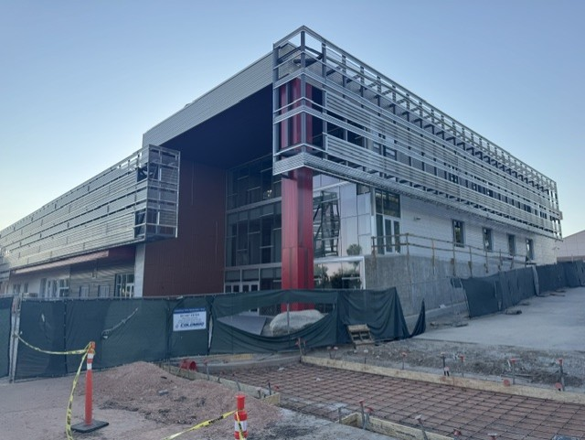
Measure J Projects

Slide 3
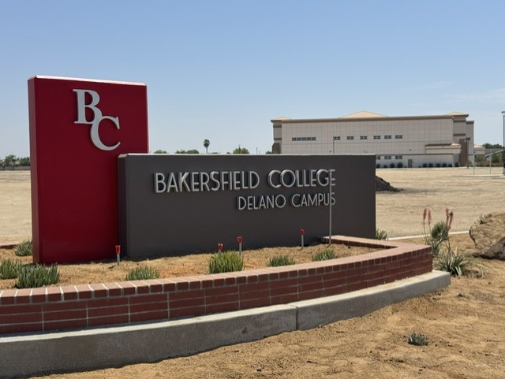
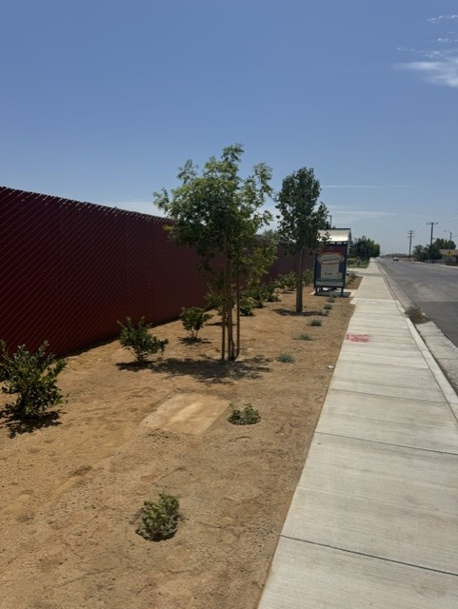
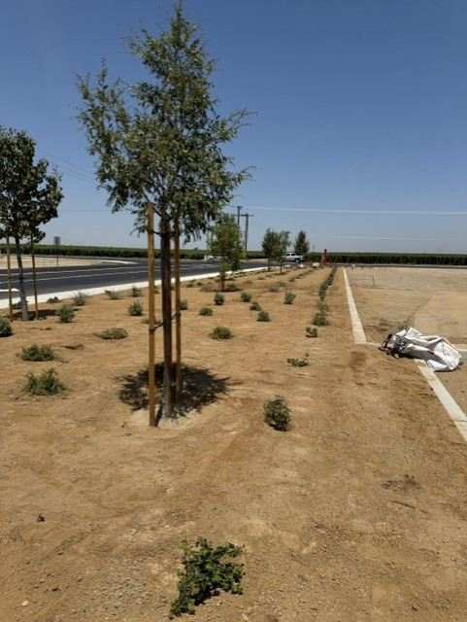
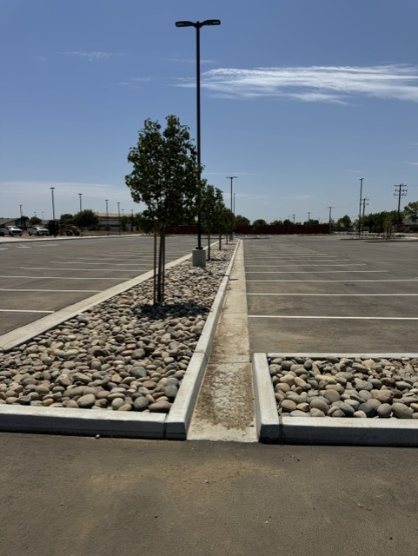
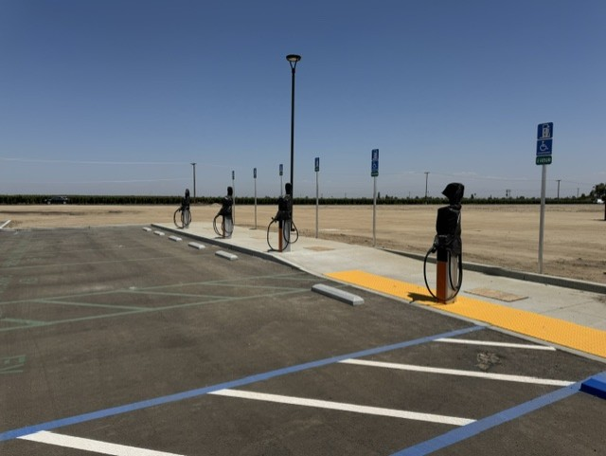
Measure J Projects

Slide 4
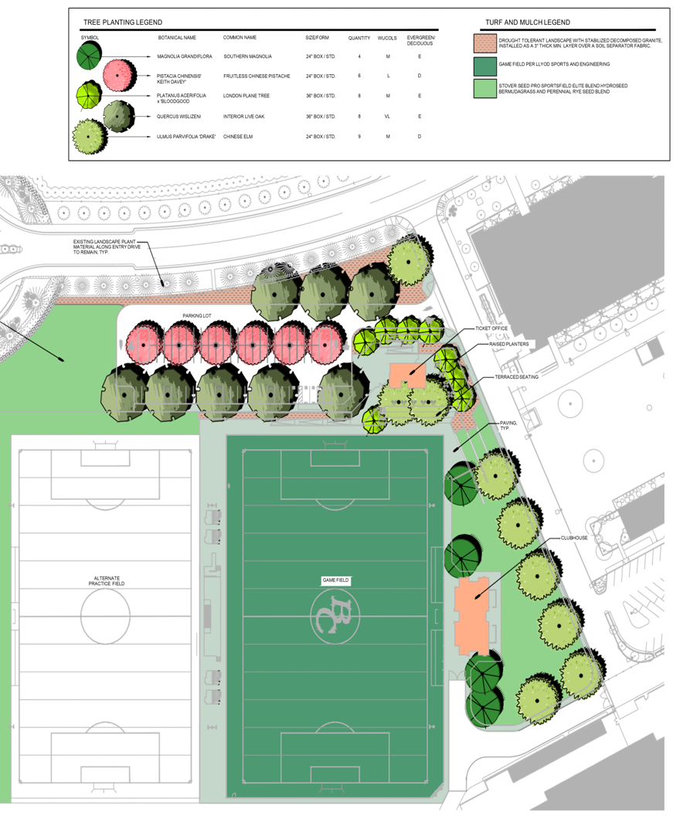
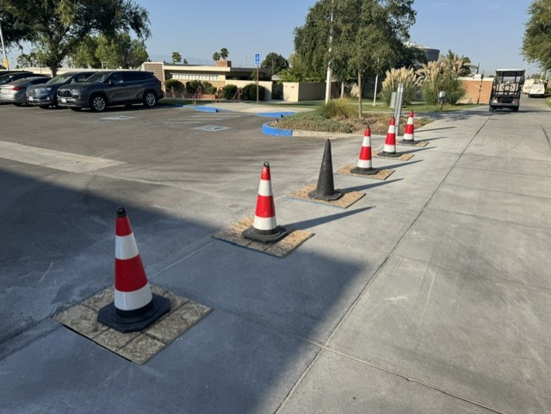
Measure J Projects – Future
Center for Student Success Building
Fine Arts Building
Swimming Pool Administration Building
Soccer Stadium Venue
Campuswide Security Bollards

Slide 5
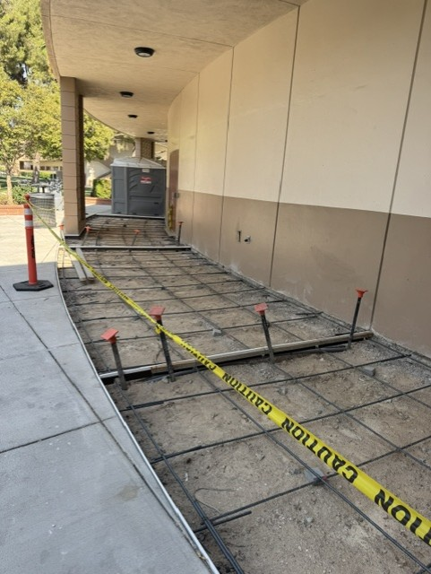
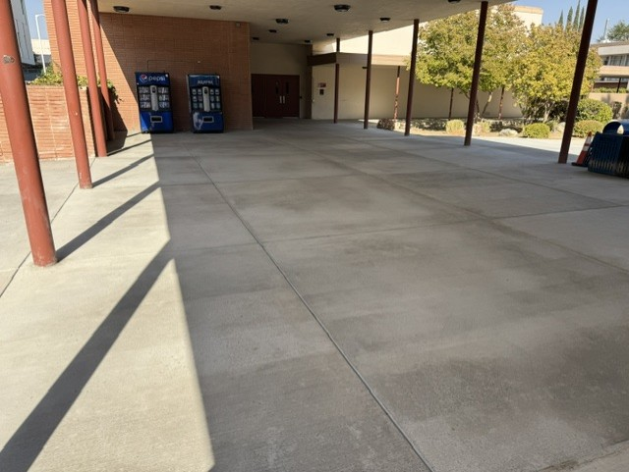
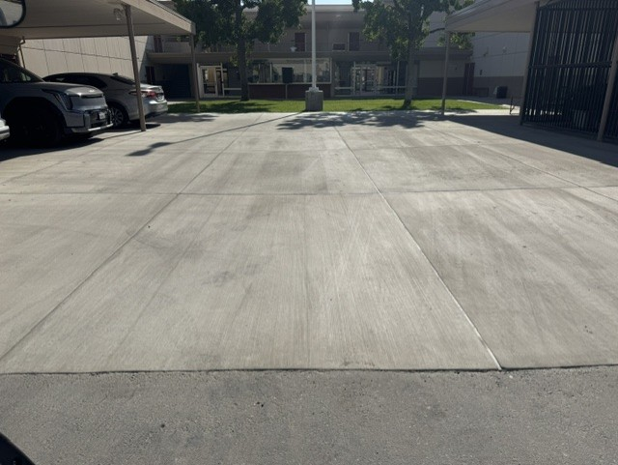
Deferred Maintenance Projects
Painting
Concrete Replacement
HVAC Equipment Replacement
FACE Building Restrooms Modernization
Language Arts Building Restrooms Modernization
Elevator Modernization – Campuswide
Floor Replacements – Campuswide
Science & Engineering Building Retro Commissioning

Slide 6
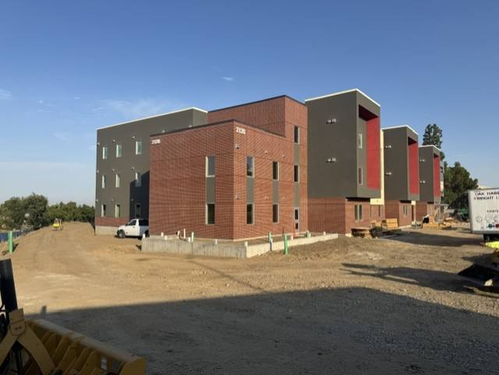
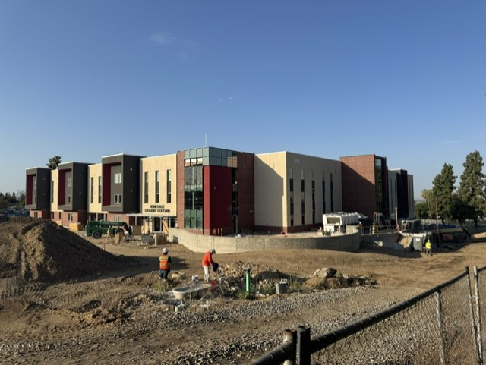
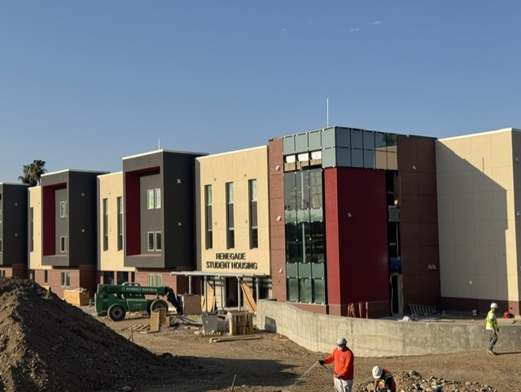
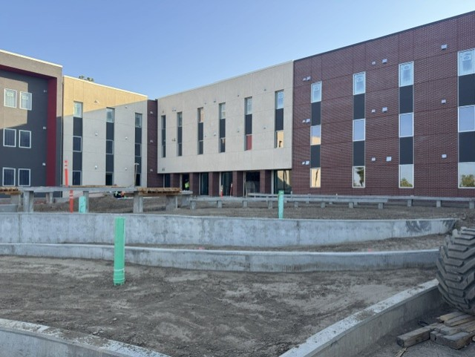
Student Housing Project

Slide 7
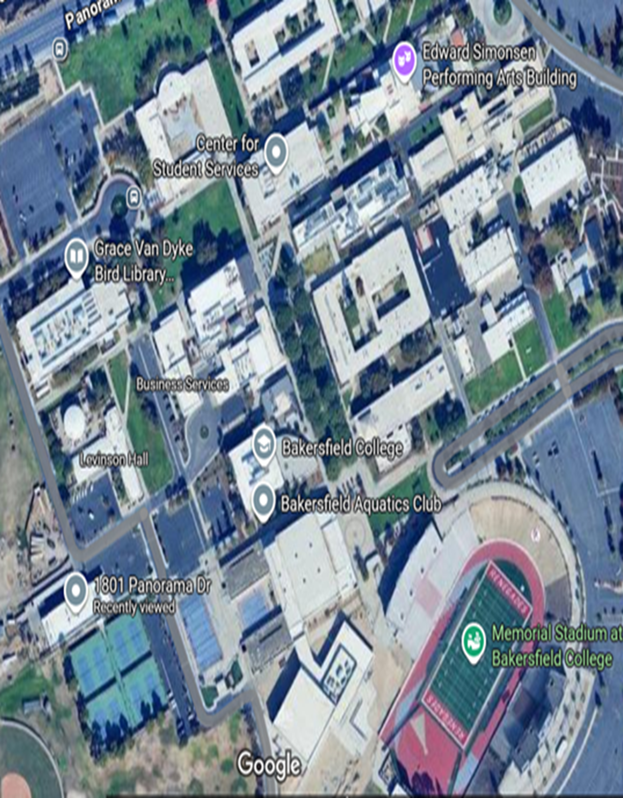
Miscellaneous Projects
Campuswide ADA Improvements
Campuswide External & Internal Speaker System
Switchgear Infrastructure Replacement
Safety Lighting Phase II
Parking Lot Eight - Solar Array & Battery Energy Storage System
Wall & Floorcovering Replacement – First Floor
Cal Water Infrastructure Improvements

Slide 8

Questions?
Questions?

