Slide 1
Kern CCD: Finance and Administrative Services

Slide 2
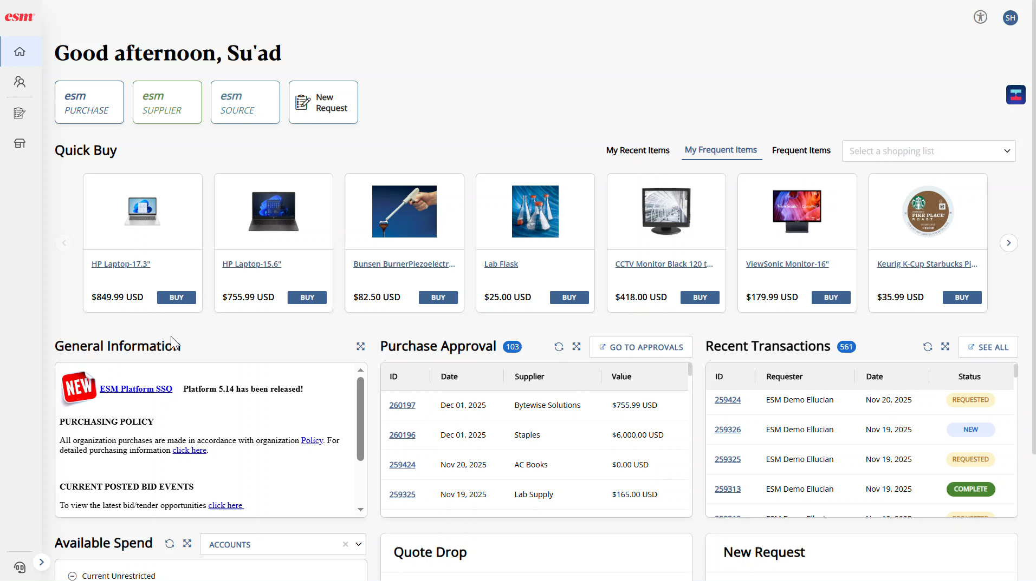
1) Banner Spend + ESM
ESM Solutions Banner Spend is a centralized procurement and sourcing platform that integrates with Banner Finance to manage purchasing requests, vendor sourcing, approvals, and compliance in one standardized system.
What It Does
Benefits for End Users
Centralizes purchase requests, vendor sourcing, and approvals
Enforces procurement rules, thresholds, and documentation
Integrates with Banner budgets and FOAPALs
Provides visibility into spend, status, and workload
Supports RFPs, bids, and vendor competition
One clear place to submit purchasing requests
Guided requests reduce errors and rework
Faster, more predictable turnaround times
Transparency: users can see request status and next steps
Fewer emails, fewer handoffs, fewer delays
Build cart
Assign FOAPAL
Submit
Central Processing
Pick items / services
Budget validated in real-time
Routes for approvals
Procure + pay end-to-end

Slide 3
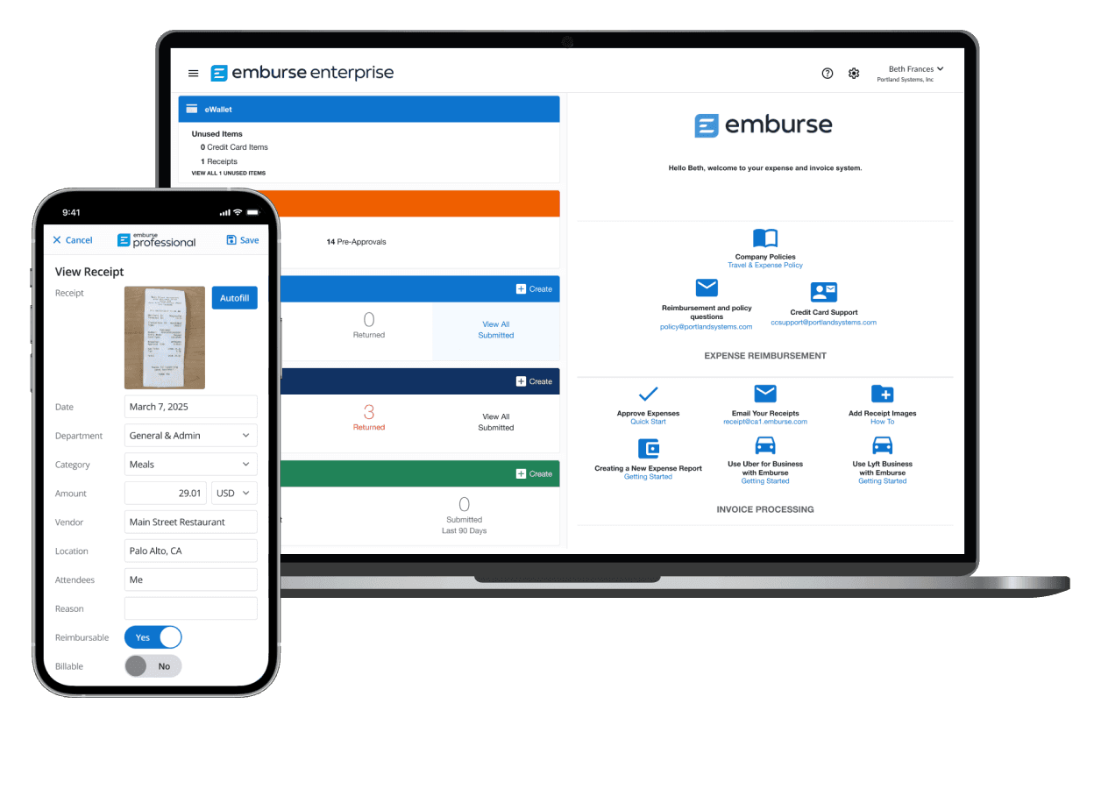
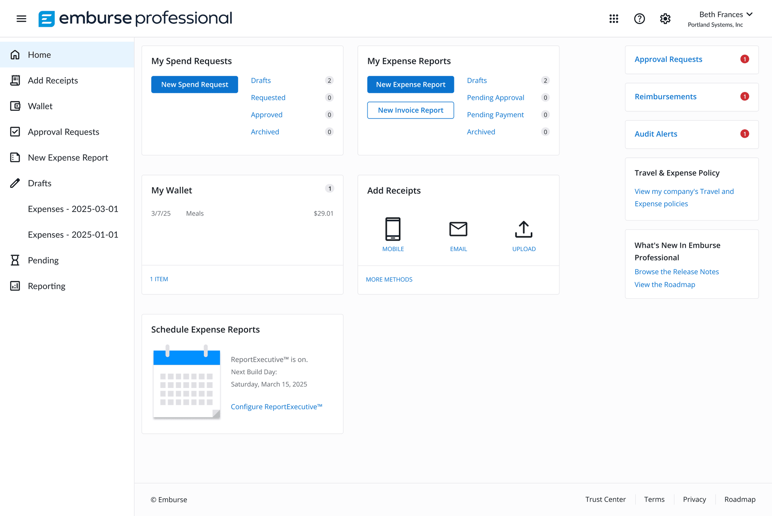
2) Travel, Expenses & Cal-Card (Banner Spend – Emburse)
Emburse is a centralized travel, expense, and reimbursement management platform that replaces manual forms and email-based processes with automated, policy-driven workflows integrated with Banner Finance.
What It Does
Benefits for End Users
Manages travel requests, expense reports, and reimbursements
Automates policy checks and approval workflows
Integrates with Banner FOAPALs and accounting
Supports receipt capture and documentation
Provides real-time visibility into expense status and spend
One clear system for travel and reimbursements
Mobile receipt capture — no lost paperwork
Faster reimbursements with fewer corrections
Clear visibility into approval status
Reduced back-and-forth emails

Slide 4

3) Emburse Accounts Payable & Invoicing Automation
Emburse provides a centralized Accounts Payable and invoice management platform that automates invoice intake, coding, approvals, and payment processing while integrating with Banner Finance and district FOAPAL structures.
What is improving
What It Does
Benefits for End Users
Centralizes invoice submission and intake (email, upload, vendor portal)
Automates invoice routing, approvals, and exception handling
Validates FOAPALs, budgets, and compliance rules
Supports PO and non-PO invoices
Provides real-time visibility into invoice status and processing queues
Text recognition pulls invoice details
Assists with creating invoice records in Banner
Improves accuracy and reduces cycle time
Supports cleaner audit trails and reporting
Benefits for FAS
Standardized AP and invoicing processes districtwide
Reduced manual data entry and paper handling
Stronger internal controls and audit readiness
Improved workload visibility and queue management
Enables centralized Accounts Payable services with consistent service levels

Slide 5
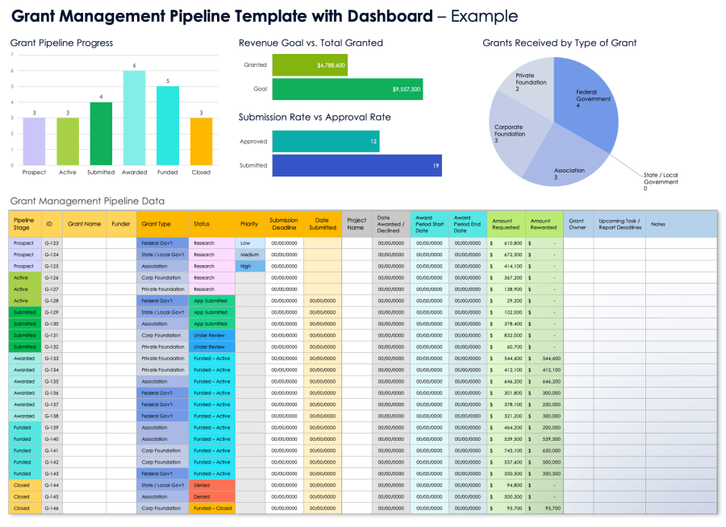
4) Grants Accounting & Oversight
Visibility for PIs and administrators
Dashboards for PI & admin teams
Process improvements
Active grants, amounts, timelines, and key contacts
Status of reporting and compliance requirements
Clearer view of spend vs. budget and remaining time
Fewer surprises at quarter-end and year-end
Enhanced grant intake process (target: end of March)
Clear expectations for accruals and prior-year items
Better alignment between fiscal and grant timelines
Standard escalation paths for exceptions
Why this matters
• Reduces risk of late invoices and prior-year corrections
• Improves the accuracy of reporting and closeout activities
• Supports consistent, districtwide handling of exceptions
Use of Smartsheets: https://youtu.be/pypwHj7vSpU
One KCCD means one standard applied consistently

Slide 6


5) Banner Modernization Updates
Self-service, cleaner data, and fewer paper forms
HR & Self-Service
Finance & Facilities
Leave balances go-live: May 1 (Admin & Classified)
Faculty/Student/Temp phases: Aug–Sep
Moving paper workflows into Self-Service Banner
Cleaner data and better transparency for employees
PHAREDS pilot with one PI; build and scale the process
Banner Communications Management (consistent messaging)
Fixed Assets module: Banner as system of record
Integration planned to push asset data to Brightly
Result: fewer paper forms, better data, and clearer accountability.
Fixed Assets: what it means for purchasing
Asset data begins with the PO and is completed at receiving.
Accurate descriptions and receiving steps support tagging, reporting, and the Brightly integration.

Slide 7

7) Student Refunds, Payments, Deposits & Marketplace
More automation, better student support, safer cash handling
TouchNet modernization
Payments & student support
Deposits & department storefronts
Cashiering and deposit workflows standardized across sites
Advisor dashboard gives staff a real-time view of a student’s account
https://vimeo.com/394996794?fl=pl&fe=cm
Payment plans for current and past-due balances (no cost to students)
On-demand statements and notifications reduce follow-up calls
https://vimeo.com/394967162?fl=pl&fe=cm
Department deposit sites for clubs/programs with approval queues
Built-in reporting and reconciliation against bank activity
Marketplace storefronts for departments (branded online sales)
https://vimeo.com/394977890?fl=pl&fe=cm
Batch processing and automated reconciliation for transactions
Additional automation
• TouchNet + ECSI integration streamlines 1098-T access and reporting
• Better transparency for students, fewer manual steps for staff
• Stronger controls for cash handling and department collections

Slide 8

8) One Card & Financial Aid Disbursements
A more flexible, student-centered experience
What we are enabling
One Card ID expansion
Refunds & disbursements
Centralized student ID for campus services (e.g., events, services, access)
Potential for wider use cases as campus needs evolve
Improved tracking and consistent identity management
Supports a more seamless student experience
Multiple options: bank account, physical check, and digital wallets
Better reporting and reconciliation for disbursements
Reduced manual handling and fewer exceptions
Improved access to funds for students
Result
More flexible, student-centered access to funds—while improving the District’s reconciliation and reporting capabilities.
https://youtu.be/AIk_2HCjmdc

Slide 9

What this means for you
How end users and FAS teams will work in the new model
For Finance & Administrative Services teams
You will see
We will focus on Service Level Agreements
Simpler, guided submissions (less guesswork)
Real-time checks that prevent NSF and non-compliant requests
Fewer forms and fewer “send it back” cycles
Clearer status tracking and standard support routes
This approach helps us:
Set clear expectations for turnaround times
Reduce confusion and rework
Empower staff and end users with reliable information
Shift from reactive to proactive service
Protect staff time while improving service quality
Support audit readiness and compliance
Centralized processing with consistent standards
Proactive communication and job aids / FAQs
Exception management and audit-ready documentation
Training, office hours, and continuous improvement loops
Deliver consistent, predictable service
What This Means for Us as a Team
We model the behavior we expect from others
We direct people to the same resources
We keep information current and accurate
We communicate with intention, clarity, and consistency
This is not about limiting access — it’s about improving access.

Slide 10
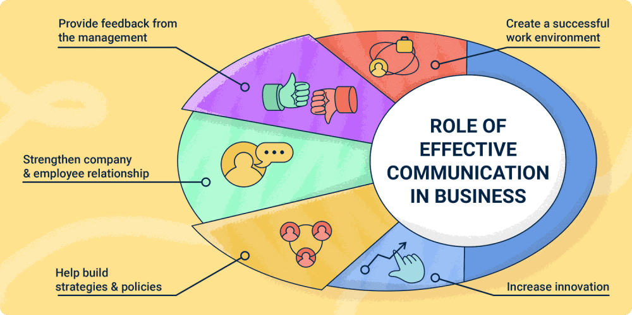
NEXT STEPS
How end users and FAS teams will work in the new model
Service Level Agreements - Communication
Standard Communication Channels
Weekly Office Hours
“Coffee with the Assistant Directors / Directors”
Scheduled, predictable time for:
Questions
Clarifications
Early problem-solving
Reduces last-minute escalations and email back-and-forth
Dedicated Webpages
Centralized, up-to-date information
Clear guidance on:
Processes
Timelines
Who to contact
Designed for self-service and transparency
Inside KCCD as the Source of Truth
FAQs
Step-by-step directions
Forms, templates, and job aids
Used consistently by all Finance & Administrative Services teams
Without shared communication standards:
Information becomes fragmented
Staff receive mixed messages
FAQs are answered differently depending on who is asked
Trust and confidence in processes erode
An SLA model requires clear, visible, and consistent communication.
One KCCD means one standard—applied consistently and communicated clearly.

Slide 11
Questions & Discussion
Thank you for helping build clear processes, shared understanding, and consistent practice.
One KCCD: Awareness & Alignment

