Slide 1


Slide 2
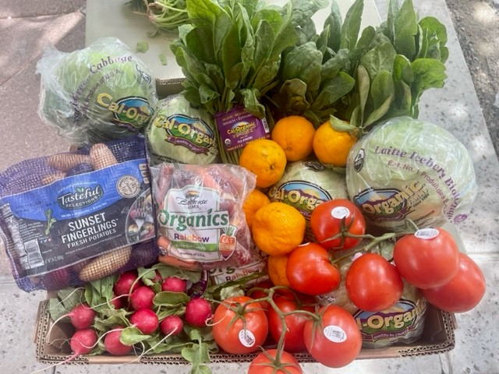
Basic Needs Five Focus Areas
Sufficient and nutritious food​
Housing search assistance for safe and stable housing​
Transportation to and from school and employment​
Adequate access to technology tools​
Appropriate physical, mental, and/or behavioral health care​

Slide 3
Basic Needs Services
Food
Four pantries
  Arvin
  BCSW
  Delano
  Panorama
Snack stations
  District
  Wasco
Daily Bread Program​
Monthly Farmer’s Market​
Hot Meal Vouchers for on-campus dining​
CalFresh Application Assistance​
Housing
Access to the Homeless Management Information System (HMIS) and partner organizations for the Continuum of Care (CoC)​​
Educational materials on tenants’ rights and responsibilities​
Housing search assistance​
Housing and utility assistance​
Referrals to community organizations for housing and homelessness prevention assistance​​

Slide 4
Basic Needs Services
Transportation
​Application assistance for California Low-Cost Auto Insurance​
Free Golden Empire Transit (GET) Bus Passes​
Kern Transit Passes​
Campus Parking Passes​
Technology
​Offer computers to complete coursework, including Chromebooks and Dell Laptops
Partnership with the bookstore to provide book vouchers
School supplies
WIFI hotspots
Calculators
California Connects Mobile Internet​
CollegeBuys

Slide 5

Basic Needs Services
Health and Hygiene
Campus Showers
​Clothing Closet
  Referrals to community resources
Crisis Text Line Awareness Campaigns​
Graduation regalia​
Free haircuts and styling
Free menstrual and family planning​ products offered in the Renegade Nexus Pantry
Referrals to Students of Concern and Mental Health Wellness team and the Student Health and Wellness Center
Referrals to community resources

Slide 6

Student Parents
A student parent is defined as a student who has a child or children under 18 years of age who will receive more than half of their support from the student (parent).
Student Parent Website
Bakersfield College Campus Map
Student Parent Outreach
  Priority Registration
  Community Building

Slide 7
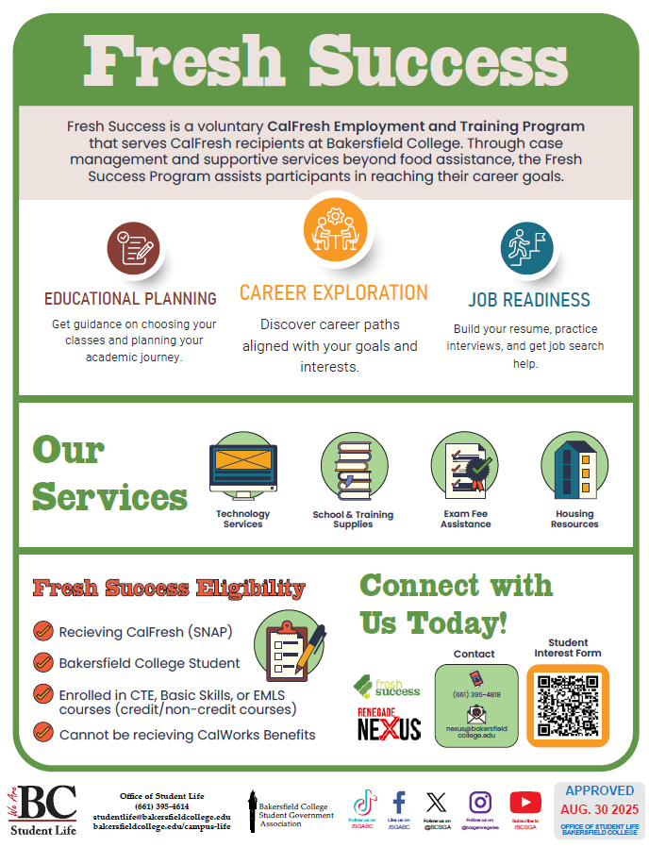

Fresh Success
Fresh Success is a voluntary employment and training program where Bakersfield College students receiving CalFresh (SNAP) benefits can receive supportive services aimed at improving employability and job readiness.
Services include, but are not limited to: School supplies, training supplies, technology services, exam fee assistance, and emergency housing support. ​
Students interested in Fresh Success should complete the Nexus Student Interest Form.

Slide 8
Contact us!
Request Help in Starfish​
  "I have a Personal Question NOT related to my academics"​
Refer them to the Renegade Nexus Website to complete the Student Interest Form: www.bakersfieldcollege.edu/services-and-resources/nexus/index.html​
Email nexus@bakersfieldcollege.edu

