Slide 1
Medical Professionals Program
Building the future of healthcare in Kern County and the greater Central Valley

Slide 2
Overview
Kern Regional K-16 Collaborative
Medical Professionals Program
Direct Pathways to Medical School

Slide 3




Kern Regional K-16 Education Collaborative
Streamlining equitable pathways from high school to postsecondary education and into the workforce
Include at least one K-12 school district, one UC campus, one CSU campus, and one California Community College District
  Establish a steering committee of at least 25% local employers
  Commit to participate in the California Cradle-to-Career Data System
  Implement at least 4 of 7 Recovery with Equity strategies to promote student success
  Create occupational pathways that incorporate work-based learning

Slide 4
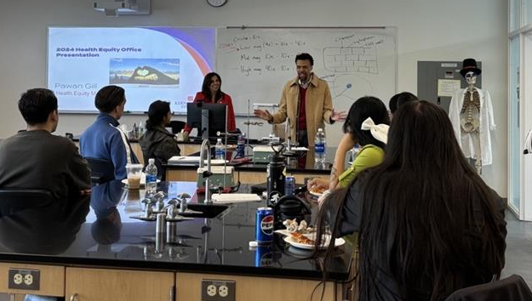
Equity and Workforce Pathways
Student Success Strategies
  Faculty/staff diversity
  Inclusive learning environments
  Retention and inclusive support
  High-tech, high-touch advising
  Early college credit and affordability
Workforce Sectors
  Healthcare
  Education
  Business Management
  Engineering/Computing
Health Equity Presentation with Kern Health Systems

Slide 5
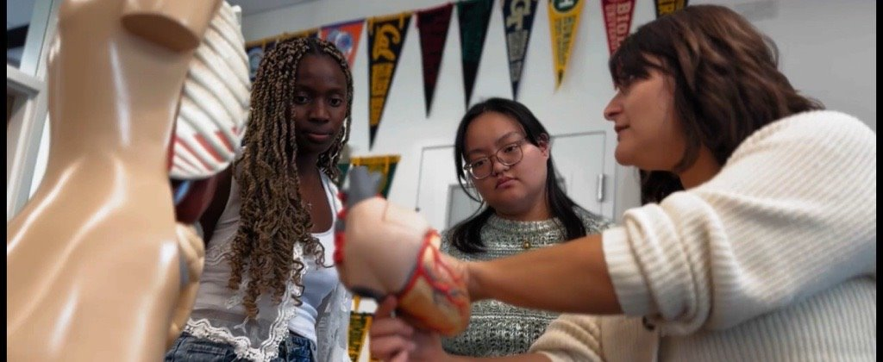
Medical Professionals Program (MPP)
Build a pre-health pipeline aligned with K16's healthcare workforce focus
Establish sustainable partnerships
Outcomes
  Medical professions pathway webpage
  Increased medical career interest
  Enrollment in foundational courses
  Student and parent engagement
  MCAT test center site in Bakersfield
  Tracking system implemented to identify students
MPP Students and BC Faculty Mentor

Slide 6
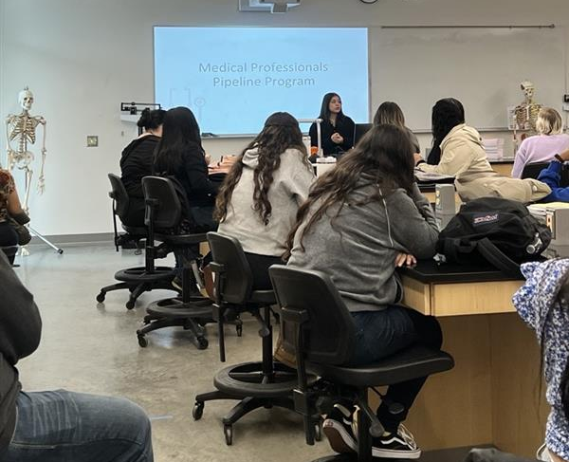
Target Students
Pursuing medical careers at the graduate level
  Medical Doctor (MD or DO)
  Dentist
  Veterinarian
  Optometrist
  Pharmacist
  Physician Assistant
  Medical/Clinical Research (PhD)
Students self-identify using an online Student Interest Form
Assigned a program-specific Student Attribute on Banner to monitor progression and program participation
MPP General Info Session

Slide 7
Student Participation Requirements
Students in the program must meet the following requirements before being able to participate in an educational field trip, medical conference, or consideration for select opportunities
Meet with their academic pathway advisor or counselor each semester
Have their education plan up to date
Meet with the Program Manager of MPP to discuss goals and access resources and opportunities
Maintain GPA and meet personal goals
Participate in at least three (3) MPP activities each semester

Slide 8
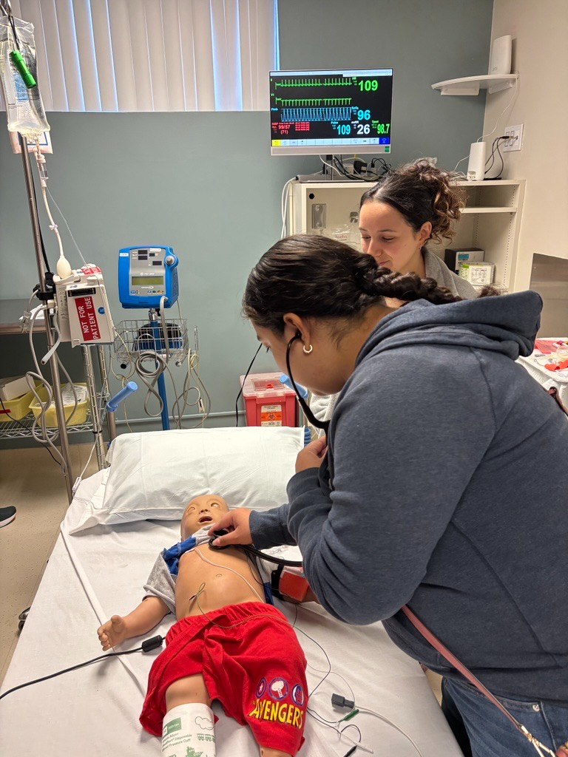
MPP Services & Support
Advising & Academic Guidance
  Course planning and transfer support through academic counselors/advisors
Mentorship & Professional Development
  Guest speakers, workshops, networking, research
MCAT & Career Prep
  Mock sessions, test prep, application guidance
Early Awareness Outreach
  K-12 events, career exploration, community engagement
BC MPP Student during Clinical Simulation Training at Kern Medical, Fall 2024

Slide 9
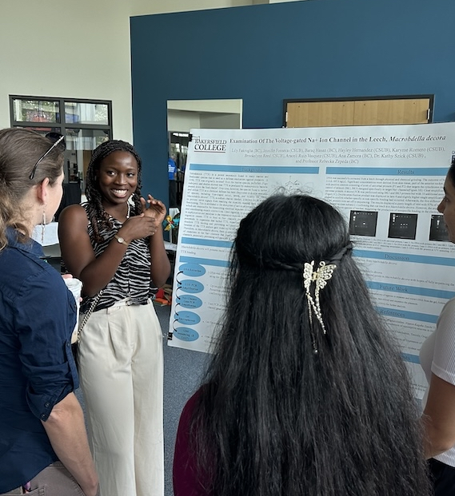
Program Impact
Students Served: 386 (as of 02/2026)
  Fall 2025 Cohort (n=94)
    70% MD/DO pathway
    20% Veterinarian pathway
    18% Physician Assistant pathway
    16% Clinical Research/PhD pathway
Retention/Engagement
  300% increase in student engagement (Fall 2024)
  48+ students accepted into summer research, career exploration programs, or employment (Summer 2025)
Partnership Growth
  Advisory board development, expanding partners
  4 medical school pathways, additional 2 in beginning stages
MPP Student Poster Presentation at
BC CSUB Summer Research Symposium

Slide 10
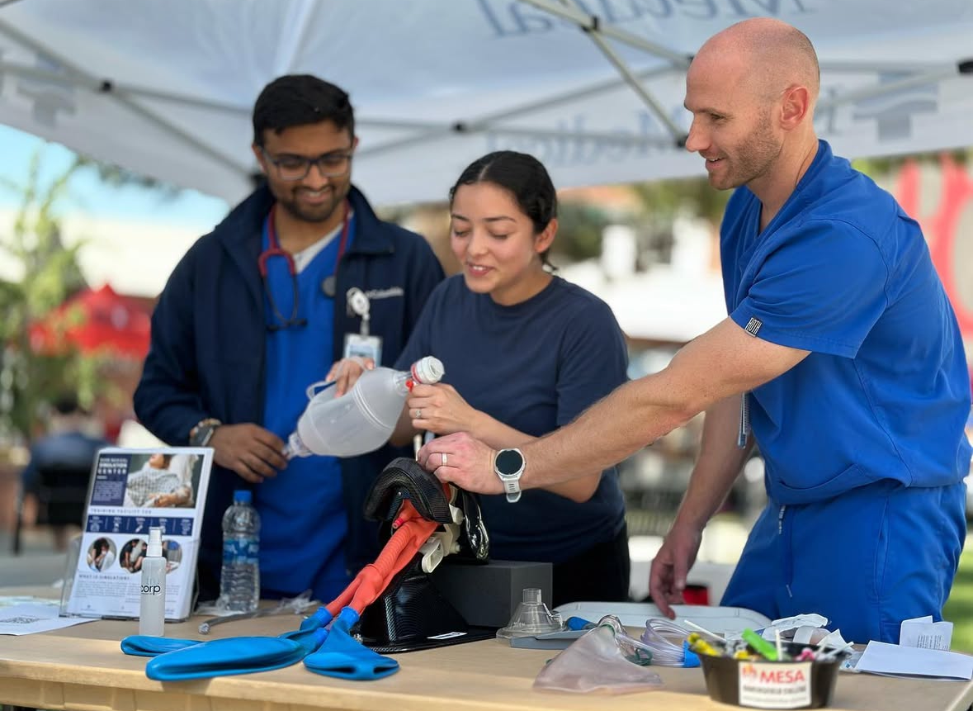
Program Sustainability
Embed MPP into Bakersfield College's strategic plan for ongoing support
Launch Pearson Vue Certified Testing Center at Bakersfield College
Expand pipeline & retention efforts
Continue K-12 outreach & pre-health awareness
Advisory board expansion to ensure regional alignment & sustainability
Kern Medical leading hands-on activity at BC Student Involvement Festival

Slide 11
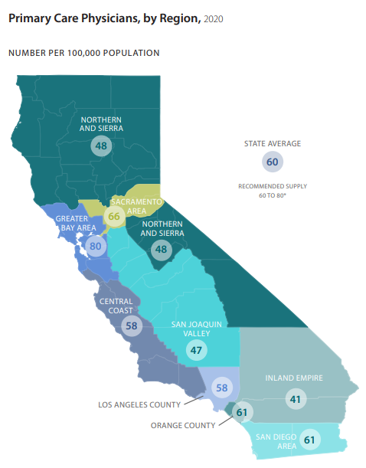
Alignment with Rural Health Needs
Kern County and the Central Valley face critical provider shortages
  Kern County is officially designated as Health Professional Shortage Area in primary care, mental health, and dental services
MPP strengthens rural healthcare workforce development
Addresses provider shortages & access inequities
Shows the impact of pre-health support programs in the Valley
https://www.chcf.org/wp-content/uploads/2021/03/PhysiciansAlmanac2021QRG.pdf
https://hpsa.us/client-pages/adventist-health-bakersfield-kern-county/?utm_

Slide 12
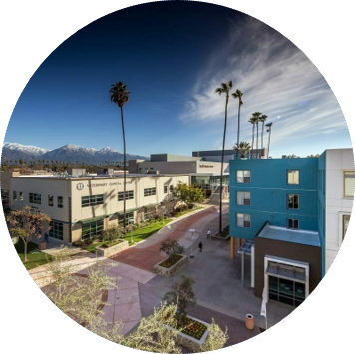
Direct Pathways to Medical School:
Western University of Health Sciences – College of Osteopathic Medicine (WesternU COMP)
5 Reserved Seats to WesternU COMP
BC students transferring to CSU Bakersfield can apply to WesternU COMP linkage for guaranteed seats in their medical school upon completing set requirements
Linkage Application Requirements:
Have at least 2 years remaining of their undergraduate degree
Completed at least one year of biology and chemistry
Have three (3) letters of recommendation – two from science or math professors and one from a pre-professional advisor
Western University of Health Sciences
Pomona, CA Campus

Slide 13
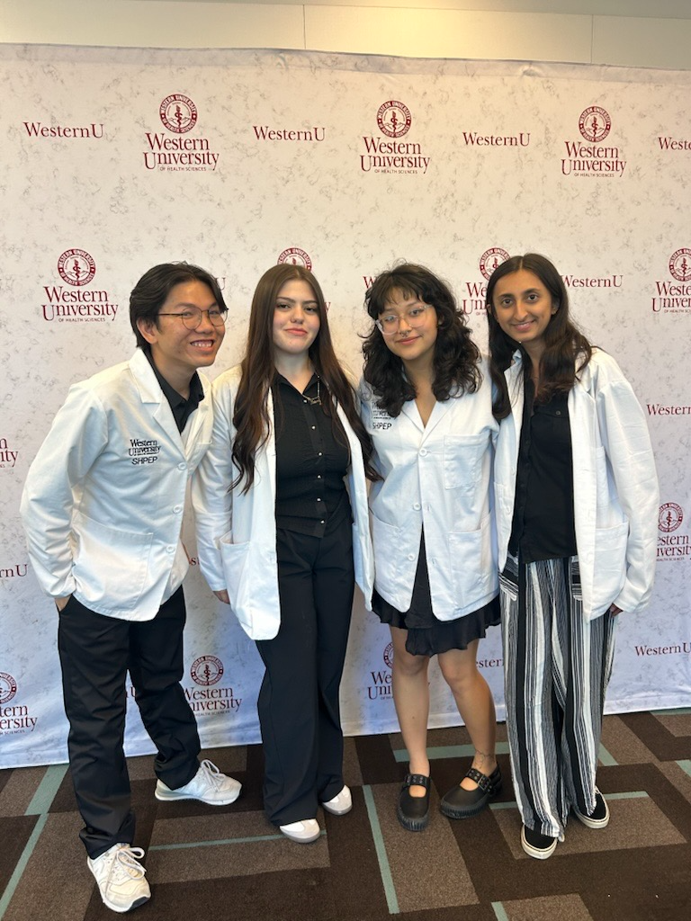
WesternU COMP Expectations
If admitted into the linkage program, the following are requirements for matriculation into COMP:
  Overall GPA ≥ 3.30
  Science GPA ≥ 3.30
  MCAT Composite ≥ 497
  At least 50 hours of physician shadowing, preferably DO
  At least 50 hours of community service
These are the minimum expectations. Students are strongly encouraged to perform at their full potential to allow a successful transition.
MPP BC students at their WesternU SHPEP White Coat Ceremony, Summer 2025

Slide 14
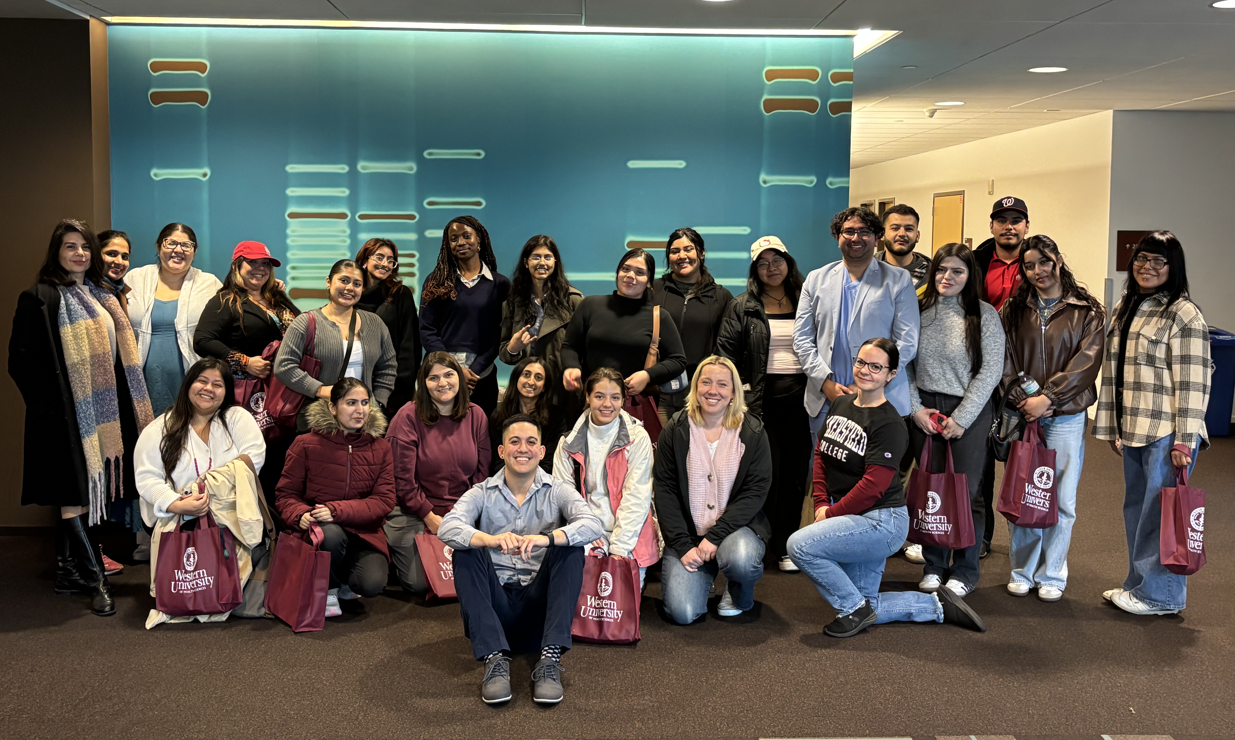
Direct Pathways to Medical School:
Western University of Health Sciences – Master’s of Science in Medical Sciences (WesternU MSMS)
5 Reserved Seats to WesternU MSMS
BC Research Laboratory Technology baccalaureate students can apply for guaranteed seats to WesternU's MSMS graduate program upon completing requirements
Students can use WesternU MSMS as an opportunity to link into one of their graduate medical programs – DO, DDM, DPM, DPT, OD, PA, or PharmD
WesternU MSMS Campus and Cadaver Lab Tour, Spring 2025

Slide 15
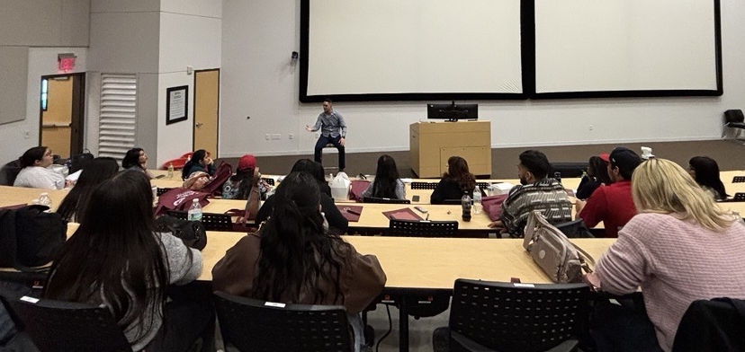
WesternU MSMS Requirements
BC RTEC Bachelor’s Degree
Science GPA ≥ 2.5
Cumulative GPA ≥ 2.5
At least 50 hours of community service
Three (3) letters of recommendation – two from science or math professors and one from an advisor
If wanting to link to a graduate medical program, students must:
Submit test scores for admissions test (MCAT, DAT, OAT, or GRE)
Have at least 50 hours of shadowing profession of interest
WesternU MSMS Presentation by Current MSMS Student, Spring 2025

Slide 16
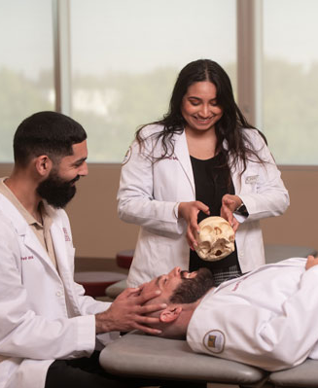
Direct Pathways to Medical School:
California Health Sciences University – College of Osteopathic Medicine (CHSU COM)
Guaranteed interviews with CHSU COM
BC Research Laboratory Technology baccalaureate students can apply for guaranteed interviews to CHSU COM upon completing requirements
Guaranteed Program Application Requirements:
Complete RTEC coursework and CHSU-COM prerequisite coursework while at BC
BC is one of the first community colleges to offer a direct pathway to medical school!
D.O. Medical Students at CHSU COM

Slide 17
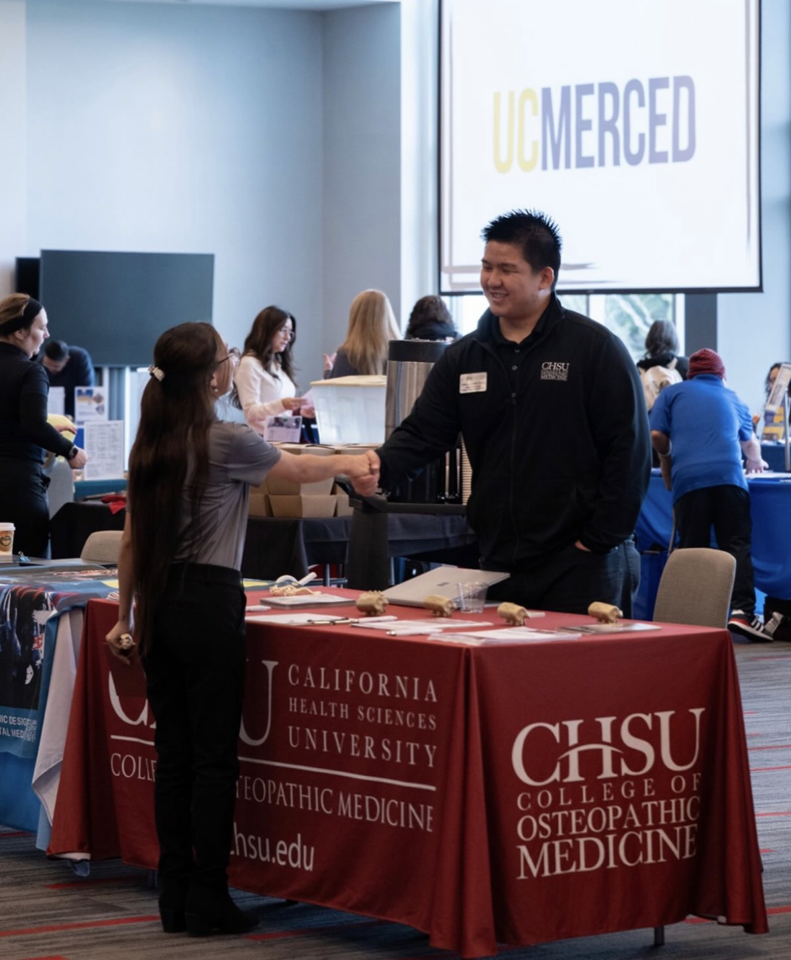
CHSU-COM Guaranteed Interview Requirements
Complete all required courses before graduating from BC
Complete Bachelor’s Degree in Research Laboratory and Technology at BC
Science GPA > 3.20
Overall GPA > 3.20
MCAT Score at or above the 50th percentile
Minimum of 50 hours of volunteering, community service, or shadowing
Comply with all other CHSU-COM and BC Guaranteed Interview Program Admissions Policy
These are the minimum expectations​. Students are strongly encouraged to perform at their full potential to allow a successful transition
CHSU at Transfer Day, Spring 2026

Slide 18

Opportunities to Partner
Partnership Opportunities:
  Mentorship
  Internships
  Shadowing
  Collaborative Workshops
  Guest Speaker/Panelist
  Advisory Committee Member
  Funding for Student Scholarships
  For more info, please contact:
  Bianca Garibay, Program Manager
  bianca.garibay@bakersfieldcollege.edu
MPP LinkTree QR Code
Program Info, Events, and Resources

