Slide 1

KCCD Accommodations and the Interactive Process
Tina Johnson -Interim Director Risk Management & Safety/Legal
Yvette Colby Coordinator -Risk Management & Safety/Legal
Finance and Administrative Services

Slide 2
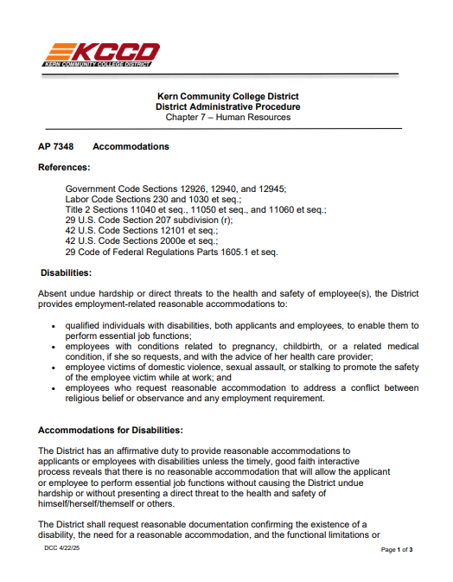
AP 7348 Accommodations
Absent undue hardship or direct threats to the health and safety of employee(s), the District provides employment-related reasonable accommodations to:
• qualified individuals with disabilities, both applicants and employees, to enable them to perform essential job functions;
• employees with conditions related to pregnancy, childbirth, or a related medical condition, if she so requests, and with the advice of her health care provider;
• employee victims of domestic violence, sexual assault, or stalking to promote the safety of the employee victim while at work; and
• employees who request reasonable accommodation to address a conflict between religious belief or observance and any employment requirement. employees with disabilities, pregnancy-related conditions, or other qualifying needs. The goal is to enable individuals to perform essential job functions and participate fully in District programs and services.

Slide 3

Requesting an Accommodation
KCCD provides a Reasonable Accommodation Application Form for employees requesting accommodations. The form requires basic information, a description of the condition and limitations, and the requested accommodations.
The form is available on the KCCD website or can be provided upon request.
Completed forms should be submitted to yvette.colby@kccd.edu.

Slide 4
Here’s how accommodations and the interactive process work at Kern Community College District:
Request Made Employee requests an accommodation or the District becomes aware of a need.
Interactive Discussion Risk Management meets with the employee, and supervisor to discuss job duties and limitations.
Documentation Risk Management will request medical and supporting documentation.
Identify Accommodations Risk Management, employee and supervisor will explore reasonable accommodation options.
Implement & Review Accommodation is implemented and monitored for effectiveness.

Slide 5
Legal Framework
This process aligns with federal (ADA) and state (California FEHA) requirements, meaning the District must engage in meaningful dialogue and consider accommodation proposals that don’t impose an undue hardship on operations.

Slide 6

What questions do you have ?

