Slide 1
Dell Equipment Quote Request
BC Technology Services Support Department
Ebony Williams
Notes:
[Start Ebony]: Good morning and welcome to BC. I am Ebony Williams, the Technology Support Services Director. We are formerly known as IT! We support more than just computers.

Slide 2
Market Pricing Update and Immediate Actions
Costs are increasing across the technology industry due to strong demand
Why?: Demand for AI-related products is growing faster than supply
Impacts: These increases affect a wide range of products, from everyday computers to large systems
Industry reports confirm prices are continuing to rise
Dell has made immediate changes in response to market conditions

Slide 3
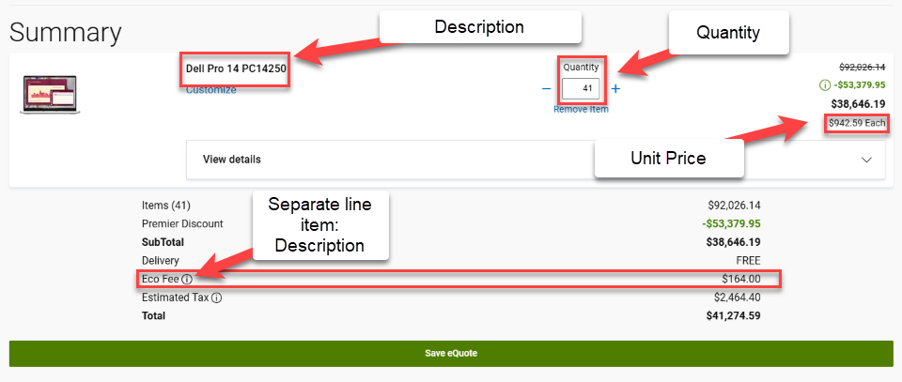
What does this mean for BC?
Dell has reduced the validity of their quotes from 30 days to 14 days.
How will IT fulfill quote requests for Dell equipment?
IT will provide a budgetary screenshot quote. See screenshot below.
NOTE: As part of the PO include eco-fee as separate line item.
Finalizing the Purchase
Upon IT will generate a final quote when the PO is finalized and fully approved.
NOTE: The quote number will no longer be in the DOC text field in the PO.
Notes:
I have two managers besides myself who support the team and daily operations. When you need support, please allow my team to assist. We are always available from an escalation's standpoint.

Slide 4
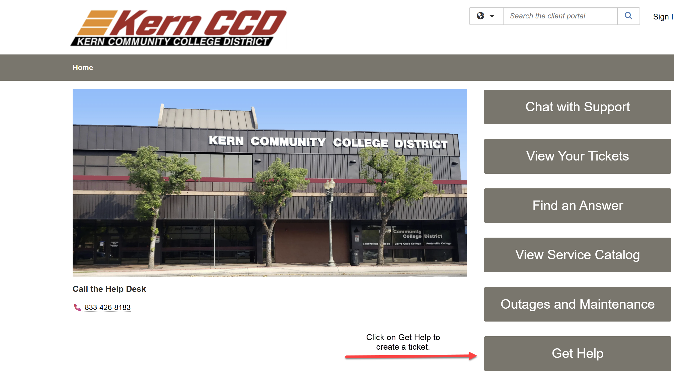
Q&A
Need a quote? Please submit a ticket using our Support Portal:
Notes:
Email is available on your smartphone a computer. You do not have to download the app, but can a

