Slide 1
BACHELOR OF SCIENCE

Slide 2






Slide 3

What is Industrial Automation?
Industrial Automation can be described as interconnected equipment, technology, and systems working together to maximize production, assure safety, use resources efficiently, and ensure product quality. It involves using physical machines and control systems to automate tasks within an industrial process. A fully autonomous factory is the extreme example.
4 year Bachelor of Science Degree
First Class Graduated in 2018

Slide 4

Why Industrial Automation?
With industries rapidly moving to utilize automated processes and with the evolution of technology, robotics, and artificial intelligence, automation has been a high priority among Bakersfield College faculty.
Meeting Workforce Demands:
Bakersfield College’s BS in Industrial Automation has been visionary in serving as the central provider of highly qualified graduates for positions in the Central Valley. Automation has decreased cost while increasing productivity, leading to growth in the STEM industry in the Central Valley.

Slide 5
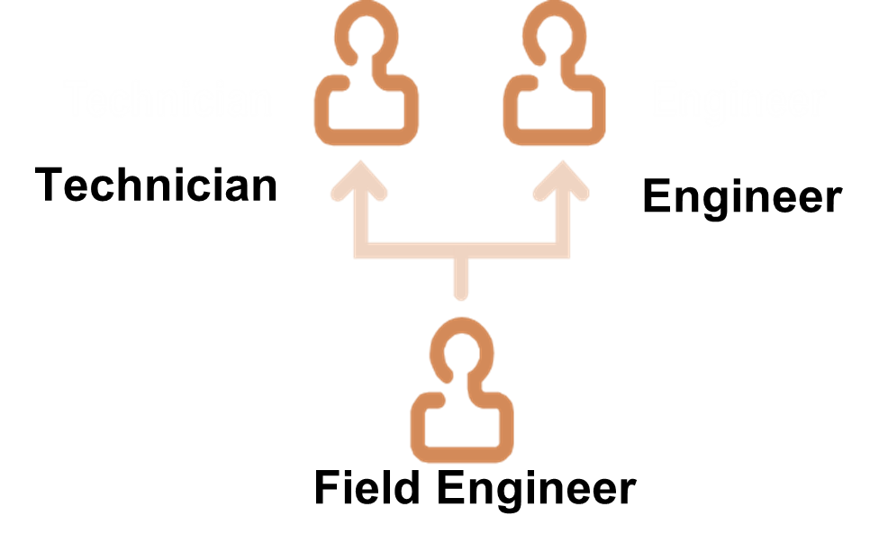

Program Overview
The Baccalaureate Program in Industrial Automation is designed to prepare individuals for technical management careers in industries that utilize automation.
“More than a technician”
Require specialized training and skills–
Maintenance or Repair.
“Works closely with an engineer”
Four-year degree is required.
Production Design or Product Development

Slide 6
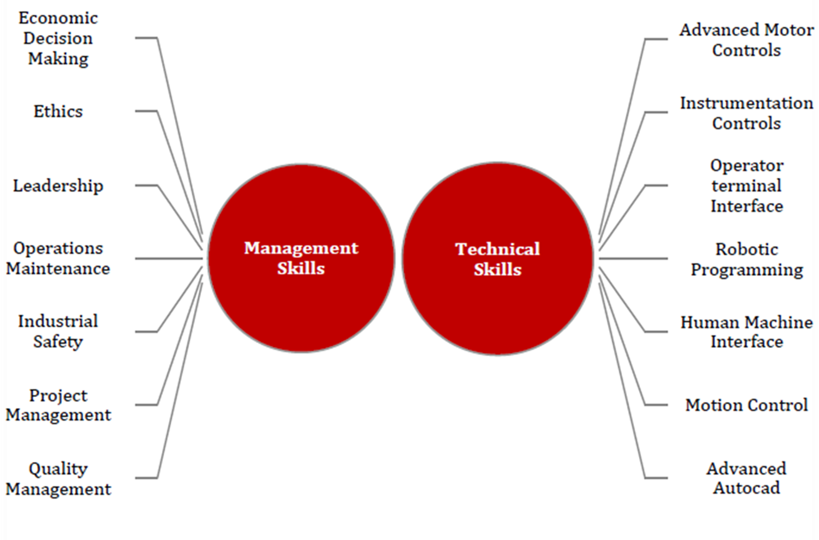
Program Overview

Slide 7
Local Hiring Employer Partners
Internship Employer Partners
Tasteful Selections
Target Distribution
Grimmway Farms
Amazon
Bolthouse Farms
Wonderful Citrus
Witron(Walmart Distribution)
Dryers Grand Ice Cream
Berry Corporation
GAF
Aera Energy
JTI Electric
Wonderful Pistachios & Almonds
Stratolaunch
Chevron
Ross
FedEx Ground
Phillips 66
Sentinel Peak Resources
JPR Systems
Frito Lay
Cintas
Twenty20 Solutions
Setton Farms
Cornerstone Engineering
Agilitech
Boeing
JG Boswell
Boeing
NASA
GAF
Aera Energy
Tasteful Selections
Wonderful Company
Lawrence Livermore

Slide 8
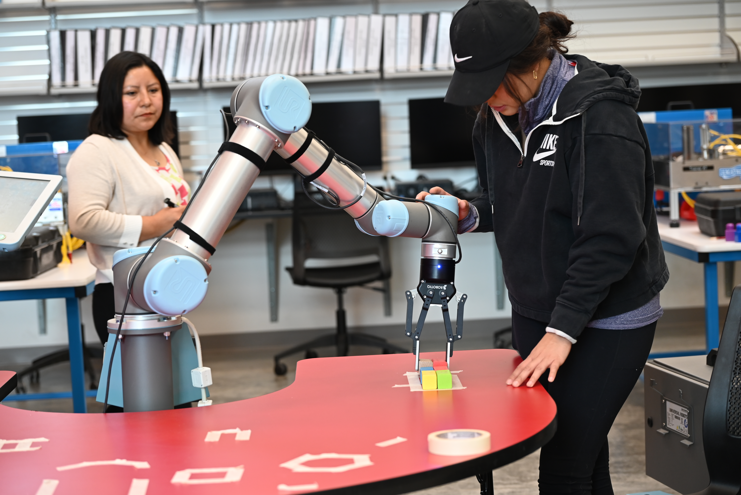
Early College (high schools offering one or more classes)
Robert F. Kennedy
Shafter High School (COA)
CTEC (AS Pathway Degree)
Kern Valley High (COA)
Wasco High
Bakersfield High
Independence High
Stockdale High
West High

Slide 9
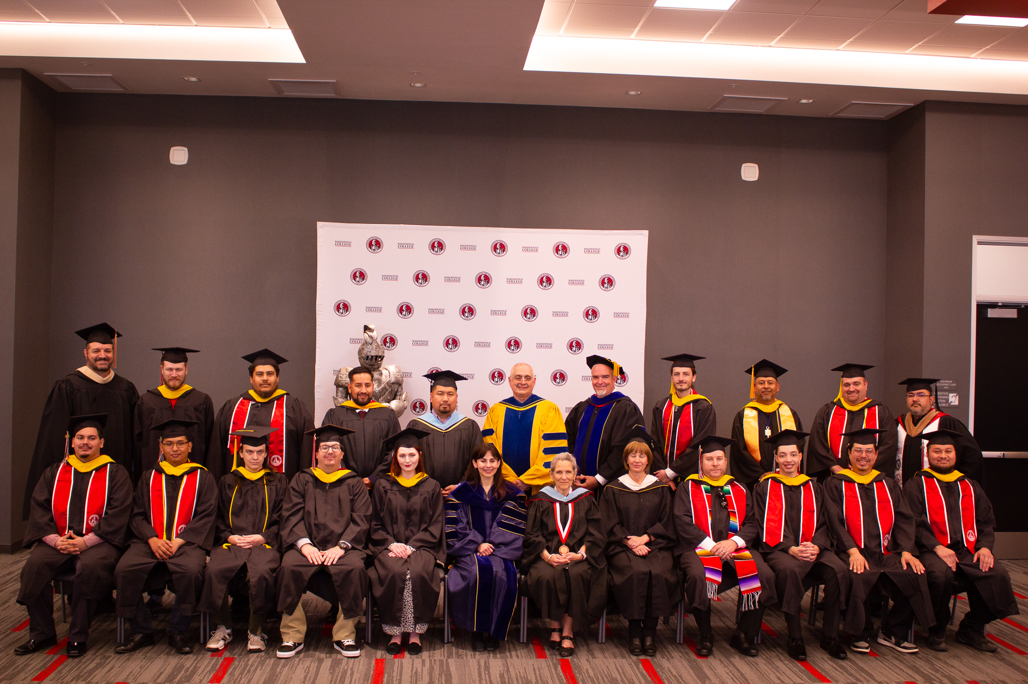
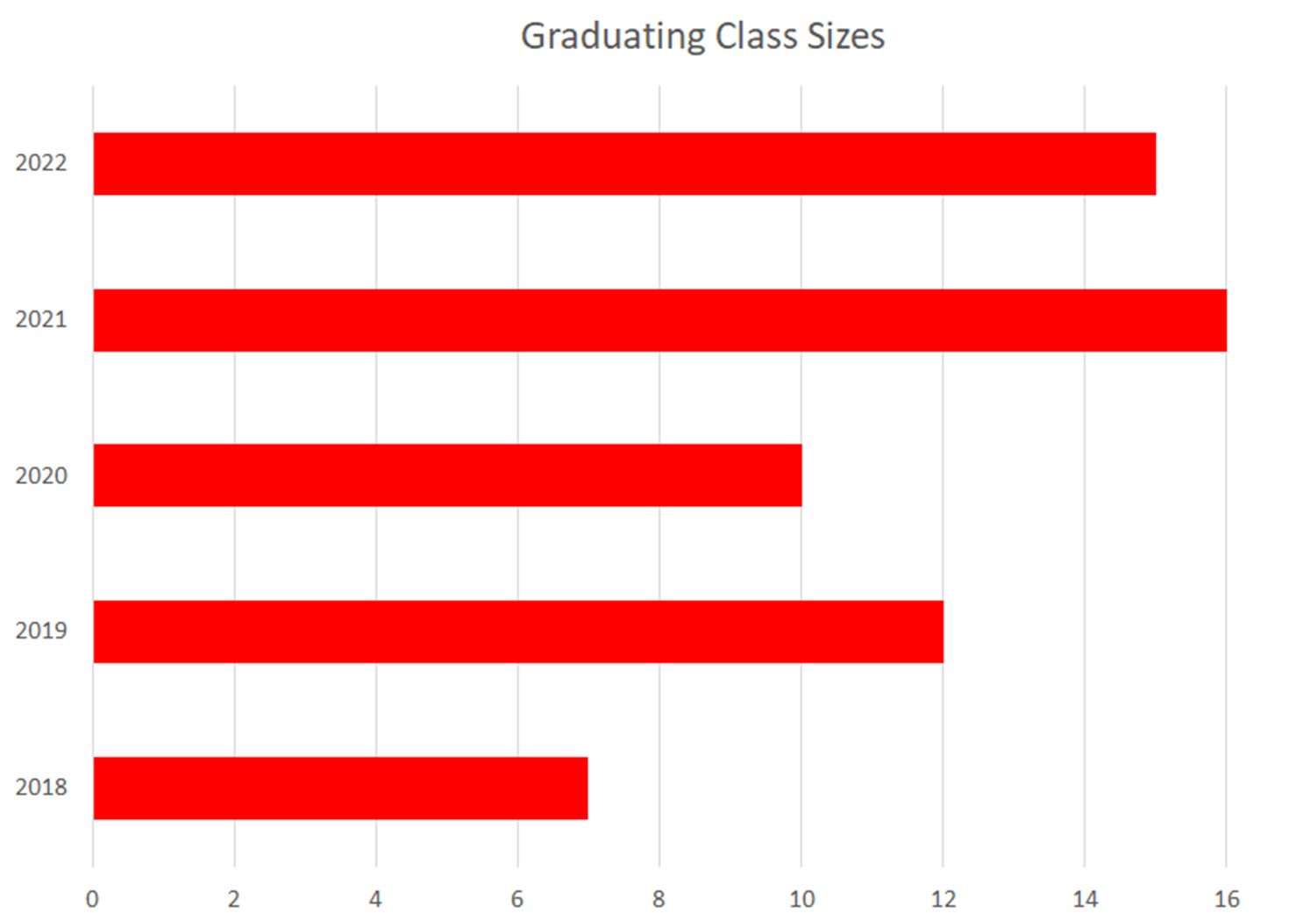
Total Alumni
91 total alumni
82 Males, 9 Females
7 Total Graduated Classes
8th graduating class with be this May(Class of 2025)

Slide 10
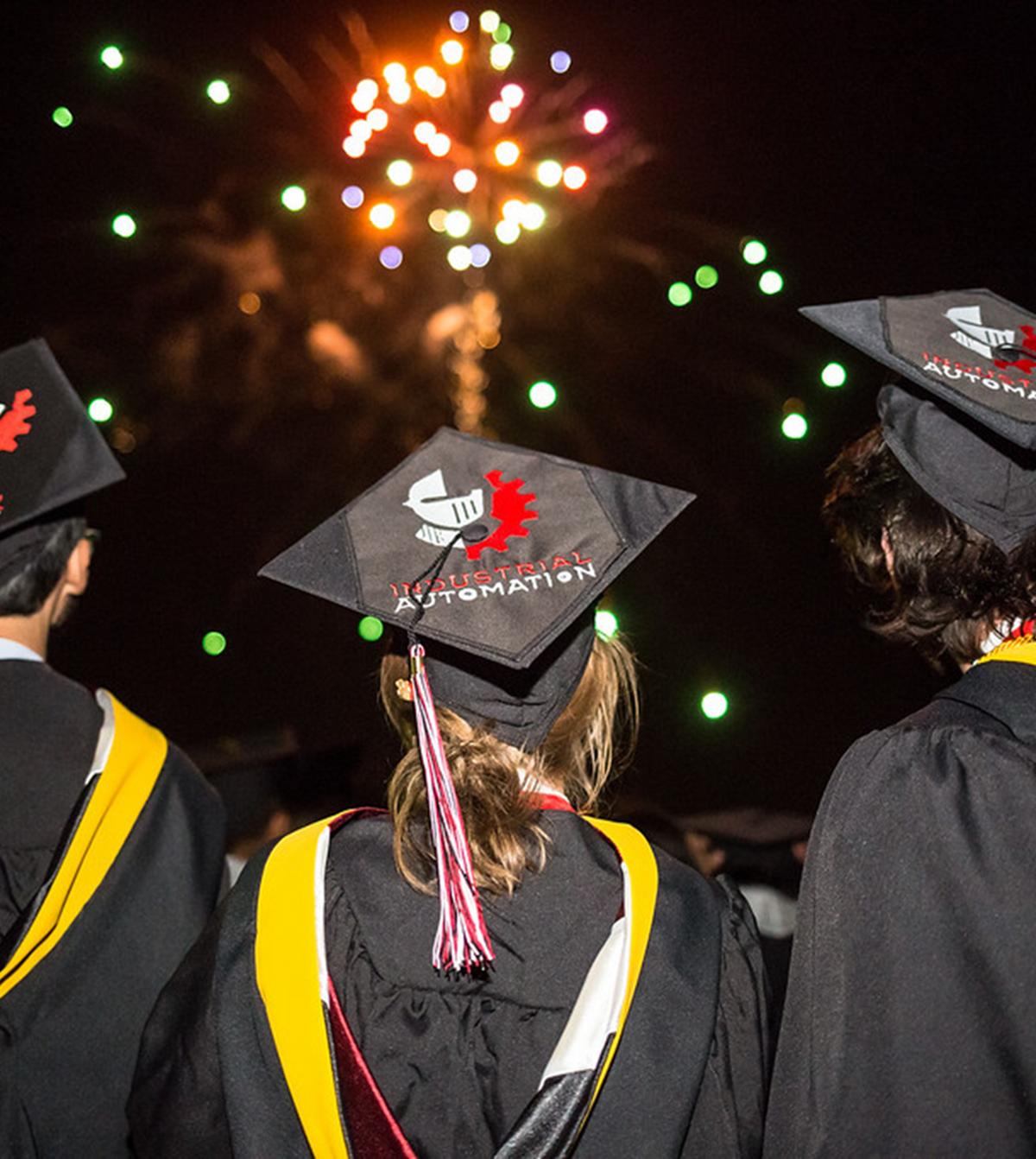


Slide 11
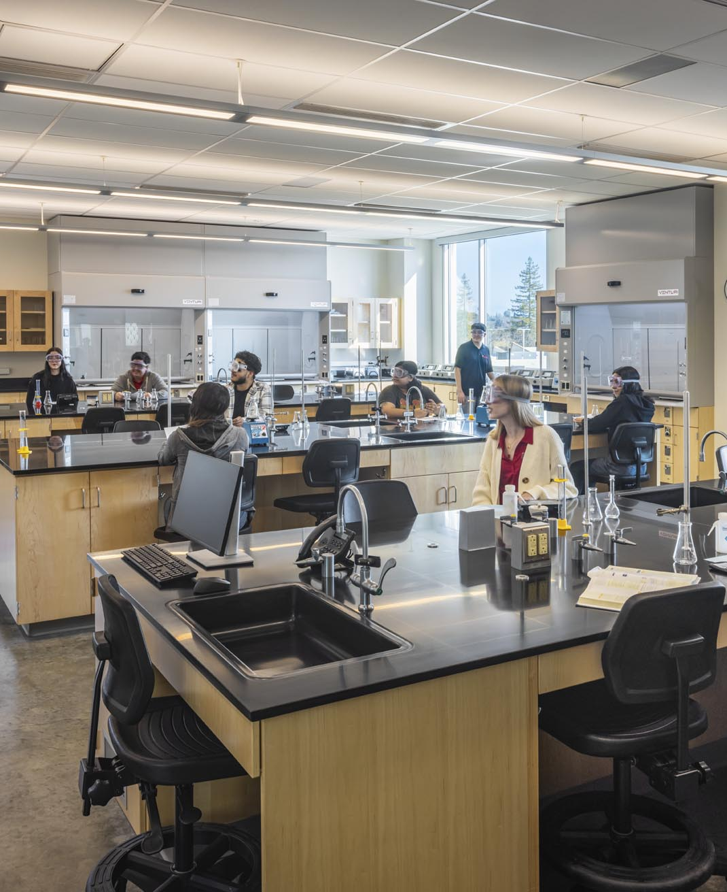
RESEARCH LABORATORY TECHNOLOGY​

Slide 12
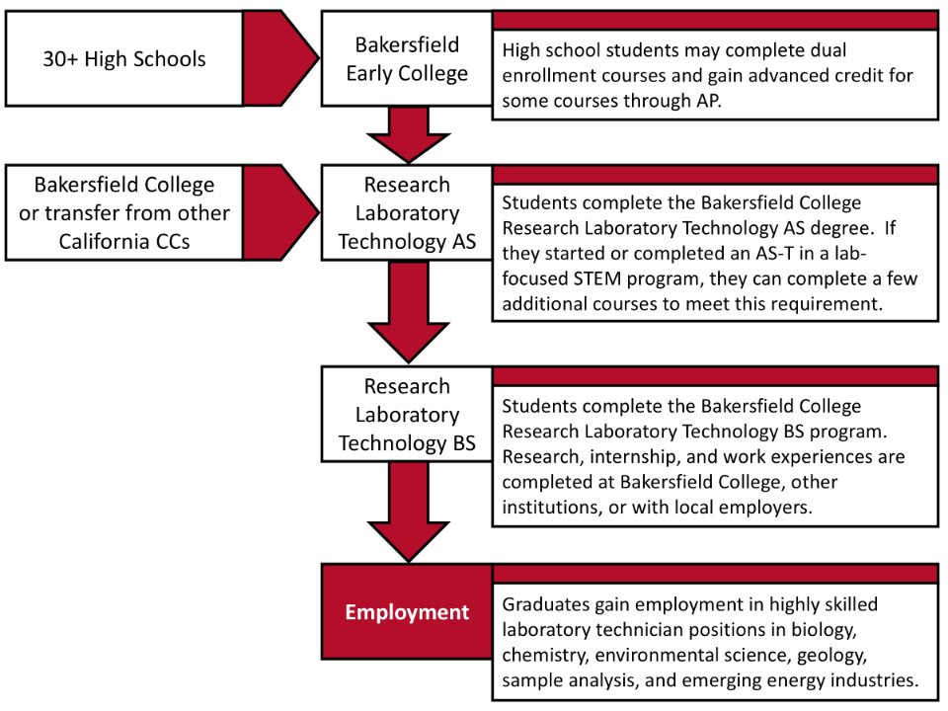
Program Pathway Opportunities

Slide 13
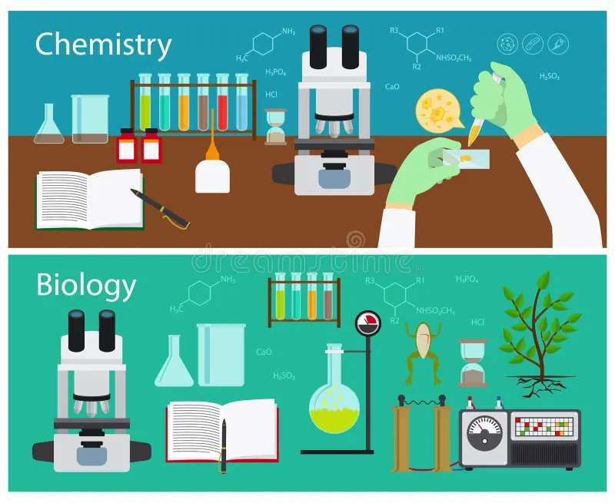
Earn your Associate of Science and Bachelor of Science degrees at BC!
Associate of Science
Bakersfield College offers an Associate Degree in Research Laboratory Technology (RTEC)
Or! Transition into the RTEC program with an Associate Degree in Chemistry or Biology.

Slide 14

Earn your Associate of Science and Bachelor of Science degrees at BC!
Bachelor of Science
Modern instrumentation for qualitative and quantitative sample analyses.
“Good lab practice” cleaning and laboratory maintenance.
Documentation skills for OSHA and other laboratory regulations and standards.​
Computer systems for program management and reporting

Slide 15
Large Labor Market
Research Lab Tech related new positions per year
Kern County >50 per year
California > 3,000 per year
Issues for Kern Employers
Need to hire university BS STEM students and train ($)
New employees leave Kern County quickly
Data from Centers of Excellence for Labor Market Research

Slide 16

LOWER DIVISION SCHEDULE
Freshman Fall
CHEM B2A Introductory General Chemistry ​
MATH B1A Precalculus I ​
ENGL B1A Expository Composition, Area 1.A ​
ARTS, Area 3.A
Freshman Spring
CHEM B1A General Chemistry I ​
MATH B1B Precalculus II ​
COMM, Area 1.C ​
Humanities, Area 3.B

Slide 17
LOWER DIVISION SCHEDULE
Sophomore Fall
CHEM B1B General Chemistry and Chemical Analysis ​
BIOL B3A General Biology I ​
Critical Thinking, Area 1.B ​
Social and Behavioral Science, Area 4
Sophomore Spring
BIOL B3B General Biology II ​
Area Elective, List A ​
Social and Behavioral Science, Area 4​
Ethnic Studies, Area 6

Slide 18
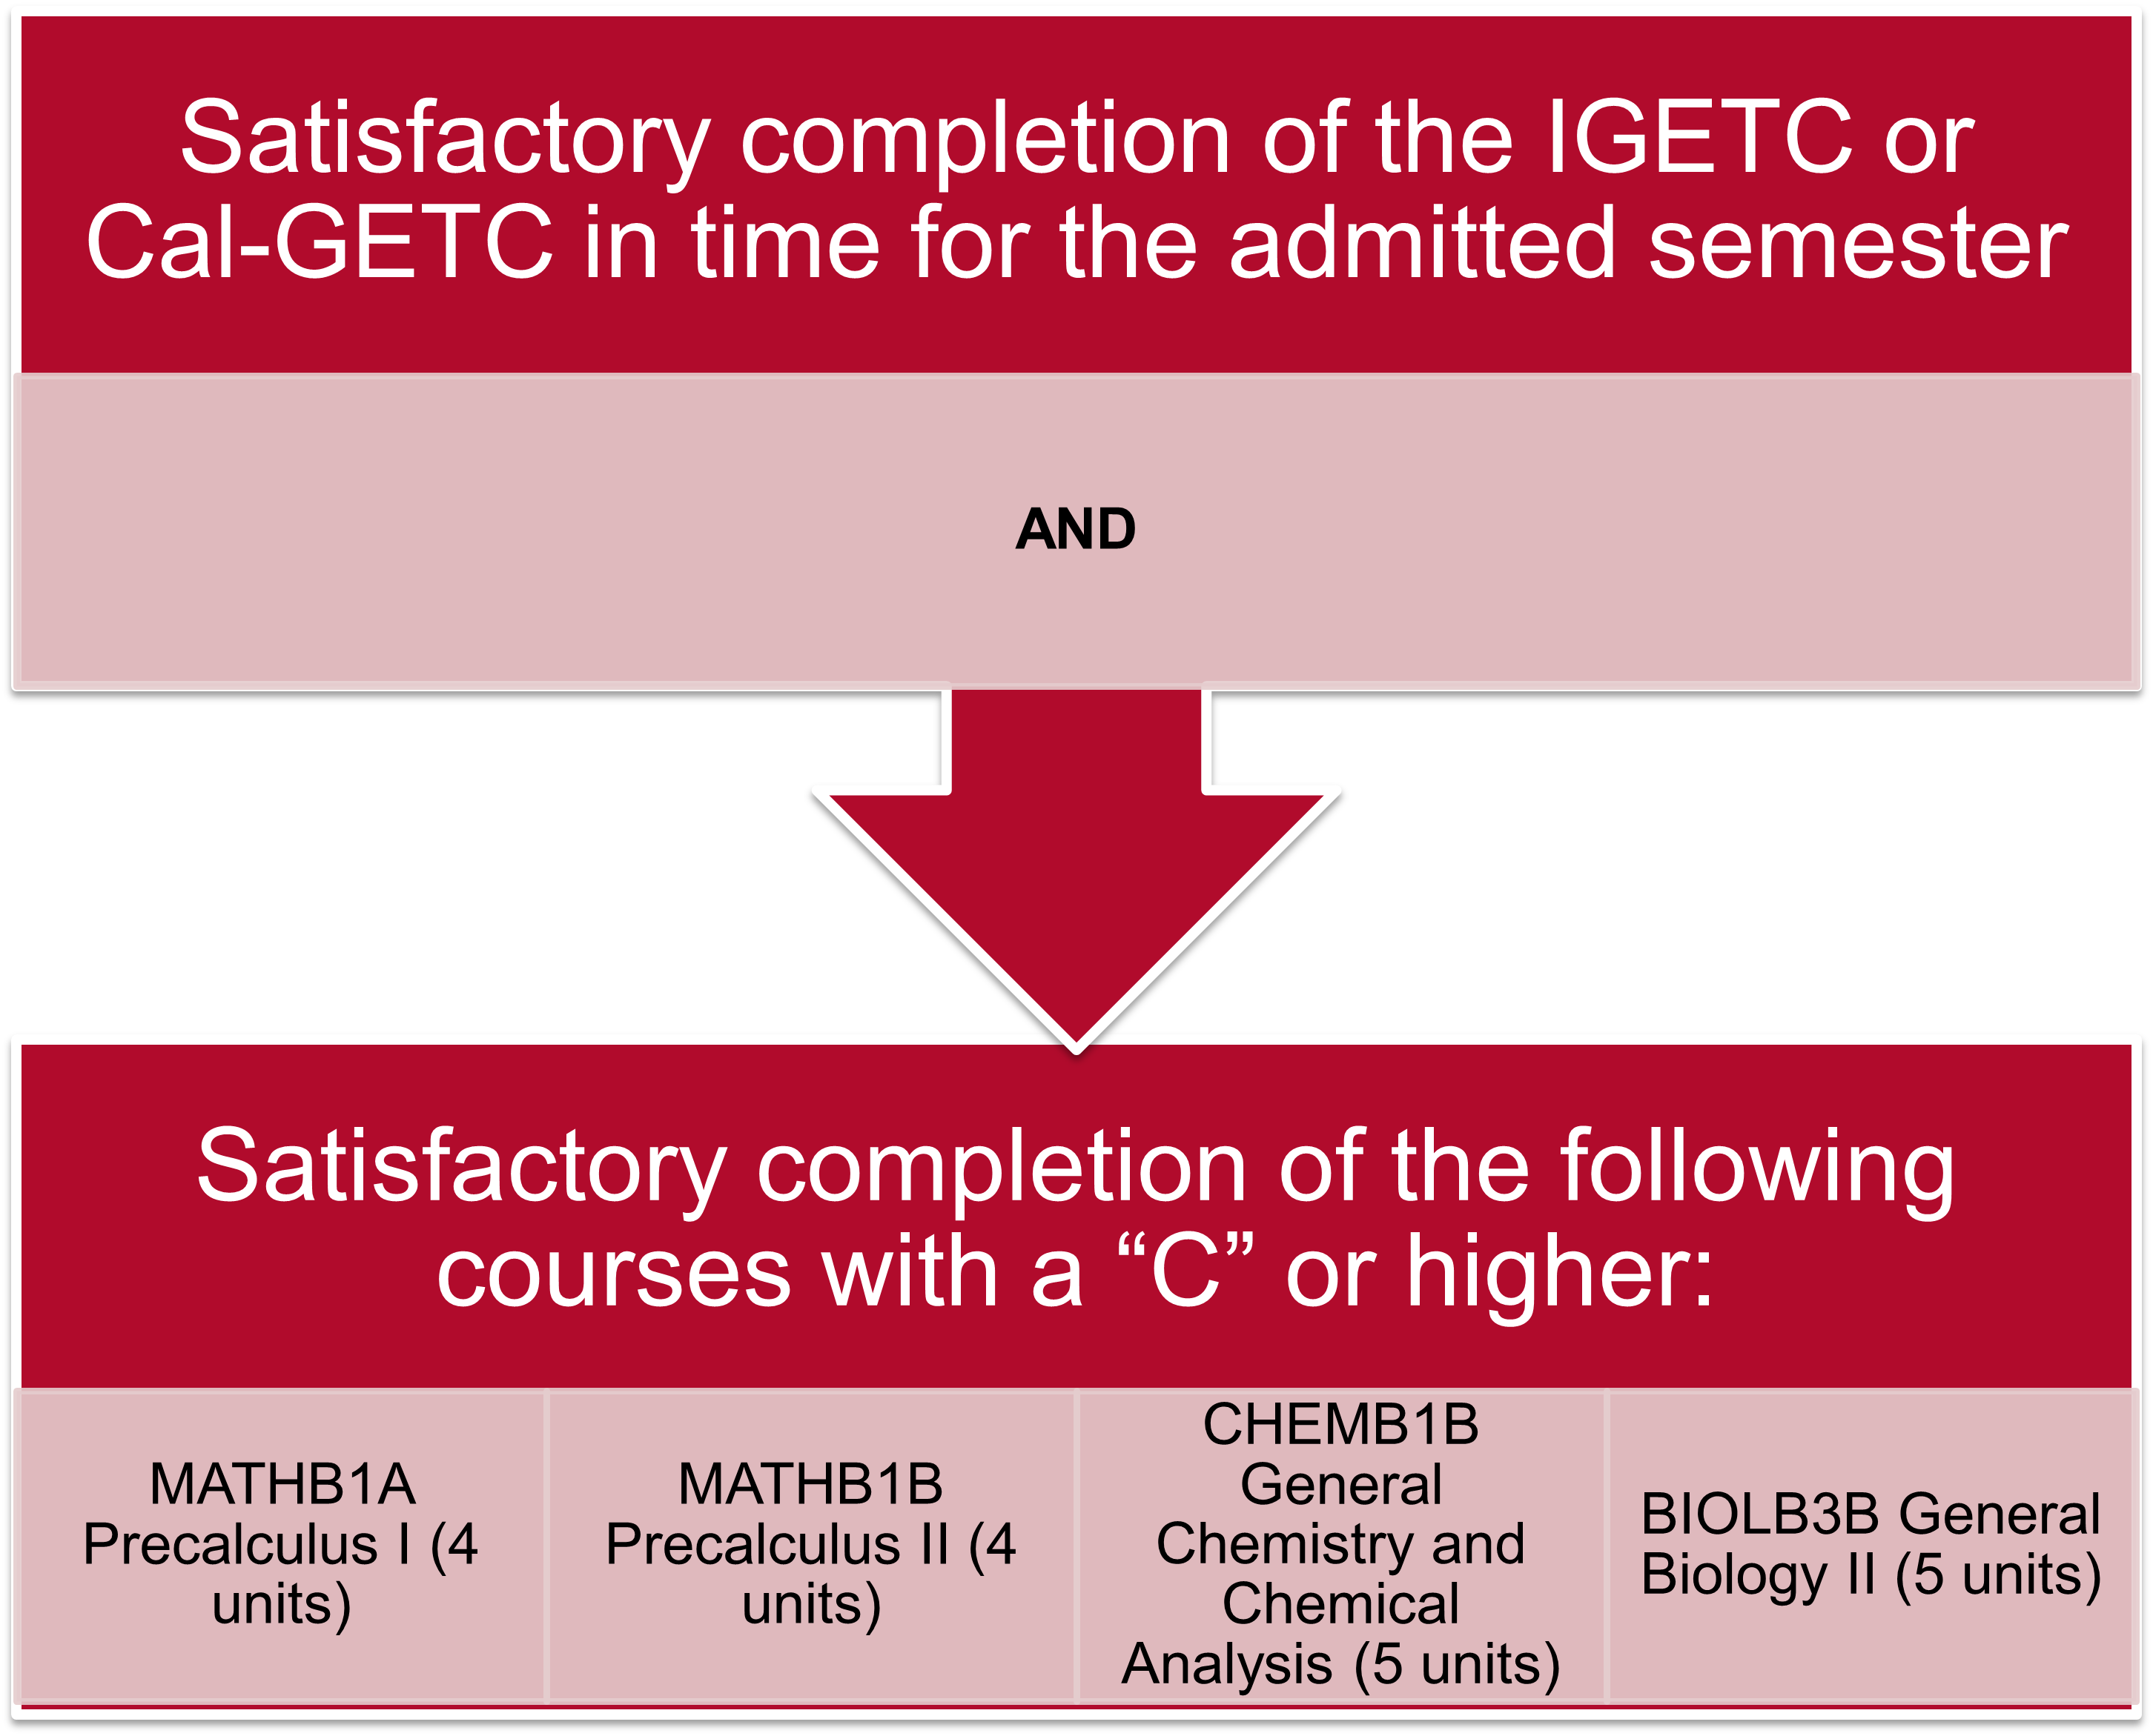
Upper Division Admission Requirements

Slide 19

UPPER DIVISION SCHEDULE
Junior Fall
CHEM B30A Organic Chemistry​
RTEC B100: Quantitative Analytical Methods and Techniques ​
RTEC B101: Laboratory Safety and Materials Management​
ENGL B100: Technical Writing
Junior Spring
RTEC B102: Inorganic/Metallic Laboratory Quantification ​
RTEC B103: Biologic/Organic Laboratory Analysis ​
INDA B140: Quality Management​
PSCY B100: Industrial and Organizational Psychology ​
Area Elective, List A

Slide 20

UPPER DIVISION SCHEDULE
Senior Fall
RTEC B110: Quantitative Analytical Methods and Techniques ​
INDA B132: Project Management for Capstone ​
Phil B100: Industry Ethics ​
Elective ​
Elective
Senior Spring
RTEC B140: Research Project Design and Execution ​
List B Elective ​
List B Elective ​
Elective​
Elective

Slide 21
Key Differences
Curriculum
Career Readiness
Research Laboratory Technology: Hands-on, practical skills.​ No need to transfer!
Biology: Broad study of life sciences.​
Chemistry: In-depth study of chemical principles.
Research Laboratory Technology: Immediate entry into lab roles.​
Biology: Foundation for advanced studies or diverse careers.​
Chemistry: Foundation for advanced chemistry careers or further education.

Slide 23

Choosing the Right Path
Career goals: Immediate employment vs. further education.​
Interest areas: Practical lab work vs. theoretical study.​
Long-term aspirations: Specific career paths and growth opportunities.

Slide 24

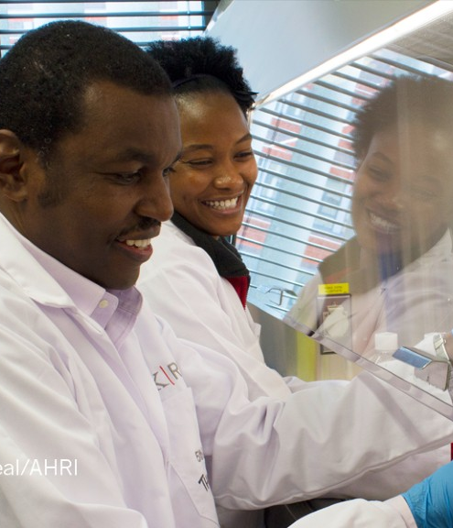
CAREER OPPORTUNITIES
Quality Control Technician: responsible for ensuring that laboratory work is conducted in accordance with established protocols and procedures, and that all results are accurate and reliable.
Biotechnology Technician: work in biotechnology companies, assisting in the development and production of biotech products, such as vaccines, drugs, and genetically modified organisms.

Slide 25

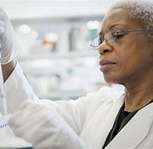
CAREER OPPORTUNITIES
Laboratory Technician: perform a variety of tasks, including setting up and maintaining laboratory equipment, preparing and analyzing samples, and recording and interpreting data
Research Assistant: work under the direction of a principal investigator, helping to design and conduct experiments, collect and analyze data, and maintain laboratory records.

Slide 26
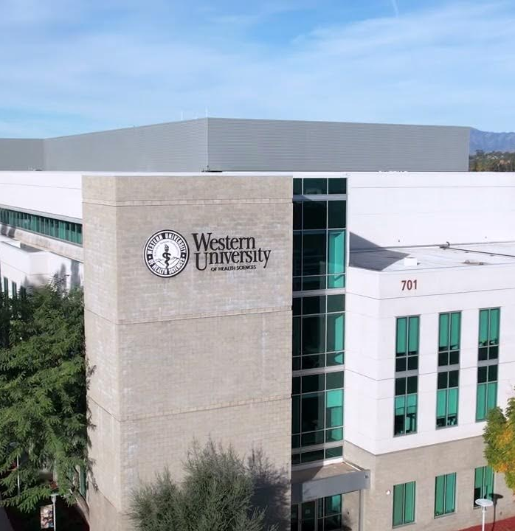
BC to WesternU Admission Agreement Preview
Enroll in BC's Research Laboratory Technology Bachelor's degree program​
Application required for upper division admission
Meet with counselor, Cynthia, and program manager, Bianca, to create education plan and prepare to apply
Guaranteed seats in WesternU’s Master of Science in Medical Science program for select RTEC grads​

Slide 27

General Course Requirements & Recommendations for Medical School Applications
Research Laboratory Technology Bachelor's Degree
Recommended Elective Courses:
  2 semesters of Biology with Lab
    BIOL B3A and BIOL B3B
  2 semesters of General Chemistry with Lab
    CHEM B1A and CHEM B1B
  2 semesters of Organic Chemistry with Lab
    CHEM B30A and CHEM B30B
  2 semesters of Physics
    PHYS B2A and PHYS B2B or PHYS B4A and PHYS B4B
  At least 1 semester of Calculus-based Math
    MATH B6A or MATH B6B

