Slide 1
Temporary Employment Assignments (TEA)
Lisa Rodriguez
Director, Human Resources (BC)
September 2024

Slide 2
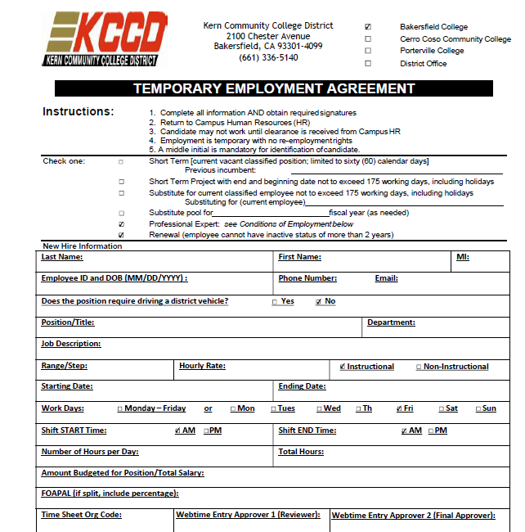
Agenda
When to complete a TEA and what to include
What happens once a TEA is signed
HR process
HR clearance and job build
Time entry
Who cannot work on a TEA

Slide 3
When and What
Complete the TEA before the person starts working on campus
Be sure to include start and end dates reflective of when the person will be working
Verify you have the right FOAPAL
Verify the person is not classified staff

Slide 4
After a TEA is Signed
The completed TEA goes to the HROnboarding@bakersfieldcollege.edu email
HR reviews TEA and logs it for tracking purposes
HR reviews employee banner efile to verify HR documents are on file and current
HR contacts temporary employee to provide onboarding packet

Slide 5
Temporary Employment Onboarding Packet
What’s in the packet
  Agreement for temporary employment
  Background check process
  TB risk assessment
  Form I-9 plus list of acceptable documents
  W-4 / DE-4
  Oath of office
  Applicant equal employment opportunity survey
  Emergency contact information
  Direct deposit form
  Designation of beneficiary
  Classified retirement status form
  Statement concerning employment not covered by social security
  Computer and network use agreement
  Workers’ compensation information
  Policy acknowledgements

Slide 6
TEA Flow
Upload items to Banner Document Management (BDM)
Position Number comes in and job builder builds job
Employee gains access to Web Time Entry
Request position number from DO
Add to Board Action
Update Banner Screens
Send Clearance Email
Yes
TEA Received: Does employee have all onboarding docs and are all tests current?
Reach out to employee to request items needed
Wait for employee to submit items
Wait for any required pre-employment test results
No
Once all items are in
Note: Once all onboarding documents are retrieved the Pre-employ background check is still updated every two years, and the TB is updated every 4 years
Employees cannot work without HR Clearance

Slide 7
HR Clearance / Job Build
Once all documents have been received and cleared, HR will request for the position to be built
HR will process necessary payroll processing paperwork
HR will notify team of clearance

Slide 8
Web Time Entry
Once the position has been built, the employee can enter time in the web time entry system
If this process is out of sync, the employee may have to enter time on a manual time sheet for processing

Slide 9
Classified Employees Cannot Be A TEA
They cannot be a professional expert
This includes teaching courses for the Levan.
CSEA Contract – Appendix G
They can be an adjunct
  Must apply
  Must meet min quals
  Must be approved by direct supervisor, appropriate VP, and College President

Slide 10
Questions?

