Slide 1
110th BC Commencement!

Slide 2
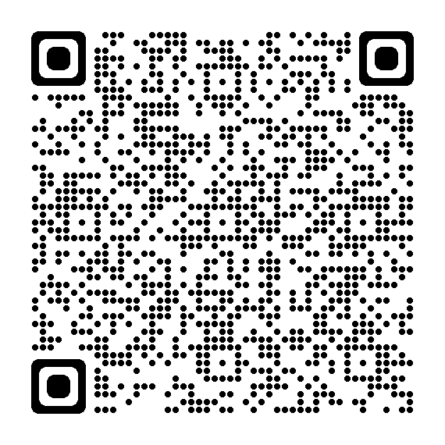
Bakersfield College
110th Commencement
Processional Sign Up

Slide 3
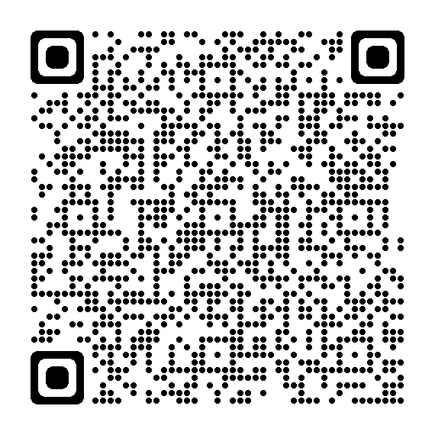
Bakersfield College
110th Commencement
Event Assistance
Check-in 3:00 pm

Slide 4
African American Pre-Commencement Event
Date: May 10, 2024
Time: 4:00PM
Location: Edward Simonsen Indoor Theatre
More Information:
  RSVP's due by May 2, 2024 by 10:00AM
  See the African American Pre-Commencement page.
  Paula Parks

Slide 5
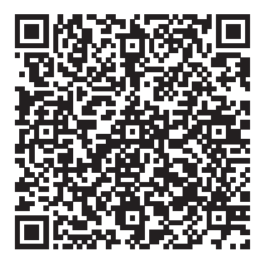

Chicano/Latino Pre-Commencement Event
Date: May 10, 2024
Time: 3:00PM
Location: Edward Simonsen Outdoor Theatre
More Information:
  RSVP’s due by April 26, 2024
  Student Application Fee: $20
Staff/Faculty/Admin participation
  Patricia Ramirez

Slide 6
Delano Pre-Commencement Event
Date: May 10, 2024
Time: 11:30AM
Location: Bakersfield College, Delano Campus - DST 109 & 118
More Information:
  1450 Timmons Avenue, Delano, CA 93215
  Brian Rodriguez

Slide 7
Industrial Automation Baccalaureate Degree
Pre-Commencement Event
Date: May 10, 2024
Time: 4:00PM
Location: Renegade Events Center (East)
More Information:
  This event is invitation only.
  RSVP’s due by April 26, 2024
  Maximum guests allowed is 6 per graduate.
  Carlos Medina

Slide 8
Lavender (LGBTQIA+) Pre-Commencement Event
Date: May 10, 2024
Time: 3:00PM
Location: Renegade Events Center (West)
More Information:
  Annual Pre-Commencement Event to honor lesbian, gay, bisexual, transgender, queer, & ally students.
  For more information, visit Lavender Pre-Commencement Event page.
  Kimy Salazar & Leo Ayala

Slide 9
Veterans Pre-Commencement Event
Date: May, 10 2024
Time: 4:00PM (graduates arrive by 3:45PM)
Location: Veterans Resource Center
More Information:
  RSVP by May 3, 2024
  For more information, visit Veterans Pre-Commencement Event.
  Jenny Frank

Slide 10
By Invitation Only Events
Education Department Accomplishment Celebration
  April 19, 6:00 pm, Renegade Event Center (East)
Firefighter 1 Graduation
  May 8, 6:00 pm, Edward Simonsen Indoor Theatre
Pre-Law Celebration
  May 2, 6:00 pm, Fireside Room
Radiological Technology Pinning Ceremony
  May 9, 6:00 pm, Renegade Event Center
RN Pinning Ceremony
  May 9, 6:00 pm, Edward Simonsen Outdoor Theatre
Scholarship Celebration
  May 3, 10:00 am, Campus Center Breezeway

