Slide 1
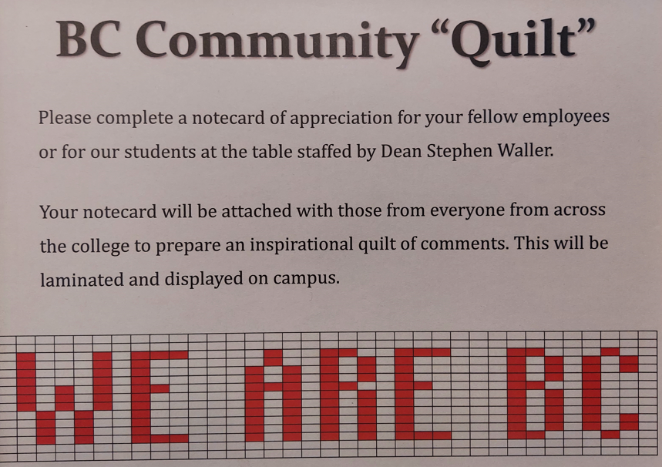
Stephen Waller, Marisa Marquez, Vikki Coffee

Slide 2
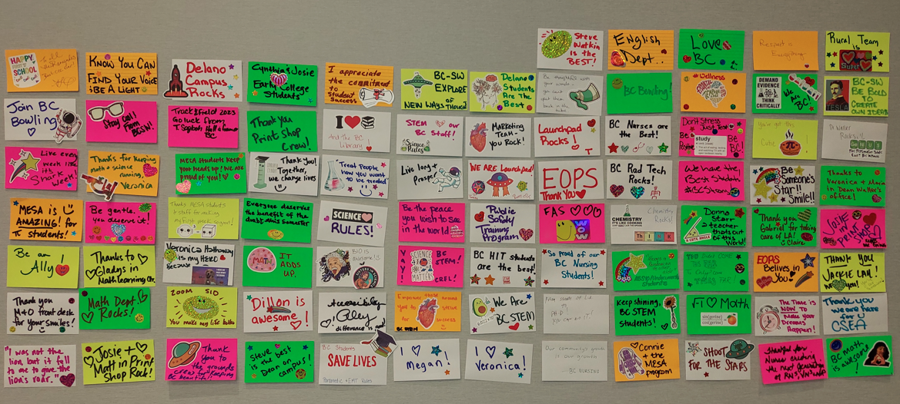

Slide 3
Your piece of the appreciation quilt…
Create a note of appreciation on an index card.
Choose your piece of fabric from a bag.
Realize how your fabric is different and the same as others.
Keep remembering to use appreciation to keep your piece of the quilt connected with other to keep our quilt strong.

