Slide 1
STEM Common Hours
Stephen Waller
Exec Dean of Instruction, STEM

Slide 2
Community College Administrators
We create…
Spaces
Time
Resources
Processes
Communications
… for students to be successful in learning

Slide 3
Resources Not Fully Used by BC Students
Faculty “Office Hours”
Academic Support Services
Advising/Counseling
Health (Physical & Mental) Services
Financial Aid and Scholarships
Grant-funded Activities and Interventions
Speaker and Other Engaging Events
  like STEM Week Zero, annual STEM &Pre-Med Conference

Slide 4
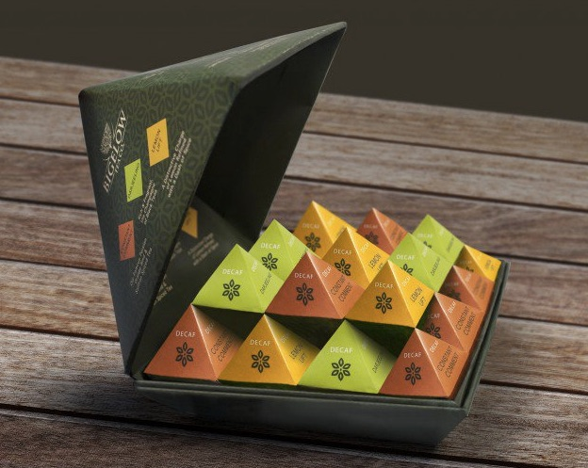
Think with More Boxes
Anyone can think
“outside of the box”.
However, a problem-solver
thinks with more boxes!
Learn about what others do
and then steal the good stuff!
This Photo by Unknown Author is licensed under CC BY

Slide 5
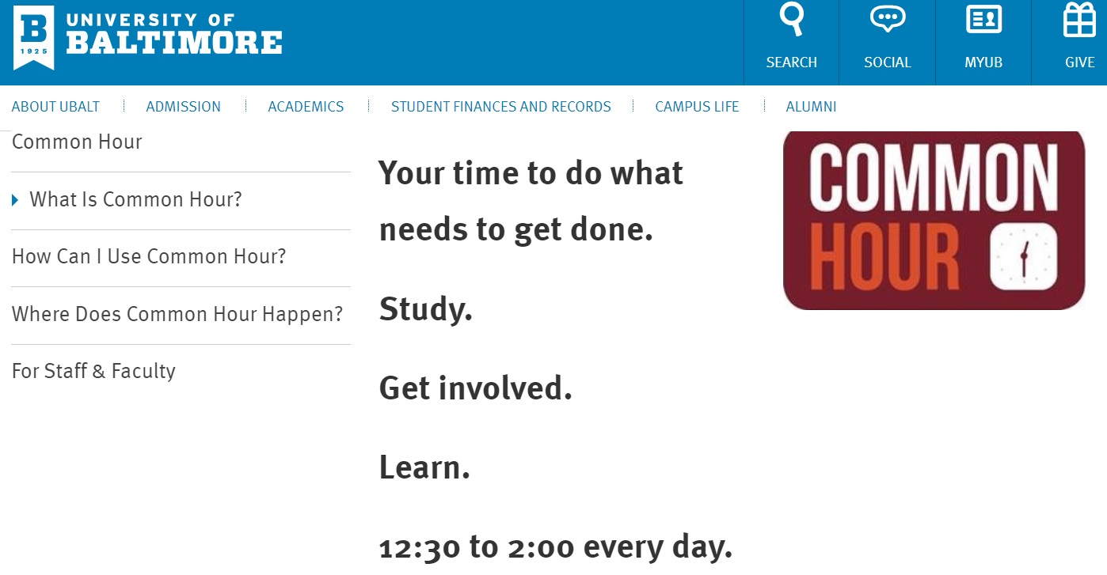
Common Hour is not Uncommon

Slide 6
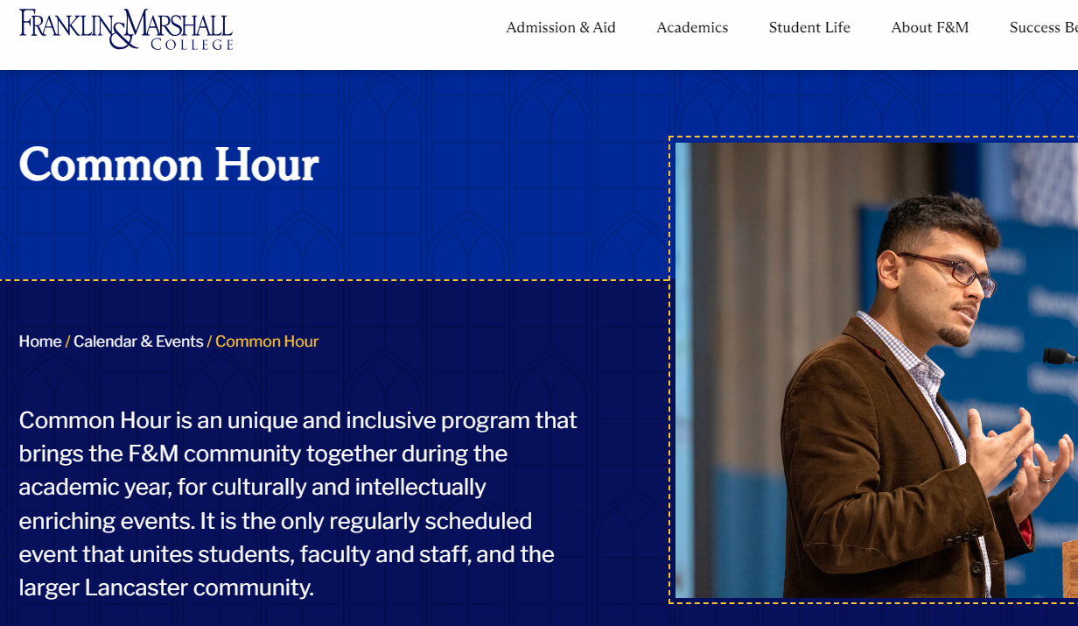
Common Hour is not Uncommon

Slide 7

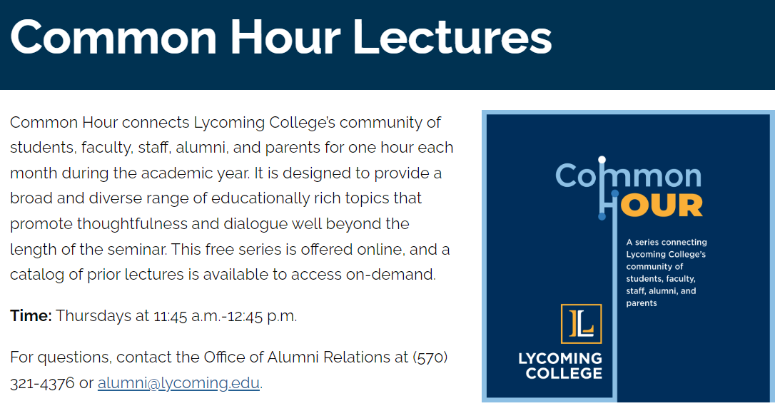
Common Hour is not Uncommon

Slide 8

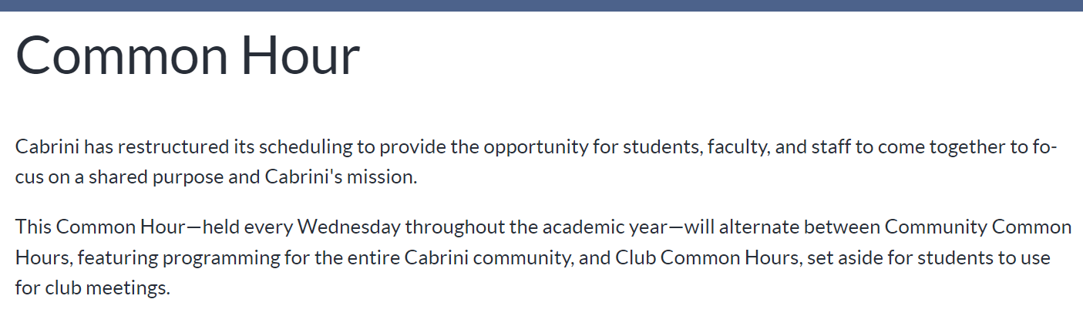
Common Hour is not Uncommon

Slide 9

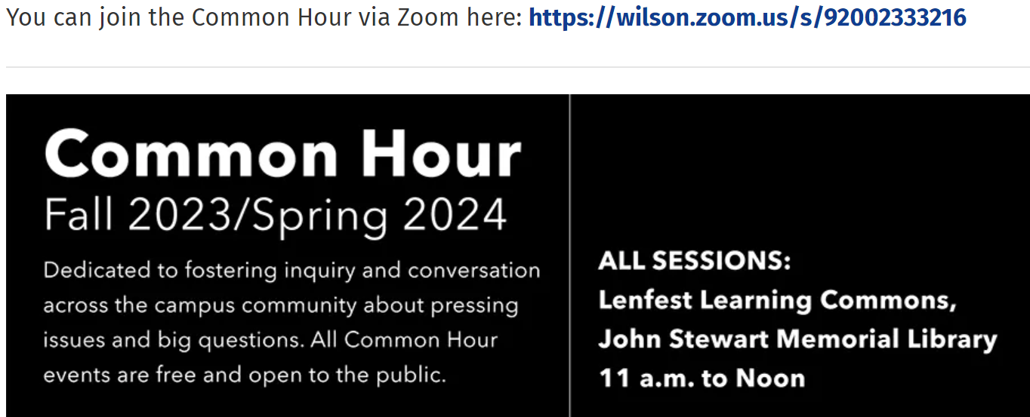
Common Hour is not Uncommon

Slide 10

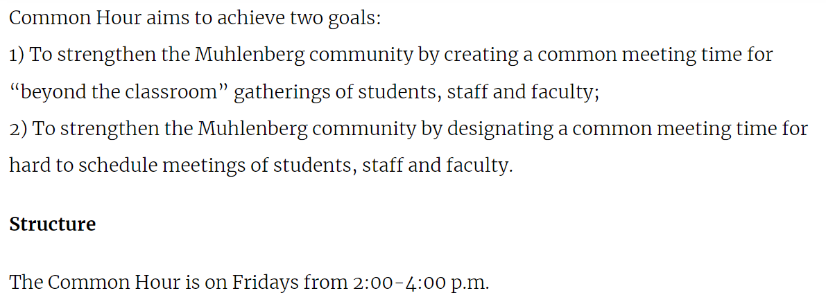
Common Hour is not Uncommon

Slide 11
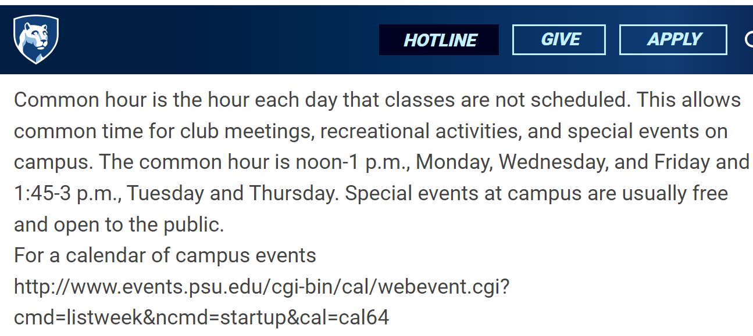
Common Hour is not Uncommon

Slide 12
BC’s First Semester with Common Hours
STEM has $ for interventions and a new building, but no time!
April 2023 – VP approves the Spring 2024 STEM schedule on the Panorama Campus to pilot STEM Common Hours.
May 2023 – STEM departments agree to delay 1:00 pm classes on Tuesdays and Thursdays to start at 1:30 pm, to give ~1 hour free time from ~12:30 – 1:30 pm without STEM classes.
September 2023 – STEM department chairs build Spring 2024 schedule for Panorama Campus with Tuesday/Thursday Common Hour.

Slide 13
STEM Common Hours Activities
Communicated to students through…
STEM Completion Coaching emails
STEM faculty
STEM Counselors and Ed Advisors
STEM Clubs and MESA
STEM Discord Channel
Google Event List STEM Common Hour Schedule

Slide 14
STEM Common Hours Activities
Tuesdays and Thursdays: ~12:30 – 1:30 pm
STEM Resource Fair
Math Matters Speaker Series
Student Research Presentations
Faculty Thursday Talks
Transfer Information Sessions (STEM and Pre-Med)
Community College BS Degree Info Sessions
MESA Workshops

Slide 15
STEM Common Hours Activities
Financial Aid Workshops (in planning stages)
Degree Navigation and Success Workshops
Pi-Day (Thursday, March 14th)
STEM Student Clubs Meetings
STEM Faculty Completion Coaching Team Meetings
STEM Faculty Research Project Information Sessions
STEM Faculty Professional Development Book Discussions

Slide 16
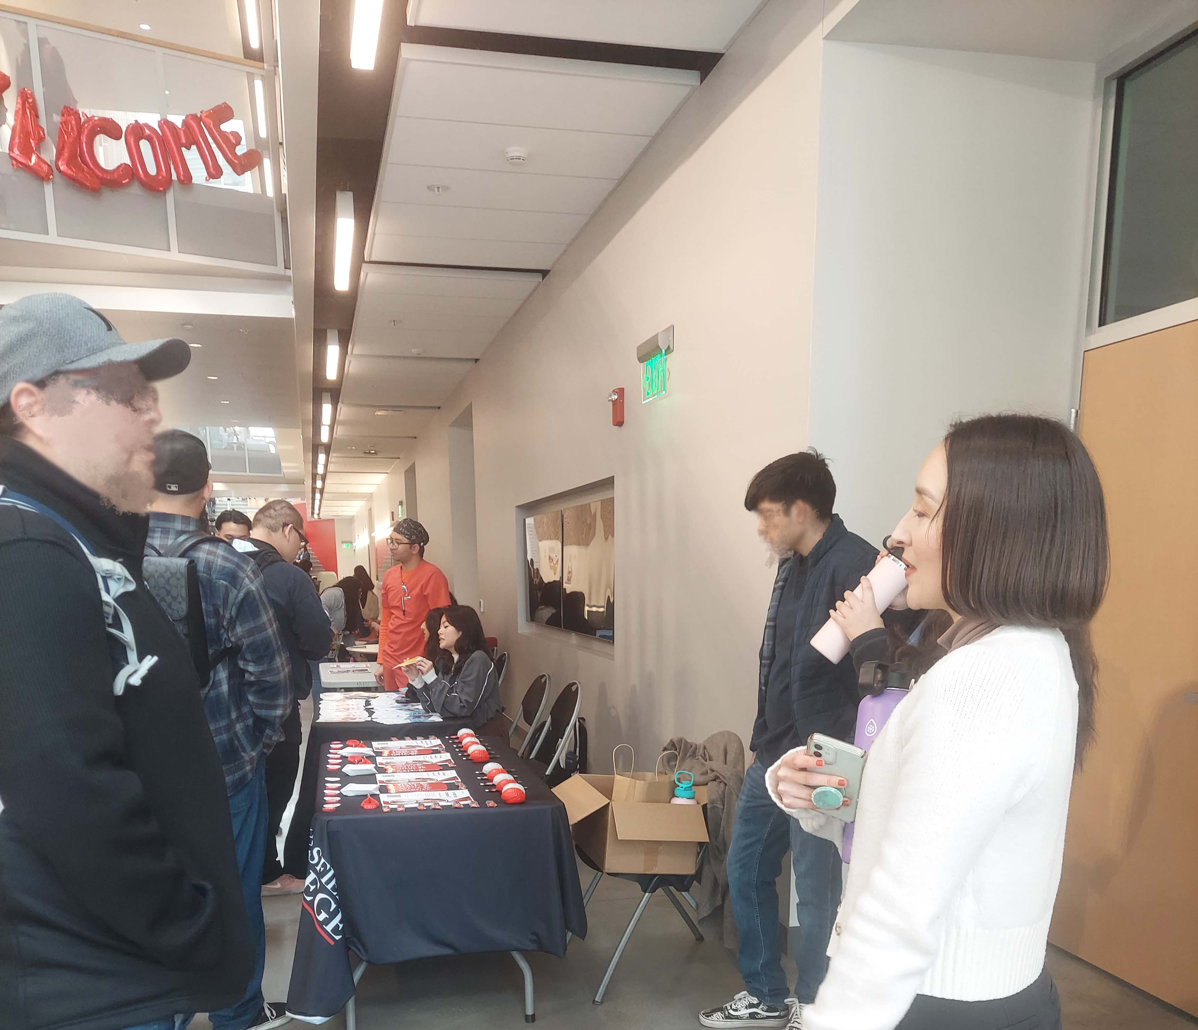
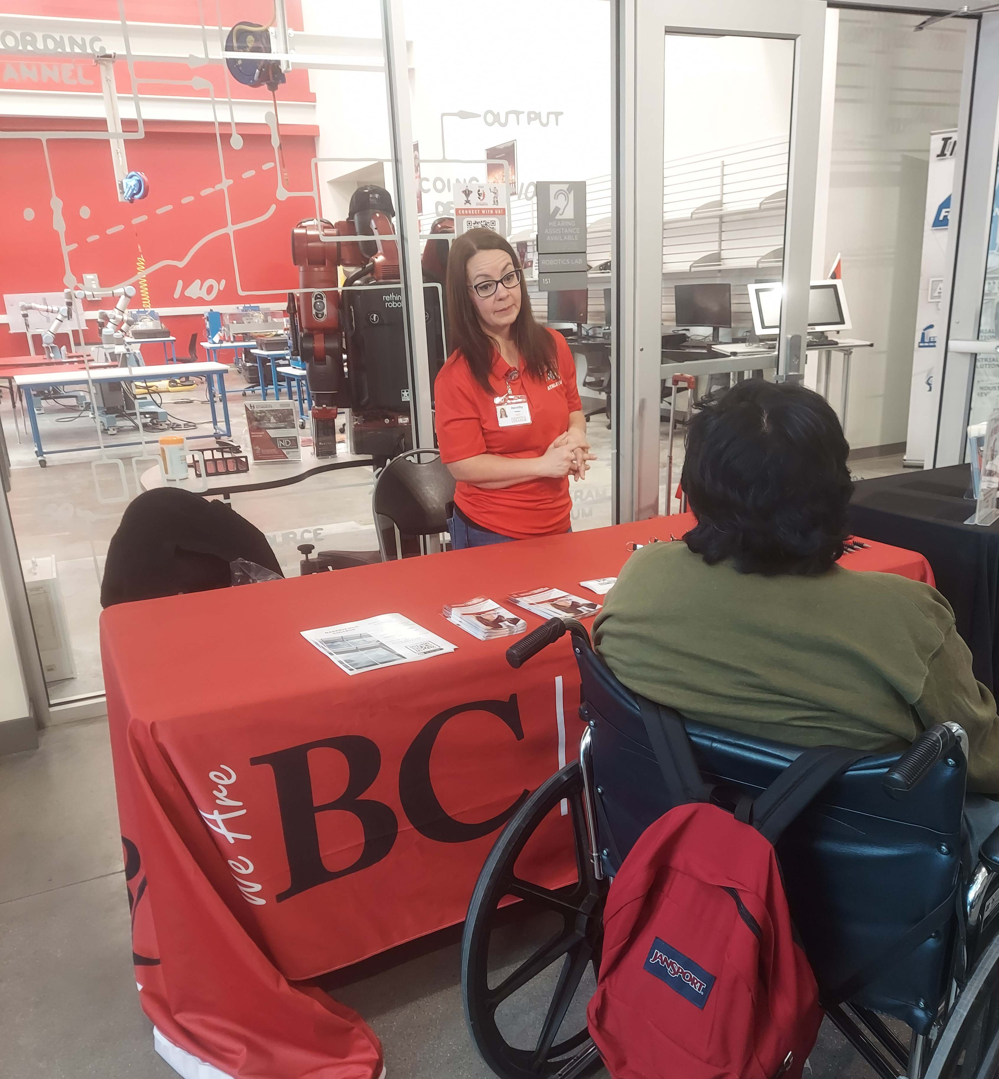
STEM Resource Fair

Slide 17
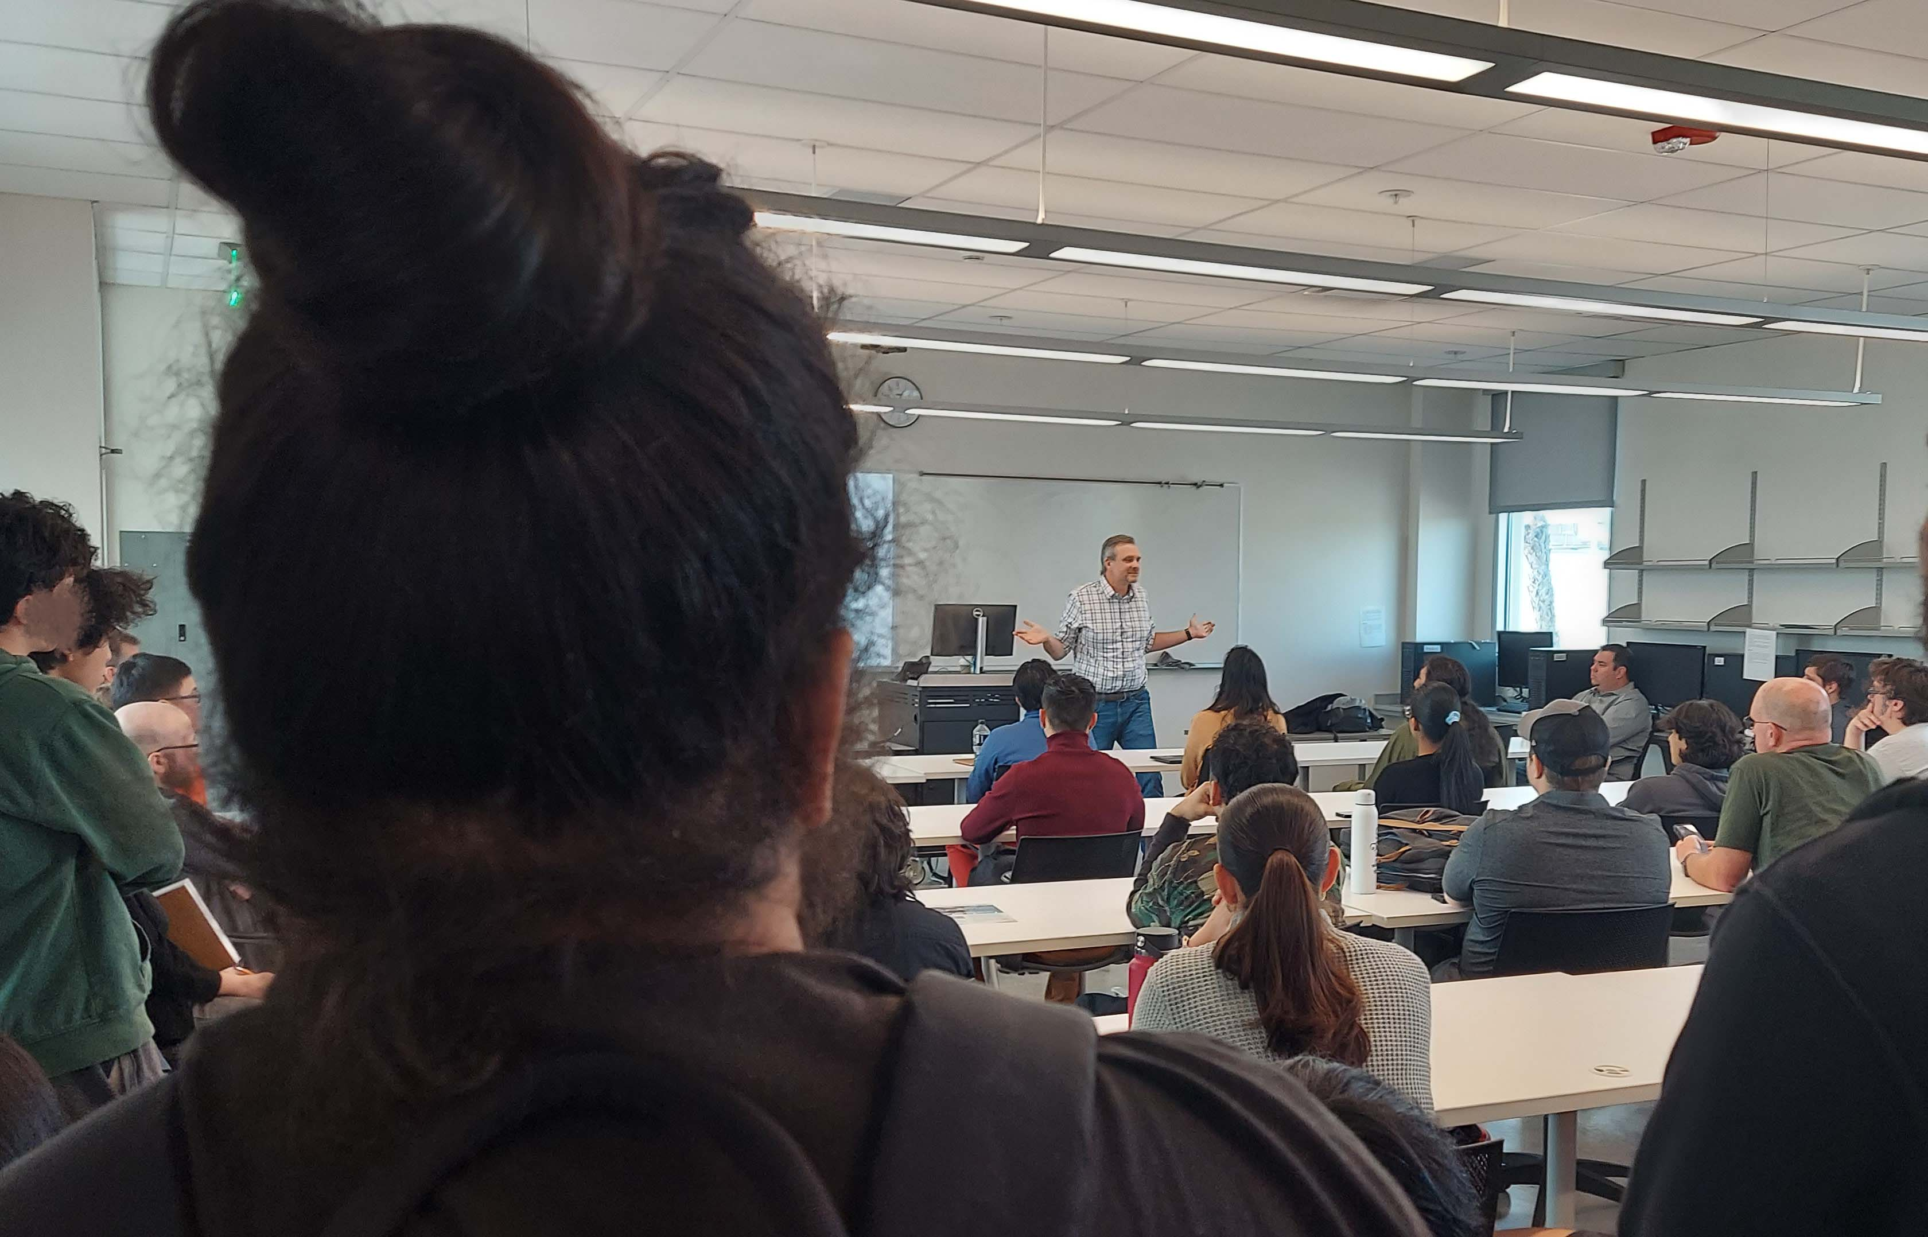
STEM Faculty Talks
Josh Lewis -
Being Successful
In Math

Slide 18
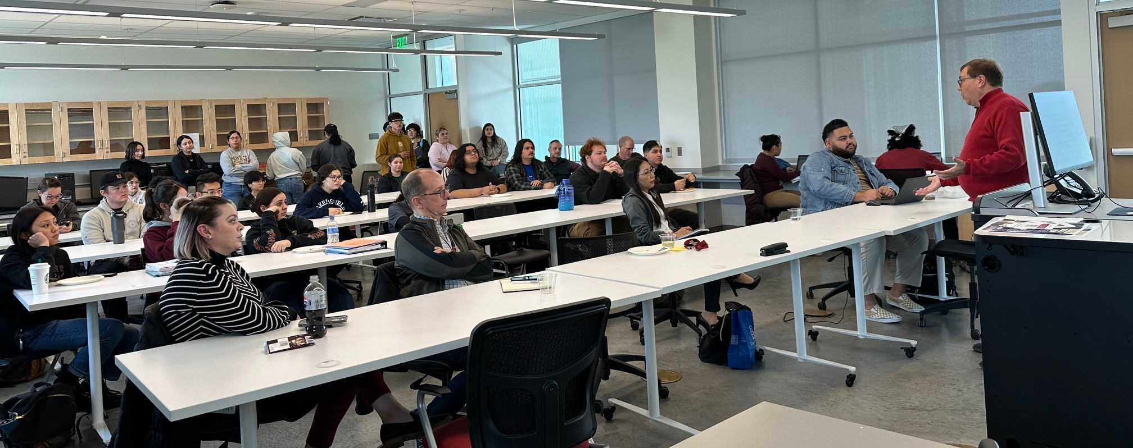
Meet the Dean Sessions
From STEM Degrees to Pedigrees

Slide 19

STEM Common Hours
We’ve only just begun!
You can have a session too!
Please join us in helping
students be successful in
learning!

Slide 20
Thanks to our STEM Team
STEM Department Chairs and Faculty
STEM Counselors and Ed Advisors
STEM Title III Grant Team
James McGarrah, Crystal Ramos, Jessica Martinez, Nicol Silva
STEM MESA Program
Connie Gonzalez, Megan McCullah
RTEC and INDA BS Programs
Dorothy Mullen, Carlos Media
STEM Pre-Med Pathway
Bianca Garibay

