Slide 1
General Education Support for Math & English
Presented to Admin Council Jan. 8, 2024
Anna Melby, Interim Associate Dean of Instruction
Kim Arbolante, Interim Writing Center Program Manager

Slide 2
Math Learning Center
(MLC)
General Science Building
Room 8
Email:
mathlearningcenter@bakersfieldcollege.edu

Slide 3

We've Moved!
The MLC has moved from the 2nd floor of the CSS building to...
GS 8
Bringing the support closer to the STEM classrooms and easier to find!

Slide 4




MLC Services
MATH B99NC
Co-requisit course for transfer level math course support.
Walk-In Tutoring
Help for students in any course with a math component.
Collaborative Workspace
Space for students to meet with study groups and ask for help from MLC professional experts.
Online Help
Zoom help sessions available.

Slide 5
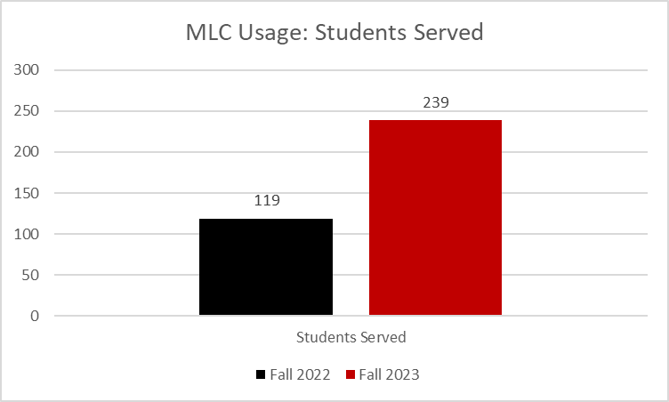
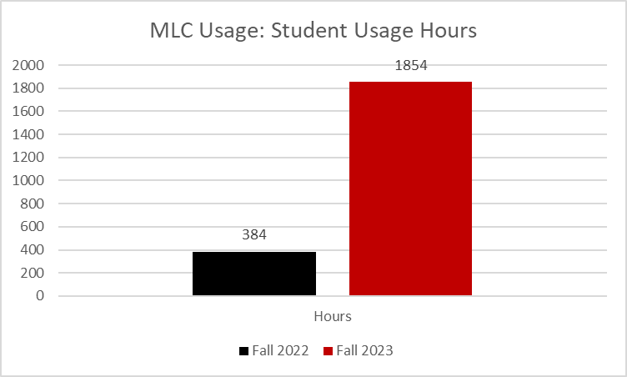
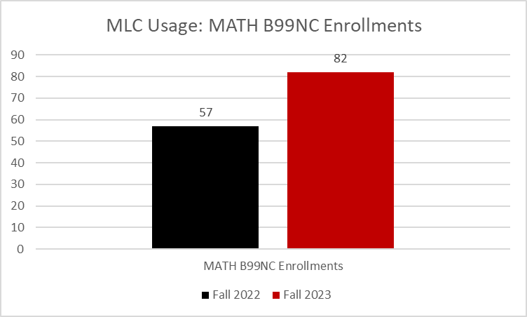
Fall 2023 MLC Usage

Slide 6
BC Writing Center
What is the Writing Center?
A team of degreed, professional Writing Specialist and English faculty who provide support that empowers students to practice and develop the skill of writing across the curriculum and beyond
6 Writing Specialists (+4) for all enrolled students
Assigned as support to targets cohorts and programs:
  Baccalaureate
  Early College
  Umoja
  Applied Tech
  Athletics
  Rising Scholars Program
  Rural initiatives

Slide 7



Available supports
General, 30 min. appointments for all enrolled students across the curriculum and for technical writing (resumes, scholarships etc.)
Embedded in-class & Canvas as support for ENGL B1a & B1aL EMLS B50 & B1a
In-person and Canvas workshops
We can collaborate with other programs for custom content
15 min. drop-ins with English faculty
Working towards adding History and EMLS dept. faculty

Slide 8
Tracking and Processes
ACDV B86 NC
Writing Center Support
Non-credit support CRN
Line of sight from English faculty
Hours and participation are not mandatory
No cost, no textbook, no grade assigned (SP)
Support provided for all courses and writing purposes
All student activities tracked in Starfish
Students can be referred via Starfish referral
Students gain access to the ACDV B86 NC Canvas by prior enrollment or via email request
All asynchronous workshops housed in the ACDV B86 NC Canvas
  Writingcenter@bakersfieldcollege.edu

Slide 9
Writing Center Locations
661-395-4735
Main campus H51-52, Zoom and Canvas support
Delano Center LRC 131
BCSW room 207
Arvin location in development

Slide 10
Writing Center Space Design
Hyflex Zoom space for workshops, embedded class activities and study hall, 26-unit PC lab w/ free printing (20 pg limit)
75 spacious seats with universal design, charging stations, DSPS accommodative study cubicle
Glass divider wall allowing for flexibility in space use without moving locations or adding additional line of sight
Space for faculty to conduct office hours in the WC; roaming librarians for reference support

Slide 11
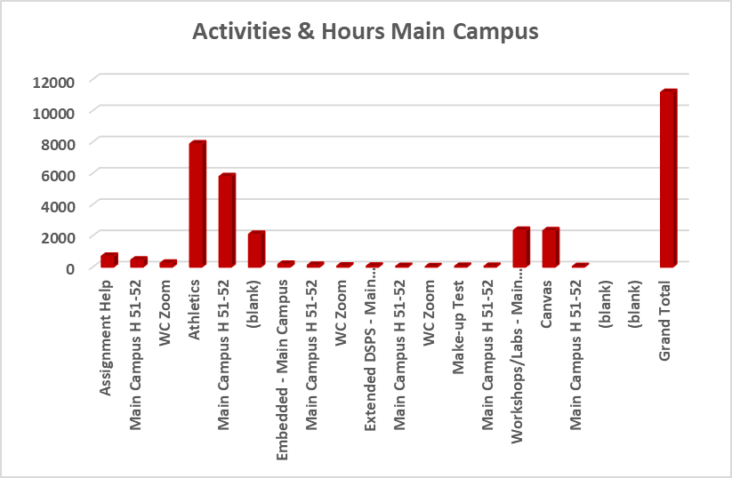
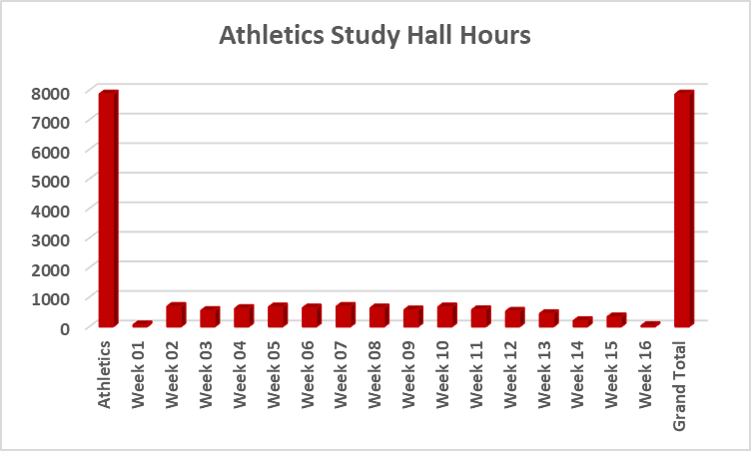
Fall 2023 ACDV B86 NC Writing Center Data
11,162.75 total participation hours
2,345 Canvas workshops completed
108.75 hours of embedded support outside of class
7,868.5 study hall hours completed
492 hours per week on average
Analysis from Athletics Dept. shows GPAs increase 3.9%

Slide 12



What's Next for the WC?
Create and implement outreach strategies to increase completion of ENGL B1a & COMM B1
Expand support to Arvin site w/ Spanish speaking Writing Specialist
Embedded
Arvin
24/7 WC
ACH Pathway
Increase # of covered CRNs by hiring more Writing Specialists
Increase hours and variety of support to create 24-hour writing help offered by BC (asynchronous support)

Slide 13
Opportunities for collaboration
Question:
What does all of this mean for you, your department and your role in student success?
Bring students in for tours/orientations
Talk to WC PM about customized workshops for the students you serve
Normalize academic support as part of the student experience at BC
Ask the students you interact with if they have completed ENGL B1a yet
  We can recommend a class with an embedded Writing Specialist
Email: kimberly.arbolante@bakersfieldcollege.edu
Call: 661-395-4435

