Slide 1
Commencement 2024
SAVE THE DATE:
Friday, May 10, 2023

Slide 2

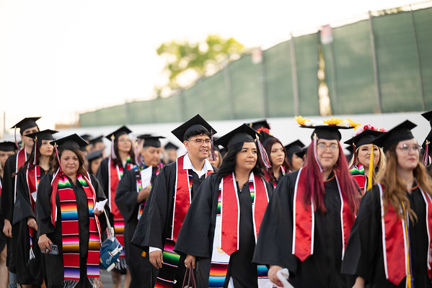
Timeline
January: Start notifying your classified staff
February: Send out reminders to sign up
March: Start signing up for commencement
April: Assign roles for volunteers
End of April: Commencement Orientation for all volunteers – Virtual
May: Send out Commencement Agenda
May 10, 2024 Commencement

Slide 3

How to get an early start?
Start encouraging your team members to sign up for commencement.
3pm to 10pm (shift time can vary)
Not sure what commencement entails? Ask the committee and watch clips from prior years.
Be on the lookout for Commencement emails

